Slide 1
Rainfall Data Patching Practical

Slide 2
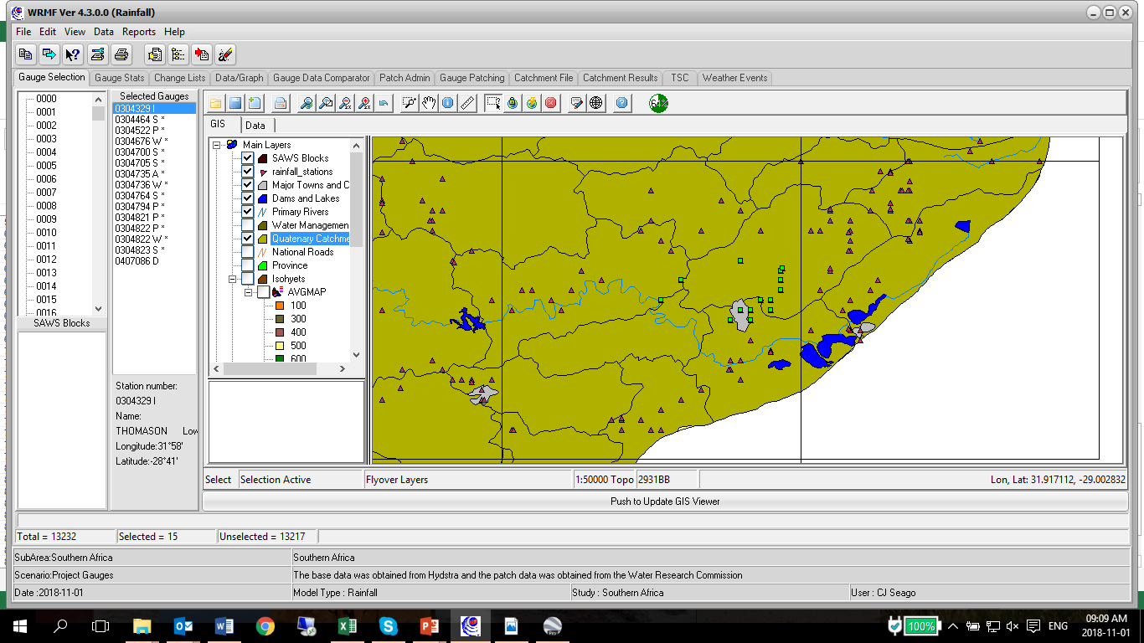
Rain MF
Select the 15 gauges nearby Richards Bay as indicated for assessment
Select Study Area
Southern Africa
Project gauges
“ok”
Untick topography
Note zoom tool
Note selection tool

Slide 3
Short list the gauges to be further assessed based on the data available, ie. remove gauges with no record
Note the years of data available in the short listed gauges
The aim is to get a high amount of intact years (common years of data)
Determine which gauge does not fit into the group based on the years of data
Determine which 2 gauges are greatly reducing the number of intact years of the group
How many gauges remain in the group to be patched

Slide 4
Copy practical data to folder on C drive: C:\Rain
View raw data files of 6 gauges
See unreliable data flagged with a “+”. These values need to be patched
View Classr.dat file: file listing all gauges
Run Classr13.exe by answering as follows:
Shifting: 1
File names file: classr.dat
Label: enter
Output file: classr.out
2 (rough patch)
1 (dates)
1956 start year
2000 end year
5
0
6

Slide 5
Manually screen for outliers
Open classr.out
Move down the results and look for outliers: clear, obvious errors in data when compared with surrounding gauges
Open raw file and flag error data with a + when find. Make sure formatting is not modified

Slide 6
Patching using Patchr
Open patchr.dat
Run patchr13.exe by answering as follows:
File names file: patchr.dat
Label: enter
0
Y
1956 start year
2000 end year
See patched files
See patched data in files where previous data with errors occurred
6 gauges in group
2 seasons
6 months per season
Months 1 to 6 in first season
Months 7 to 12 in second season

