Slide 1
WRYM TRAINING:
USUTHU SYSTEM

Slide 2
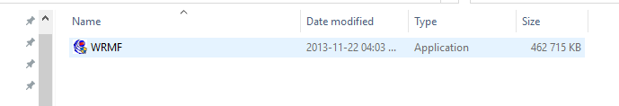
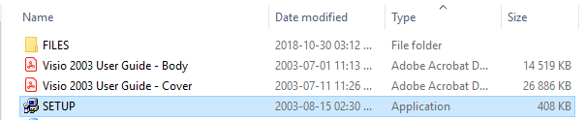
1. INSTALLING WRYM MF
Copy folder “WRYM” to path C:\
Double click on WRYM MF to install MF
Click “ok” twice when DLL message comes up
Double click on Setup to install Visio

Slide 3
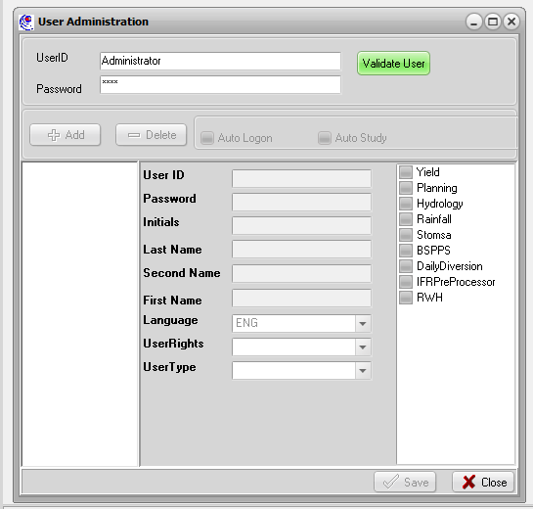
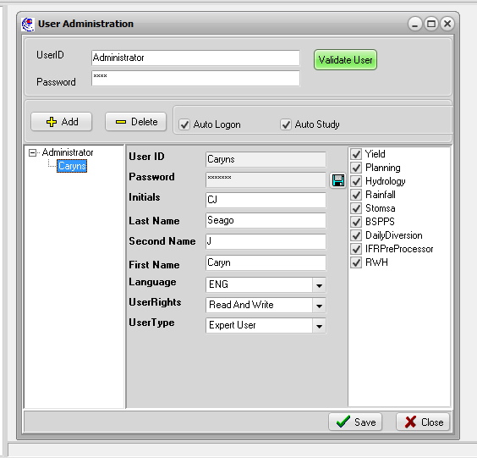
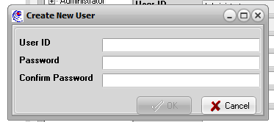
2. USER ADMINISTRATION
File, User Administration
Type Administrator, wrmf is the password
Click “Validate User”
Click Add
Type in User ID and password (remember these)
Fill in remaining details, make sure “auto study” and “auto logon” are ticked
Make sure “Read and Write” and “Expert User” are selected

Slide 4
3. Log on
File, log on
Type in user ID and password, remembered from before
You will only ever have to log on once, thereafter it will remember you because “auto logon” was selected

Slide 5
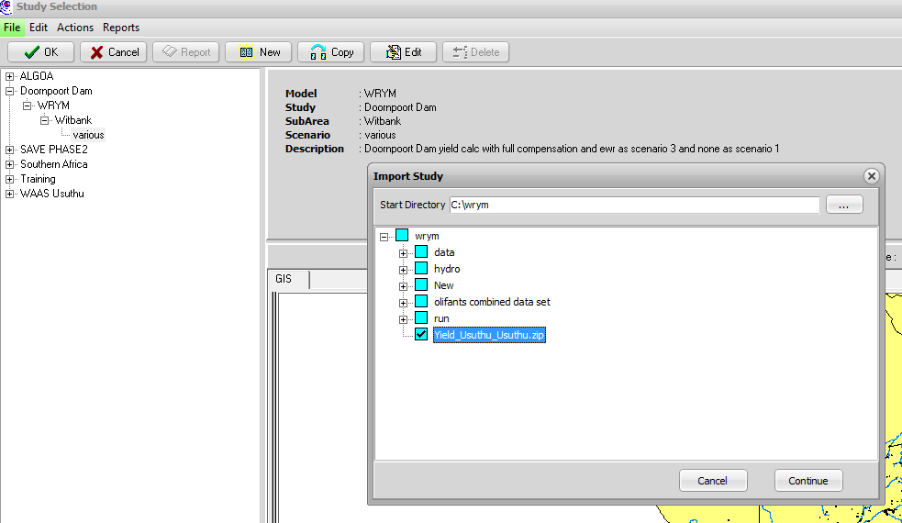
4. Importing Usuthu Study
File, import study
Browse to directory C:/WRYM, Tick “Yield_Usuthu_Usuthu.zip”
Continue
Start
Close

Slide 6
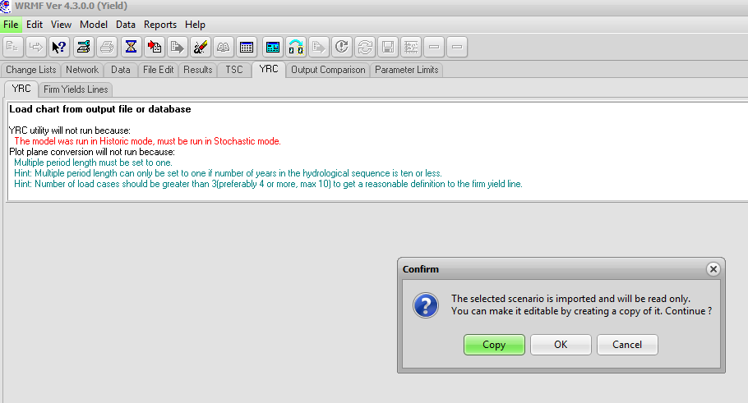
5. Opening Study
Open tree view
Highlight “Base”
Ok
Copy
Rename to “Base Train”
Ok
Start
Close

Slide 7
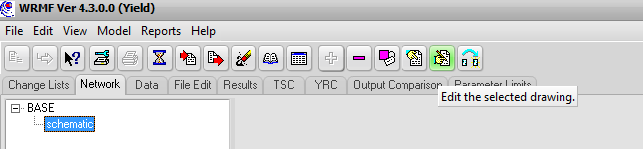
CATCHMENT ORIENTATION USING NETWORK DIAGRAM
Tab: network
Button: edit selected drawing
Click “ok” when Visio message comes up
See hard copy print outs, A3 schematic and Map

Slide 8
CATCHMENT & SCHEMATIC ORIENTATION
Locate 6 Tertiary Catchments (W51, 52, 53, 54, 55 and 56)
See incremental runoffs indicated for each quaternary catchment
Delineating a catchment, inflows to nodes and dams, eg. W54B
Locate major Dams as per Locality Map. What are there reference numbers? Confirm the quaternary catchments that the following fall in:
  Heyshope, Jericho, Morgenstond, Westoe
Nodes without inflow
Channels: general flow = rivers
Demands
  Irrigation blocks
  Point abstractions eg. Amsterdam
Return flows

Slide 9
50% B42G
50% B42G
100% B42G
B42G
B42G
50% B42G
40% B42G
50% B42G
40% B42G
B42G
B42G
10% B42G
10% B42G

Slide 10
MODEL INPUT DATA
Hydrology: 24 catchments:
  aff: afforestation reduction (million m³/month)
  inc: incremental runoff (million m³/month)
  ran: rainfall (mm)
  irr: alien reduction (million m³/month)
Nodes
  With Inflow (31)
  Without Inflow (25)
Reservoirs (32)
  Large stand alone (7)
  Dummy dams: farm dams lumped together (25)
Irrigation blocks (27)

Slide 11
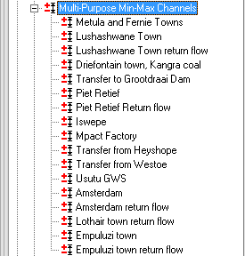
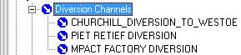
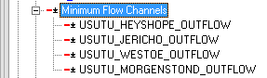
MODEL INPUT DATA
Channels
  General flow: rivers (88)
  Min-Max: Demands / return flows / Transfers (17)
  Diversions (3)
  Loss (1)
  Minimum flows (4)
  Pumping (1)
  EWRs (1)
  Yield channel

Slide 12
Diversion Efficiency Explanation
10 m³/s x 31 days = 27 million m³/month
More realistic flow profile over month
27 million m³/month
Diversion relationship relates
Daily observed flows with monthly requirements and limits abstractions depending on flows as such
Times of shortfall where daily flow
< monthly average

Slide 13
QUESTIONS ON MODULE
What is the January evaporation in mm from Jericho Dam?
What channel flows out of node 21?
What is the October crop requirement for irrigation block 47?
What is the full capacity of Dummy Dam 66?
What is the annual demand of Fernie and Metula Towns?
From which quaternary catchment does Piet Retief obtain its demand?
What is the natural inflow in year 1952 month 4 (ie. January 1953) of quat W52A
What is the minimum flow release at Westoe Dam?

Slide 14
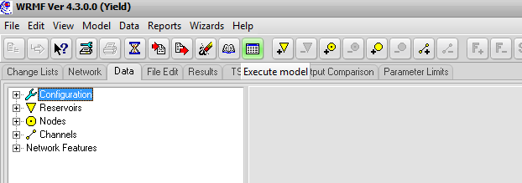
RUNNING THE MODEL AND NODE BALANCES
  Run the model
  Look at Morgenstond Dam profile, only flow in channel 119 when Dam full
  Carry out a balance around
    Simple node (93) Annual average
    Node with inflow (5) Annual average
    Reservoir (8: Westoe) August 1920

Slide 15
Balances
inc – aff - ali: 0.587
7: 0.404
8: 0.991
76: 0.632
77: 0.448
78: 0.038
79: 1.042
Inflows:
0.587 + 0.404 = 0.991
Outflows:
0.991
7
5
8
76
77
93
79
inc – aff - ali: 0
163: 0.077
9: 0.090
148: 1.539
161: 0.037
10: 0
Rainfall: 0
Evaporation: 0.206
78
Rain
Inflows:
0.632 + 0.448 = 1.08
Outflows:
0.038 + 1.042 = 1.08
163
Evaporation
161
9
8
10
148
Inflows:
0 + 0.077 + 0.09 + 0 = 0.167
Outflows:
1.539 + 0.037 + 0 + 0.206 = 1.782
Difference = 1.615 m³/s
= 4.33 million m³ (31 days)
Change in reservoir storage:
55.2 – 50.87 = 4.33 million m³

Slide 16
YIELD DETERMINATION
  Yield at Heyshope
    Confirm position of Yield Channel on node 109 (yield node of Heyshope including 10% loss)
    Turn off demands for transfer to Grootdraai and Driefontein town / Kangra Coal
    Run Target drafts 69 and 70, confirm historic yield is 69 million m³/a
    Run Just target draft 70 with “full” output
    In which month is the yield requirement not supplied
    Confirm Heyshope Dam empty in that month
  Combined yield at Jericho
    Move yield channel onto Jericho Dam
    Turn off demand to Usutu GWS
    Determine combined yield (Westoe, Jericho and Morgenstond Dams)
    What is the failure month?
    Are all three dams empty in this month?
    Go over reservoir penalty structures and operating rule
    Record flow in channel 13 and demand to irrigation block 15

Slide 17
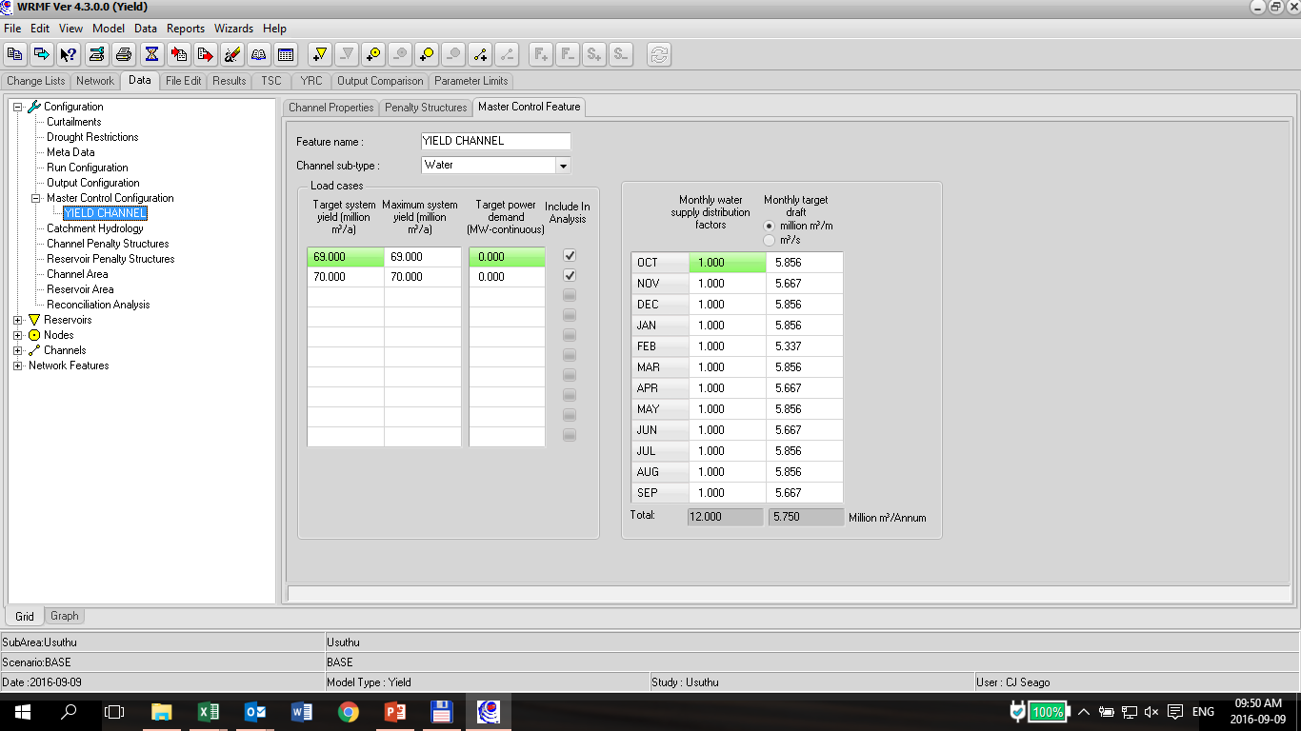
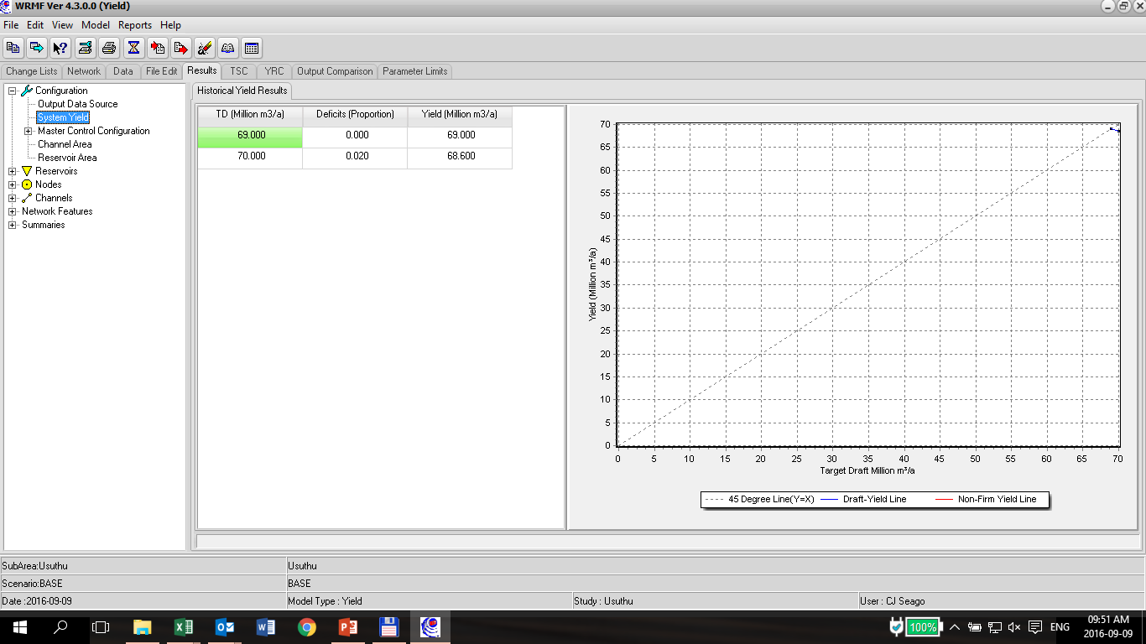
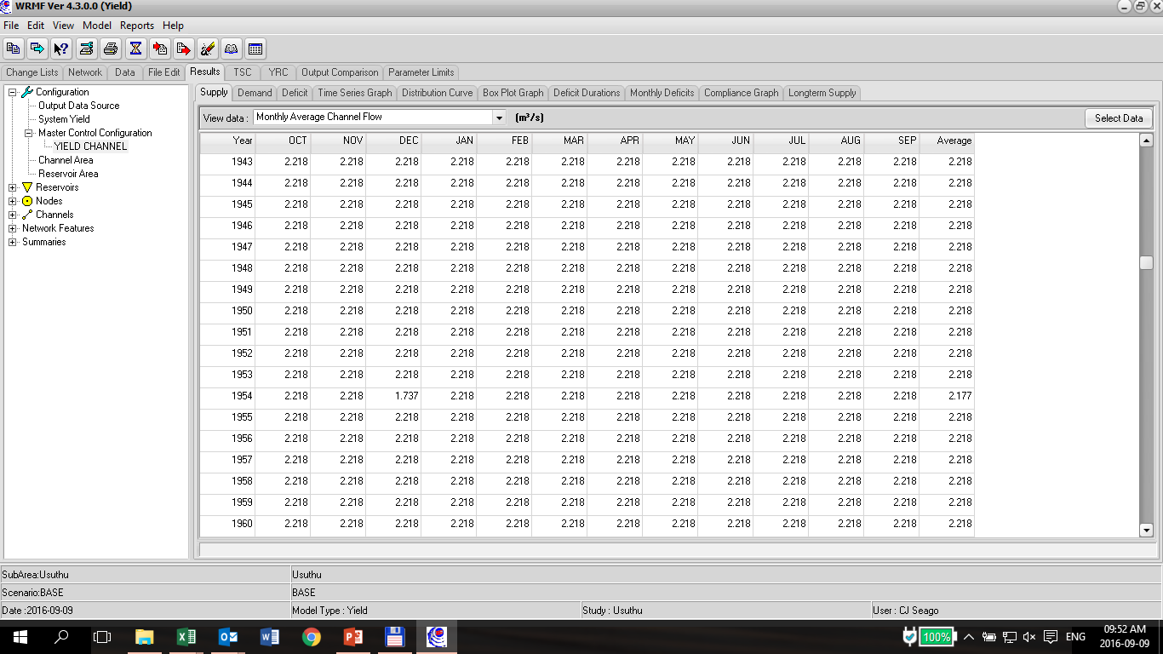
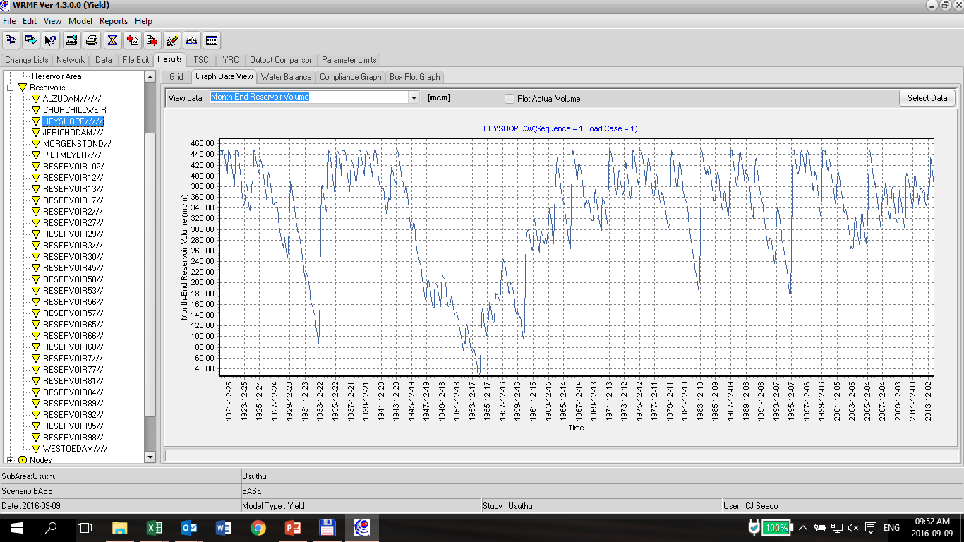

Slide 18
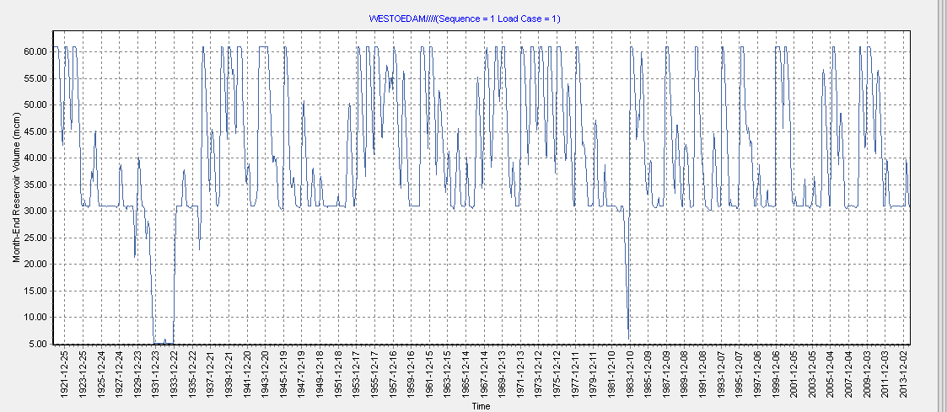
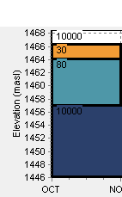
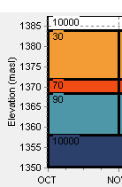
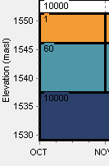
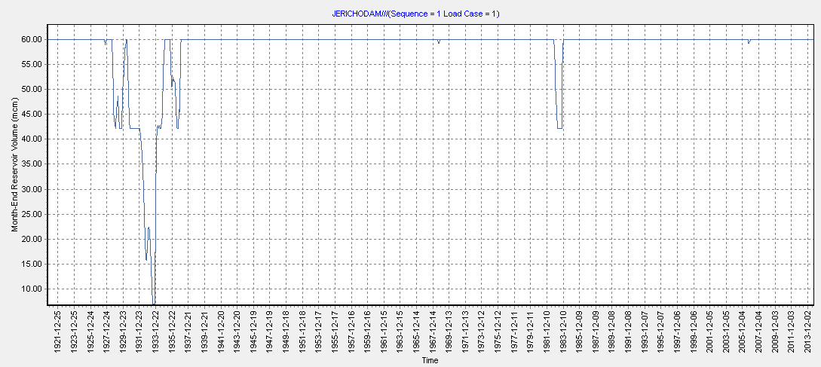
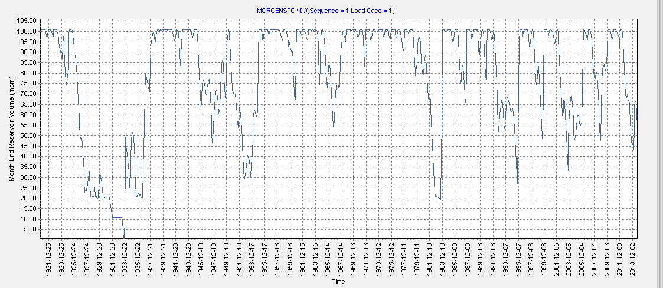
Penalty structures
1
Jericho
Morgenstond
Westoe
4
2
Order of use from Dams, from lowest penalty to highest
6
3
5
7

Slide 19
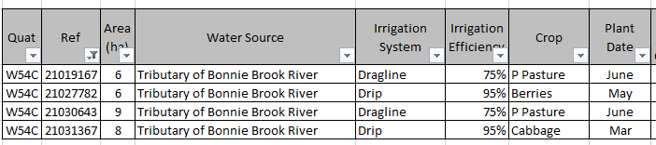
LICENSE QUERY
  JPJ Naude Boerdery
    Existing user
    Would like to increase use
    Would like to construct farm Dam
  Use model to determine impact of increased abstraction and new farm dam on downstream flows
  Locate existing user
    reference number 21019167
    Included in block 15, demand channel number 3, lumped with 3 other users
    Had current area in WARMS as 6ha
  Split irrigation block 15 into 2 components, ie separate user 21019167 and build in new farm dam
33%W54C
164
16
3
15
17
4
A
x
B
z
y
161
9
10
11

Slide 20
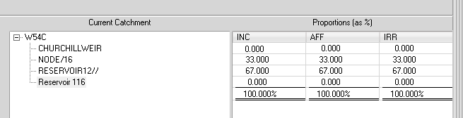
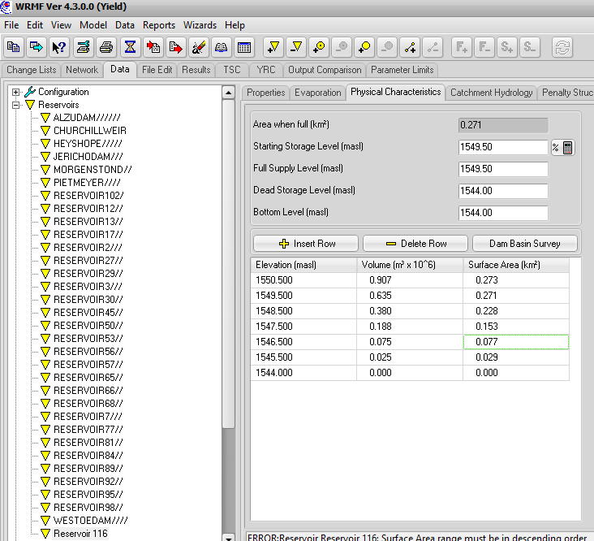
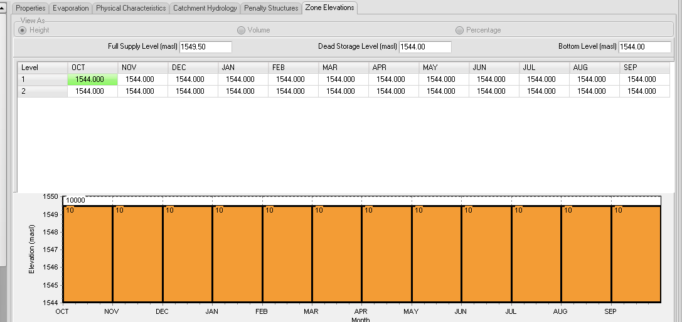
Irrigation block 15: size 29ha – 6ha = 23ha (0.23km²)
Create new reservoir (A), penalty structure 1 (10 cost)
Physical characteristics as below
Assign to catchment W54C, 0% inflow
Evaporation same as Churchill weir

Slide 21
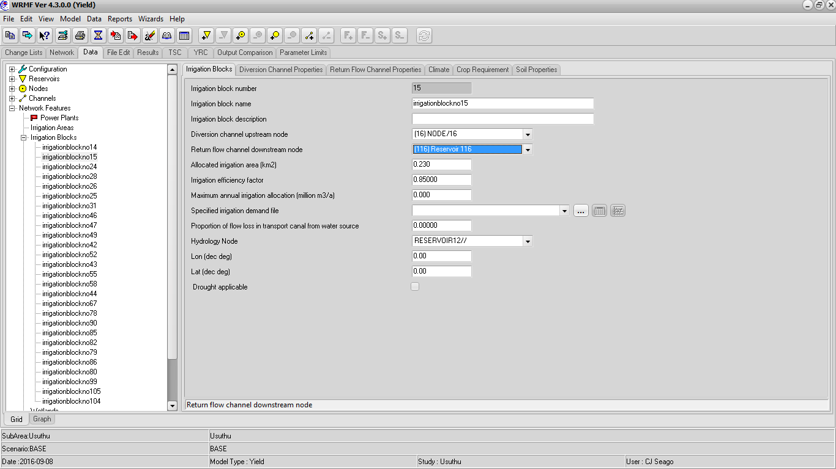
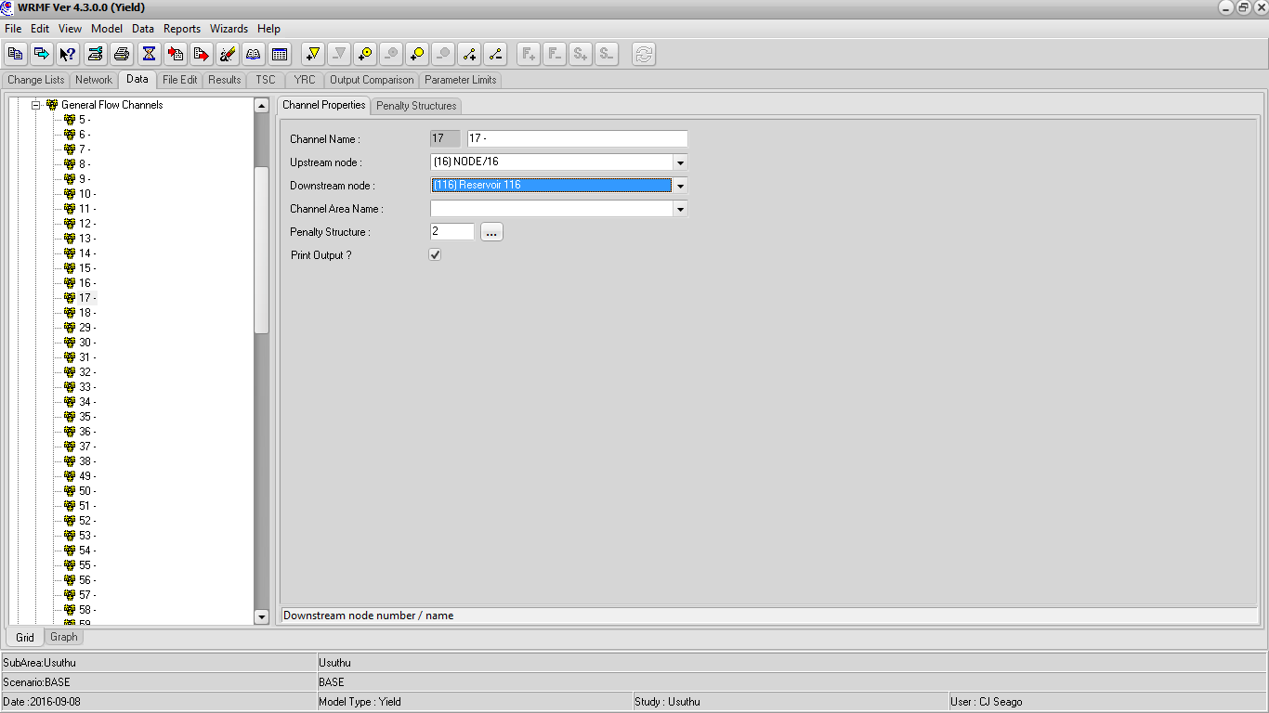
Downstream node of channel 4, change from 9 to new reservoir number
Downstream node of channel 17, change from 9 to new reservoir number
Add new spill channel (z), from new reservoir to node 9. This should be a general flow channel, penalty 500

Slide 22
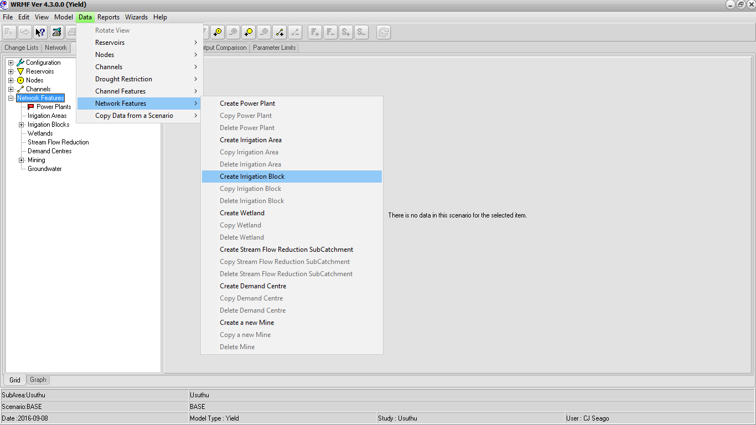
Add new irrigation block (B, demand: x, return flow: y)
Upstream node: new reservoir, downstream node 9
Everything identical to block 15 except for area which should be 19ha (0.19 km²)

Slide 23
Run model and check
  Demand of new block channel
  flow in channel 13 –
  behaviour of new farm dam
Now increase new block size to 62ha (19 + 25 + 18)
Run model and check
  Demand of new block channel
  flow in channel 13 –
  behaviour of new farm dam

Slide 24
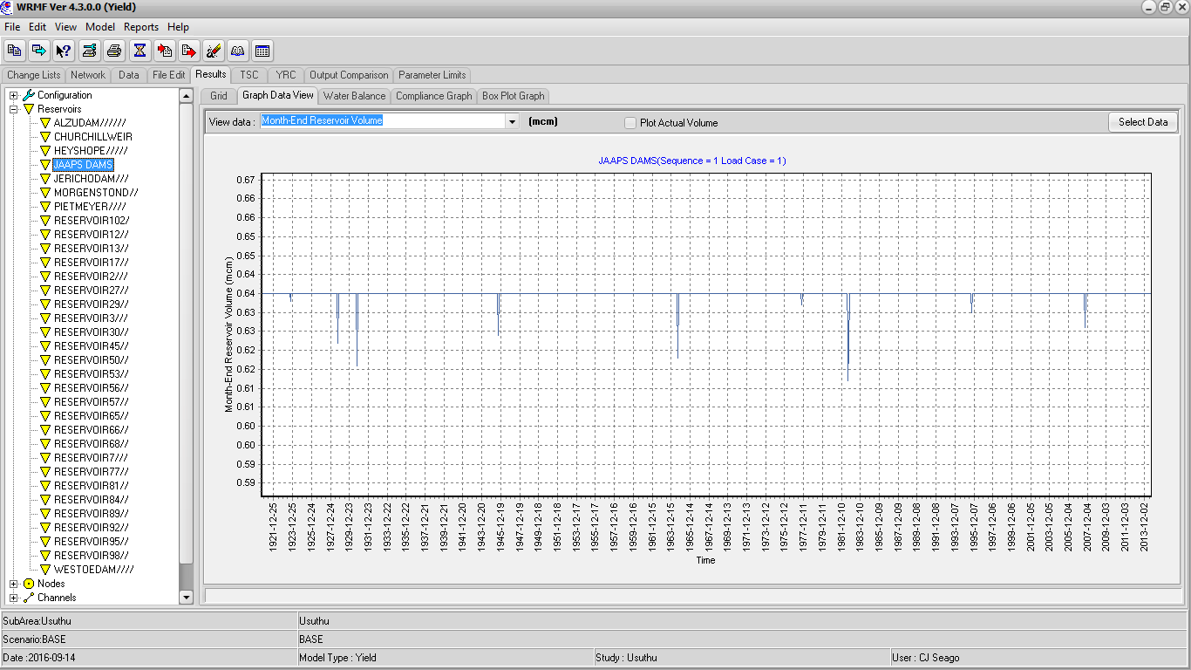
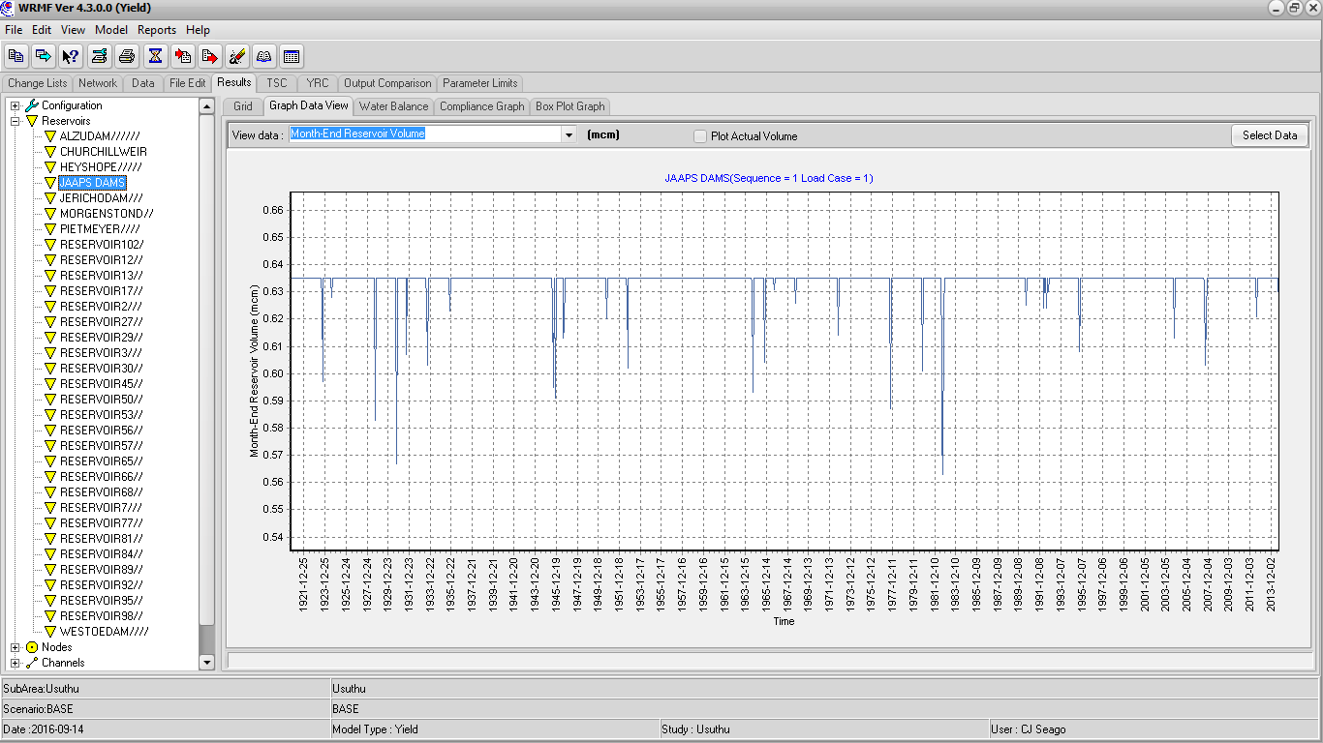
19HA
62HA
189 000m3/a

