Slide 1
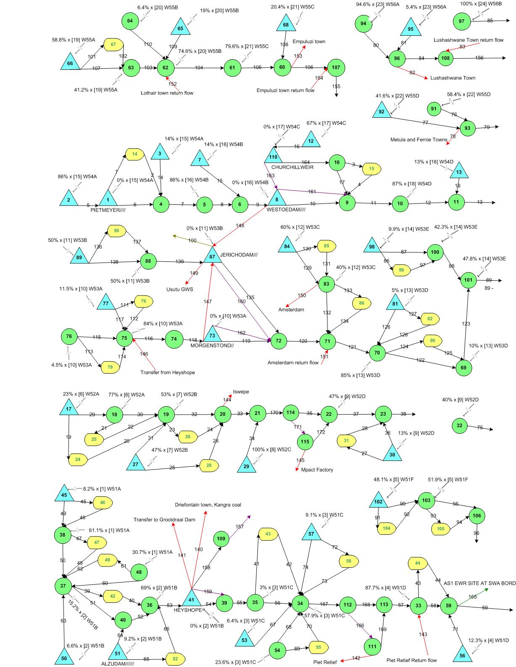
W55
W56
W54
W53
W52
W51

