Slide 1
Practical: Drawing a Long Term Yield Curve: Krugersdrift Dam

Slide 2
Practical data onto computers
Copy practical “krug” into C:\WRYM\ folder

Slide 3
Set up study
Open WRMF
Study Selection screen
Select “New” tab
Complete as indicated

Slide 4
On “Yield model” tab
Browse for wrym.dat in C:\WRYM\KRUG\RUN\
Open
Save
Highlight LTPRACTICAL
Click OK
Click close

Slide 5
Unclick “import hydrology files”
Ok with error message
Go to tab “YRC”
This stands for Yield Reliability Curves
Load chart data from file: blue square icon
Long term curve will load
Include assurance lines 1 in 20, 50, 100, 200
Note no target draft on left hand of 1 in 20 years
Load chart data from file again
Yes to “combine 2 sum.outs”
Browse to add sum.out1
Add TDs 26, 28, 30, remove TD 24
Load chart data from file again
Yes to “combine 2 sum.outs”
Browse to add sum.out2
Add TD 33
Note all assurances have TD on left and right of line

Slide 6
Manipulating curve
Zoom into right hand side where curve ends
Base yield lines should not cross each other
Click on curve to adjust, curve will go bold
Right click, select “when X = 100%, Y = ?”
Edit Y value to move curve to not cross others

Slide 7
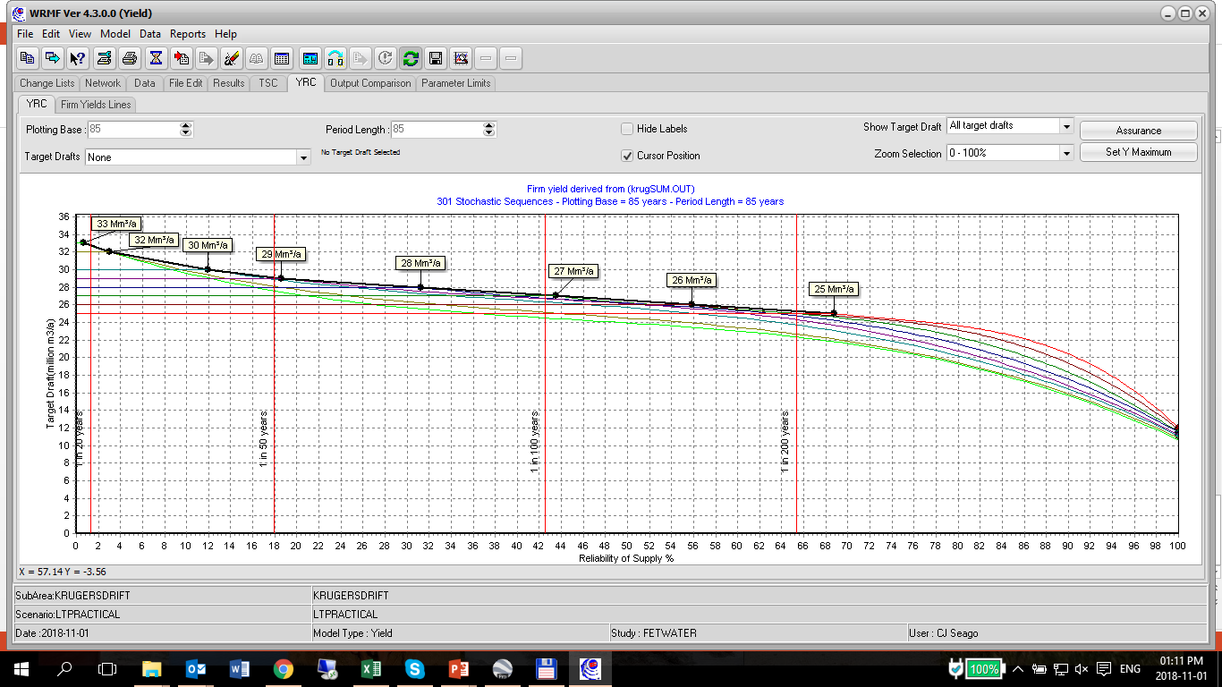
Final result

