Slide 1
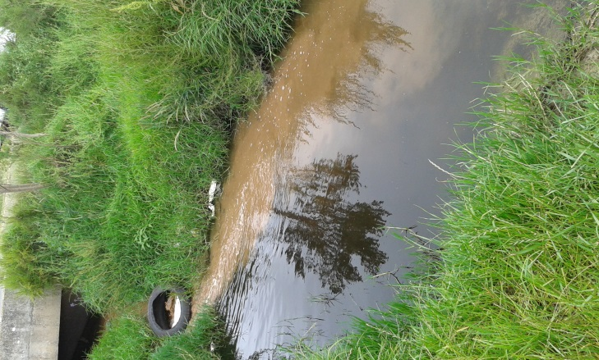
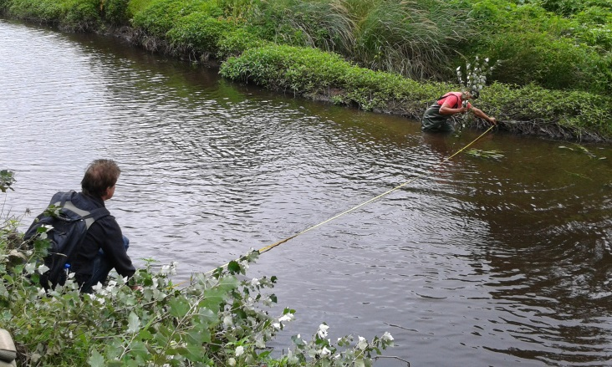
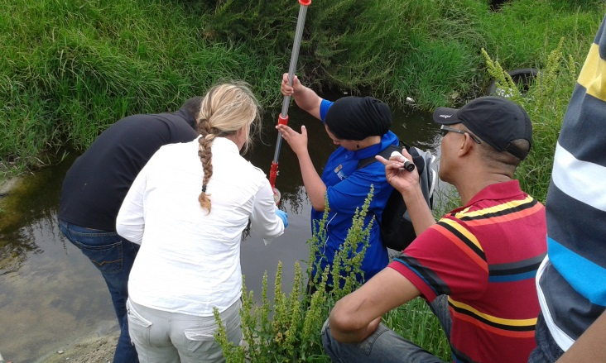
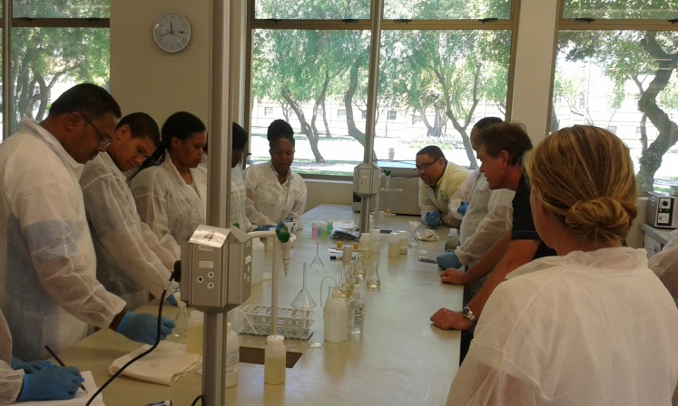
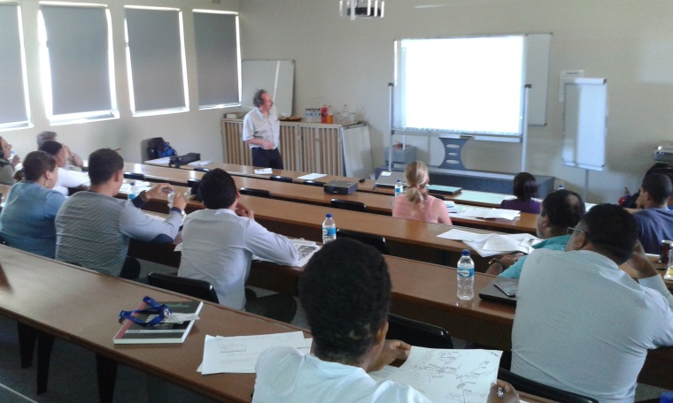
FETWATER
Caryn Seago
WRP Consulting Engineers
FETWATER III Pilot Training Introduction

Slide 2
History
Early 2000s
Phase 1 and 2
NWRS: KPI: Number of Qualifications Developed in the Water Sector

Slide 3
Focus Areas
Focus Areas
Water resource planning and Implementation
Regulatory requirements
Water Monitoring and Assessments
Institutional Management and water governance
Water Infrastructure
Water Use and Sanitation

Slide 4
Focus Areas
Definition
“Planning and Implementation”
Management
Water Resources Management
“the activity of planning, developing, distributing and managing the optimum use of water resources (surface & groundwater). Ideally, water resource management takes into account all the competing demands for water and seeks to allocate water on an equitable basis to satisfy all uses and demands.”

Slide 5
Priority Occupation
Water Resources Manager / Specialist / Practitioner

Slide 6
Priority Occupation
Water Resources Manager / Specialist / Practitioner

Slide 7
Organizing Framework for Occupations (OFO) Code

Slide 8
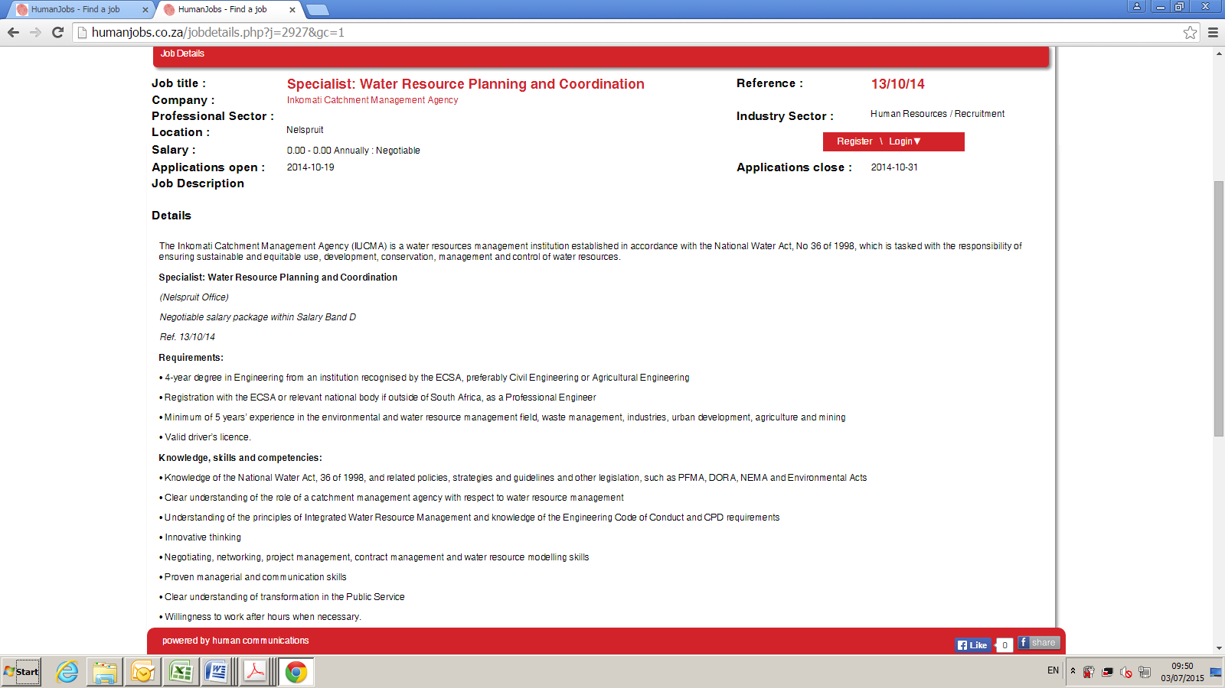
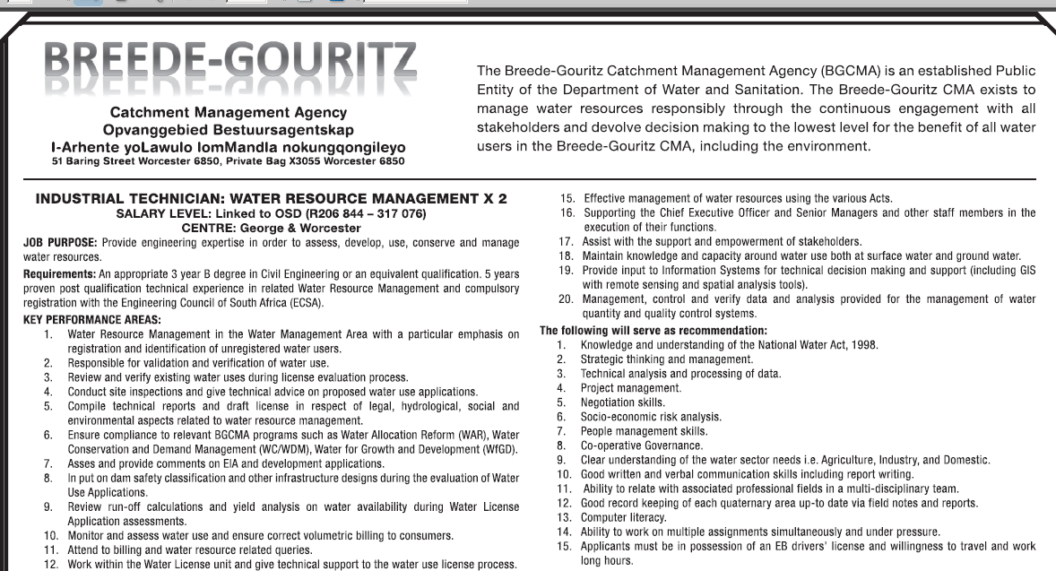
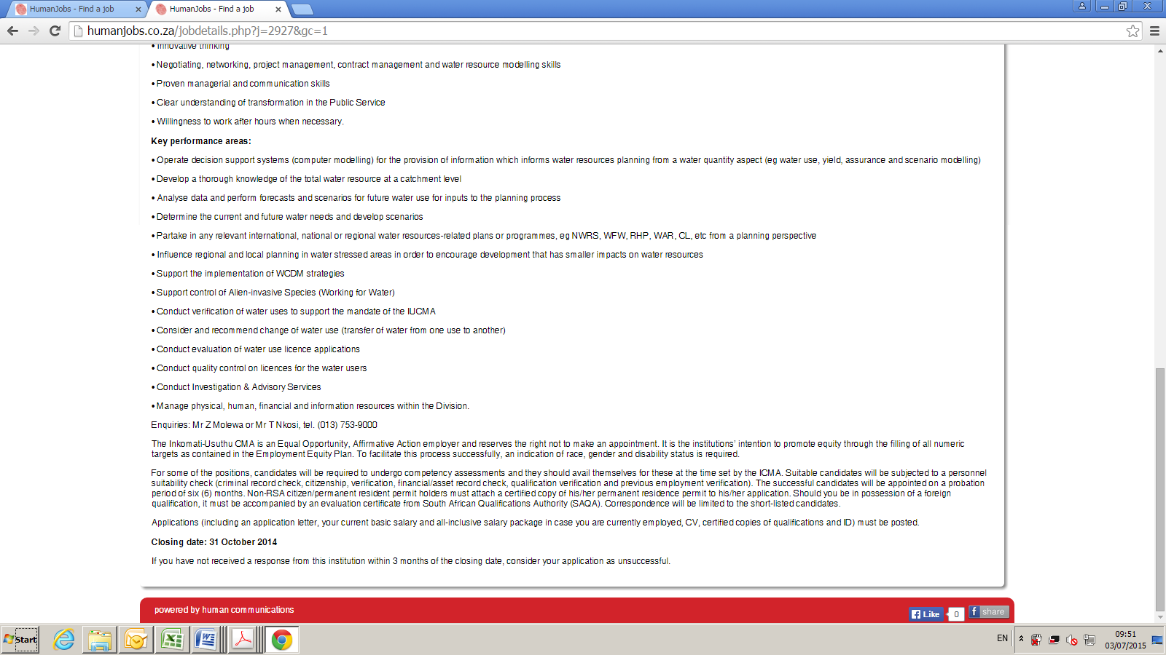
Job Descriptions

Slide 9
ADVERT | Requirements | Knowledge, skills and Competencies | Key Performance areas
INKOMATI –USUTHU CMA | 3 | 8 | 14
BREEDE-GOURITZ CMA | 3 | 16 | 12
POLOKWANE PROTO CMA | 3 | 11 | 13

Slide 10
Sakhile Mamba
Water Resources Practitioner

Slide 11
FUTURE TYPICAL JOB ADD FOR CMA
Water Resources Practitioner / Specialist / Manager
Academic: Either BSc Engineering or 4 year science degree
Professional Registration: Require Registration with ECSA OR SACNASP (as Water Resources Scientist)
Qualification: Need to be certified as a Water Resources Practitioner

Slide 12
Progress & Methodology
Community of Expert Practitioners: CEP
Qualification Council for Trade and Occupations: QCTO
Developed Curriculum
Knowledge Specification
Practical Specification
Work Place Experience
Learning material development
Piloting

