Slide 1
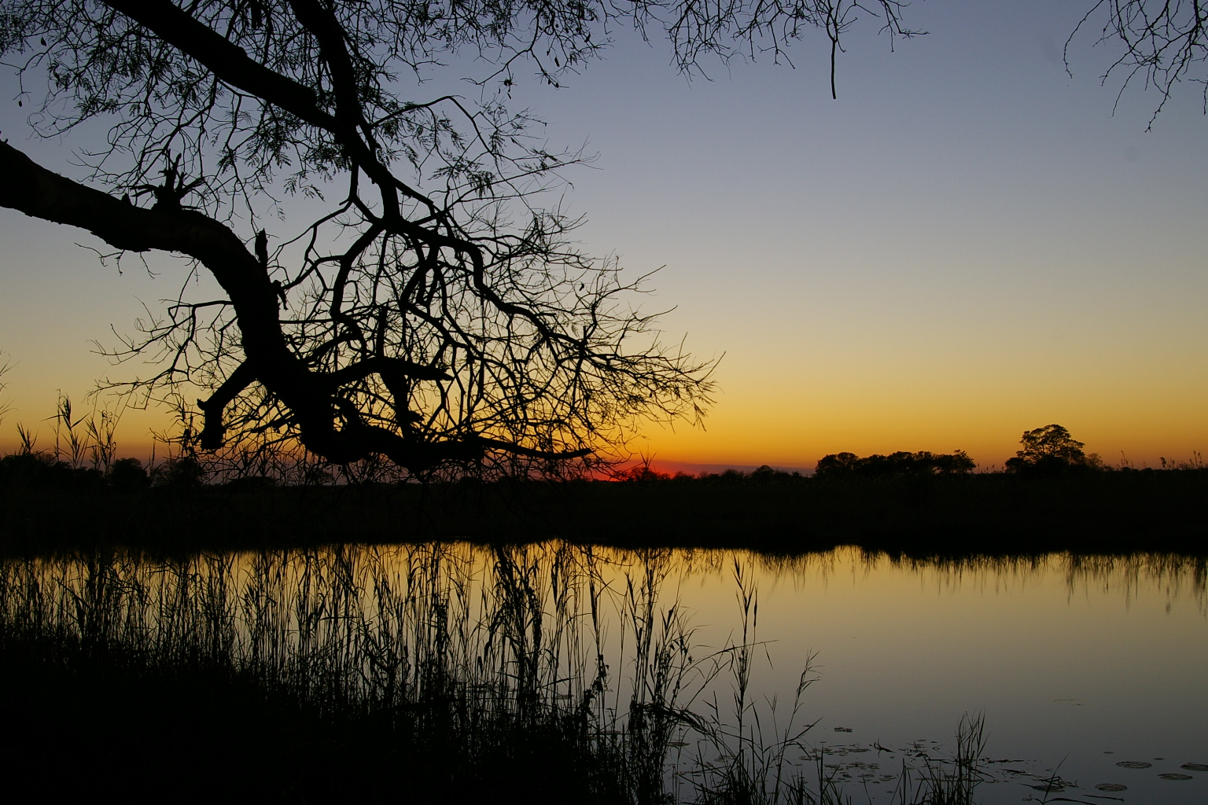
BASIC HUMAN NEEDS RESERVE

Slide 2
BASIC HUMAN NEEDS RESERVE
Calculate per quaternary catchment the source of water and number of households and individuals who are dependant on these sources.
Those receiving water from a recognised formal water source are excluded.
Similar process followed to determine households dependant on groundwater not provided from formal groundwater schemes.
BHN determinined at various scenarios of which minimum is 25 litres per person per day. Other scenarios as 55 and 60 also investigated to allow Water Affairs to select the BHNR.
DOUBLE COUNTING MUST BE AVOIDED.

Slide 3
BASIC HUMAN NEEDS RESERVE (slide 2)

Slide 4
LEGAL ISSUES AND GAZETTING

Slide 5
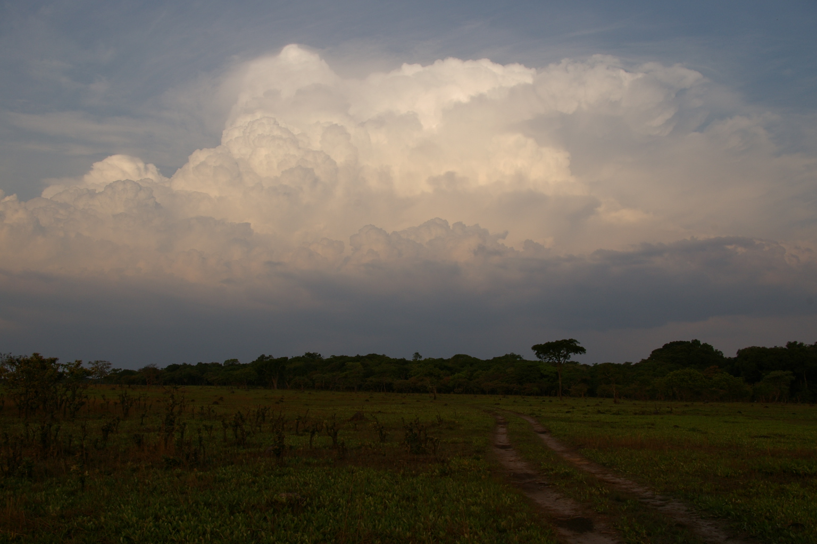
LEGAL ISSUES & GAZETTING
First gazettes recently gazetted for Classes and RQOs.
Process is to end the study with a public meeting to discuss results (stakeholder engagement ongoing during the studies).
Results are then prepared in a Legal Notice and provided for public comment.
All comments documented in the Comments and Responses Register (as happened during the duration of the study).
Gazette is then prepared and submitted.

Slide 6
LEGAL ISSUES & GAZETTING (slide 2)
There are issues, constraints and uncertainties with the information that is included in the gazette and the template is not yet stable.
Initial indications that are important is that:
The Class and RQOs must be immediately implementable
Low confidence information should not be included
Water Act is written in such a way that you cannot change the Class, RQOs or the Reserve.

Slide 7
LEGAL ISSUES & GAZETTING (slide 3)
Class: The Class is gazetted for the IUA and the TEC for each RU, i.e. the Catchment Configuration (rivers and estuaries).
Easy, robust
BUT – have realised that sometimes you have to leave RUs out if long term changes or phased approach is required. Immediately applicable is the challenge
Groundwater?? Imbedded in the rivers EC in some way.
Wetlands??

Slide 8
LEGAL ISSUES & GAZETTING (slide 5)
RQOs:
  Based on good advice – all detail of EcoSpecs and TPCs taken out and only component categories provided. Very robust. Allows for adjusting EcoSpecs through monitoring as all EcoSpecs are hypothesis and CANNOT be fixed in a gazette. I.e. – allows Learning by Doing.
  Estuaries – Some concerns: Providing categories for hydrology is confusing. Detail provided for hydrology and hydrodynamics are good. BUT – all categories provided – must be clear that they do not link to the river table – should have included a numerical estuary table.

Slide 9
LEGAL ISSUES & GAZETTING (slide 4)
RQOs:
  Hydrology RQO – only the TEC (does not / should not include the use).
  Cannot – should not include full FDT (EWR rule) – space. Latest thinking is just to provide an allocated volume.
  This is NB as it allows for adaptive management and flexibility in how the allocation is managed to achieve the TEC.
  Does not and SHOULD NOT represent a minimum flow. MUST therefore be linked to the RQO report with full technical detail.

Slide 10
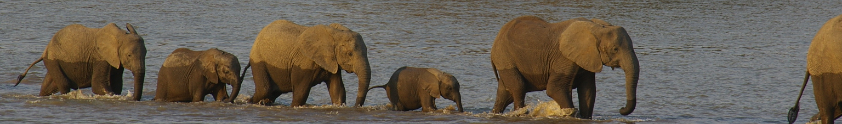
CO-OPERATIVE GOVERNANCE

Slide 11
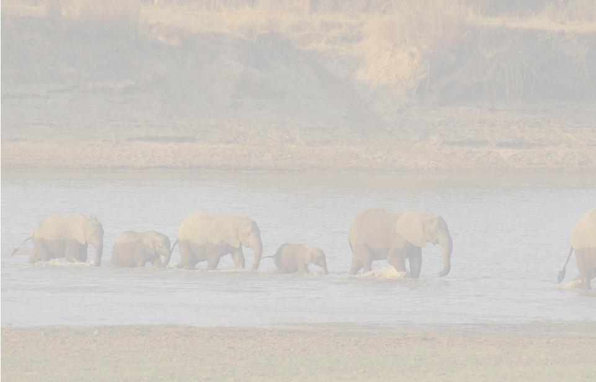
CO-OPERATIVE GOVERNANCE
The DWS regulatory functions are:
Water use (all types) abstraction control and enforcement.
Water pollution prevention, control and enforcement; and
Monitoring, auditing and reporting.
The Department of Environmental Affairs (DEA) regulatory aspects (with some of these functions devolved to provincial agencies) relating to RQO implementation are:
EIAs (National Environmental Management Act - NEMA).
Estuarine Management Planning (Integrated Coastal Management (ICM) Act).
Conservation planning (Biodiversity Act); and
Protected Areas (Protected Areas Act).

Slide 12
CO-OPERATIVE GOVERNANCE (slide 2)
The DAFF regulatory aspects (with some of these functions devolved to provincial agencies) related to RQO implementation are:
Fisheries management, control and enforcement.
Mariculture.
Agriculture.
The district and metropolitan municipality regulatory aspects related to ROQ implementation are:
Recreational water quality (National Health Act 2003

Slide 13
CO-OPERATIVE GOVERNANCE (slide 3)
It is not the intention of the implementation activities to either duplicate or replace existing legislation and/or institutions that already manage aspects affecting the RQOs, but to rather harness these and inform the relevant authorities that can take action using existing acts and legislation. The plan should therefore allow for the linkages that will initiate the appropriate actions to enforce compliance in accordance with procedures already in place.

Slide 14
CO-OPERATIVE GOVERNANCE:
ESTUARIES (slide 4)
The Guidelines for the Developmentand Implementation of Estuarine Management Plans in terms of the National Estuarine Management Protocol (DEA, 2015) recognises that effective institutional structures and arrangements are crucial for the successful implementation and coordination of activities according to the EMP.
The EMPs should, in turn, encapsulate the findings and recommendations of the Classes and RQOs.
In this light the Protocol requires that the EMP includes details on the institutional capacity and arrangements that will be required for managing the various elements of an EMP, taking into account different departmental mandates.

Slide 15
CO-OPERATIVE GOVERNANCE:
ESTUARIES (slide 5)
Chapter 5 of the ICM Act provides direction on institutional arrangements that would contribute to cooperative coastal governance in South Africa.
According to the ICM Act, the embodiment of cooperative coastal governance is vested in coastal committees that are established at national, provincial and municipal levels. The Protocol does not propose new institutional arrangements specifically aimed at estuarine management.
Rather the Protocol states that provincial and municipal coastal committees shall serve as the forums for monitoring the implementation of EMPs and reporting of progress and achievements related to EMPs.
It remains crucial that the estuarine management authorities provide specific details on the institutional arrangements that they propose, specifically dealing with the technical cooperation and coordination in estuarine management.
Notes:
ICM: Integrated Coastal Management Act

Slide 16
CO-OPERATIVE GOVERNANCE:
ESTUARIES (slide 6)
Institutional model that can be considered for stronger technical coordination and cooperation is the national Estuaries Management Sub-Committee (an advisory body to Working Group 8.
This Working Group provides government authorities and other key role players with management responsibilities, the opportunity to coordinate activities and to address disputes or uncertainties that may arise during implementation.
Continuous stakeholder engagement will remain critical – even during implementation phase.

Slide 17
CO-OPERATIVE GOVERNANCE:
WETLANDS AND RIVERS (slide 7)
Wetlands: Most common problems are associated with destruction of habitat and not changes in flow. Wetlands also impacted by DWS, DEA, DAFF.
Rivers: Desktop nodes require improvements based on a high Ecological and/or Socio-Cultural important.
Of relevance here are the RUs that require non flow-related measures to improve.
These relate to catchment activities or water quality changes that impact on the riparian zone.
EG: Removal of riparian vegetation, alien vegetation infestation, erosion, sedimentation – difficult to implement and would require efforts of various institutions.

Slide 18
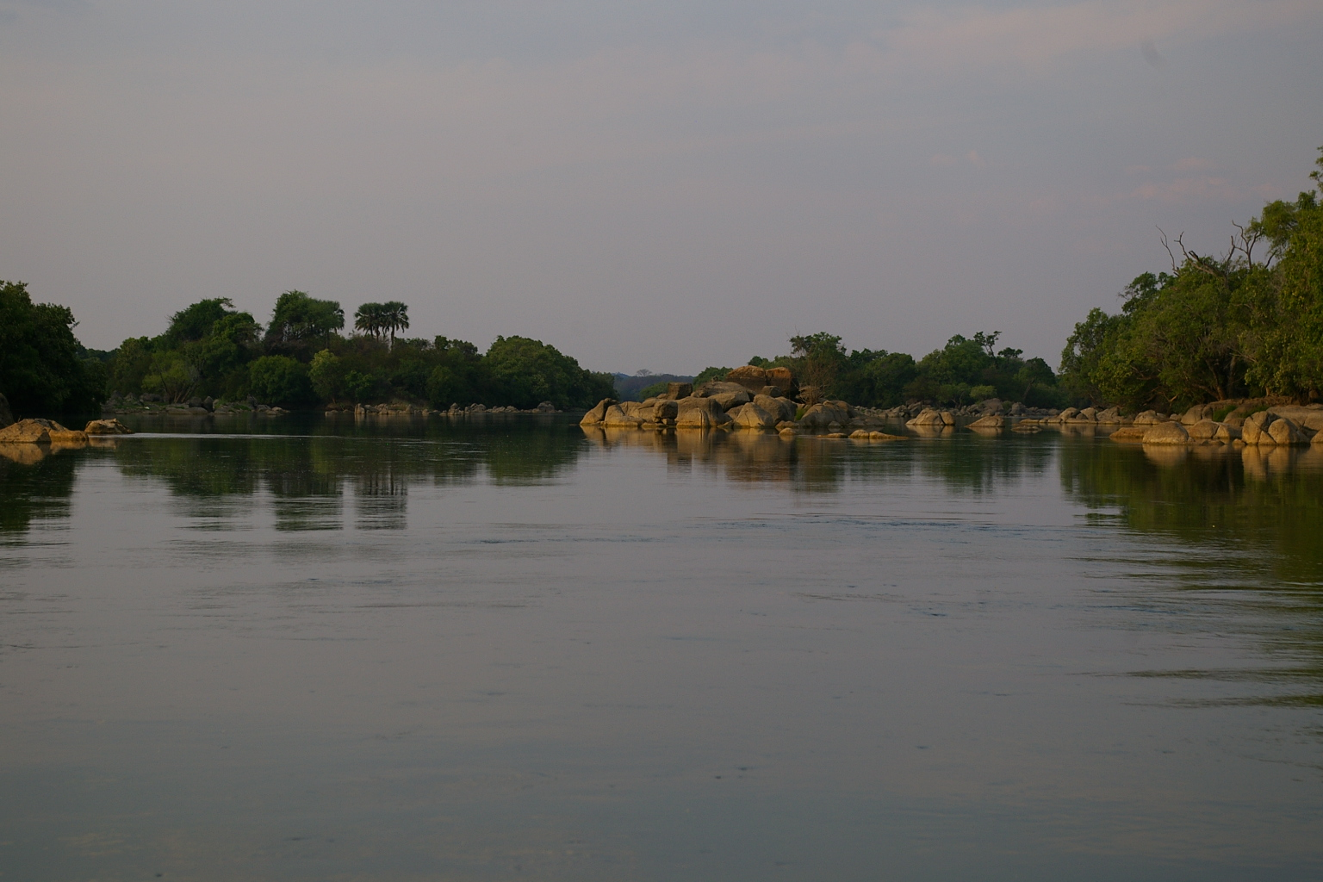
IMPLEMENTATION
(Specific to hydrological Reserve implementation)

Slide 19
IMPLEMENTATION
(Specific to hydrological Reserve implementation)
RQOs provide the information required to achieve the TEC.
The ‘master driver’, i.e. the flow must therefore be managed according to operating rules.
Those rules must provide the EWRs according to the frequency and duration required – i.e. variable flows linked to a trigger.
Most simple scenario is using natural inflows to measure the percentiles the natural flows represent, and then providing those flows downstream of a dam for the EWR percentile (EWR rule)
Problems associated with this is that there are often no natural flows to use and/or there are a lack of hydrological gauges. Alternative is to use rainfall as a trigger.
Tools exist – have been applied on the Letaba (successfully and a demonstration of cooperative governance at a very local level). Also on the Olifants River through involvement of NGOs with external funding.

Slide 20
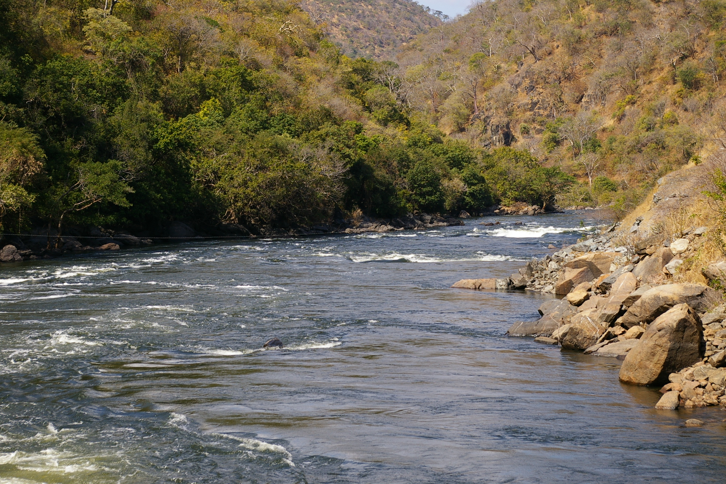
IMPLEMENTATION TO MONITORING
IMPLEMENTATION REQUIRES MONITORING TO DETERMINE WHETHER THE TEC IS BEING MET.
SA NWA makes provision for the protection of aquatic resources through the specification of ecological requirements → Ecological Reserve (ER)
NWA requires a national monitoring system to:
- measure compliance with RQOs
- monitor the health of aquatic ecosystems.
Two types of monitoring required:
Compliance monitoring (eg hydrological and water quality monitoring)
Response monitoring to determine whether the TEC is being met. (Biota and habitat)

Slide 21
MONITORING
How do you apply / interpret the theoretical determination in the real world?
EWRM operates within the following concepts: Reference condition is natural
Monitoring baseline is PES and survey info undertaken during reserve
Important to assess whether there is a trend in baseline
This is the standard (benchmark) against which future deviations can be measured.
Therefore: PES = baseline

Slide 22

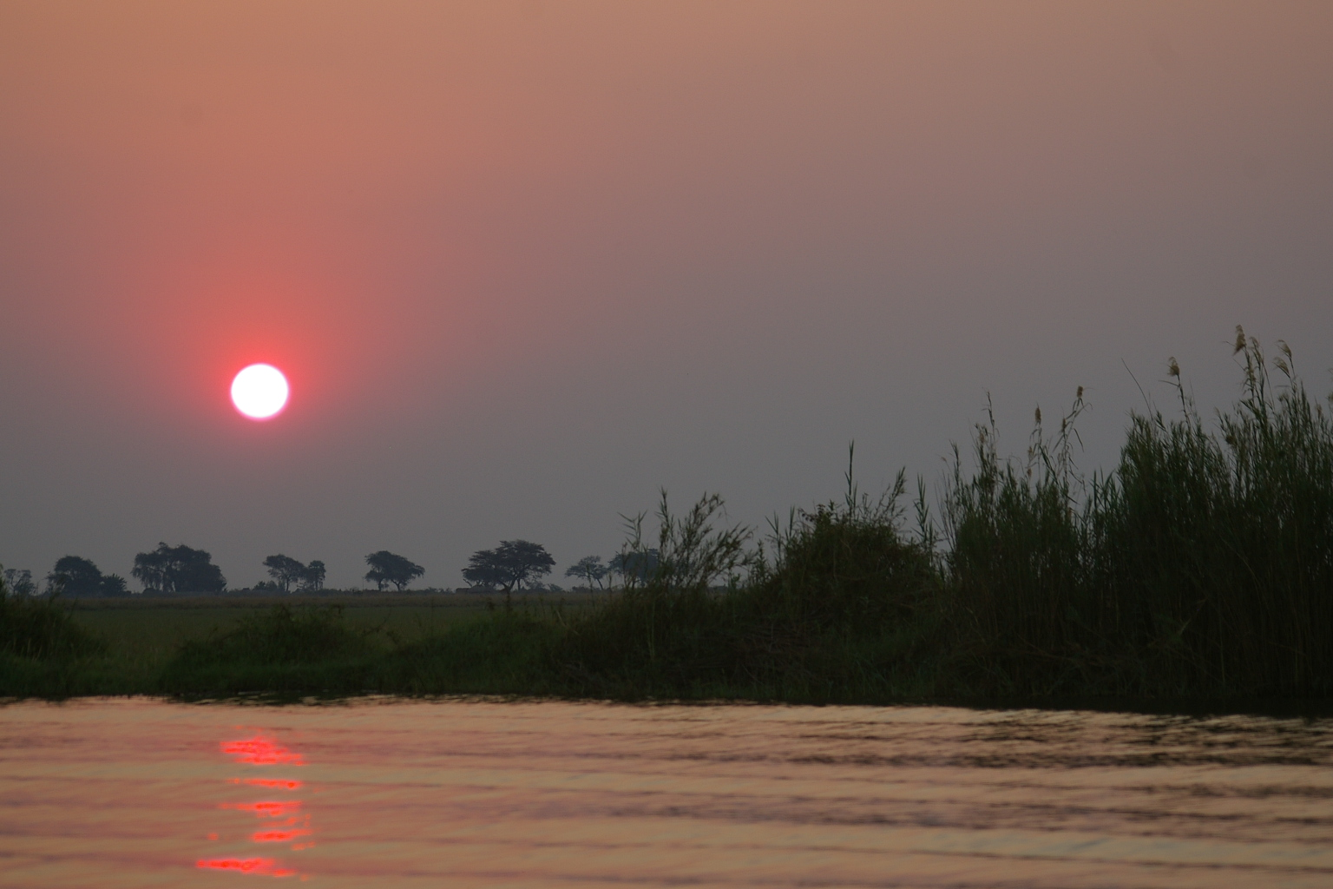
EWRM – BIOLOGICAL REPONSES MONITORING
Clearly distinguish setting management objectives ito drivers to achieve/maintain the TEC
and
Defining EcoSpecs for biophysical responses that describes (and measures) different levels of detail for the Ecological Category.
In essence – during an EWR study we are determining flow requirements (main driver) that could result in a certain ecological state defined through an EC. These flow requirements inform management objectives supported by the other drivers. Must – as all biological responses to drivers are predicted - be tested through monitoring.

Slide 23
NB
Determining ecological response through monitoring, confirms the predictions made during an EWR study.
Monitoring has to determine whether the management objectives has resulted in the expected response, ie, the expected EC.
Crucial that monitoring be driven by objectives – foundation.

Slide 24
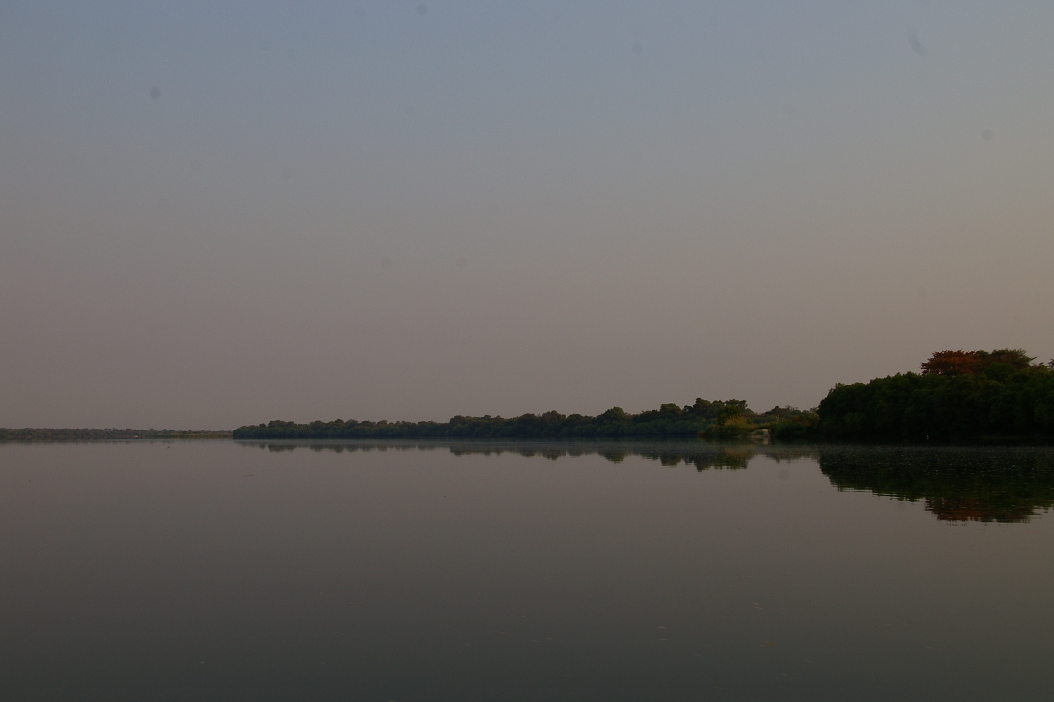
MONITORING DSS
Purpose of DSS:
Guide & inform managers re condition of river
Suggest alternative management actions if EcoSpecs not met
Often uncertain when EcoSpecs are not met, whether it is due to natural events or anthropogenic activities.
This can be due to lack of knowledge on how ecosystems and biota respond to disturbance
or
lack of information on the problem

Slide 25
MONITORING DSS
Solution: Use a DSS that follows an adaptive resource management approach with TPCs in a DSS.
When TPCs are reached, assess cause of change.
Decide whether managed action is needed, or recalibrate TPC.
This approach being tested for practical application in the Letaba River.
Without a EWRM DSS, you are monitoring for monitoring’s sake, ie collecting data that that fills up files
(Ref Nigel Kemper - 1990)
WHY DO YOU NEED DSS?

Slide 26
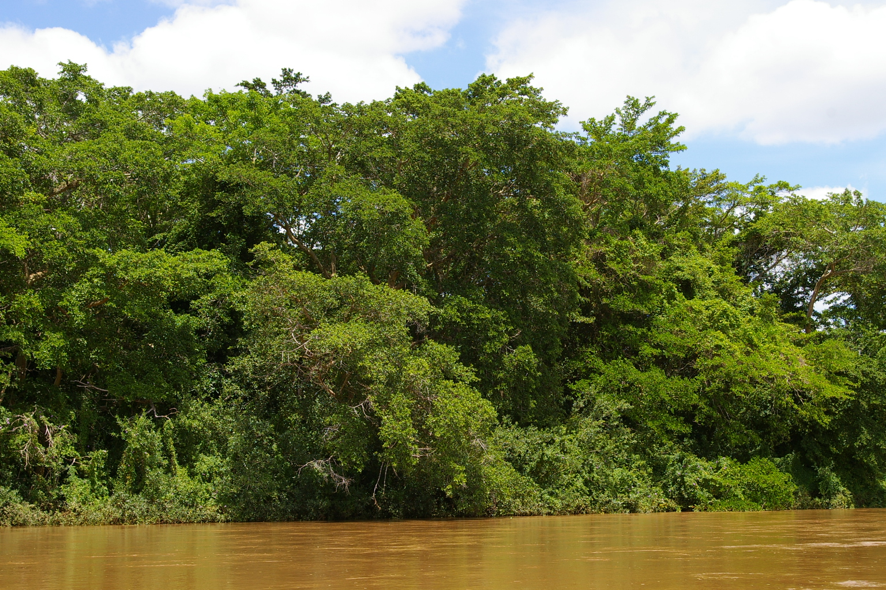
RELEVANT INTERNATIONAL ENVIRONMENTAL LAWS

Slide 27
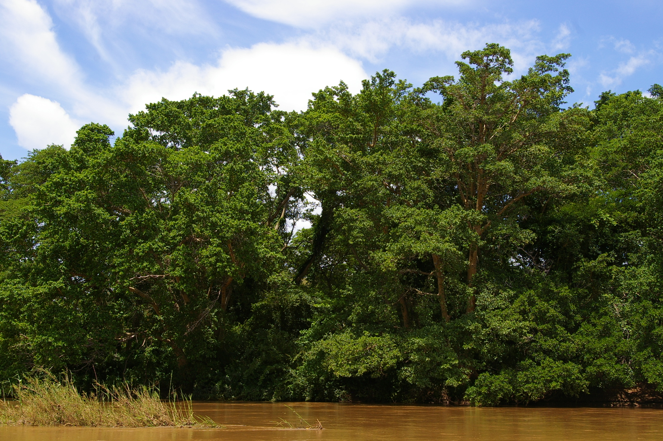
INTERNATIONAL ENVIRONMENTAL LAW
Based on slides from:
Introduction to Environmental law (Garyn Rapson)
INTERNATIONAL OBLIGATIONS
Stockholm Convention, 1972–co-ordinated approach, Principle 21.
UNCED, Rio Conference, 1992
  Rio Declaration on Environment and Development
    Rio Principles adopted by 178 Member States
    Member states to put in place adequate legislative instruments to address environmental issues
  Agenda 21
    programme of action for sustainable development worldwide
Paris Agreement
  South Africa ratified this international Climate Change Agreement in November last year

Slide 28
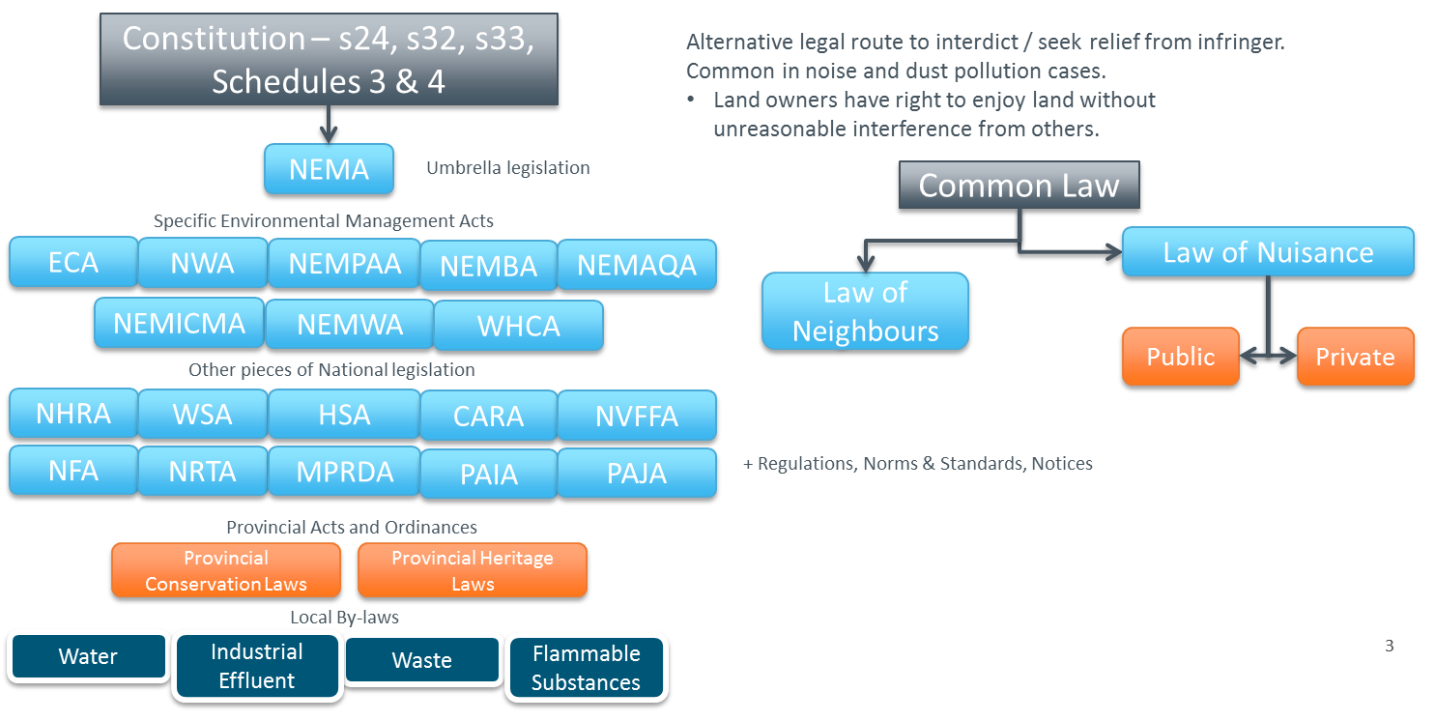
SOUTH AFRICAN ENVIRONMENTAL LAW

Slide 29
NEMA and the EIA regulations
The 2014 Environmental Impact Assessment Regulations provide for the procedure to be followed when undertaking the EIA which is required for an authority to grant an EA. (The most up to date EIA Regulations and listing notices were published on 04 December 2014 and were amended on 07 April 2017.)
The regulations seek to prevent lengthy EIA approval processes by providing very specific time periods within which to consider applications for environmental authorisations.
  The intention of the DEA is that all applications should be completed within 1 year.

Slide 30
NATIONAL ENVIRONMENTAL MANAGEMENT: BIODIVERSITY ACT 10 OF 2004 (NEMBA)
The objectives of NEMBA are to, within the framework of the NEMA, to provide for, inter alia, the management and conservation of biological diversity within South Africa and of the components of such biological diversity; to give effect to ratified international agreements relating to biodiversity which are binding on the Republic; and to provide for cooperative governance in biodiversity management and conservation.
Section 56 (1) of NEMBA provides that the Minister of Environmental Affairs may publish list of threatened species in need to national protection which must be categorised (must be reviewed every 5 years).

Slide 31
ALIEN AND INVASIVE SPECIES
Section 65 of NEMBA provides that a person may not carry out a restricted activity involving an alien species without a permit, which permit may be issued only after a prescribed assessment of risks and impacts on biodiversity.
Approximately 559 species / groups of species are included in the list of invasive species in 11 separate lists, including marine plant, bird, fresh-water invertebrate and microbial species.
560 species / groups of species have been listed in the list of alien species, in 12 separate lists, including mammal, reptile, fresh-water fish and terrestrial invertebrate species.

Slide 32
NATIONAL ENVIRONMENTAL MANAGEMENT: PROTECTED AREAS ACT 57 OF 2003 (NEMPAA)
The purpose of NEMPAA is to provide for the protection and conservation of ecologically viable areas representative of South Africa’s biological diversity by declaring such areas as protected areas
NEMPAA provides for the following kinds of protected areas:
  nature reserves, national parks, and protected environments;
  world heritage sites;
  marine protected areas;
  specially protected forest areas,
  mountain catchment areas.

Slide 33
NATIONAL WATER ACT 36 OF 1998 (NWA)
Section 19: Imposes a duty of care on certain categories of persons to prevent pollution of a water source.
The CMA or the Minister can issue directives under this section. Failure to comply with such directives is an offence.
Section 22: A person may only use water without a licence in the following circumstances:
  Water use is permitted by Schedule 1;
  Under a section 39 general authorisation; and
  Water use is the continuation of an "existing lawful water use".

Slide 34
NATIONAL WATER ACT (NWA) CONTINUED
Section 21: Lists the water uses for which authorisation under the NWA, in the form of a water use license ("WUL"), is required and which will eventually be priced. The section contains an extremely wide definition of "water use." A company may, therefore, be required to apply for a WUL where it was not previously required, or ensure that such water uses are covered by another form of authorisation under the NWA.
The list of water uses includes amongst others:
  taking water from a water resource;
  storing water;
  impeding or diverting the flow of water;
  stream flow reduction activity;
  engaging in a controlled activity;
  discharging waste;
  disposing of waste;
  altering the bed, pans, course or characteristics of a watercourse;
  using water for recreational purposes.

Slide 35
NATIONAL FORESTS ACT 84 OF 1998 (NFA)
Chapter 3: Part 3: deals with the protection of trees. The Minister is required to annually publish a list of all species protected under section 12, as well as an appropriate warning of the prohibitions set out and the consequences of its infringement, in the Government Gazette.
Latest list of protected trees was published in 2017 - includes Baobab, Marula, Leadwood and many Yellowwoods, Stinkwoods and Milkwoods.
The prohibitions in section 15 provide that "no person may cut, disturb, damage, destroy or remove any protected tree; or collect, remove, transport, export, purchase, sell, donate or in any other manner acquire or dispose of any protected tree", except under a licence granted by the Minister.

Slide 36
CONSERVATION OF AGRICULTURAL RESOURCES ACT 43 OF 1983 (CARA)
The core purpose of CARA is to provide for control over the utilization of the natural agricultural resources of South Africa in order to promote the conservation of the soil, the water sources and the vegetation and the combating of weeds and invader plants; and for matters connected therewith.
Section 6: In order to achieve the objects of CARA the Minister may prescribe control measures which may relate to amongst others:
  the irrigation of land;
  the prevention or control of waterlogging or aliention of land;
  the utilization and protection of vleis, marshes, water sponges, water courses and water sources;
  the regulating of the flow pattern of run-off water;
  the control of weeds and invader plants;
  the restoration or reclamation of eroded land; or

Slide 37
One Environment SYSTEM (OES)
The roll-out of the OES commenced on 8 December 2014 and entails the streamlining of the licensing processes for mining rights, EAs and water use licenses in South Africa
Under the OES, the Minister of Mineral Resources will issue EAs and waste management licenses in terms of NEMA and NEMWA respectively, for prospecting and mining activities, as well as activities relating to the primary processing of minerals. The Minister of Environmental Affairs will be the appeal authority for these authorisations, and the competent authority for any non-mining related activities.

Slide 38
One Environment SYSTEM (OES)
The Ministers of Environmental Affairs, Mineral Resources, as well as Water and Sanitation have agreed on fixed time-frames for the consideration and issuing of the permits, licenses and authorisations in their respective legislation. The aforementioned Ministers further agreed to synchronise the process for the issuing of permits, licenses and authorisations within a 300 day period. In the event that a decision to issue a licence is appealed, an additional maximum period of 90 days is provided for legislatively, to finalise the process.

Slide 39
ENVIRONMENTAL IMPACT ASSESSMENTS (EIAs)
Slides from information from Endangered Wildlife Trust*
Requires a Developer/Applicant to consider the environmental impacts of the proposed activity/development and to consider alternatives and mitigation measures;
Provides the public with a meaningful opportunity to understand and comment on the proposed activity;
Provides the government decision-makers with important information to assist them in deciding whether to approve or deny the Application
The main stakeholders/parties involved are: the Applicant/Developer; the Environmental Assessment Practitioner; the Competent Authority (based on the outcome of the EIA process will either grant or refuse the requested Environmental Authorisation); and the Interested and Affected Parties.
* www.ewt.gov.za

Slide 40
SCOPING AND EIAS
Scoping and EIA is the thorough environmental assessment required for activities contained in listing 2. The activities listed in listing 2 are activities that due to their nature and/or extent are likely to have significant impacts that cannot be easily predicted. Listing 2 activities are therefore higher risk activities that potentially cause higher levels of pollution, waste and environmental degradation.
The Scoping Report must contain a roadmap for the Environmental Impact Assessment, referred to as the Plan of Study for the EIA, specifying the methodology to be used to assess the potential impacts, and the specialists or specialist reports that are required.
The Applicant may only proceed with the EIA after the Competent Authority has approved the Scoping Report and the Plan of Study for the EIA.
The Scoping and EIA Process culminates in the development and submission of the Environmental Impact Assessment Report and the Draft Environmental Management Plan to the Competent Authority.

Slide 41
WETLANDS AND THE EIA PROCESS
Considering Wetlands In The EIA Process
Wetlands are ecosystems or habitats for specific plants and animals that are saturated with water. The presence or absence of water determines their formation, processes and characteristics.
Wetlands are characterised by specific vegetation, particular soils and the presence of water at least for a period of time in the year. A wetland may have all of these characteristics or only one or two of them.
Floodplains, marshes, bogs, deltas, swamps, peatlands, estuaries, river catchments and lakes are all types of wetland.

Slide 42
WETLANDS AND THE EIA PROCESS (slide 2)
Wetlands are classified as the most threatened ecosystem in the world.
In the EIA process, the following should be done:
The wetland should be delineated or sketched.
The biodiversity should be assessed to determine its value.
The impact of the development on the wetland - and its functions - should be assessed, and mitigation measures (actions to moderate) put in place to reduce these impacts.
The cumulative impact on the broader catchment should be taken into account.
Wetlands must always be buffered with an appropriate area from any type of development which may impact on the wetland ecosystem.

Slide 43
EIA, RESERVE AND RQO PROCESSES
As has been demonstrated: There are solid processes supported by a legal framework for EIAs, the Reserve and RQOs.
There are also significant links and overlaps and a serious need for cooperative governance in these processes.
Furthermore, no integrated framework exist showing the links and chronological order of investigations required.
Note: If one Googles EIAs and the Reserve – there are no hits that clearly include both of these processes.
Very simple example: Scenario evaluation showing impact on downstream environment links in 100% with an EIA evaluation. EIAs should consider these impacts on the severity assessments. Should also consider the Class and RQOs and compliance. If EIAs precede these studies, then any specialist studies within EIAs should feed into Reserve studies etc.
Many examples – some times it happens, but – NO formalised integrated process.

