Slide 1

CLASSIFICATION, RESOURCE QUALITY OBJECTIVES AND THE RESERVE

Slide 2
WATER ACT: CLASSIFICATION SYSTEM
Part 1: Classification system must be designed
Includes guidelines and procedures for determining classes in respect of
- procedures for determining the Reserve
- procedures for water quality requirements of water users
- set out water uses for instream or land-based activities which activities must be regulated or prohibited
- provide for such other matters relating to the protection, use, development, conservation, management and control of water resources

Slide 3
WATER ACT: CLASSIFICATION AND RQOs
Part 2: Use and apply the systems (part 1) to determine the class and RQOs
Purpose of RQOs is to establish clear goals relating to the quality of the water resource.
In determining RQOs, a balance must be sought between the need to protect and sustain water resources, and the need to develop and use them.
Once the class of a water resource and the resource quality objectives have been determined, they are binding on all authorities and institutions when exercising any power or performing any duty under this act.

Slide 4


WHAT IS CLASSIFICATION
Balance between
Protection
(Ecology)
Use
&
includes Water balance, quality, socio-economics
Expressed as Ecological state

Slide 5






HOW IS CLASSIFICATION DESCRIBED?
Ecology
Use
CLASSES | DESCRIPTION
I (mostly A & B) | Ecology: Mostly in good condition. Use: Minimal
II (Mostly C) | Ecology: Mostly in moderate condition Use: Medium
III (Mostly D) | Ecology: Mostly in poor condition. Use: High, so a work-horse river.

Slide 6

HOW IS ECOLOGY DESCRIBED?
Close to Natural: Good condition
Very different to Natural: Very Poor condition
{
{
Categories

Slide 7
WHAT SCALE DO WE CLASSIFY AT?
Classify every Integrated Unit of Analysis (IUA)
IUAs are similar ito land use &/or ecological state. So, an IUA consist of many river reaches and/or estuaries.
Provide the Catchment Configuration for every IUA (Provide the ecological state for each of the river reaches and estuaries).
Ecological state can be the Present Ecological State (PES), a Recommended Ecological Category (REC), or a Target Ecological Category (TEC; for management purposes) once classified.

Slide 8
IUAs & CATCHMENT CONFIGURATION
RU 1_2
IUA 2
RU 1_1
IUA 1
RU 1_3
RU 1_4
IUA 4
IUA 3

Slide 9
HOW DO WE CLASSIFY?
Gather relevant information
Build a step-by-step picture of the study area in terms of water resources:
present uses and implications
the ecological state and water requirements
future needs (ecological and user)
Determine a balance – and implications
Apply numerous analysis tools

Slide 10
ASPECTS CONSIDERED IN CLASS DETERMINATION
Ecological Water Requirements: River RUs, Estuaries, Wetlands, Groundwater
User water requirements (How much water is used and discharged?):
Hydrological assessment (How much water is available and what are future planned uses):
Socio-economic activities relying on water:
  GDP, Jobs (water stored and abstracted as well as waste water discharges).
  EcoSystem Services (use of water in the rivers).

Slide 11
CLASSIFICATION WITHIN INTEGRATED WATER RESOURCE MANAGEMENT
(1 OF 2)
Increasing water use to provide for population growth, new and improved water service provision and economic activities to establish sustainable socio-economic environment.
Planned development of potential future infrastructure developments (Eg dams, pipelines, pumping schemes, hydro-electric, WWTW and discharges, interbasin transfers).

Slide 12
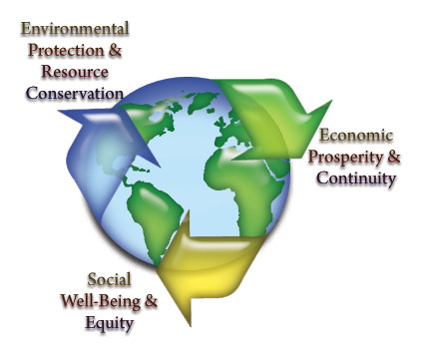
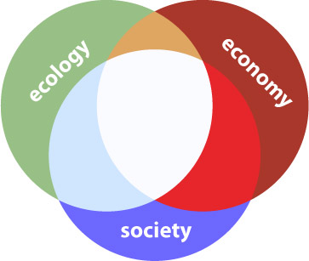
CATCHMENT ANALYSIS
Catchment Resource Availability
Ecological
Water Requirements
Socio-Economic
Water Requirements
Protection
Use
Water Resource Class
(Decision)

Slide 13
SCENARIO EVALUATION AS PART OF CLASSIFICATION
Key to WRCS is balancing protection and use
Scenarios are plausible definitions (settings) of all the factors that influence the water balance and water quality
Scale of the analysis requires the aggregation of land use effects: Operational scenarios are based on flow and water quality related aspects and not on non-flow related aspects (managed through the RQO process)

Slide 14
GENERAL APPROACH WHEN EVALUATING OPERATIONAL SCENARIOS
Define operational SCs
Yield modelling
Predict Consequences
Ecological
EGSA
Economics
Non-Ecological Water quality
Rivers
Estuaries
Rank, optimise, recommend Scenario
Define Class (and catchment config)
Test with stakeholders

Slide 15
DETERMINING ECOLOGICAL CONSEQUENCES OF SCENARIOS
Need to answer the ‘what if’ questions
Express in terms of change in Ecological Category AND degree in which the REC is met
Detailed process to predict changes in all the biophysical components per site and per scenario.
Then to integrate and demonstrate in systems context

Slide 16
DETERMINING ECOLOGICAL CONSEQUENCES OF SCENARIOS
Geomorphology
Geomorphology
Geomorphology
AVERAGE SCORE FOR EACH SCENARIO & STANDARDISE TO 1
Physico-chemical
Physico-chemical
Physico-chemical
Fish
Fish
Fish
Macroinvertebrates
Macroinvertebrates
Macroinvertebrates
Riparian vegetation
Riparian vegetation
Riparian vegetation
Consequences
Consequences
Consequences
EC FOR PES & REC
EC FOR SC
COMPARE EC TO REC
Evaluate scenarios
Determine PES, REC and %
Predict EC and %
Determine degree to which REC is met
Rank Scenarios at each EWR site

Slide 17
DETERMINING ECOLOGICAL CONSEQUENCES OF SCENARIOS
RELATIVE ECOLOGICAL IMPORTANCE OF SITES
PES
EIS
Locality in conservation areas
Confidence
Length of river
WEIGHT
Ecological ranking of scenarios per EWR site
APPLY WEIGHT TO
OUTPUT
Ecological ranking of scenarios for the system

Slide 18
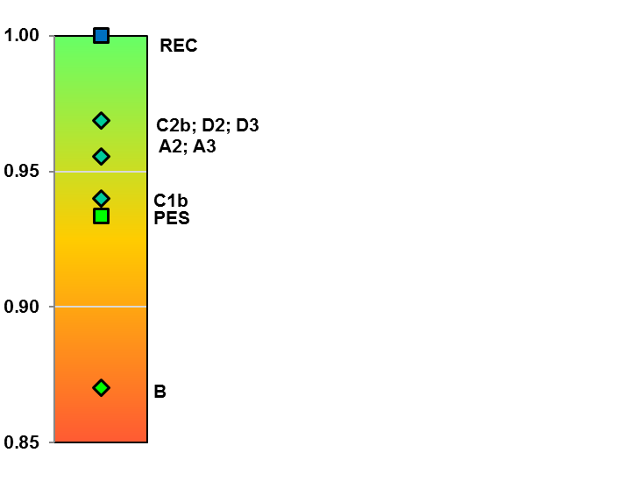
  TRAFFIC DIAGRAMS
  A traffic diagram is a bar graph that is shaded according to the colours of a traffic light.
  This implies that the items at the top (in the green section) is better than the ones below.
  The scale of the bar graph could be anything, the importance is the ranking order and the distance between scenarios on the bar graph.
  The purpose is to rank scenarios for all the different components using different scales of measurements, but visually being able to compare the rankings using traffic diagrams.

Slide 19
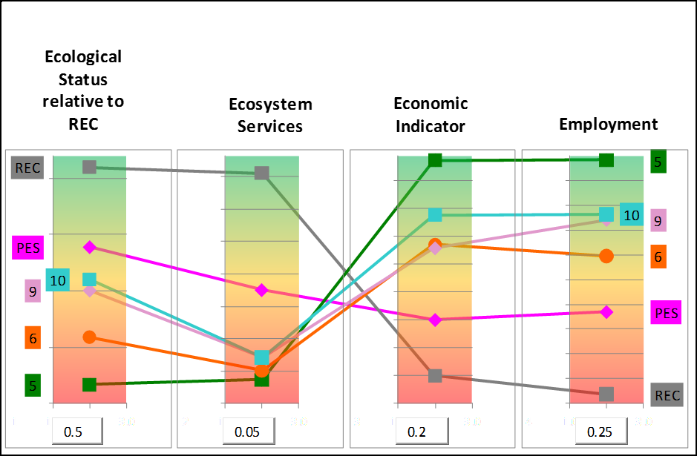
VISUALISATION OF VARIABLE SCORES

Slide 20
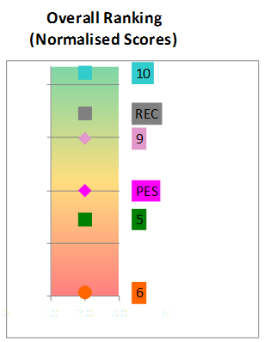
VISUALISATION OF VARIABLE SCORES
(Slide 2)

Slide 21
SENSITIVITY ANALYSIS AND SYNTHESIS OF RESULTS
Weights |  |  |  |  |  | Rank Position of Scenario (Normalisation Ranking Method)
Alternative | Ecology | EcoSystem Services | GDP | Jobs |  | S2b | S53 | S54 | S61 | S62 | S63 | S65 | S69 | S2c | S70
1 | 0.50 | 0.05 | 0.20 | 0.25 |  | 10.0 | 3.0 | 2.0 | 8.0 | 9.0 | 5.0 | 7.0 | 1.0 | 6.0 | 4.0
2 | 0.50 | 0.10 | 0.20 | 0.20 |  | 10.0 | 3.0 | 2.0 | 9.0 | 8.0 | 5.0 | 6.0 | 1.0 | 7.0 | 4.0
3 | 0.50 | 0.15 | 0.15 | 0.20 |  | 10.0 | 3.0 | 2.0 | 9.0 | 7.0 | 6.0 | 5.0 | 1.0 | 8.0 | 4.0
4 | 0.50 | 0.05 | 0.15 | 0.30 |  | 10.0 | 3.0 | 2.0 | 8.0 | 9.0 | 5.0 | 7.0 | 1.0 | 6.0 | 4.0
5 | 0.50 | 0.05 | 0.30 | 0.15 |  | 10.0 | 3.0 | 2.0 | 8.0 | 9.0 | 5.0 | 7.0 | 1.0 | 6.0 | 4.0
6 | 0.25 | 0.25 | 0.25 | 0.25 |  | 10.0 | 6.0 | 3.0 | 4.0 | 8.0 | 2.0 | 9.0 | 1.0 | 7.0 | 5.0
7 | 0.20 | 0.10 | 0.40 | 0.30 |  | 8.0 | 6.0 | 7.0 | 2.0 | 9.0 | 1.0 | 10.0 | 4.0 | 3.0 | 5.0
8 | 0.15 | 0.10 | 0.45 | 0.30 |  | 8.0 | 6.0 | 7.0 | 2.0 | 9.0 | 1.0 | 10.0 | 4.0 | 3.0 | 5.0
9 | 0.50 | 0.05 | 0.20 | 0.25 |  | 10.0 | 3.0 | 2.0 | 8.0 | 9.0 | 5.0 | 7.0 | 1.0 | 6.0 | 4.0
10 | 0.40 | 0.20 | 0.10 | 0.25 |  | 10.0 | 5.0 | 2.0 | 8.0 | 7.0 | 3.0 | 6.0 | 1.0 | 9.0 | 4.0
11 | 0.30 | 0.30 | 0.15 | 0.25 |  | 10.0 | 5.0 | 3.0 | 6.0 | 8.0 | 2.0 | 7.0 | 1.0 | 9.0 | 4.0
12 | 0.30 | 0.20 | 0.25 | 0.25 |  | 10.0 | 6.0 | 3.0 | 5.0 | 8.0 | 2.0 | 9.0 | 1.0 | 7.0 | 4.0
Rank: 1 = best, 10 = worse.

Slide 22
DERIVING THE WATER RESOURCE CLASS FOR EACH IUA
Recommended Class Criteria Table
 |  | % EC representation at units represented by biophysical nodes in an IUA |  |  |  |  | Prominent Ecological Categories
 |  | ≥ A/B | ≥ B | ≥C | ≥ D | < D
Class I |  | 0 | 60 | 80 | 95 | 5 | A & B
Class II |  |  | 0 | 70 | 90 | 10 | C
Class III | Either |  |  | 0 | 80 | 20 | D
 | Or |  |  |  | 100
Unit Percentages:
Length of river in a given Ecological Category divided by the total river length in an IUA .

Slide 23
RESULTING IUA CLASSES FOR ALL SCENARIOS
IUA | Scenarios and Management Class
 | PES | REC | S2b | S53 | S54 | S61 | S62 | S63 | S65 | S69 | S2c | S70
T31 | II | II | II | II | II | II | II | II | II | II | II | II
T32_a | II | II | II | II | II | II | II | II | II | II | II | II
T32_b | III | II | II | II | II | II | II | II | II | II | II | II
T33_a | II | II | II | II | II | II | II | II | II | II | II | II
T33_b | II | II | II | II | II | II | II | II | II | II | II | II
T34_a | I | I | I | I | I | I | I | I | I | I | I | I
T34_b | II | II | II | II | II | II | II | II | II | II | II | II
T35_a | I | I | I | I | I | I | I | I | I | I | I | I
T35_b | I | I | I | I | I | I | I | I | I | I | I | I
T35_c | II | II | II | II | II | II | II | II | II | II | II | II
T35_d | II | II | III | III | II | III | III | III | II | II | III | III
T36_a | I | I | I | I | I | I | I | I | I | I | I | I
T36_b | I | I | I | I | I | I | I | I | I | I | I | I

Slide 24
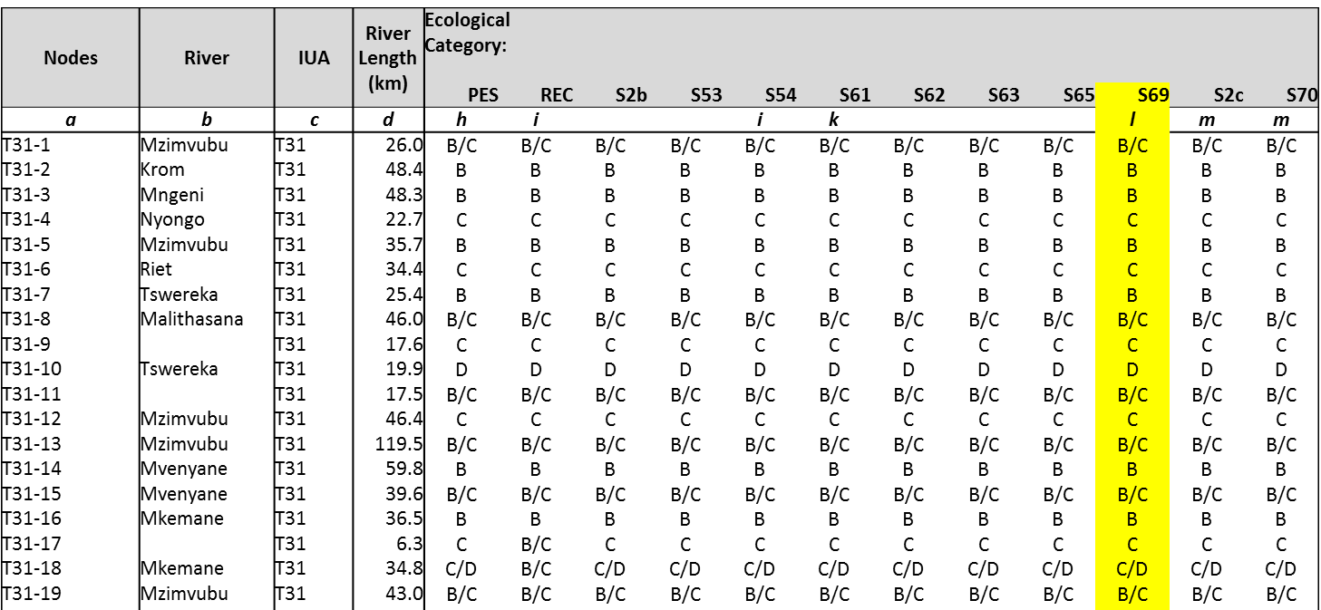
ECOLOGICAL CATEGORIES FOR ALL SCENARIOS

Slide 25
RESOURCE QUALITY OBJECTIVES

Slide 26
  RQOs AND WATER RESOURCE
  CLASSES
Water Resource Class
Operational Scenarios
Informs
Defines
RQOs

Slide 27
  WHAT ARE RESOURCE
  QUALITY OBJECTIVES?
Resource Quality Objectives provide information to resource managers on how to manage the Integrated Units of Analysis to maintain or achieve the Water Resource Class and the ecological needs.
Resource Quality Objectives for a water resource are a numerical or narrative (descriptive) statement of the conditions which should be met to ensure that the water resource is protected.

Slide 28
FOR WHICH COMPONENTS/INDICATORS ARE RQOS SET?
Quantity, pattern and timing of instream flow (hydrology).
Water quality (numerical values that define the fitness of use and/or ecological requirements for various variables).
Characteristics and condition of riparian habitat and biota (% alien vegetation, cover, species).
Characteristics and condition of instream habitat and biota (frequency of occurrence, species/taxa, abundance, habitat).
NOTE: Not all RQOs are set for all river reaches and estuaries – depends on priority and indicators selected.

Slide 29
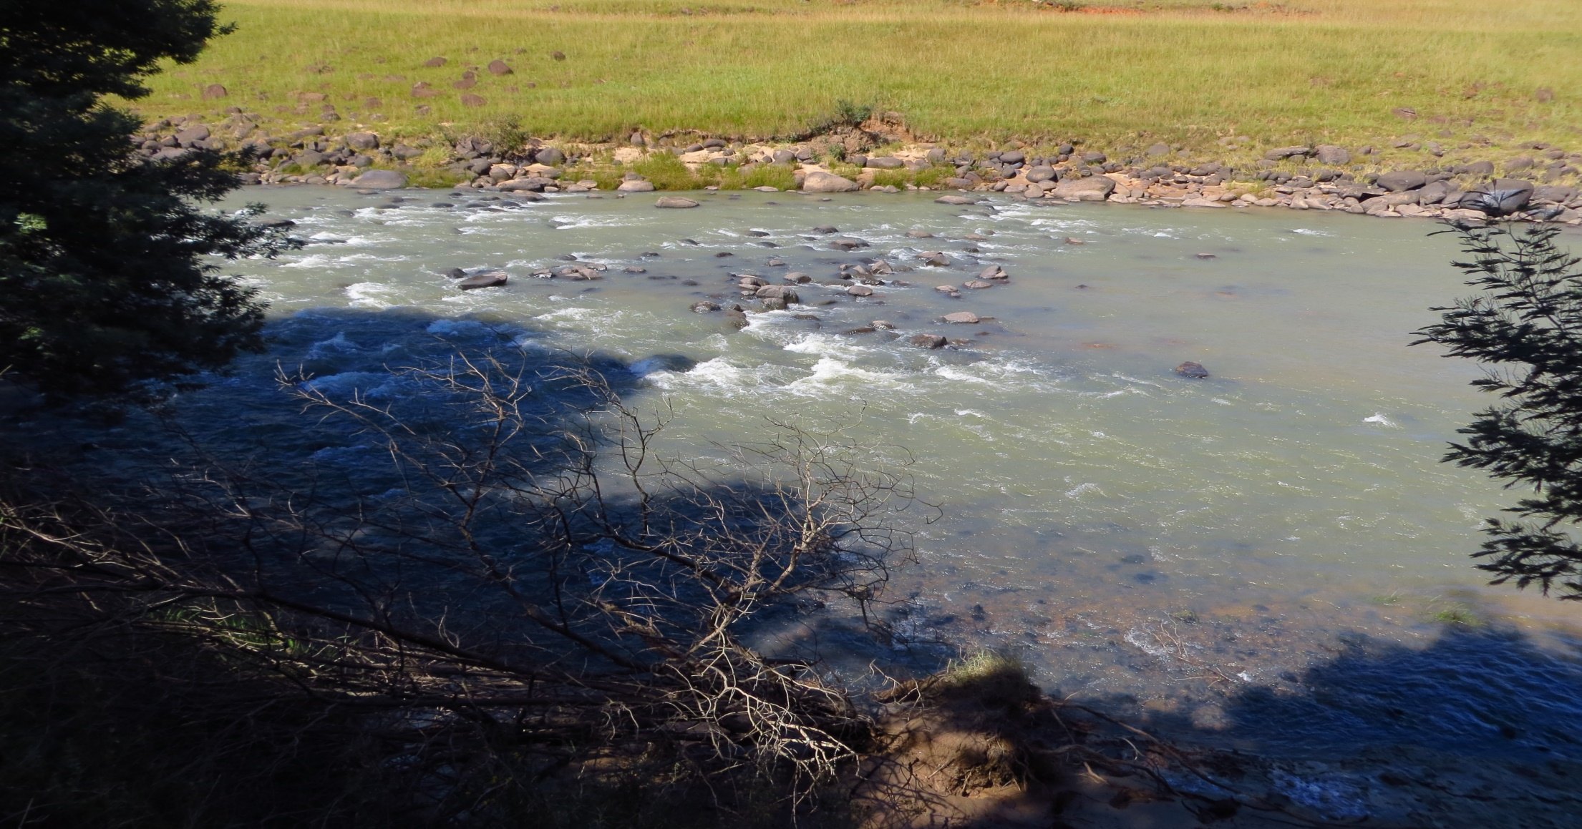

TSITSA RIVER - MZIMEWR1
 |  | PES | TEC
Hydrology | nMAR% | 31 | 31
 | Drought (90%) Aug | 0.66 m³/s | 0.66 m³/s
 | Aug (60%) | 0.8 m³/s | 0.8 m³/s
Habitat & Biota (EcoStatus C) | Geomorph | C/D | D
 | Water quality | B | B
 | Fish | C | C
 | Invertebrates | C | C
 | Vegetation | C/D | D

Slide 30


Mzimvubu Estuary RQO = Target Category B
Component | EC | Resource Quality Objectives*: Drivers
Hydrology | A | Protect flow regime to create required habitat for biota.
Hydrodynamics | A | Maintain mouth conditions to create the required habitat: Mouth not to close or become very constricted. Changes in tidal amplitude at the tidal gauge nor more than 20% from 2017 baseline.
Physical habitat (Sediments) | A/B | River inflow distribution patterns (floods) and suspended sediment concentration in river inflow not to deviate by more than 20% of present. No deviation in sedimentation and erosion patterns in estuary.
Water Quality (salinity) | A/B | Maintain salinity regime.
Water Quality (other) | C | Maintain the water quality to meet the target EC for both river inflow and in the estuary. Note a naturally turbid system. Metals in water and sediment not to exceed target values. Recreational guidelines specified.
*The RQOs provided here include some numerical information. All narrative RQOs supported by numerical RQOs are in the technical reports.

Slide 31



Mzimvubu Estuary RQO = Target Category B
Component | EC | Resource Quality Objectives*: Responses
Microalgae Macrophytes | C
Invertebrates | A/B
Fish | B/C
Birds | C/D

Slide 32
INTEGRATED FRAMEWORK

Slide 33
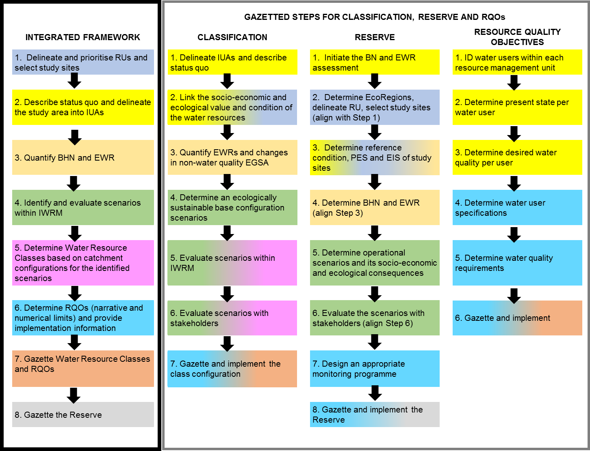
INTEGRATED FRAMEWORK

Slide 34
INTEGRATED FRAMEWORK
Step 1: Delineate and prioritise RUs and select study sites
Step 2: Describe status quo and delineate the study area into IUAs
Step 3: Quantify BHNR and EWR
Step 4: Identify and evaluate scenarios within IWRM
STAKEHOLDER ENGAGEMENT
Step 5: Determine Water Resource Classes based on catchment configurations for the identified scenarios
Step 6: Determine RQOs (narrative and numerical limits) and provide implementation information
Step 7: Gazette Water Resource Classes and RQOs
Step 8: Gazette the Reserve

