Slide 1
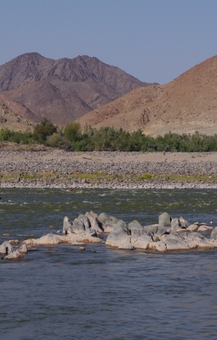
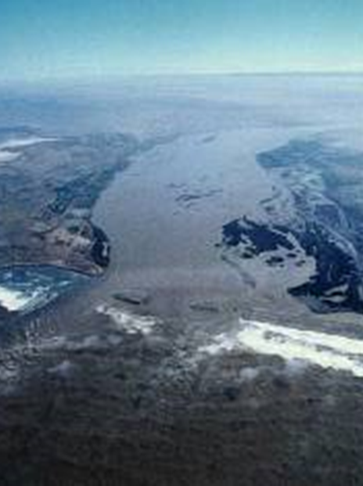
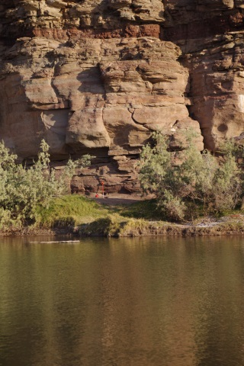
ECOLOGICAL WATER REQUIREMENTS
general

Slide 2
ECOLOGICAL WATER REQUIREMENTS
Setting flow requirements that maintain HABITAT for instream and riparian biota at a specified state.
Very simply – flow & its associated characteristics (water quality, sediment, patterns) that should be left or provided in the river system for biota dependant on it as well as any people dependant on a natural functioning river (Goods & Services).
TWO PROCESSES:
EcoClassification: Determining Present state, importance and future state
Quantifying the volume required

Slide 3
ECOLOGICAL WATER REQUIREMENTS
EcoClassification

Slide 4
What is Ecological Classification?
EcoClassification consists of 3 processes:
Present Ecological State (PES)
The PES describes the river according to ecological status or health compared to natural conditions
Ecological Importance
The EIS evaluates and rate a range of criteria to determine an overall importance (Low to Very High)
Recommended Ecological Category (REC)
The REC is an improved PES (if the PES is low) motived by a High of Very High importance

Slide 5
ECOCLASSIFICATION (slide 2)
The process can be described in terms of a range of questions:
What state do you want your river to be in future?
To answer this, you need to know:
What state it is in now?
Why is it in that state?
What is important about your river (ecological and socio-cultural)?

Slide 6
ECOCLASSIFICATION (slide 3)
Steps in EcoClassification:
  Estimate the natural condition (the “A”).
  Evaluate human impacts & describe how it has influenced the ecological state.
  Identify whether changes are related to flow or other factors.
  Determine the Ecological Importance and Sensitivity (EIS).
  Recommend the Ecological Category to aim for (REC).

Slide 7
ECOCLASSIFICATION (slide 4)
Detailed approach for each EFR site and reach
Present Ecological State:
FIRST: Have to know what state your system drivers are in.
System drivers are hydrology (key), water quality, geomorphology
SECOND: Need to know how the response biota respond to the changes in drivers.
Response biota for rivers are fish, bugs (invertebrates), riparian plants and diatoms
THEN THE RESPONSES IS INTEGRATED TO GIVE THE ECOLOGICAL STATUS OF THE RIVER - ECOSTATUS

Slide 8
ECOCLASSIFICATION TOOLS (slide 4)
Models that measure the state that each of the drivers and the response biota is in.
Models provide the state in terms of A – F
Natural Changed Changed completely
Hydrology: Reference hydrology, present hydrology – how much has it changed.
Geomorphology: Reference substrate, shape of channel, sediment transport – how much has it changed.
Water quality: Nutrients, pH, Oxygen, Temperature, Salts etc.

Slide 9
ECOCLASSIFICATION TOOLS (slide 5)
Fish and invertebrates:
Identify species that would be there under reference condition.
Identify species that is present now.
Identify how sensitive the species are to changes in flow, sediment and water quality – i.e. if only tough species are left and sensitive ones have disappeared, then one can assume that the drivers have been impacted on.
Riparian vegetation
Identify how riparian vegetation has changed from reference by looking at the impacts.
Look at riparian vegetation in terms of cover, abundance, exotics.
Measure in terms of woody and non-woody and for marginal and non-marginal areas

Slide 10
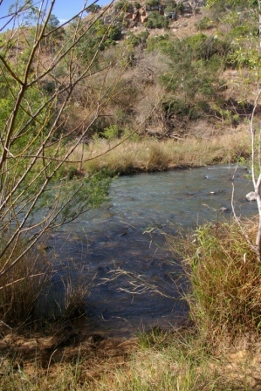
EFR 2: ASSEGAAI
Driver Components | PES
HYDROLOGY | D
WATER QUALITY | B/C
GEOMORPHOLOGY | B
Response Components | PES
FISH | C
AQUATIC INVERTEBRATES | B/C
INSTREAM | B/C
RIPARIAN VEGETATION | C
ECOSTATUS | C
Upstream dams, forestry, abstractions
Nutrients, salts
Decreased sediment transport capacity, less floods
Fish species missing, abundances, diseases, trout
Bugs missing, abundances, some sensitive groups
Exotic vegetation, erosion, grazing

Slide 11
ECOCLASSIFICATION TOOLS (slide 7)
Ecological Importance and Sensitivity (EIS) is evaluated using similar models to determine Very High, High, Moderate and Low Importance.
Based on the outcome of the EIS, the Recommended Ecological Category (REC) can be derived as follows:
  If Importance is High or Very High – the REC should be improved if the PES is lower than a B.
NB: need an indication whether flow, water quality or land use/catchment activities must be improved.
The PES assessment which identified the reasons is NB.

Slide 12
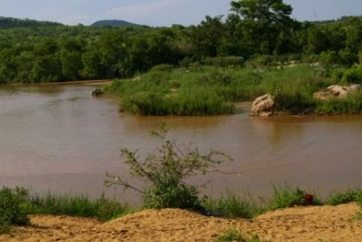
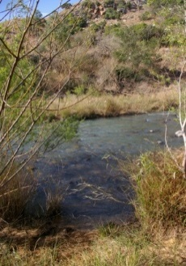
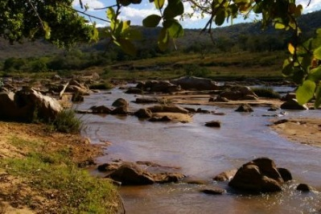
PES AND REC ECOSTATUS
EFR1: NGWEMPISI
EIS = HIGH
PES
C
REC
B/C
PES
C
EIS = HIGH
REC
B/C
EFR2: ASSEGAAI
EFR3: MHKONDVO
PES
C
EIS - MODERATE
REC
C

Slide 13
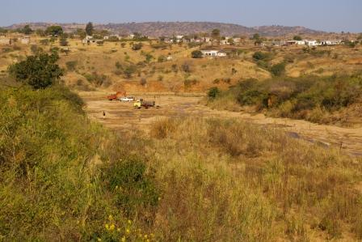
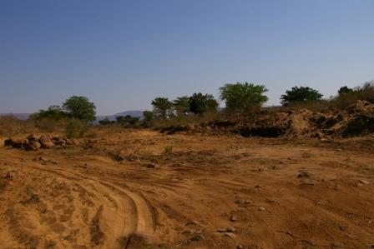
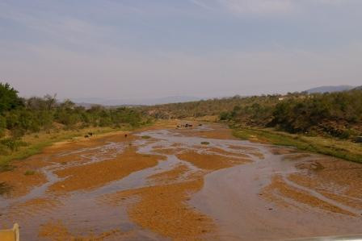
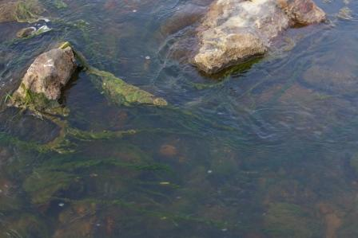
Rivers with lots of problems
Spekboom
Ingwavuma
Mhlathuze
Lusushwane

Slide 14
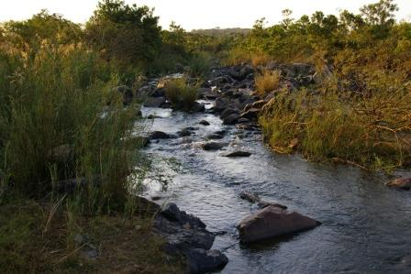
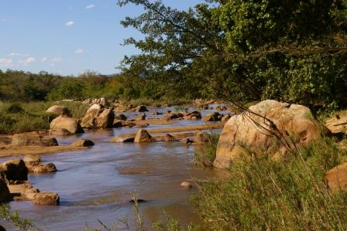
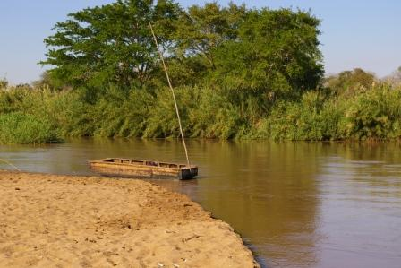
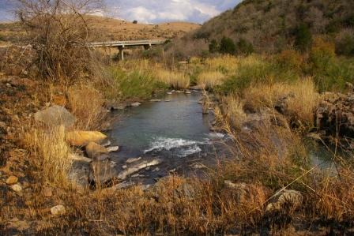
Rivers with less problems – reasonable condition
Lusushwane
Mkondvo
Maputo
Ngwempisi

Slide 15
ECOCLASSIFICATION AND EWRS
EcoClassification is a process with associated tools. EcoClassification can be used as a stand-alone process for other uses such as in EIAs etc.
The EWR process always includes EcoClassification and cannot stand on its own
Links in process as follows:
1. Set flow requirements for different ECs
2. Test other flow requirements to determine impact on EC
3. Set monitoring objectives in terms of EC
4. Measure monitoring results against desired EC
31

Slide 16
ECOLOGICAL WATER REQUIREMENTS
how

Slide 17
ECOLOGICAL WATER REQUIREMENTS (slide 1)
Now to know what state you want your river to be in and you need to know what you must do to keep or get your river in that state.
How much flow does your river need?
Which flow regime will provide suitable habitat (water quality and geomorphology) for the animals and plants dependant on the river?
Will the above be suitable to maintain or improve the Goods and Services?
Are there other flow regimes that will also result in an acceptable state (and with less impact on the users)?
Are there non-flow related problems that must be addressed at source so that you do not use water to mitigate those problem?

Slide 18
ECOLOGICAL WATER REQUIREMENTS (slide 2)
How do we determine EWRs?
Determine low flows (base flows)
&
high flows (floods)
in different seasons and different conditions (droughts, normal, between etc)
HIGH FLOWS
flow
LOW FLOWS
days
32

Slide 19
ECOLOGICAL WATER REQUIREMENTS (slide 3)
NORMAL PERIOD
60%
flow
Oct
(end of dry season)
Dec to March
Wet season
May to Sept
Dry season
DROUGHT PERIOD
90%
flow
Oct
(end of dry season)
Dec to March
Wet season
May to Sept
Dry season

Slide 20



ECOLOGICAL WATER REQUIREMENTS:
LOW FLOWS (slide 4)
Determine the instantaneous flows for each month for normal years and drought years.
Based on the fish and bugs’ habitat requirements
Habitat requirements: Depth, velocity, substrate, cover, marginal plants, overhanging plants.

Slide 21
ECOLOGICAL WATER REQUIREMENTS: LOW FLOWS (slide 5)
FISH
Some fish cannot live without flowing water
-other fish can survive in pools
-BUT need enough depth to move from one place to feed and to breed;
Need place to hide from enemies (birds, other fish, anglers)
BUGS
Depth not always as important; BUT need velocity and
very specific substrate
and
marginal vegetation

Slide 22
ECOLOGICAL WATER REQUIREMENTS: HIGH FLOWS (slide 6)
GEOMORPHOLOGY
Maintains the river channel.
Moves the rocks and sand
Cleans the rocks – open spaces for bugs and small fish to live in.
RIPARIAN VEGETATION
Needs floods to clear out rubbish and undergrowth
Deposits nutrients and sediments (soil)
Supplies moisture in the soil/groundwater
THEN

Slide 23
ECOLOGICAL WATER REQUIREMENTS: RESULT (slide 7)
High flow EFR
LOW FLOWS
Low flow EFR
days

Slide 24
ECOLOGICAL WATER REQUIREMENTS: (slide 8)
CHALLENGES WHEN DETERMINING EWRs
Lack of information from hydrological and quality monitoring
Limited understanding of some species habitat requirements
NBNB: know the habitat requirements, but do not know the duration it requires – or how often it can handle bad conditions before it cannot bounce back (eg drop a category)
All users’ flow requirements are provided as a volume linked to assurance of supply
Same for EWR – i.e. Compatible

Slide 25
ECOLOGICAL WATER REQUIREMENTS: (slide 9)
Where do HYDRAULICS fit in?
It has to do about flow RATE (not volume) and it is used to translate habitat requirements (expressed in terms of hydraulic parameters – width, depth, wetted perimeter, velocity) to FLOW.
Get hydraulics wrong – everything = wrong

Slide 26
ECOLOGICAL WATER REQUIREMENTS:
ESTUARIES
Principles are the same.
EcoClassification similar process for estuarine drivers and responses
EWR method top-down– i.e., respond to scenarios
Complex situation as one has thresholds with mouth opening and closing and marine conditions.
Problems with estuaries are often WWTW
Other problems are insufficient fresh water – mouth closing to much and then
ALL THE OTHER ANTHROPOGENIC ISSUES.
NB is link to DEA, DAFF etc regulations as well as Estuary Management Plans

Slide 27
ECOLOGICAL WATER REQUIREMENTS:
WETLANDS
Principles are the same.
EcoClassification process not well developed
EWR methods not well developed
Catchment approaches problematic due to number of wetlands and different types.
Floodplain wetlands (Nylsvlei, Pafuri eg) follow river methods. Hydrodynamics however complicated and expensive.
Important links to DEA regulations amongst others

Slide 28
ECOLOGICAL WATER REQUIREMENTS:
LAKES
Few lakes in SA
Processes that do exist has rarely been used – linked to lake levels and frequency of inundation of riparian areas.
Many large lakes unique – needs specific approaches

Slide 29
ECOLOGICAL WATER REQUIREMENTS:
GROUNDWATER
Original intent was to determine the groundwater component of the Ecological Reserve, i.e.
Of the EWRs, how much comes from groundwater so as to protect that component from being abstracted via groundwater.
Accepted process exists – in some ways controversial as focusses somewhat on determining allocatable groundwater.
Lack of understanding of dependence of ecosystems on groundwater – especially the groundwater which is not traditional – vadose zone (unsaturated zone). The vadose zone water often plays a major ecological role – but is not considered.

