Slide 1
THE RESERVE: WHY, HOW, LINKS, CONTEXT, LEGAL ISSUES –
ALL IN THE CONTEXT OF INTEGRATED WATER RESOURCES MANAGEMENT
DELANA LOUW
RIVERS FOR AFRICA eFLOWS CONSULTING
AUGUST 2018

Slide 2
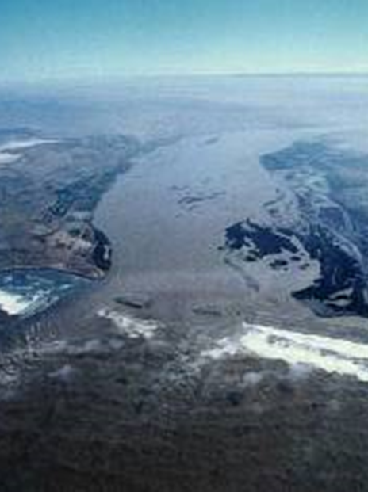
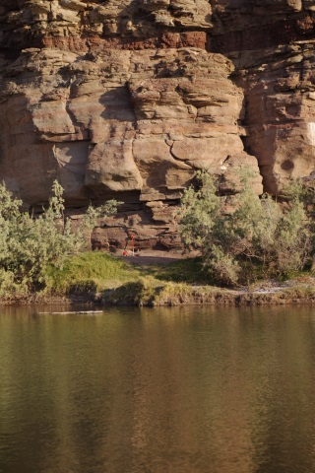
OUTLINE OF TRAINING PRESENTATION
Determination of Environmental Flow Requirements – Why, How, Broad Principles
EFRs Reserve within context of the SA Department of Water and Sanitation and the National Water Act (1998)
Resource Directed Measures: Ecological Reserve Approach, methods, tools and steps
Rivers, estuaries, wetlands, groundwater
Relevant ecological habitats
Ecosystem health and monitoring

Slide 3
OUTLINE OF TRAINING PRESENTATION (slide 2)
Context: Classification and RQOs The Reserve does not stand on its own
National Water Resource Classification and the Reserve
Resource Quality Objectives and the Reserve
Integrated framework (Reserve, Classification and RQOs) Step by Step
Basic Human Needs
Legal issues and gazetting
Cooperative governance, links to EIAs and other related processes
Implementation and monitoring
Relevant environmental laws

Slide 4
ECOLOGICAL WATER REQUIREMENTS

Slide 5
ECOLOGICAL WATER REQUIREMENTS (EWRs)
Various applicable terminologies: Instream Flow Requirements, Environmental Water Requirements, Environmental Flow Requirements, Ecological Water Requirements, eFlows etc
WHY called the Ecological Reserve?
Specific to the Water Act as it is water RESERVED for the natural environment and people (EWR) to ensure a sustainable river at a specified state of health (ECOCLASSIFICATION)

Slide 6
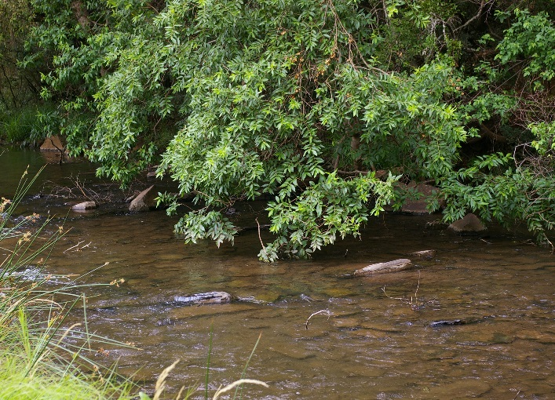
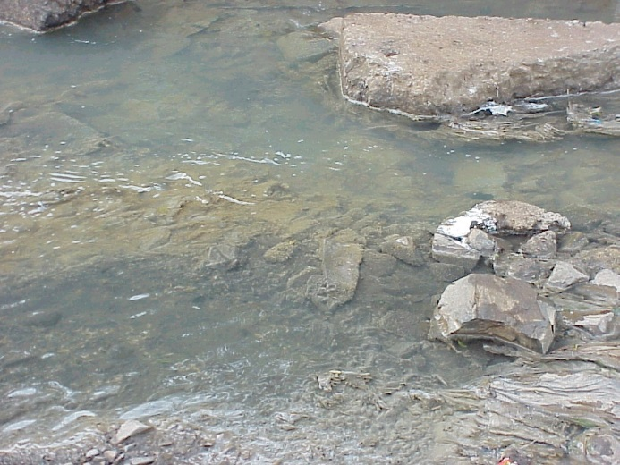
ECOLOGICAL WATER REQUIREMENTS (EWRs): WHY??
Society needs water – drinking, washing, cooking, growing food, industries, mining, power, dilution and transport of waste etc.
In the process of using water, people can damage rivers, wetlands, lakes etc.
DAMAGED ECOSYSTEMS DO NOT WORK VERY WELL AND MAY FAIL US WHEN WE NEED THEM MOST.

Slide 7
ECOLOGICAL WATER REQUIREMENTS (EWRs): WHY?? (slide 2)
Gradual realisation world wide from around 1980s – messing with ecosystem functioning has consequences.
The consequences are not only ‘green’, i.e. in terms of biodiversity, conservation, bunny hugging, etc, BUT
Can have a serious impact on socio economics, economics and ecosystem services, eg.
Salmon fishing and migration
Blackfly Sea fisheries
Agriculture Tourism
Recreation Disease

Slide 8
ECOLOGICAL WATER REQUIREMENTS (EWRs): HOW
Species protection approach
versus
Ecosystem protection approach
Basically requires the following:
Understanding of WHAT is happening in the system and WHY – status quo.
Determining how you want your ecosystem to function in future – future state (compared to present state).
Determining the measures to achieve this state.

Slide 9
ECOLOGICAL WATER REQUIREMENTS (EWRs): HOW (slide 2)
Measures consist of managing flow and quality and/or
Non-flow or anthropogenic activities.
Managing flow by determining flow requirements follows three approaches:
Bottom up approach: Setting flow requirements for different river states.
Top down approach: Evaluating different flow scenarios and predicting the resulting river states
Using desktop approaches that can have the base of either of the above.

Slide 10
ECOLOGICAL RESERVE AND THE WATER ACT

Slide 11
BEFORE THE WATER ACT - 1998
Previous Water Act: Based on a principle that the right of people to use water was linked to land ownership.
However, Water Affairs started involvement with the universities, the Kruger National Park, Water Research Commission, etc in exploring flow requirements and its necessity as part of IWRM.
Important WRC study was to test international (American) method on the Olifants River – this led to South Africa developing its own methods and becoming a world leader at that stage in EWR determination.
Water Affairs even invited to participate with university institutes in demonstrating methods in Australia.

Slide 12
BEFORE THE WATER ACT – 1998 (slide 2)
The result was that when the then Minister of Water Affairs (Kadar Asmal) investigated whether the concept of EFRs could be incorporated into the new Water Act, processes were already in place.
Also, very important is that some officials of Water Affairs encouraged and made sure that even prior to the new Water Act, Instream Flow Requirements (as it was then called in South Africa) was considered and determined in all Reconnaissance, Pre-feasibility, Feasiblity, construction and strategic planning studies in Water Affairs – it therefore became the standard even before it became law.

Slide 13
THE WATER ACT – 1998
SOME FOR ALL FOR EVER
The 2 main principles of the Water Act are:
Equity (fairness to people living now)
Sustainability (fairness to people in the future and to the environment)
Equity: Water ecosystems (water resources) if damaged to much cannot sustain human water use.
Sustainability: Use water ecosystems but watch out for distress signals and respond to them – then we and our grandchildren can go on using water and water ecosystems, now and on into the future.

Slide 14
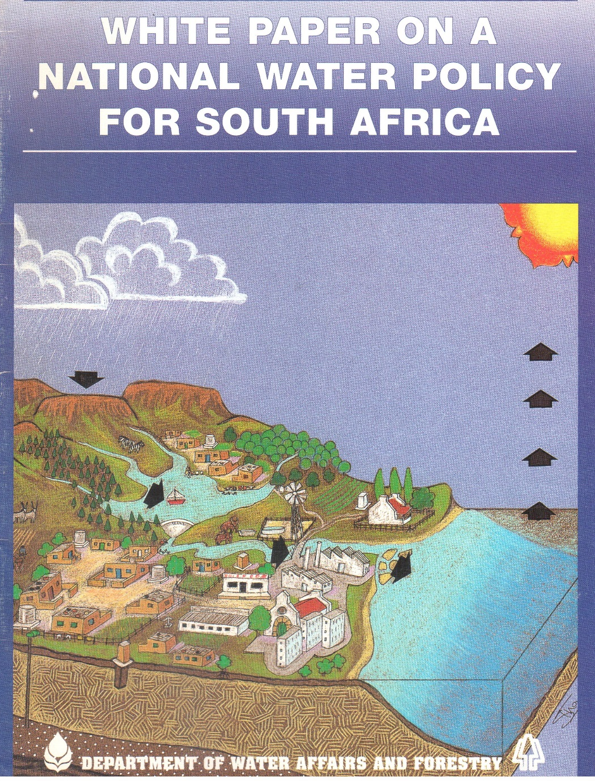
THE WATER ACT: WHITE PAPER ON A NATIONAL WATER POLICY (1997)

Slide 15
THE WATER ACT: WHITE PAPER ON A NATIONAL WATER POLICY (1997)
Important aspect contained in the above document formed the basis of the New Act in terms of EFRs
Only that water required to meet basic human needs and maintain environmental sustainability will be guaranteed as a right. This will be known as the Reserve.
The Bill of Rights also gives all South Africans the right to an environment that is “not harmful to their health or well-being” as well as the right to have the environment protected for the benefit of present and future generations.

Slide 16
THE WATER ACT: WHITE PAPER ON A NATIONAL WATER POLICY (1997) (slide 2)
Duty of Government to make sure that water pollution is prevented, that there is sufficient water to maintain the ecological integrity of our water resources and that water conservation and sustainable, “justifiable economic and social development” are promoted.
The way we use or abuse our rivers has an effect on estuaries and the ocean around our coast.
If the use of water resources remains within their capacity to recover that level of use can probably be sustained in the long term. It is not necessary for a water resource to be left untouched to remain functional.

Slide 17
THE WATER ACT: WHITE PAPER ON A NATIONAL WATER POLICY (1997) (slide 3)
The intention of “environmentally sustainable water use” is to balance water use with the protection of the resource in such a way that the resources are not degraded beyond recovery.
The sustainable use of water resources means that, even where the immediate demands for development are very high, society must find different development approaches which make sure that the use of water resources does not destroy their ability to recover.
The process of balancing social & economic benefits as well as of determining environmental objectives should involve those affected in weighing up the options on an informed basis. Must take place within the guidelines of national policy and within a national framework. The public trust role requires that Government establishes the system which achieves this result.

Slide 18
THE WATER ACT 1998
(environmental flows – the Reserve)
Chapter 3, Part 3: the Reserve
The Reserve consists of two parts – the basic human needs reserve and the ecological reserve.
The BHN provides for the essential needs of individuals served by the water recourse in question and includes water for drinking, for food preparation and for personal hygiene.
The ecological reserve relates to the water required to protect the aquatic ecosystems of the water resource.
The Reserve refers to both the quantity and quality of the water in the resource and will vary depending on the class of the resource.
The Minister is required to determine the Reserve for all or part of any significant water resource

Slide 19
THE WATER ACT 1998
(environmental flows – the Reserve) (slide 2)
Chapter 3, Part 3: the Reserve
If a resource has not yet been classified, a preliminary determination of the Reserve may be made and later superseded by a new one.
Once the Reserve is determined for a water resource it is binding in the same way as the class and the RQOs.
Preliminary determination of the Reserve
Until a class has been determined, the minister
may, for all or part of a water resource; and
must, before authorising the use of water under section 22(5) make a preliminary determination of the Reserve
A determination of the Class, RQOs or the Reserve supersedes a preliminary determination

