Slide 1
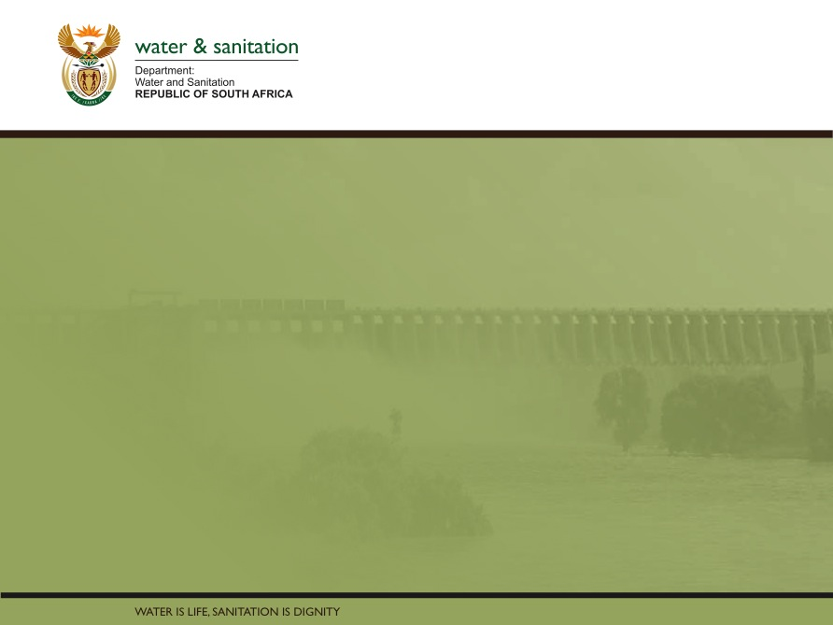

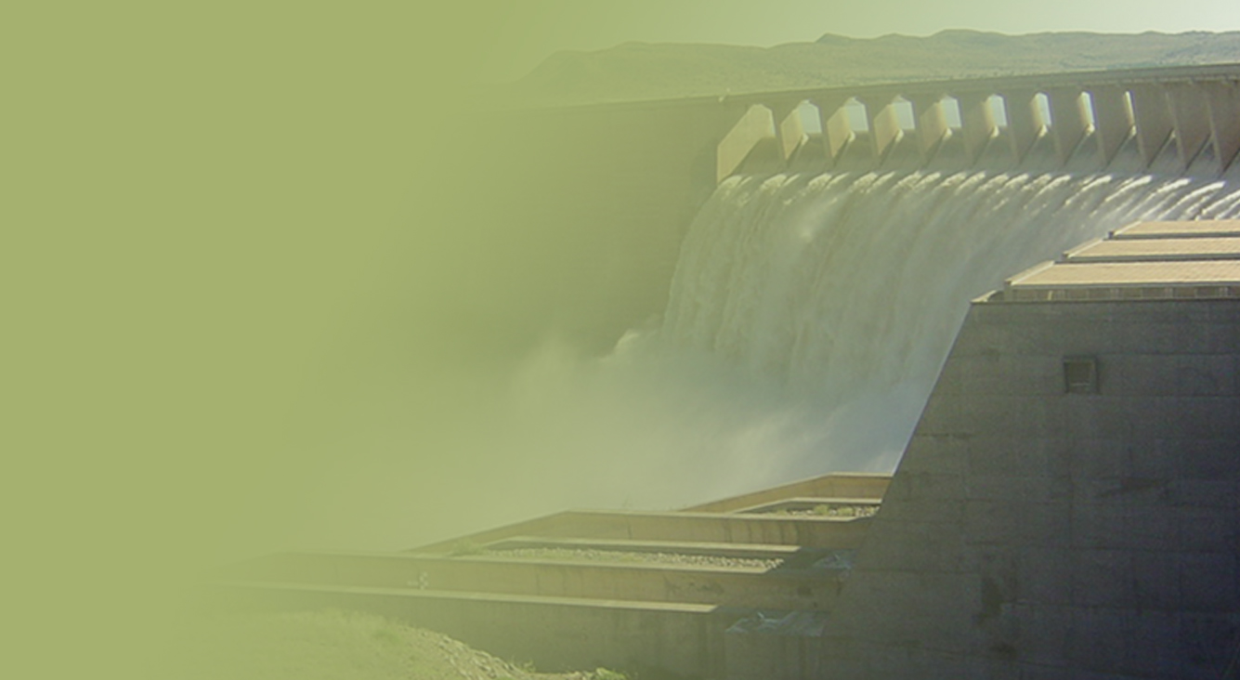
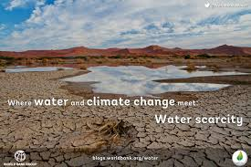
Climate Change Aspects
Water Sector
Presented by: Chris Moseki
Date: 22 August 2018
PRESENTATION TITLE
Presented by:
Name Surname
Directorate
Date

Slide 2
Presentation – Discussion points
Water situation in RSA – big (national) picture
  South Africa compared to the World & SADC region
  Total available water per capita & water stress
  Some of the key challenges (natural & human induced)
Climate change aspects
  Climatic and non-climatic stress factors
  Water and climate
  Projections for the next 3 months
  Adaptation / response
Conclusions

Slide 3
At national level;
South Africa’s water situation, prior to factoring climate change, compared to
  the rest of the World, and compared to
  Southern Africa region (SADC)
is not satisfactory.

Slide 4
Message 1: Africa is a resource based economy continent, with a low runoff: rainfall ratio and high evaporation rate
RSA: Only 8% of the rainfall is available as surface water runoff
Notes:
Mean annual rainfall
South Africa = 500mm (World = 860mm)
65% of SA < 500mm
21% of SA < 200mm
Severe and prolonged droughts – 10 years
25% - drained by perennial rivers (seasonal)
75% - drained by seasonal to episodic rivers (event related).

Slide 5
Total renewable water resources (per capita in m³) (After DEA, 2017 - Literature Review 3rd SAEO Report)
RSA is currently a water stressed country with looming physical water scarcity, particularly due to unsustainable use and climate change

Slide 6
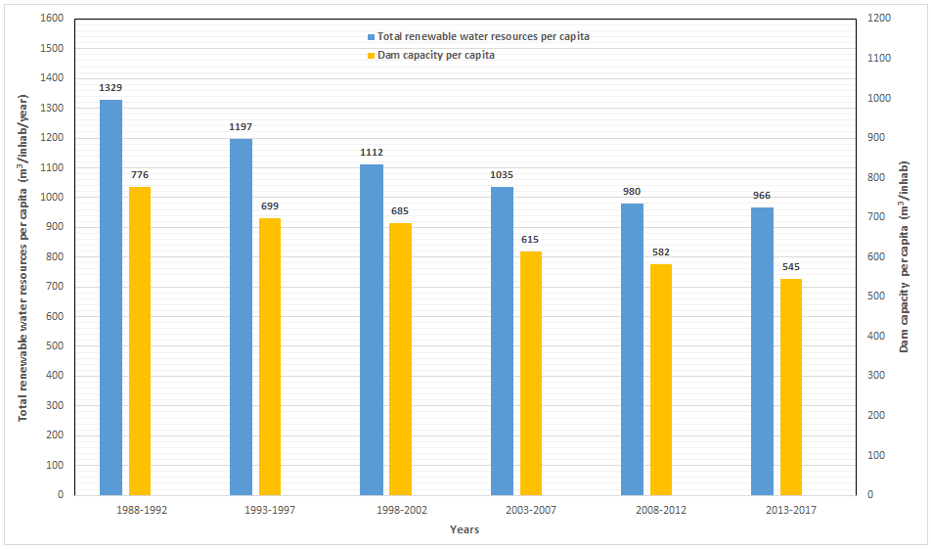
Trend of available water and total storage capacity in South Africa
Note: RSA is currently stressed (i.e.
below 1 000 m³ per capita per year)
Stress
Scarcity
Dr Mwendera - ARC, 2017

Slide 7
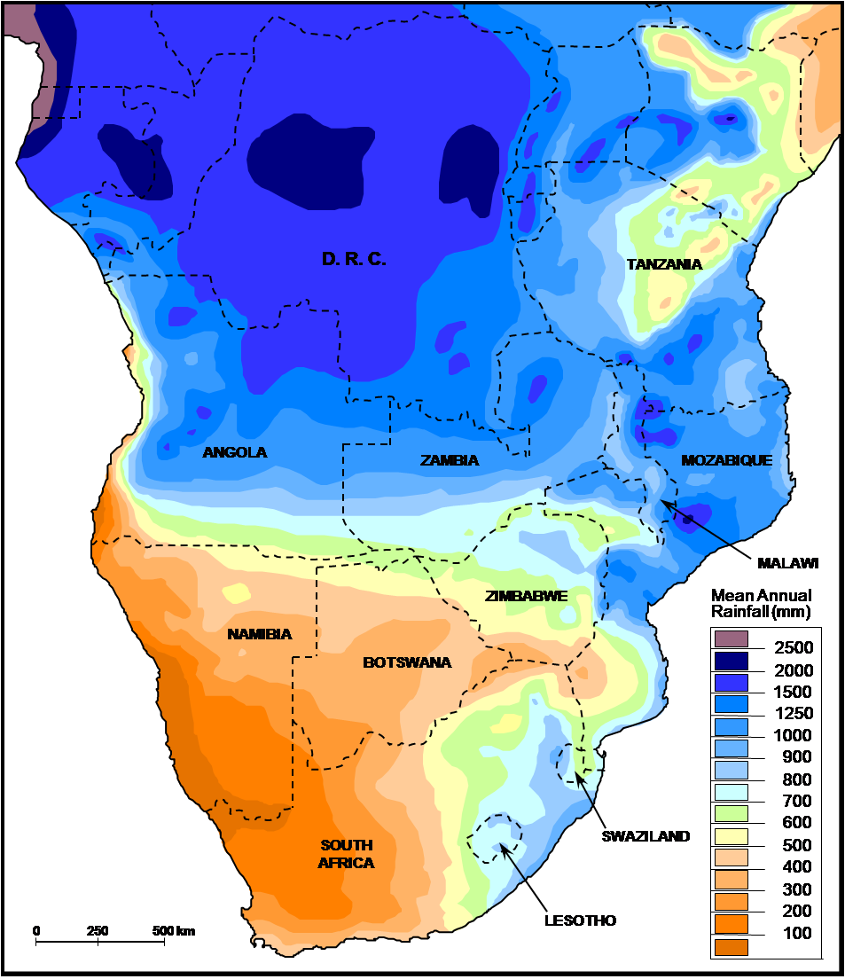
South Africa is a water thirsty country
(average annual rainfall & water resource situation)
Rainfall high: 1500mm N & E; reduces towards S & W: 100mm;
Water availability is skewed in terms of distribution (estimated at 650 billion m³)
Evaporation rates far exceeds precipitation (relatively higher in areas where it rains less)
Water is not always fit for use, even under natural conditions (due to inhospitable host rocks?)
This translates into water stress
Sustainable water use and management is therefore imperative

Slide 8
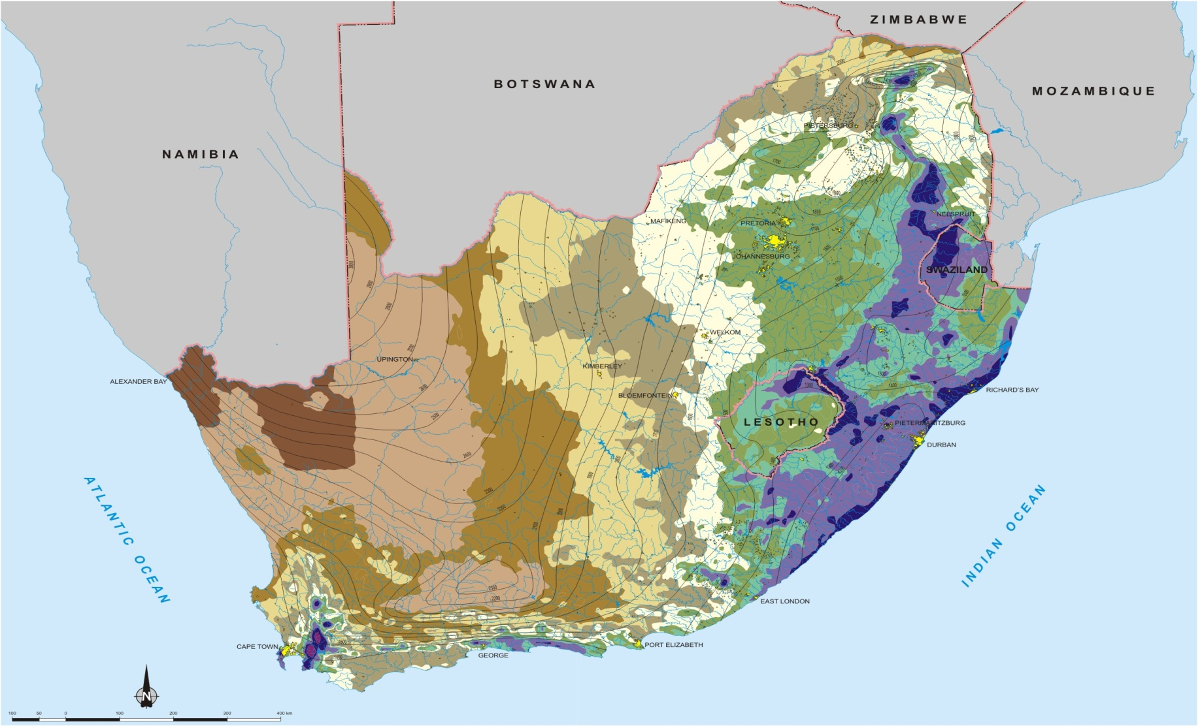
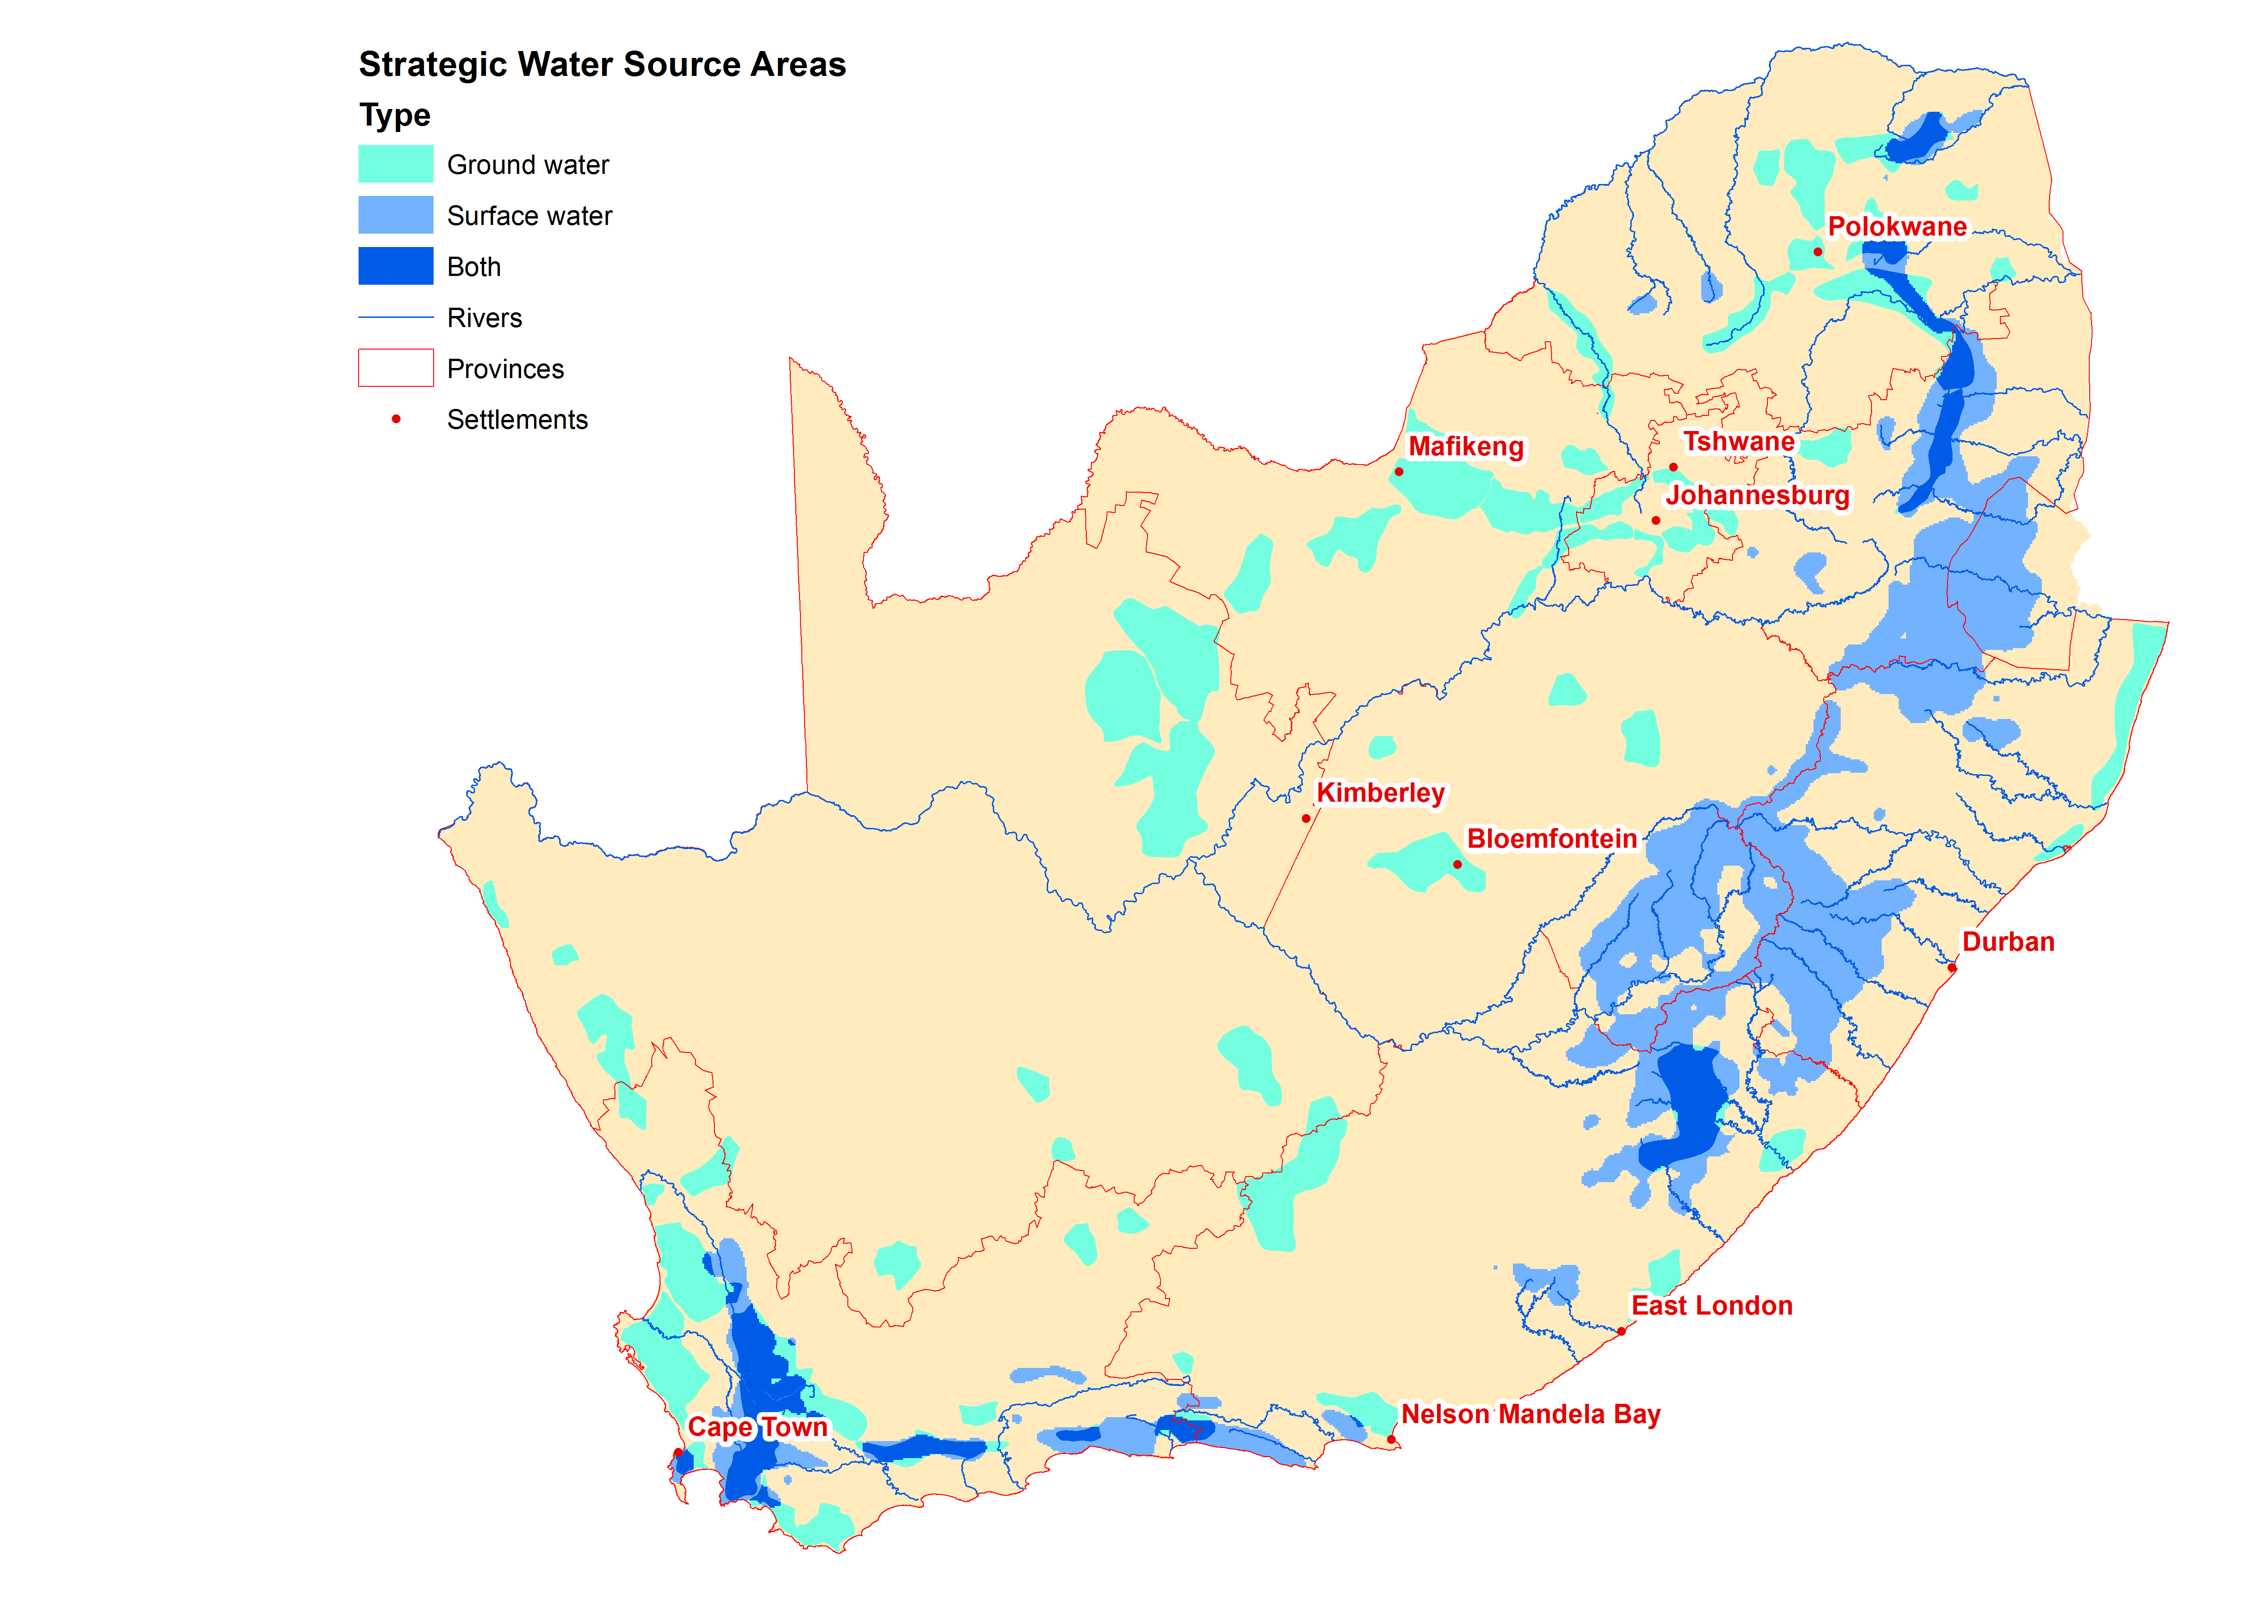

Slide 9
Key message is that
  South Africa is currently water stressed
  and may
  become water scarce, lest the problem gets addressed
  Hence, protection of the limited resource is imperative (“save water”)

Slide 10
South Africa’s water distribution
  at national scale, under natural conditions
  internationally shared river basins
  the water resource is limited

Slide 11
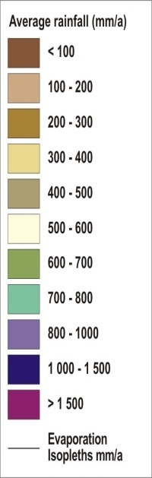
National Rainfall and Potential Evaporation
Note skewed distribution
of rainfall ,and increase
eastwards while evaporation
rates increase westwards
Notes:
11
Semi-arid climate, highly variable, long droughts.
Uneven rainfall distribution, decreases from east to west.
Potential evaporation increases from east to west, in most parts much higher than rainfall.
World terms: water scarce, becoming water stressed.
Most water from surface resources.
No real large rivers in SA (Flow in Orange River only 10 % of that of Zambezi River where rivers discharge into the ocean).
Generally hard rock formations, little groundwater.
Groundwater main source in rural and dry areas (small quantities).

Slide 12
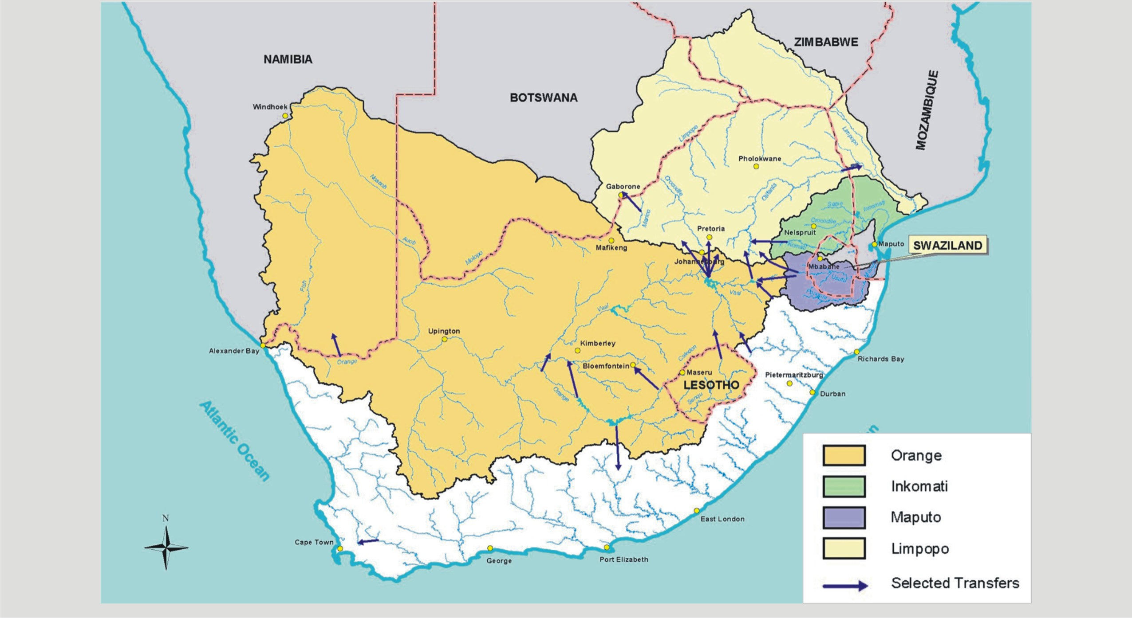
Internationally shared basins
4 rivers shared with 6 neighbouring countries
basins cover 60 % of SA land area
Contribute 45% of country's total river flow
support ± 70% of gross domestic product
Notes:
Four of our main rivers are shared with 6 neighboring countries.
International basins cover 60 % of SA land area.
Contribute 45% of country's total river flow.
These areas support ± 70% of gross domestic product and similar proportion of population.
Several international inter-catchment transfers and inter-country systems have been introduced (including Lesotho Highlands Water Project).
International liaison and Partnerships
Neighboring States & SADC
AFRICA (AMCOW)
Global

Slide 13

Efficiency in water use / cut in losses; can address
  water stress challenges
  Lead by example …

Slide 14
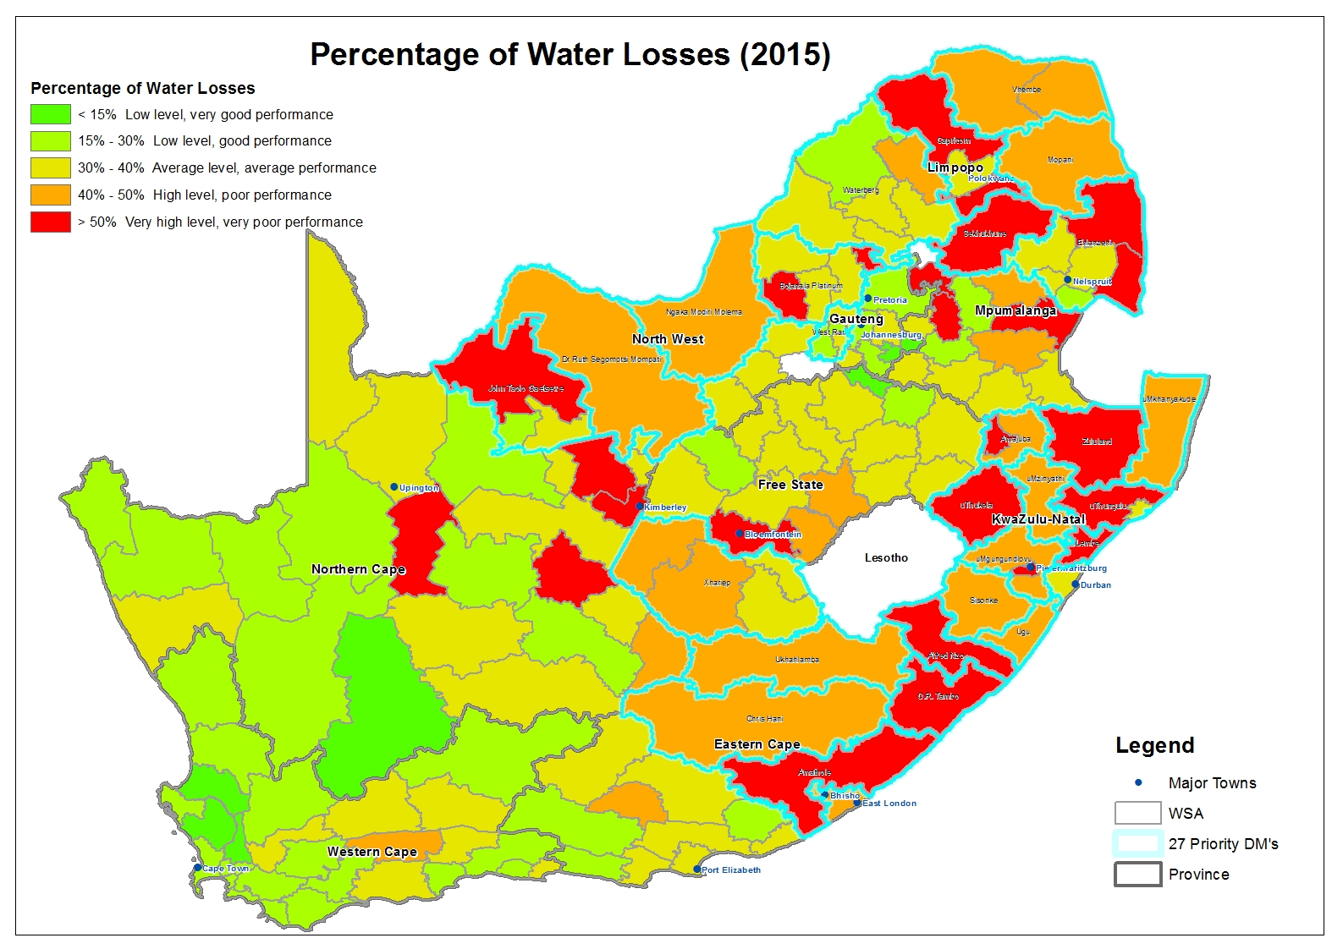
Non-revenue water is estimated to be an average 36.6% of the water supplied (1.6 billion m³/annum with an estimated value of R7 billion annually)
What’s the latest NRW (i.e. July 2018)?

Slide 15
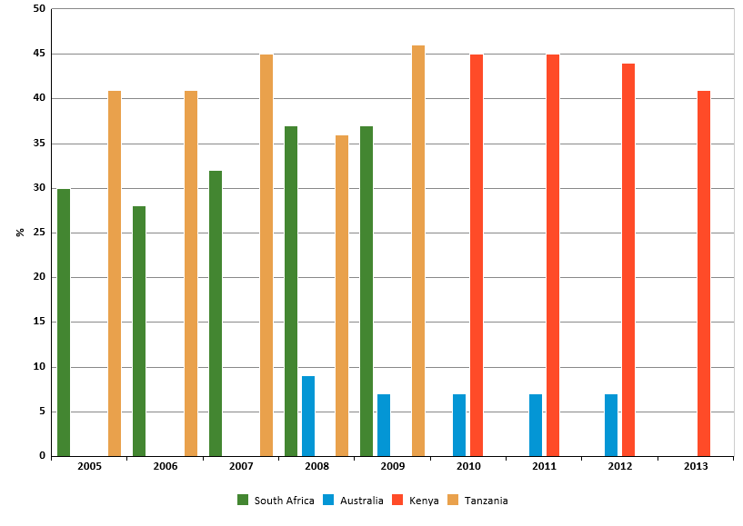
Non Revenue Water
Non-revenue water (2012):
South Africa was at 37.8%,
Australia 7% and California
at less than 10%
Data source: KNOEMA Virginia, USA

Slide 16
Climate change

Slide 17
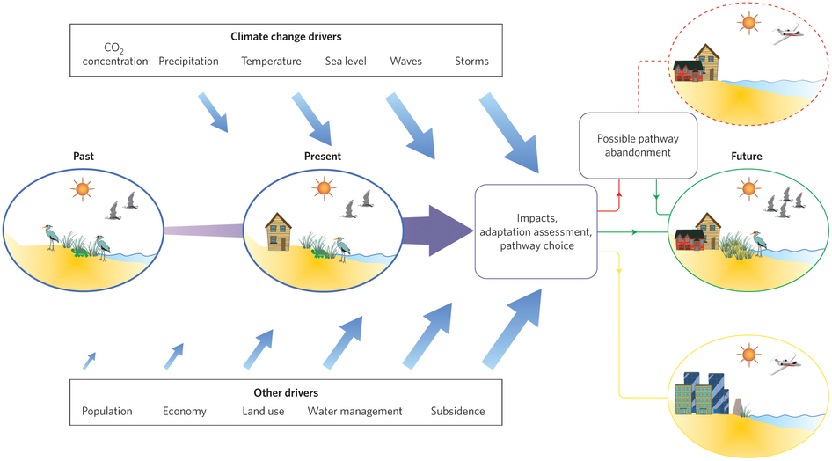
Other (global change) stress factors often overshadow climate impacts
However, attribution is ever illusive & requires good skill

Slide 18
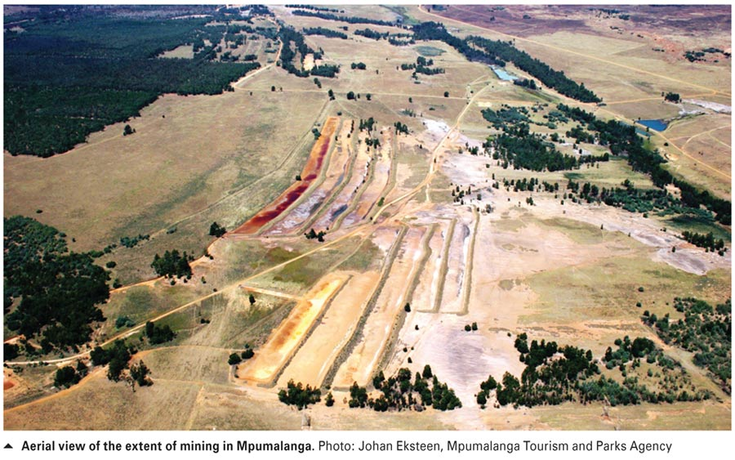
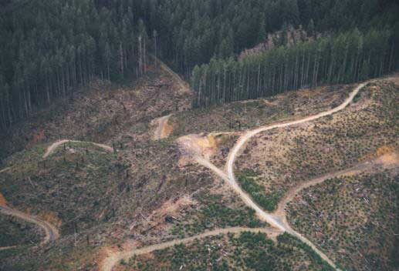
Non-climatic impacts
Non-climatic Impacts:
Wetlands and mining
Wetlands and land-use
Under these conditions,
climate change (e.g. if frequent
floods occur as a new norm)
is likely to exacerbate the
problem.
Habitat loss - deforestation

Slide 19
Urban population growth
2000
2050

Slide 20
Example of non-climatic factors
(withdrawals exceed recharge by up to 40%)

Slide 21
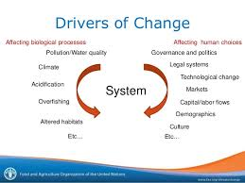
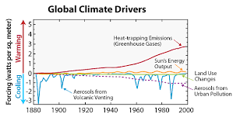
Drivers of climate change
Change results from a variety of factors (e.g. GHGs, ΔLU, solar energy & aerosols)
Change due to land-use sometimes markedly masks other factors
However, the major drivers of CC are CO₂,
  CH₄,
  N₂O,
  Chlorofluorocarbons
  and O₃
CO₂ and methane are the most prominent
Present at highest concentration (contribute 60%)
Very low concentration compared to CO₂ but 230 times more efficient (contribute 6%)
Less than 1% of CO₂ but 25 times more efficient (contributes 10%)
Extremely Very low concentration compared to CO₂ but 15 000 times more efficient (contribute 25%)

Slide 22
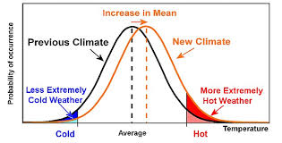
Is climate change becoming a new norm?

Slide 23
Climate change and water …
  Linkages to water
  Climate change and extreme events

Slide 24

Climate change is mostly felt through water …
Terrestrial
Ecosystems
(water dependent)
Reduced Water
Supply
Aquatic
Ecosystems
(water dependent)
Water
Quality
(e.g. algal blooms))
Climate Change
also impacts on various water
related sectors
Biodiversity
(water dependent)
Rain-fed
Agriculture
(reduced producttion)
Health
(water borne diseases)
Irrigated
Agriculture
(reduced flow)
Infrastructure
Design
(storage options)
Disaster
Risk
Management
(e.g. drought)
Sea level rise (saline water intrusion.)
Adapted from Schulze, 2013
Notes:
Water is key to developments. It cuts across all sectors.

Slide 25
How does climate change relate to drought?
Trends over a long time, without reverting back
Natural or anthropogenic causes
It commonly known that,
  Climate change is a permanent change in the mean state of climate, (characterised by seasonal rainfall or temperature changes – temporally and spatially)
  Drought is an extreme event: a non-permanent variation in climate (signified by deficiency in water)
However,
  The risk of (i.e. hydrological or meteorological) drought increases as temperatures rise.
  Frequent, intense and sustained increase in temperature often results in climate change
  Hence, climate change corresponds to frequency and intensity in drought
Short periods, may recur over time
Natural phenomenon

Slide 26
Impact of climate change.
On …
  Groundwater recharge
  Runoff
  Evaporation
  Dam sedimentation, etc.

Slide 27
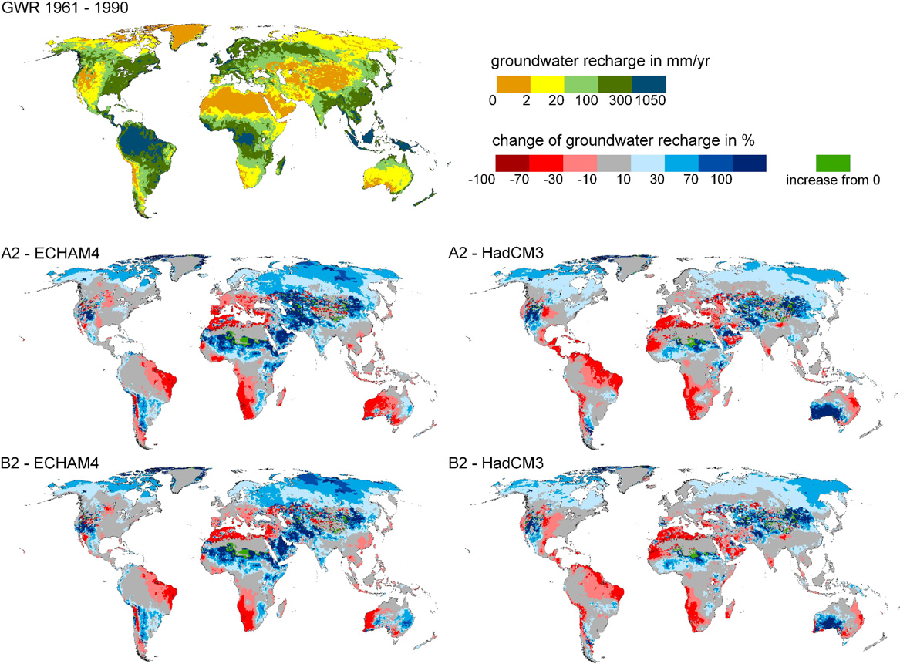
The impact of climate change on groundwater recharge by 2050, is projected to increase in northern latitudes, but to decrease strongly, by 30 –70% or even more than 70%, in semi-arid zones, including the Mediterranean, north-eastern Brazil and south-western Africa
Döll, 2009

Slide 28
The hydrological model was used to quantify the impact of climate change on state of groundwater resources in terms of changing levels and recharge, and the findings are that 20% decrease in mean annual rainfall volumes could translate to an 80% decline in recharge for areas that currently receive 500 mm rainfall per annum or less in southern Africa.
(Cave et al., 2003)

Slide 29
Mean Annual Recharge based on monthly rainfall records for 1950 to 2006

Slide 30
Impact of climate change.
on …
  Water quality

Slide 31
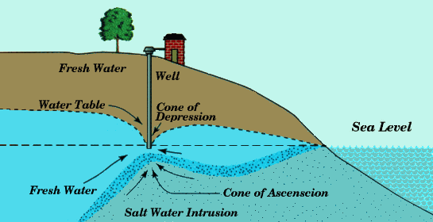
Alternatively, salt water intrusion may be triggered by over-pumping, perhaps driven by demands or drought.
Climate change impact on water quality:
(Taylor, 2013)
“The effects of seawater intrusion have been observed most prominently in association with intensive ground­water abstraction around areas with high population densities (e.g. Bangkok, Jakarta and Gaza).”

Slide 32
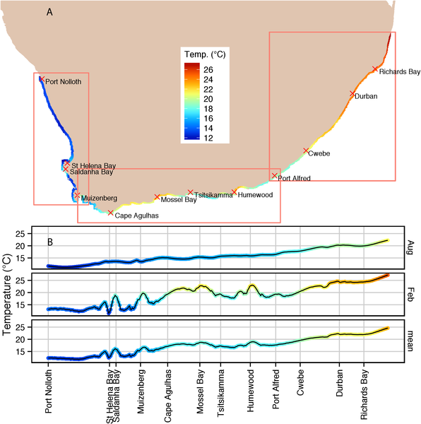
Sea level rise is driven by rise in sea surface temp
Smit et al, 2013

Slide 33
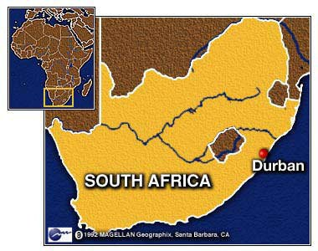
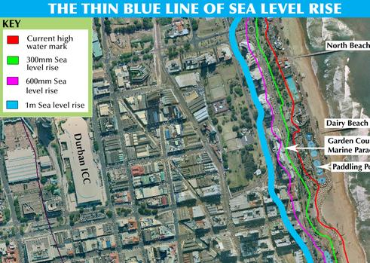
In the east coast of South Africa (Durban) the sea level rises at 2.74 mm per year

Slide 34
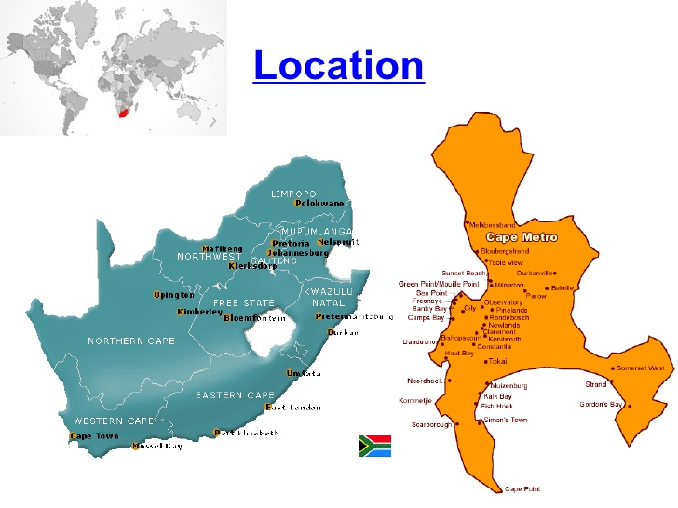
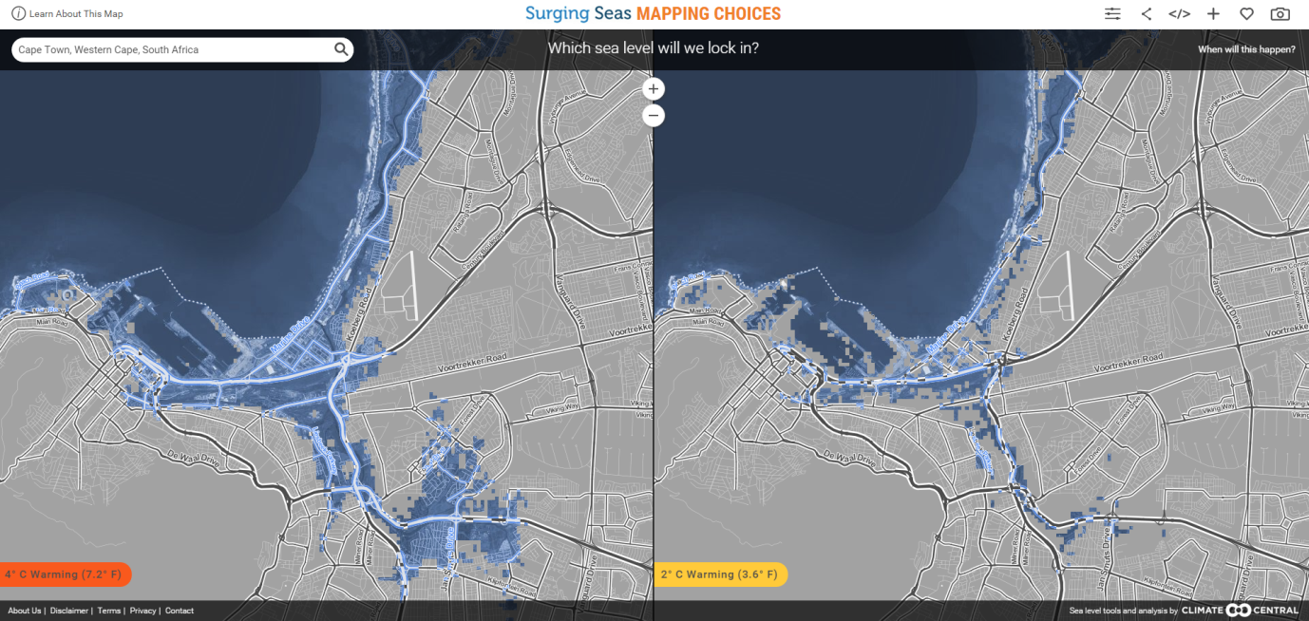
In the south coast of South Africa (Cape Town) the sea level rises at 1.47 mm per year

Slide 35
Some perceptible changes

Slide 36
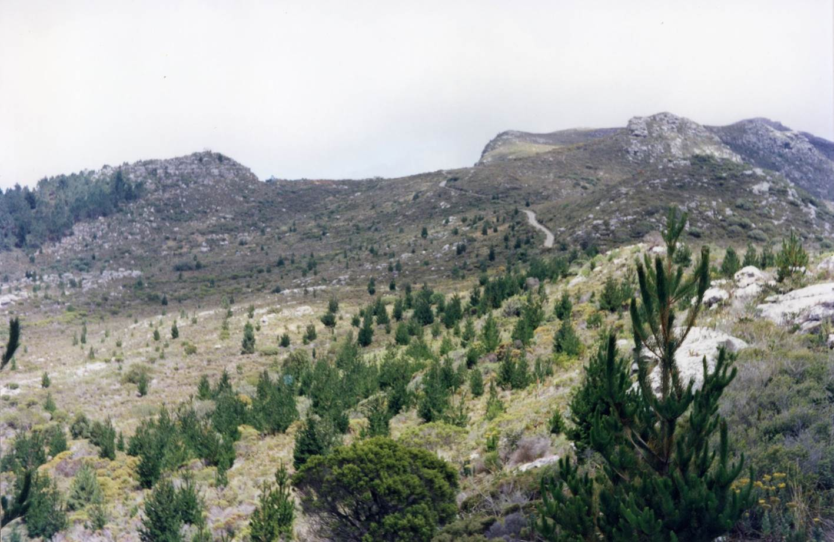
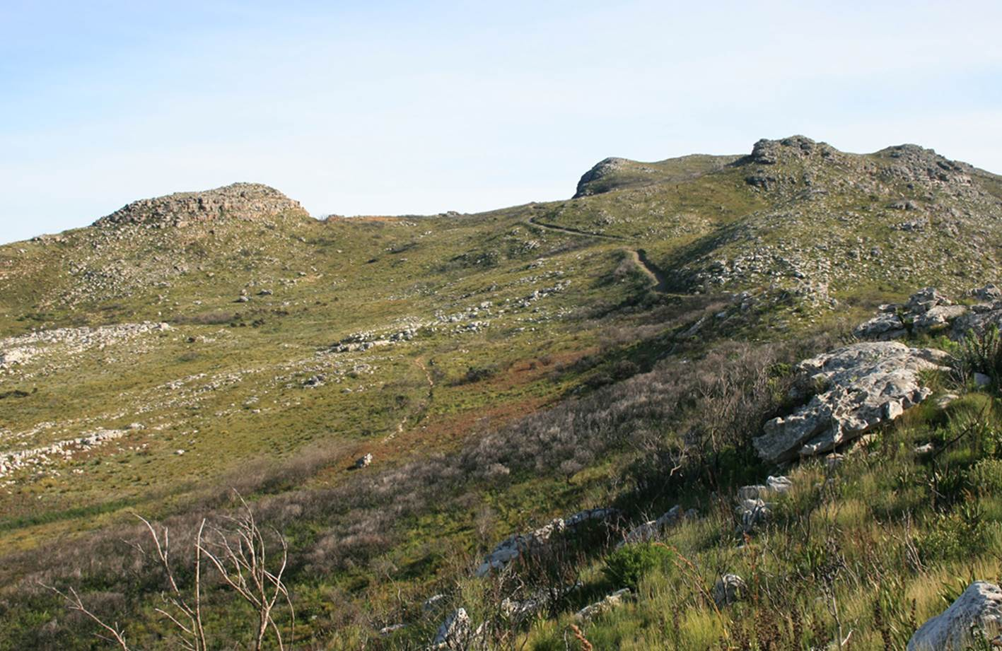
Picture by J Cowen
1999
These pictures show
the African savannah
being taken over by
trees and shrubs
Picture by John Watermeyer
2016

Slide 37
Projected changes (in the next 3 months)

Slide 38
Seasonal rainfall prediction for August-Sept-October 2018

Slide 39
Seasonal temperature prediction for August-Sept-October 2018

Slide 40
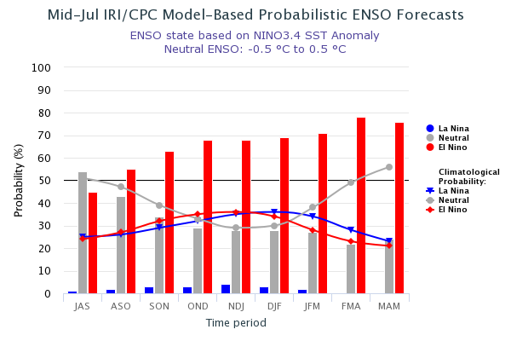
The El Nino effect:
Warming increases from 45% in August to 55%, 63% and 68% in September,
October and November respectively.

Slide 41
Adaptation / response …

Slide 42
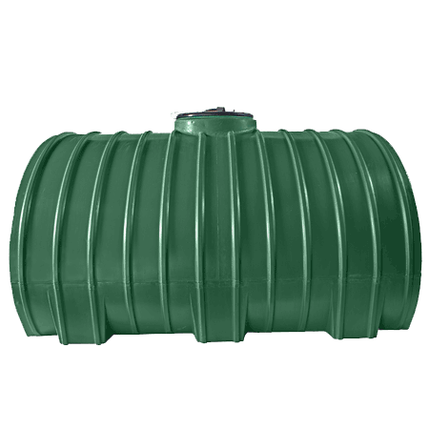
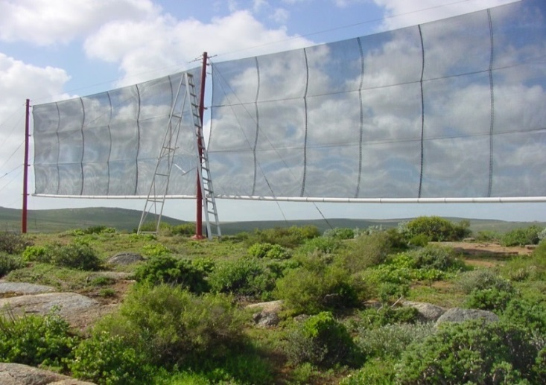
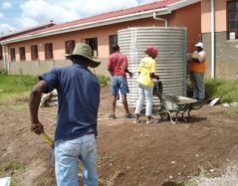
    Avoid overexploitation of resources
Adaptation may entail …
  sustainable water use and management (e.g. improve efficiency, conserve water, etc.)
  develop unconventional sources (e.g. reuse, rainwater harvesting, fog harvesting, etc.)
  Learn to live with nature (adjust to change) since we are dependent on nature for survival
Innovation
Observe conservation ethics

Slide 43
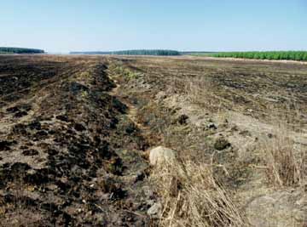
Rehabilitation of wetlands
WWF – Mondi Wetland Programme
Challenge:
Drained, dry & neglected after agriculture activity for 60yrs +
Rehabilitation:
Removal of alien vegetation, plugged drains, adding causeways for roads
Re-established appropriate buffer zones for plantation
Following a rainy season the wetland was restored.
Zoar wetland, before and after rehabilitation

Slide 44
Conclusions
RSA is water stressed – likely to be water scarce
Non-climatic stress factors renders the country vulnerable to potential climate change impacts
Grappling with climate variability, while contending with the changing climate
  Global change (i.e. both climatic and non-climatic)
The solution entail water conservation (efficiency in use) and development of supply
Unconventional water sources and innovative solutions could save RSA from water scarcity

