Slide 1
PROJECT PLANNING

Slide 2
Approval and Gazetting ito Section 109 and 110 of NWA

Slide 3
Typical Interventions
Management interventions:
Water Conservation and Water Demand Management.
Optimal system operation.
Adjusting assurance of supply.
Reallocation.
Rainfall harvesting
Infrastructure developments:
Water re-use
Augmentation Schemes
Surface
Groundwater
Notes:
Urban, Rural domestic
Review WC/WDM strategies of key WSA
Determine realistic potential savings, cost estimations & implementation program, Review after 18 months

Slide 4
DWS WATER RESOURCE DEVELOPMENT PROJECTS FUNNEL
Reconnaissance Phase
Pre-feasibility Phase
Feasibility
Phase
Decision Support Phase
Design/ Documentation Phase
Construction/ Implementation Phase
LEGEND
Surface water
Groundwater
Re-use of water
Acid mine drainage
Importation of water
Desalination of seawater
Capacity (million m³/a)
Phase completed
Phase in progress
Decision to progress to next phase
Integrated Vaal River System
200+
511
465
356
650
Desalination
151
100
393
Zambezi
transfer
Mzimvubu-Vaal
transfer
Orange-Vaal
Transfer
Thugela-Vaal
(Jana)
Thugela-Vaal
(Mielietuin)
Use of acid
mine drainage
LHWP
Phase II
Orange River System
556
216
Raising of
Gariep Dam
Mzimvubu-
Kraai transfer
Boskraai Dam
VD Kloof Dam
Low level Storage
Vioolsdrift Dam
Crocodile West River System
100
90
126
Zambezi
transfer
Vaal-Crocodile
Transfer
Re-use of effluent
from Vaal
40
14
Mokolo Crocodile Augment
Project Ph2 (Crocodile)
Mokolo Crocodile Augment.
Project Ph1 (Mokolo)
Olifants River System
200
190
33
55
5
80
Zambezi
transfer
Vaal–Olifants
Transfer
Use of acid
mine drainage
Olifants Dam
Malmani Dolomite Aquifer
ORWRDP: De Hoop
Dam
ORWRDP Bulk Conveyance
KZN Coastal Water Supply Systems
218
46
40
220
60
uMkhomazi-Mngeni transfer Ph2 (Impendle Dam)
Isithundu
Dam
100+
Re-use
uMkhomazi-Mngeni transfer
Ph1 (Smithfield)
37
Raising of Hazelmere Dam
Mooi-Mgeni Transfer Phase II (Spring Grove)
Desalination
Lower Thukela Scheme
50+
32
16
50+
20
123
Algoa Water Supply System
Mzimvubu-Vaal transfer
Guernakop Dam/ Raising of Kouga Dam
Re-use to industrial standards
Desalination
Nooitgedacht Low Level Storage Dam
8
Groundwater schemes
9
14
20
83
23
Western Cape Water Supply System
110
27
Cape Flats
Aquifer
West Coast Aquifer
TMG
Aquifer
Re-use
Voëlvlei Augment.
Phase 1
Voëlvlei Augment.
Phase 2&3
Upper Molenaars diversion
46
160
Mitchell’s Pass diversion
Desalination
241
60
23
7
Ntabalenga Dam
14
Ludke Dam
40
15
Crocodile East Dam
Xhariep Pipeline
Lusikisiki:
Zalu Dam
Nwamitwa Dam
Raising of Tzaneen Dam
Other areas
(incl. Amatole, Mhlatuze & Outeniqua)
Thukela-Mhlatuze Transfer
Re-use
(Mhlatuze)
16
Ncwabeni Off-channel Storage Dam
Clanwilliam Dam Raising
23
Clanwilliam Conveyance Infrastructure
Koonap River :
Foxwood Dam
Lalini Dam
Nwamitwa
Aquifer
Oct 2017

Slide 5
Some Feasibility study modules
Water Resources Assessment
Assessment of Augmentation from Groundwater
Intermediate Reserve Determination
Domestic Water Requirements
Irrigation Potential Assessment
Water Distribution Infrastructure
Materials and Geotechnical Investigations
Dam Feasibility Design
Regional Economics
Environmental Screening
Record of Implementation Decisions

Slide 6
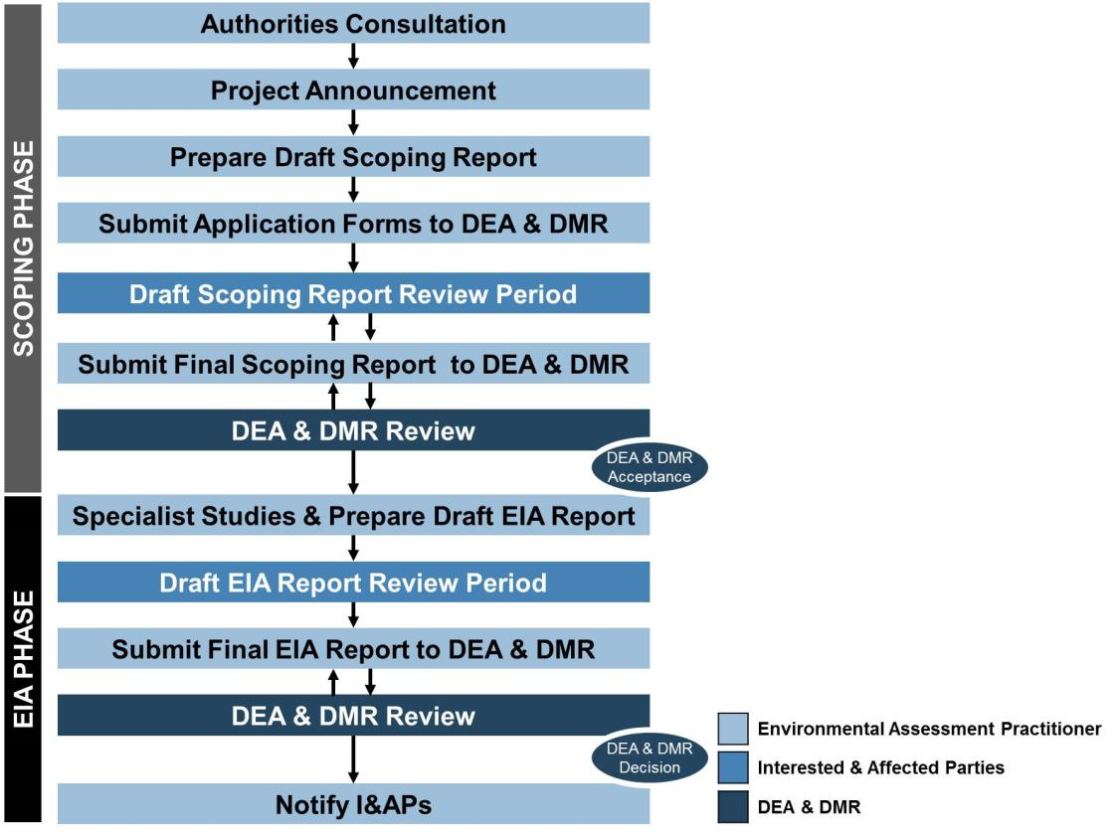
ENVIRONMENTAL IMPACT ASSESSMENT
Process Completed

Slide 7
Case study

