Slide 1
law society of the Northern provinces
introduction to environmental law
Garyn Rapson
16 May 2017

Slide 2
international environmental law
INTERNATIONAL OBLIGATIONS
Stockholm Convention, 1972 – co-ordinated approach, Principle 21.
UNCED, Rio Conference, 1992
Rio Declaration on Environment and Development
Rio Principles adopted by 178 Member States
Member states to put in place adequate legislative instruments to address environmental issues
Agenda 21
programme of action for sustainable development worldwide
Paris Agreement
South Africa ratified this international Climate Change Agreement in November last year
Notes:
Principle 21: "states have, in accordance with the Charter of the UN and principles of international law, the sovereign right to exploit their own resources pursuant to their own environmental policies, and the responsibility to ensure that activities within their own jurisdiction or control do not cause damage to the environment of other states or of areas beyond the limits of national jurisdiction."
Rio Declaration – 27 principles.

Slide 3
south african environmental law
Constitution – s24, s32, s33, Schedules 3 & 4
Alternative legal route to interdict / seek relief from infringer.
Common in noise and dust pollution cases.
Land owners have right to enjoy land without unreasonable interference from others.
NEMA
Umbrella legislation
Common Law
Specific Environmental Management Acts
ECA
NWA
NEMPAA
NEMBA
NEMAQA
Law of Nuisance
Law of Neighbours
NEMICMA
NEMWA
WHCA
Public
Private
Other pieces of National legislation
NHRA
WSA
HSA
CARA
NVFFA
NFA
NRTA
MPRDA
PAIA
PAJA
+ Regulations, Norms & Standards, Notices
Provincial Acts and Ordinances
Provincial Conservation Laws
Provincial Heritage Laws
Local By-laws
Water
Industrial Effluent
Waste
Flammable Substances
Notes:
Section 24: everyone has the right to an environment that is not harmful to their health or well-being; and to have the environment protected for the benefit of present and future generations, through reasonable legislative and other measures that ‑
prevent pollution and ecological degradation;
promote conservation; and
secure ecologically sustainable development and use of natural resources while promoting justifiable economic and social development.

Slide 4
Environment?
Reminder of Portion 2
Remaining Extent of Portion 4
NEMA, s1
anthropocentric
broad
Portion 1
Portion 4
Farm Carter Block 458
Notes:
“environment” means the surroundings within which humans exist and that are made up of -
(i) the land, water and atmosphere of the earth;
(ii) micro-organisms, plant and animal life;
(iii) any part or combination of (i) and (ii) and the interrelationships among and between them; and
(iv) the physical, chemical, aesthetic and cultural properties and conditions of the foregoing that influence human health and wellbeing;

Slide 5
Environmental law?
Reminder of Portion 2
Public health
Conservation
Pollution Control
Land Use Control
Remaining Extent of Portion 4
NEMAQA
Portion 1
NWA
NEMPAA
Environmental Medium approach
NHRA
SPLUMA
Portion 4
NEMBA
NFA
CARA

Slide 6
general principles of environmental legislation
Polluter Pays Principle
NEMA provides that:“[t]he costs of remedying pollution, environmental degradation and consequent adverse health effects and of preventing, controlling or minimising further pollution, environmental damage or adverse health effects must be paid for by those responsible for harming the environment."
Cradle-to-grave Principle
NEMA provides that:“the responsibility for the environmental health and safety consequences of a policy, programme, project, product, process, service or activity exists throughout the life cycle of the policy, programme, project, product, process, service or activity.”
Sustainable Development
Overarching principle reflected in Constitution and environmental legislation
Fuel Retailers case
Kyalami Ridge case
Notes:
Minister of Public Works and Others v Kyalami Ridge Environmental Association and Others (Mukhwevho intervening) 2001 (3) SA 1151 (CC) where Chaskalson J made the following comment on section 2 of NEMA:
"the section does not make provision for rights and obligations, instead it sets out principles expressed in times of abstract than in concrete terms.“
Henderson says the principle is a guide as opposed to being decisive in nature. Nevertheless it has found its application under section 18 of the Waste Act.
In Fuel Retailers Ngcobo J held that the obligation of the environmental authorities to consider socio-economic factors includes the obligation to consider the impact of the proliferation of filling stations and of proposed filling station on existing ones. This obligation is wider than the requirement to assess need and desirability under the Ordinance. It also comprehends the obligation to assess the cumulative impact on the environment of the proposed development.
He reasoned that unsustainable developments are in themselves detrimental to the environment if a development such as a filling station may have a substantial impact on the environment. The proliferation of filling stations poses a potential threat to the environment, which arises from the limited end-use of filling stations upon their closure. However, he stressed that the objective of considering the impact of a proposed development on existing ones is not to stamp out competition; rather it is to ensure the economic, social and environmental sustainability of all developments. The filling station infrastructure that lies in the ground may have an adverse impact on the environment

Slide 7
National Environmental Management Act 107 of 1998 (NEMA)
Section 28 places a duty of care on persons who cause significant pollution or degradation to the environment to take reasonable measures to prevent such damage from occurring, continuing or recurring.
Section 24: the Minister / MEC may identify certain activities which may not commence without an environmental authorisation ("EA") from the competent authority.
Applicant to consider, investigate, assess and report the consequences for or impacts on the environment of the listed or specified activity to the competent authority.
This requirement is fulfilled through the process of conducting an Environmental Impact Assessment ("EIA").
Section 24 further provides that an applicant must comply with any Environmental Management Programme ("EMPr") prescribed in terms of NEMA.
It is an offence for a person to commence with a listed activity without any authorisation
Section 24G provides for the rectification of the unlawful commencement of a listed activity (in terms of section 24F) and the unlawful commencement of a waste management activity (in terms of the National Environmental Management Waste Act, 59 of 2008 ("NEMWA") without the requisite EA and waste management licence (respectively) from the competent authority.
An applicant in terms of section 24G may pay an administrative fine determined by the Minister, which may not exceed R5 million.
Section 49: Provides for the offences under NEMA, particularly where a person commences or continues with a listed activity without a license.

Slide 8
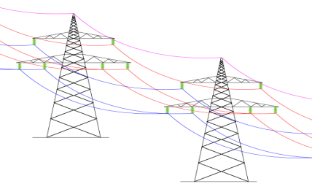
NEMA
S24F
S24G
S30 – emergency incidents
s31L
EA
Notes:
“environment” means the surroundings within which humans exist and that are made up of -
(i) the land, water and atmosphere of the earth;
(ii) micro-organisms, plant and animal life;
(iii) any part or combination of (i) and (ii) and the interrelationships among and between them; and
(iv) the physical, chemical, aesthetic and cultural properties and conditions of the foregoing that influence human health and wellbeing;

Slide 9
nema and the eia regulations
The 2014 Environmental Impact Assessment Regulations provide for the procedure to be followed when undertaking the EIA which is required for an authority to grant an EA. The EIA Regulations provide three Listing Notices which list the activities that may not commence without a license.
The most up to date EIA Regulations and listing notices were published on 04 December 2014 and were amended on 07 April 2017.
The regulations seek to prevent lengthy EIA approval processes by providing very specific time periods within which to consider applications for environmental authorisations.
The intention of the Department of Environmental Affairs ("DEA") is that all applications should be completed within 1 year.

Slide 10
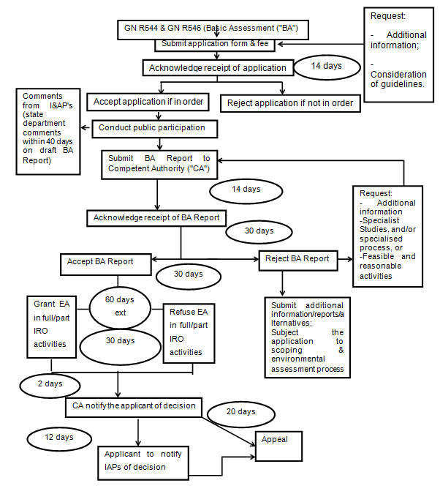
NEMA: Basic Assessment procedure

Slide 11
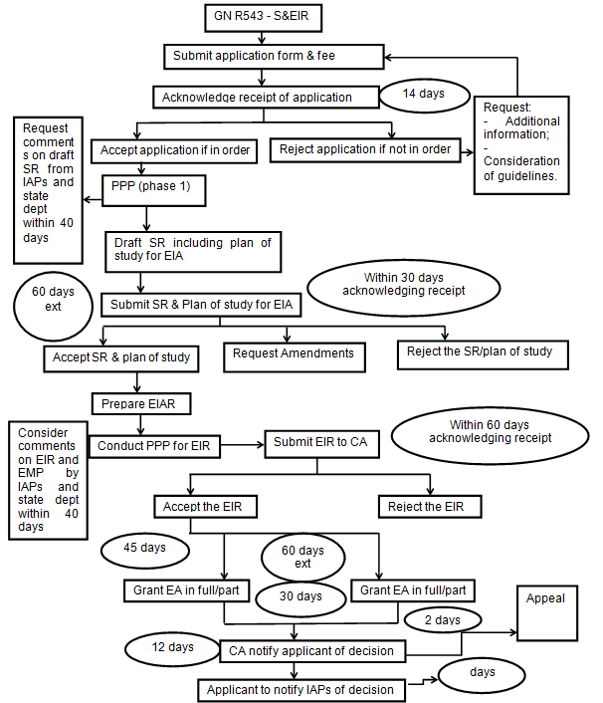
NEMA: Scoping and EIA process

Slide 12
Criminal liability for environmental offences
S v Nkomathi Anthracite Proprietary Limited ("Nkomathi Anthracite")
On 29 August 2012, Nkomati Anthracite pleaded guilty to eight charges under NEMA.
The company pleaded guilty to contraventions of section 24F of NEMA.
The contraventions in terms of section 24F of NEMA included the commencement of listed activities in terms of NEMA without an environmental authorisation. Such activities included the construction of roads, the clearance of vegetation, the excavation of soil and rock in a watercourse, and construction of facilities on-site.
Nkomathi Anthracite was fined R1 000 000, the payment of which was suspended, and also instructed to pay an amount of R4 000 000 to the DEA Environmental Management Inspectorate for the purpose of the proper execution of enforcement duties, environmental rehabilitation and enforcement training.
S v Anker Coal & Mineral Holdings SA Proprietary Limited ("Anker Coal")
Anker Coal pleaded guilty to contraventions of section 28(15), 32 and 34 of NEMA. The activities undertaken by Anker Coal which are the subject of this plea and sentence agreement include drilling prospecting holes in wetlands and other sensitive areas, prospecting activities took place within the 1:100 year floodline, failing to submit a rehabilitation plan, failing to remove core materials from wetlands and submitting inaccurate information to the DMR.
Anker Coal was fined a collective amount of R180 000, suspended for five years. Anker Coal was also ordered to pay a neighbouring farmer an amount of R144 000.

Slide 13
director liability
S v Blue Platinum Ventures (Pty) Ltd ("Blue Platinum")
In January 2014, the Naphuno Regional Court in Limpopo Province sentenced Mr Matome Maponya, the Managing Director of Blue Platinum to five years in prison for causing damage to the environment. Moponya's sentence of imprisonment was suspended for five years, on condition that the damage done by the mining operations be rehabilitated within three months.
Blue Platinum, Matome Maponya and five other directors had been charged with offences under NEMA, specifically section 24F. Blue Platinum and Matome Maponya pleaded guilty to a contravention of section 24F of NEMA.
Matome Maponya was not given the option of a fine, and his sentence is linked directly to the rehabilitation of the environment. This is particularly important as this was the first case imposing director liability in terms of NEMA.

Slide 14
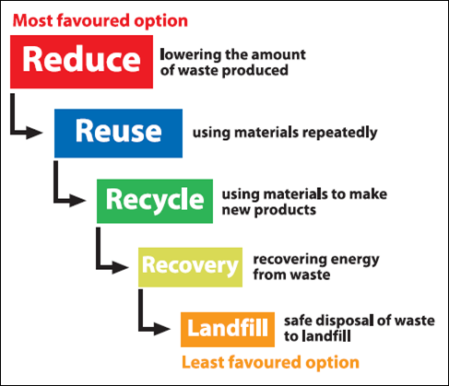
National Environmental management: Waste Act 59 of 2008 (nemwa)
The NEMWA with the exception of sections 28(7)(a), 35 to 41 and 46, came into operation on 1 July 2009.
Fundamental shift in the legal framework dealing with waste management.
Greater regulatory focus being afforded to all aspects of waste management throughout the waste cycle.
The framework of the management of waste under NEMWA centers around the concept of a waste hierarchy.
The NEMWA does, however, address those situations where the hierarchy is not implemented successfully through providing additional measures for the remediation of contaminated land.

Slide 15
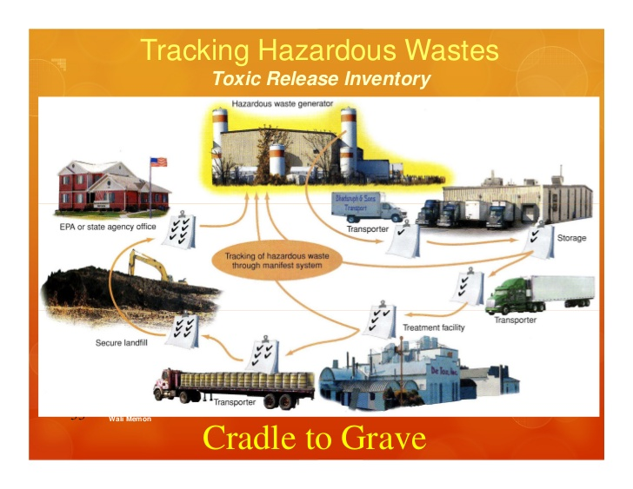
General principles
In terms of section 16(1) of NEMWA, a holder of waste must, within the holder’s power, take all reasonable measures to manage waste in an environmental sensitive manner.
Cradle-to-grave

Slide 16
specific waste management obligations
Specific obligation | Content
Storage of waste | In terms of section 21 of NEMWA, when temporarily storing waste ,steps must be taken to, inter alia, ensure that the waste containers are safe, measures are taken to prevent accidental spillage or leaking, nuisances such as odour, visual impacts and breeding of vectors do not arise; and pollution of the environment and harm to health are prevented.
Removal of waste | In terms of section 24 of NEMWA no person may collect waste for removal from premises unless such person is authorised by law to collect that waste, where authorisation is required (in terms of local by-laws), if a waste provider is used.
Transport of waste | In terms of section 25 of NEMWA transporters of waste for gain may be required to register with the relevant waste management officer in the DEA, province or municipality, as the case may be, and to furnish such information as may be required. Transporters of dangerous goods must also comply with Chapter 8 of the NRTA which sets out very specific obligations on the transportation of dangerous goods.
Disposal of waste at a permitted landfill | Section 26 of NEMWA provides that no person may dispose of waste, or knowingly or negligently cause or permit waste to be disposed of, in or on any land, water body or at any facility unless the disposal of that waste is authorised by law.
Waste information | The National Waste Information Regulations GNR 625 GG 35583 of 13 August 2012 were published and came into force on 1 January 2013. The purpose of the regulations is to regulate the collection of data and information to fulfil the objectives of the national waste information system. SAWIS registrations NB. Once registered quarterly reports must be submitted in terms of Regulation 8 and appropriate records must be kept in terms of Regulation 9 for 5 years.

Slide 17
waste management licences
Section 19 of the NEMWA provides for the listing of waste management activities that have or are likely to have a detrimental effect on the environment.
On 29 November 2013 the list of waste management activities was published in GN 921.
Waste management activities include: storage of general and or hazardous waste; treatment of general waste or treatment of effluent; the remediation of contaminated land; the disposal of general waste; construction, expansion or decommissioning of facilities and associated structures and infrastructures; recovery of hazardous waste including refining, utilisation or co-processing of waste; and the disposal of general and or hazardous waste to land.

Slide 18
national environmental management: biodiversity act 10 of 2004 (nemba)
The NEMBA came into operation on 01 September 2004. Sections 49, 57, 65, 66, 71 and Chapter 7 came into operation on 1 April 2005. Whereas Chapter 6 and section 105 came into operation on 1 January 2006.
The objectives of NEMBA are to, within the framework of the NEMA, to provide for, inter alia, the management and conservation of biological diversity within South Africa and of the components of such biological diversity; to give effect to ratified international agreements relating to biodiversity which are binding on the Republic; and to provide for cooperative governance in biodiversity management and conservation.
Section 56 (1) of NEMBA provides that the Minister of Environmental Affairs may publish list of threatened species in need to national protection which must be categorised (must be reviewed every 5 years).

Slide 19
TOPS Species and regulations
A List of Threatened or Protected Species has been published in GN R324, Government Gazette 37596 of 29 April 2014 and categorises threatened or protected species as follows:
CATEGORY: Critically Endangered Species - Indigenous species facing an extremely high risk of extinction in the wild in the immediate future.
CATEGORY: Endangered Species - Indigenous species facing a high risk of extinction in the wild in the near future, although they are not a critically endangered species.
CATEGORY: Vulnerable Species - Indigenous species facing a high risk of extinction in the wild in the medium-term future, although they are not a critically endangered species or an endangered species.
CATEGORY: Protected Species — Indigenous species of high conservation value or national importance that require national protection.

Slide 20
Biodiversity permits
Section 57 provides that a person may not carry out a restricted activity involving a listed species without a permit. Restricted activities include:
hunting, catching, capturing or killing any living specimen of a listed threatened or protected species by any means, method or device whatsoever;
gathering, collecting or plucking any specimen of a listed threatened or protected species;
conveying, moving or otherwise translocating any specimen of a listed threatened or protected species; and or
picking parts of, or cutting, chopping off, uprooting, damaging or destroying, any specimen of a listed threatened or protected species.

Slide 21
alien and invasive species
Section 65 of NEMBA provides that a person may not carry out a restricted activity involving an alien species without a permit, which permit may be issued only after a prescribed assessment of risks and impacts on biodiversity.
On 1 August 2014 the 2nd final version of the Alien and Invasive Species Regulations, to be read with the Species Lists were published by the Minister of Environmental Affairs and came into force on 1 October 2014.
Approximately 559 species / groups of species are included in the list of invasive species in 11 separate lists, including marine plant, bird, fresh-water invertebrate and microbial species.
560 species / groups of species have been listed in the list of alien species, in 12 separate lists, including mammal, reptile, fresh-water fish and terrestrial invertebrate species.
Restricted activities involving listed Alien and Invasive Species (only Category 2 invasive species) cannot be undertaken without a permit.

Slide 22
NEMBA
TOPS permits
AES
Notes:
“environment” means the surroundings within which humans exist and that are made up of -
(i) the land, water and atmosphere of the earth;
(ii) micro-organisms, plant and animal life;
(iii) any part or combination of (i) and (ii) and the interrelationships among and between them; and
(iv) the physical, chemical, aesthetic and cultural properties and conditions of the foregoing that influence human health and wellbeing;

Slide 23
national environmental management: air quality act 39 of 2004 (nemaqa)
NEMAQA came into force on 11 September 2005.
The objective of NEMAQA is to protect the environment by providing reasonable measures for the protection and enhancement of the quality of air in South Africa, the prevention of air pollution and ecological degradation; and securing ecologically sustainable development while promoting justifiable economic and social development.
NEMAQA requires the establishment of a national framework for achieving these objectives and the adoption of national, provincial and local standards for ambient air quality.
It further requires the formulation of air quality management plans and pollution prevention plans; the declaration of priority areas, controlled emitters and controlled fuels; and the preparation of atmospheric impact reports.

Slide 24
Atmospheric emission licences
Section 21 of NEMAQA, the Minister of Environmental Affairs must publish a "List of Activities which result in Atmospheric Emissions"
These listed activities were first published in 2010. A new list of activities (and associated emission standards) was subsequently promulgated on 22 November 2013 in terms of the list of activities as published in GN R 893 Government Gazette 37054, as amended. The list was further amended on 12 June 2015 by GN R 552 Government Gazette 38863.
Section 22 of NEMAQA requires that an Atmospheric Emissions Licence ("AEL") or a provisional AEL must be obtained before a listed activity may commence.
Failure to obtain an AEL or provisional AEL is an offence, and if convicted, a person is liable to a fine not exceeding R5 million or to imprisonment for period not exceeding five years and in the case of a second or subsequent conviction, to a fine not exceeding R10 million or imprisonment for a period not exceeding 10 years or in both instances to both a fine and such imprisonment.
The NEMAQA Amendment Act of 2014 incorporates section 24G of NEMA and applies to the commencement, without an AEL, of a listed activity or the activity specified in item 2 in Listing Notice 1 and items 5 and 26 in Listing Notice 2, relating to air quality in terms of Chapter 5 of NEMA.

Slide 25
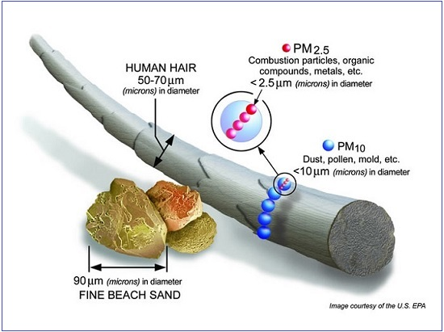
general air pollution standards
The NEMAQA also prescribes certain ambient air quality standards which apply generally to all activities.
PM10 standards
PM2.5 standards
Dust Fallout

Slide 26
Atmospheric Emission Reporting Regulations
The National Atmospheric Emission Reporting Regulations were published on 2 April 2015 under GN R283 of GG 38633.
PURPOSE: regulate reporting of data and information from an identified point, non-point and mobile sources of atmospheric emissions to an internet-based National Atmospheric Emissions Inventory System ("NAEIS") toward the compilation of atmospheric emission inventories.
The reporting requirements in these regulations apply to the groups of emission sources and corresponding data providers as classified in regulation 4 and listed in Annexure 1.
Data providers must register on the NAEIS within 30 days from the date upon which these regulations came into effect, being 2 April 2015, or within 30 days after commencing an activity or activities classified as emission source in terms of regulation 4.
A data provider must submit the required information for the preceding calendar year, as specified in Annexure 1 to these regulations, to the NAEIS by 31 March of each calendar year

Slide 27
ghg reporting regulations
On 3 April 2017 the National Greenhouse Gas Emission Reporting regulations published in GN R 275 Government Gazette 40762 ("GHG Reporting Regulations") were published.
PURPOSE: to introduce a single national reporting system for the transparent reporting of GHG emissions which will be used to update and maintain a National Greenhouse Gas Inventory and will assist South Africa in meeting its international obligations in relation to climate change mitigation.
Category A data providers must submit the GHG emissions and activity data for all of their facilities and in accordance with the data and format requirements specified in Annexure 3 for each preceding calendar year, to the competent authority by 31 March of each year (or the next working day).
Category B data providers, on the other hand, must submit emissions and activity data collected only when requested to do so by the competent authority.
All designated data providers, whether Category A or Category B will be required to register their facilities on the NAEIS or with the competent authority where activities at their facilities exceed the thresholds listed in annexure 1 by 7 May 2017 or within 30 days after commencing such activity if at a later stage.

Slide 28
NEMAQA
AEL
Comply with air quality standards
Reporting obligations
Notes:
“environment” means the surroundings within which humans exist and that are made up of -
(i) the land, water and atmosphere of the earth;
(ii) micro-organisms, plant and animal life;
(iii) any part or combination of (i) and (ii) and the interrelationships among and between them; and
(iv) the physical, chemical, aesthetic and cultural properties and conditions of the foregoing that influence human health and wellbeing;

Slide 29
national environmental management: protected areas act 57 of 2003 (NEMPAA)
The purpose of NEMPAA is to provide for the protection and conservation of ecologically viable areas representative of South Africa’s biological diversity by declaring such areas as protected areas
Section 9: NEMPAA provides for the following kinds of protected areas:
nature reserves (including special nature reserves and wilderness areas), national parks, and protected environments;
world heritage sites;
marine protected areas;
specially protected forest areas, forest nature reserves and forest wilderness areas declared in terms of the National Forests Act, 84 of 1998;
mountain catchment areas declared in terms of the Mountain Catchment Areas Act, 63 of 1970.
Section 17: Provides the purpose of the declaration of protected areas.

Slide 30
national environmental management: protected areas (NEMPAA) continued
The Minister may declare any area a Protected area, by notice in the government gazette, as long as it is in line with the purposes of NEMPAA (section 18, 20, 22A, 23 28).
Section 31: Provides for the consultation process that must be undertaken by the Minister. The Minister must consult all relevant organs of state (as NEMPAA supersedes most conflicting legislation), any lawful occupier with a right in land in any part of the affected area and follow a public participation process (in terms of section 33).
It is important to note the statutory restrictions under Part 4 of NEMPAA.
For example, mining or prospecting activities cannot be undertaken in a protected area.
Section 89: Where a person unlawfully accesses, lands or takes off from an aeroplane, mines, or conducts a commercial activity in a protected area, that person will be liable to a fine not exceeding R5 million or to imprisonment not exceeding 5 years, or both (and up to a R10 million fine and 10 years imprisonment, or both on a second offence).

Slide 31
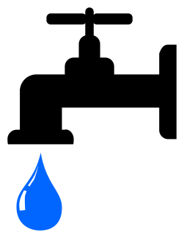
National water act 36 of 1998 (NWA)
Section 19: Imposes a duty of care on certain categories of persons to prevent pollution of a water source. A person is required to take all reasonable measures to prevent any pollution from occurring, continuing or recurring.
The Catchment Management Agency ("CMA") or the Minister can issue directives under this section. Failure to comply with such directives is an offence.
Section 22: A person may only use water without a licence in the following circumstances:
Water use is permitted by Schedule 1;
Under a section 39 general authorisation; and
Water use is the continuation of an "existing lawful water use".
Section 151: A person convicted of an offence of the NWA can be liable to a fine and imprisonment of up to 5 years (or 10 years on a second offence), or to both

Slide 32
National water act (NWA) continued
Section 21: Lists the water uses for which authorisation under the NWA, in the form of a water use license ("WUL"), is required and which will eventually be priced. The section contains an extremely wide definition of "water use." A company may, therefore, be required to apply for a WUL where it was not previously required, or ensure that such water uses are covered by another form of authorisation under the NWA.
The list of water uses includes:
taking water from a water resource;
storing water;
impeding or diverting the flow of water in a watercourse;
engaging in a stream flow reduction activity contemplated in section 36;
engaging in a controlled activity;
discharging waste or water containing waste in to a water resource through a pipe, canal, sewer, sea outfall or other conduit;
disposing of waste in a manner which may detrimentally impact on a water resource;
disposing in any manner of water which contains waste from, or which has been heated in, any industrial or power generation process;
altering the bed, bans, course or characteristics of a watercourse;
removing, discharging or disposing of water found underground if it is necessary for the efficient continuation of an activity or for the safety of people; and
using water for recreational purposes.

Slide 33
Water use licences
Both raw water use which involves extracting and storing of raw water, as well as waste discharge / disposal related water uses are regulated under the NWA.
Waste related water uses include the disposal and storage of wastewater in wastewater treatment systems, such as oxidation ponds and wastewater ponds. Impoundments such as the evaporation dams, pollution control dams, maturation dams and return water dams are also considered to be water uses.
Licence applications under the NWA must be in the prescribed format and contain the required information (there are specific application forms and supporting documents which need to be completed / provided for each water use that needs to be authorised).
On 24 March 2017, the Minister of Water and Sanitation published, in accordance with the OES, regulations regarding the procedural requirements for water use licence applications and appeals under the NWA. For the first time since the NWA came into force, these regulations provide for specific timeframes and steps to be taken in the processing of a water use application. According to Regulation 3 and Annexure A, an IWUL application must be considered and a decision on such an application made within a period of 300 days after the application has been submitted.

Slide 34
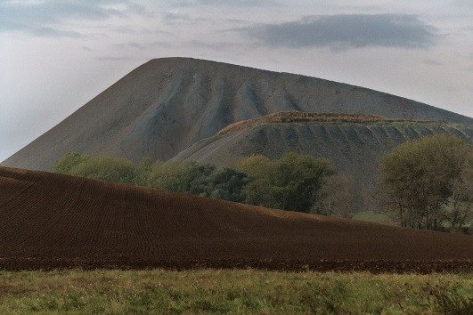
NWA
WUL
Duty care
Notes:
“environment” means the surroundings within which humans exist and that are made up of -
(i) the land, water and atmosphere of the earth;
(ii) micro-organisms, plant and animal life;
(iii) any part or combination of (i) and (ii) and the interrelationships among and between them; and
(iv) the physical, chemical, aesthetic and cultural properties and conditions of the foregoing that influence human health and wellbeing;

Slide 35
national heritage resources act 25 of 1999 (nhra)
"Heritage resources" refer to any place or object of cultural significance.
Heritage resources which are of cultural significance or other special value for the present community and for future generations are considered to be part of the 'national estate' and fall within the sphere of operations of heritage resource authorities (South African Heritage Resource Agency ("SAHRA"), Provincial heritage Resource Agencies ("PHRA") and local authorities).
Section 34: No person may alter or demolish any structure which is older than 60 years except under the authority of a permit issued by the provincial heritage authority.
Section 35: Provides for the protection of archaeological and paleontological sites and material and meteorites.
Section 36: Deals with burial grounds and graves. Graves are broadly defined to include any place of interment or anything associated with such place e.g. headstones, markers etc.
Section 51: Failure to obtain a necessary permit can result in a fine or imprisonment of up to 2 years, or both.

Slide 36
national heritage resources (nhra) continued
Section 38: Any person who intends undertaking a development activity listed in this section or that will change the character of a site in certain respects (which would include constructing a road, mining etc) shall at the earliest stages of initiating such a development, notify the responsible heritage resources authority and furnish it with details regarding the location, nature and extent of the proposed development.
These development activities include, inter alia:
the construction of a road, wall, powerline, pipeline, canal or other similar form of linear development or barrier exceeding 300m in length;
the construction of a bridge or similar structure exceeding 50m in length;
any development or other activity which will change the character of a site:
exceeding 5 000m² in extent; or
involving three or more existing erven or subdivisions thereof; or
involving three or more erven or divisions thereof which have been consolidated within the past five years; or
the costs of which will exceed a sum set in terms of regulations by SAHRA or a provincial heritage resources authority;
the re-zoning of a site exceeding 10 000m² in extent; or
any other category of development provided for in regulations by SAHRA or a PHRA.
The authority can request that a heritage impact assessment report be submitted. After consideration of the report, and whether a heritage resource will be impacted, the authority will decide whether the development may proceed (and may place any limitations on the development)

Slide 37
Heritage?
Notes:
“environment” means the surroundings within which humans exist and that are made up of -
(i) the land, water and atmosphere of the earth;
(ii) micro-organisms, plant and animal life;
(iii) any part or combination of (i) and (ii) and the interrelationships among and between them; and
(iv) the physical, chemical, aesthetic and cultural properties and conditions of the foregoing that influence human health and wellbeing;

Slide 38
hazardous substances act 15 of 1973 (HSA)
Section 2: The Minister may declare, in a gazette notice:
any substance or mixture of substances which, in the course of customary or reasonable handling or use, including ingestion, might, by reason of its toxic, corrosive, irritant, strongly sensitizing or flammable nature or because it generates pressure through decomposition, heat or other means, cause injury, ill-health or death to human beings, to be a Group I or a Group II hazardous substance.
any electronic product to be a Group III hazardous substance.
The definitions of these groups under the HSA are as follows:
Group I, Group II or Group III hazardous substance, under the HSA means a substance, mixture of substances, product or material declared in terms of section 2(1) to be a Group I, Group II or Group III hazardous substance, respectively; and
A Group IV hazardous substance refers to radioactive material.

Slide 39
hazardous substances act (HSA) continued
Section 3: A person requires a license (section 4) for the following activities:
selling of a Group I substance;
sell, let, use, operate or apply any Group III hazardous substance; and
install or keep installed any Group III hazardous substance on any premises.
Section 3A: Written authority is required for the production, acquisition, disposal, importation and exportation of Group IV hazardous substances.
Section 8 & 9: Provide for the appointment and duties and powers of Inspectors. An inspector can inspect any Group III or IV hazardous substance and demand any information regarding any grouped hazardous substance. Section 9B provides that an inspector or police officer can seize any grouped substance, without prior notice, where it is reasonably believed that the substance will be used in some way to commit an offence under the HSA.
Section 18: Provides offences under the HSA, most of which relate to interference in terms of an inspector. The highest penalty under the HSA can amount to a fine or up to 10 years imprisonment, or both.

Slide 40
national forests act 84 of 1998 (NFA)
Chapter 3: Part 3: deals with the protection of trees. The Minister is required to annually publish a list of all species protected under section 12, as well as an appropriate warning of the prohibitions set out and the consequences of its infringement, in the Government Gazette.
Latest list of protected trees was published in 2017 - includes Baobab, Marula, Leadwood and many Yellowwoods, Stinkwoods and Milkwoods.
The prohibitions in section 15 provide that "no person may cut, disturb, damage, destroy or remove any protected tree; or collect, remove, transport, export, purchase, sell, donate or in any other manner acquire or dispose of any protected tree", except under a licence granted by the Minister.

Slide 41
conservation of agricultural resources Act 43 of 1983 (CARA)
The core purpose of CARA is to provide for control over the utilization of the natural agricultural resources of South Africa in order to promote the conservation of the soil, the water sources and the vegetation and the combating of weeds and invader plants; and for matters connected therewith.
Section 6: In order to achieve the objects of CARA the Minister may prescribe control measures which shall be complied with by land users to whom they apply. These control measures may relate to:
the irrigation of land;
the prevention or control of waterlogging or aliention of land;
the utilization and protection of vleis, marshes, water sponges, water courses and water sources;
the regulating of the flow pattern of run-off water;
the utilization and protection of the vegetation;
the prevention and control of veld fires;
the control of weeds and invader plants;
the restoration or reclamation of eroded land or land which is otherwise disturbed or denuded; or
the construction, maintenance, alteration or removal of soil conservation works or other structures on land.
Control measures may in terms of section 6(3):
contain prohibitions or obligations; and
provide for exemptions which may be granted.
Any land user who refuses or fails to comply with any control measure which is binding on him, shall be guilty of an offence.

Slide 42
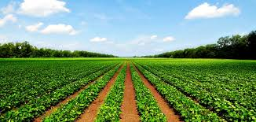
conservation of agricultural resources (CARA) continued
Section 7(6)(a) and (b): Any land user who refuses to receive a direction served on him in the prescribed manner or refuses or fails to comply with a direction binding on him shall be guilty of an offence.
Section 23: A person convicted of an offence under section 6 or 7 will be liable, at most, to a fine of up to R5000 or to imprisonment of up to 2 years, or both.
Section 15: The Minister may establish a conservation committee, in respect of any area determined by the Minister, to promote the conservation of the natural agricultural resources of the area.

Slide 43
mineral petroleum resources development act 29 0f 2002 (mprda)
In the preamble of the MPRDA, the State affirms its obligation to:
protect the environment for the benefit of present and future generations
ensure ecologically sustainable development of mineral and petroleum resources promote economic and social development.
Section 5 provides that a prospecting right, mining right, exploration right or production right granted in terms of the MPRDA and registered in terms of the Mining Titles Registration Act, 1967 is a limited real right in respect of the mineral or petroleum and the land to which such right relates. Subject to the MPRDA, any holder of a prospecting right, a mining right, exploration right or production right may:
enter the land to which such right relates together with his or her employees, and bring onto that land any plant, machinery or equipment and build, construct or lay down any surface, underground or under sea infrastructure which may be required for the purpose of prospecting, mining, exploration or production
remove and dispose of any such mineral found during the course of prospecting, mining, exploration or production,
subject to section 59B of the Diamonds Act, 1986, (in the case of diamond) remove and dispose of any diamond found during the course of mining operations;
subject to the National Water Act, 1998, use water from any natural spring, lake, river or stream, situated on, or flowing through, such land or from any excavation previously made and used for prospecting, mining, exploration or production purposes, or sink a well or borehole required for use relating to prospecting, mining, exploration or production on such land; and
carry out any other activity incidental to prospecting, mining, exploration or production operations, which activity does not contravene the provisions of the MPRDA.

Slide 44
mineral petroleum resources development (mprda) continued
Where a person wishes to carry out a prospecting right or a mining right, they must receive approval from the competent authority.
Failure to obtain approval is an offence and may be subject to a fine of R500 000 for each day that that the offence persists.
Section 43 provides for the issuing of a closure certificate. The holder of a prospecting right, mining right, retention permit, mining permit remains responsible for any environmental liability, pollution, ecological degradation the pumping and treatment of extraneous water, compliance to the conditions of the environmental authorisation and the management and sustainable closure thereof, until the Minister has issued a closure certificate in terms of the MPRDA to the holder or owner concerned.
The holder of the right must apply for a closure certificate upon:
the lapsing, abandonment or cancellation of the right or permit in question;
cessation of the prospecting or mining operation;
the relinquishment of any portion of the prospecting of the land to which a right, permit or permission relate; or
completion of the prescribed closing plan to which a right, permit or permission relate.

Slide 45
One Environment SYSTEM (OES)
The roll-out of the OES commenced on 8 December 2014 and entails the streamlining of the licensing processes for mining rights, EAs and water use licenses in South Africa
Under the OES, the Minister of Mineral Resources will issue EAs and waste management licenses in terms of NEMA and NEMWA respectively, for prospecting and mining activities, as well as activities relating to the primary processing of minerals. The Minister of Environmental Affairs will be the appeal authority for these authorisations, and the competent authority for any non-mining related activities.
The Ministers of Environmental Affairs, Mineral Resources, as well as Water and Sanitation have agreed on fixed time-frames for the consideration and issuing of the permits, licenses and authorisations in their respective legislation. The aforementioned Ministers further agreed to synchronise the process for the issuing of permits, licenses and authorisations within a 300 day period. In the event that a decision to issue a licence is appealed, an additional maximum period of 90 days is provided for legislatively, to finalise the process.
The following key amendments to NEMA are noted:
Amendment to section 24C: Minister of Mineral Resources is the competent authority for the prospecting, mining, exploration, production activity on a mining area.
Insertion of section 24S: which provides that residue stockpiles and residue deposits must be deposited and managed in accordance with the provisions of NEMWA.
Amendment of section 43: the Minister of Environmental Affairs will be the appeal authority against a decision taken by the Minister of Mineral Resources regarding environmental matters in terms of NEMA in so far as it relates to prospecting, mining, exploration, production or primary processing activities related to these activities.

Slide 46
The relationship between the MPRDA and NEMA
Section 24 of the Bill of Rights – NEMA & MPRDA enacted to give effect to this section.
In 2007/ 2008, the DEA and the Department of Mineral Resources ("DMR") agreed that environmental regulation of the mining industry would be removed from the purview of the MPRDA and would be wholly regulated under the NEMA. This was to be the OES for the mining industry.
Section 16 & 22 of the MPRDA: Any person who wishes to apply to the DMR for a prospecting right or mining right (respectively) must simultaneously apply for an environmental authorisation in terms of NEMA, and in doing so, must prepare an EMPr. Previously, applicants had to submit these applications to different authorities, but it is one streamlined process under the OES.
Section 37 of the MPRDA: Confirms the adoption of the principles for sustainable development as set out in section 2 of NEMA as well as other generally accepted principles of sustainable development.
Section 38A of MPRDA: The DMR is responsible for implementing environmental provisions in terms of NEMA as it relates to prospecting, mining, exploration, production or activities incidental thereto on a prospecting, mining, exploration of production area.
Section 38B of the MPRDA: Previously approved EMPRs in terms of the MPRDA will be deemed to have been approved and considered to be an EA issued in terms of the NEMA. Similarly, for any new applications for rights and / or permits, as well as the renewal of rights and or permits, applicants will need to demonstrate compliance with the NEMA as opposed to the MPRDA.

Slide 47
problems with the interplay of the MPRDA and NEMA in the mining context, under the OES
The DMR has come under criticism for not undertaking its environmental compliance responsibilities adequately, which has left a gap in terms of compliance monitoring in relation to mines.
The question is whether the DEA can still perform compliance monitoring in terms of mining and prospecting activities or whether this is reserved solely for the DMR, under the OES?
This was the issue presented in the Western Cape High Court between the DEA and Mineral Sands Resources (MSR) in March this year.
A search and seizure operation conducted by the DEA on MSR's mine in the Western cape was declared invalid based on the fact that the DMR and not the DEA had to be the Department to authorise such investigations in terms of the OES and NEMA.

Slide 48
Financial Provisioning regulations
Section 24P of NEMA, which took effect from 8 December 2014, regulates the financial provision for the remediation of environmental damage.
This section requires financial provision to be made before an EA can be issued for a mining operation. This will include compliance with with the prescribed financial provision for the rehabilitation, closure and on-going post decommissioning management of negative environmental impacts.
This financial provision will need to be assessed annually by the holder of the right and increased to the satisfaction of the Minister of Mineral Resources.
The increase will be determined by an audit report which must be submitted annually, as prepared by an independent auditor.
Further, an annual rehabilitation plan, a final rehabilitation plan and an environmental risk assessment must also be drawn up and reviewed.
The Financial Provisioning Regulations were published on 20 November 2015 and were a key set of laws to finalise the transition into the OES. These Regulations govern the transition from the MPRDA section 41 regime to the new NEMA section 24P regime.
They apply to new and existing holders of prospecting and mining rights in terms of the MPRDA.

Slide 49
Financial Provisioning regulations continued
In terms of the Regulations, the applicant or holder of a right or permit must ensure that the financial provision is, at any given time, equal to the sum of the actual costs of implementing these plans and reports for a period of at least 10 years forthwith.
The Regulations provide for a 60 day time period in which the Minister of Mineral Resources may consider the assessment of financial provision and issue his decision. The Regulations also provide the format that financial provisioning (in the form of a bank guarantee, deposit or trust) must take, in the annexures to the Regulations
Any financial provision approved in terms of the MPRDA is deemed to be approved under the Financial Provisioning Regulations, on condition that a holder that operates in terms of such approved financial provision at the time of the coming into operation of the Financial Provisioning Regulations must review and align such approved financial provision with the provisions of the Financial Provisioning Regulations. In this regard, a review assessment must be conducted.
These Regulations have been a source of contention and although they came into operation in November 2015 and are applicable to new applicants, they do not yet apply to existing rights holders. The transition for the Regulations to apply to the existing rights holders has effectively been delayed until 20 February 2019 (the Regulations were supposed to come into effect for existing rights holders on 20 February 2017).
The balance of proposed amendments to the Regulations need to still come through.

Slide 50
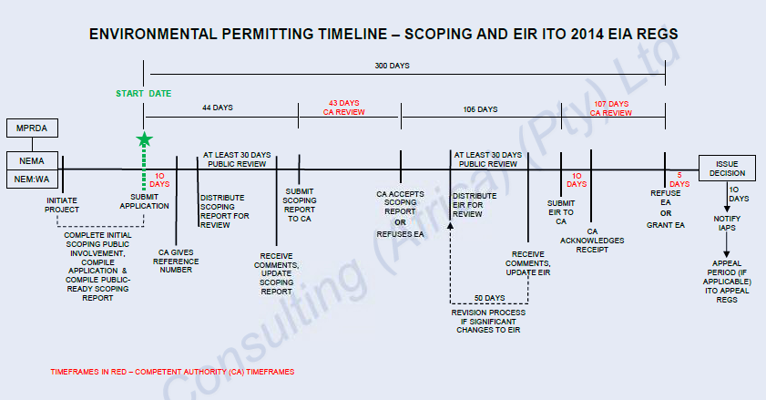

Slide 51
environmental authorisations / risks in respect of renewable energy projects
The following environmental authorisations and consents may be needed for the commencement of a renewable energy project:
Land
rezoning approval;
confirmation of no restitution claims;
SALA exemptions;
Electricity
general licence;
Distribution / transmission licence;
Environmental
EA and EMP in terms of NEMA;
Confirmation from DEA that there are no appeals to the EA;
SAHRA, DAFF, NFA and NEMBA permits;
WUL and WML;
Other
civil aviation consent ( for wind projects) or a confirmation of water availability (for CSP projects)
Square kilometre array consent;
Procurement permits (in relation to Electricity Regulation Act, Public Finance management Act, Preferential procurement Policy Framework Act, board approval from Eskom);
tax and customs permits (stage consignment letter); and
permits relating to construction in terms of the Occupational Health and Safety Act, 1983.

Slide 52
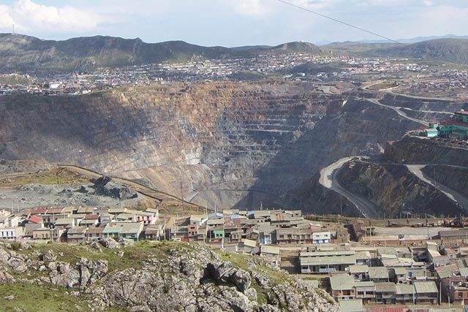
contaminated land
Contamination may occur through:
a water source in terms of the NWA;
by hazardous materials in terms of the HSA;
in relation to land in terms of NEMWA.
Contamination of land is governed under NEMWA. The contaminated land provisions require an owner of land that is significantly contaminated, or a person who undertakes an activity that caused the land to be significantly contaminated, to notify the Minister of Environmental Affairs of that contamination as soon as that person becomes aware of the contamination
The Minister may also declare as "investigation areas" land which she believes to be contaminated or land on which "high-risk activities" have taken or are taking place. "Investigation areas" must be recorded in a National Contaminated Land Register and assessed to determine if remediation is required. If it is found to be contaminated it will be declared a "remediation site" and a remediation order will be issued.
Where land is deemed contaminated or a remediation site, it will be certified as such on the title deeds. The transfer of contaminated land will be restricted until it has been cleaned up according to plans issued by the authorities. If a person is found to have contaminated land, that person will be liable to rehabilitate the land.
Offences in terms of contaminated land can amount to a fine of up to R5 million or to imprisonment for up to 5 years, and include:
The failure to notify the Minister once a person becomes aware of any contamination;
The failure to notify a transferee of any contamination;
The failure to notify the Minister of the transfer of a remediation site; and
The failure to conduct a site assessment (which can amount to R10 million fine / 10 years imprisonment).
Notes:
*s38 of MPRDA deleted

Slide 53
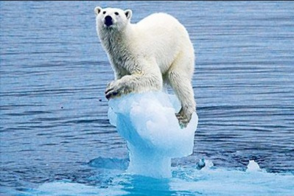
climate change – carbon tax
Carbon tax is based on emissions linked to fuel inputs.
The primary objection of implementing carbon taxes is to change future behaviour, rather than to raise revenue.
This will be done by implementing a carbon price / tax as a mitigation measure.
In 2015 the Carbon Tax Bill was published for public comment. A new draft has not yet been released.
In November 2016 South Africa ratified the Paris Agreement, which is the United Nations Framework Convention on Climate Change dealing with greenhouse gases emissions mitigation, adaption and finance, starting in the year 2020.
The GHG Reporting Regulations is the first step in implementing the imminent imposition of carbon tax for identified affected sectors in SA.
It is planned that GHG's will be classified as priority air pollutants. Once this occurs, with the GHG Reporting Regulations, it will complete the regulatory regimes for the mandatory reporting of air emissions to the NAEIS. This system will be the basis for the formalisation of carbon tax.
Notes:
The changes intend to mitigate carbon exposure and address climate change in the following manner:
encouraging a shift in production and consumption patterns towards low carbon and more energy efficient technologies. Pricing carbon emissions address the problem of negative externalities, as polluters should pay for their emissions;
carbon intensive factors of production, products and services are likely to be replaced with low carbon emitting alternatives;
carbon price will create dynamic incentives for research, development and technology innovation in low carbon alternatives.
.
A rate of R120 per ton CO2e increasing at 10 per cent will be implemented during the first phase. Thereafter it will range between R12 and R48
The tax base
The carbon tax will be based on emissions derived from emission factors linked to the fuel inputs used. It will cover emissions from all stationary sources, including process emissions.
The key design features of the carbon tax are:
a. A phased approach to the implementation of the carbon tax. The first phase (introductory) will be for five years, effective from 1 January 2015 to 31 December 2019 followed by Phase 2 of another five years, from 2020 to 2025. Follow up phases can be explored at a later stage.
b. An across the board basic 60 per cent tax free threshold of actual emissions below which the tax will not be payable.
c. Additional 10 per cent relief for certain sectors to allow for technical or structural limitations to reduce emissions (process emissions).
d. Up to an additional 10 per cent relief for emissions intensive and trade intensive sectors, e.g. iron and steel, cement, glass, etc. to take into account the risk of carbon leakage and competitiveness concerns. .
e. Offsets could be used by firms to reduce their carbon tax liability up to limits of 5 or 10 per cent, depending on the sector.
f. Emissions from the agricultural and waste sectors will be exempt during the first phase. This complete exemption will be reviewed during the second phase.
g. The electricity sector will qualify for a tax free threshold of up to 70 per cent and some sectors will be able to qualify for a tax free threshold of up to 90 per cent during the first phase.

Slide 54
THANK YOU
Garyn Rapson
Email: garyn.rapson@webberwentzel.com
Twitter: GarynR (follow me for the latest environmental developments)
Legal Notice: these materials are for training purposes only and do not constitute legal or other professional advice

