Slide 1

Pilot Training Week 2: 5 November 2018
Disaster Management and Development of Operating Rules

Slide 2
Disaster Management
WRMP performs three main roles
  Plans for water resources
  Selects appropriate interventions
  Operates water resources
Correct planning and operation assist with disaster management
Focus in SA on droughts, though floods also important

Slide 3
Background: what?
Operating rules sometimes referred to as “drought” operating rules
Rules governing the operation of a selected system which can include one or more water resources
  Dams
  Groundwater
  Infrastructure

Slide 4
Background: why?
Important to adhere to rules to efficiently manage water resources
Rules assist with obtaining highest yield out of a system
Rules assist with reducing costs of operating a system
Rules assist with providing users with their water at the required assurance of supply

Slide 5
Types of Operating Rules
Inter Reservoir: highest yield
Large system: annual rule
Single Dam system: Simplified

Slide 6
Inter Reservoir
Definition: Rule defining levels of dams at which transfers from other resources need to take place
To obtain the maximum yield out of a system from the various dams included

Slide 7
Inter Reservoir
Yield_{(Dam 1)} + Yield_{(Dam 2)} + Yield_{(Dam 3)} often does not equal Yield_{(Dam 1,2,3)}
Causes of differences
  Infrastructure constraints
  Evaporation
  Dynamics of hydrology

Slide 8
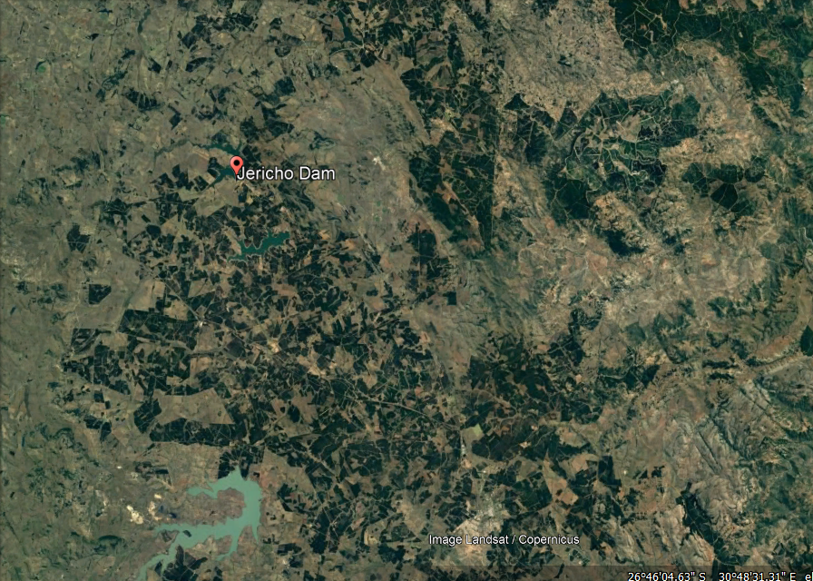
Westoe Dam
Heyshope Dam

Slide 9
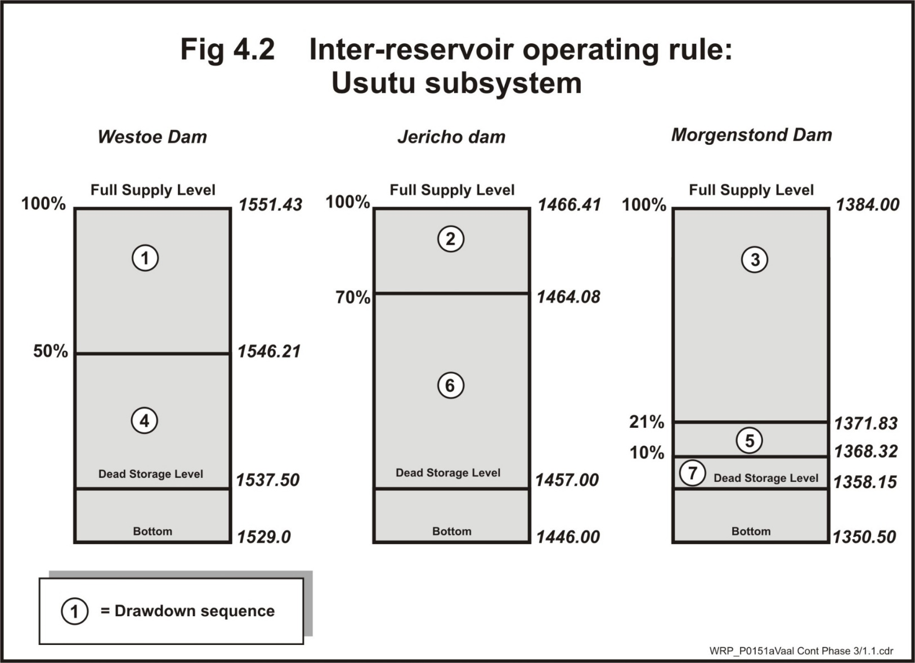

Slide 10
Caledon / Riet-Modder

Slide 11
Large System: Annual Analyses
Generally standard operating rules for large systems
Annual assessments carried out to see if deviations from the generic rule can occur
Deviations should not result in longer term risk for water users

Slide 12
Large System: Annual Analyses
Reasons for deviations
  Cost cutting
  Starting storages
  Short term infrastructure outages
Examples
  Pump from Thukela to Vaal
  Eskom discretional allocation

Slide 13
Process of Annual Operating Analyses
Starting Conditions
Infrastructure outages
Updated requirements
Scenario planning
Update Model and Analyses
Systems Operating Forum
Gazetting
Monthly Monitoring

Slide 14
Starting Conditions
Decision date
Most systems 1 May, end of wet season, start of dry season, little rain likely to occur
Obtain storages of major dams in system: https://www.dwa.gov.za/Hydrology/Weekly/Province.aspx

Slide 15
Infrastructure Outages
Liaison with operators
Determine timing and duration of any planned infrastructure outages or reduction in capacity over short to medium term, current operating + 2 years

Slide 16
Updated Requirements
Focus on larger users, important to get accurate existing and short term future requirement projections
Gather information from available studies taking place in parallel to obtain updated requirements for other users

Slide 17
Scenario Planning
Meeting scheduled with small group of key Stakeholders, decision makers
Present information obtained, starting conditions, infrastructure constraints, updated requirements
Short list 5-6 scenarios to be assessed for operating year

Slide 18
Update Model and Analyses
Configure updated information into model base data set
Configure deviations of base data set representing defined scenarios
Undertake Planning Model analyses
Assess and package results relating to
  Projected dam storages
  Target transfers
  Required restrictions

Slide 19
Systems Operating Forum
Meeting including wider group of Stakeholders relevant to system
Present
  Previous years system behaviour comparing simulated with actual observations
  Starting conditions and updates for current year
  Defined scenarios
  Analyses results
Obtain agreement n final defined operating rule for current year

Slide 20
Gazetting Restrictions
Obtain agreement from users for restrictions per sector if required
Provincial office drafts the Gazette Notice with Chief Directorate: Integrated Water Resource Planning support for approval by the Director-General on behalf of the Minister
Published in the government gazette
Responsibilities
  Implementation: National Water Resource Infrastructure Branch
  Monitoring: WRPS: SO
  Compliance and Enforcement: Regional offices

Slide 21
Monitoring System behaviour
Typically done on Monthly basis
Track actuals vs simulated projections for
  Dam storages
  Major abstractions
  Required transfers and releases
Where deviations occur
  Understand and Explain
  Sound warning

Slide 22
Monitoring graph

Slide 23
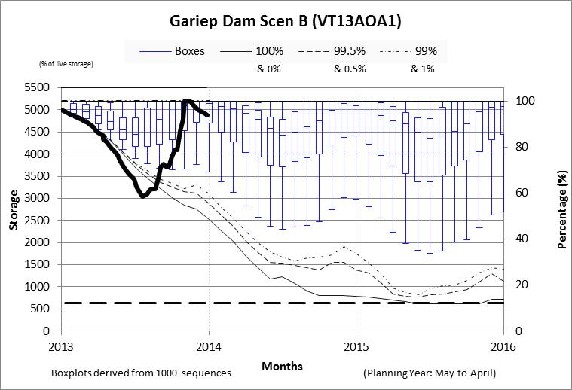
Monitoring graph

Slide 24
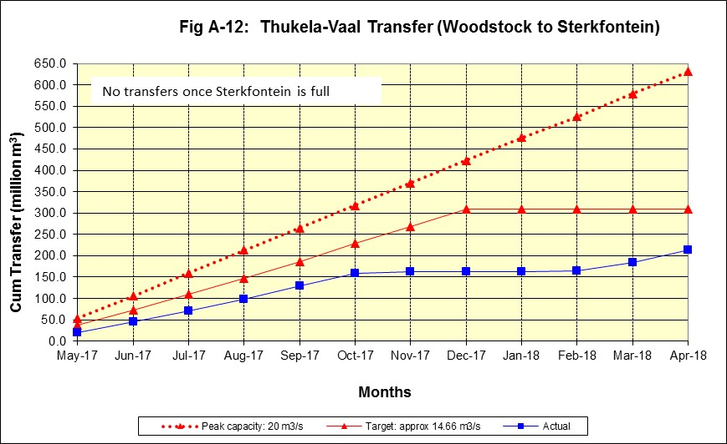
Monitoring graph

Slide 25
Simplified System
Stand Alone Dams
History
Approach
  Similar to Large Scheme Annual runs
  Starting storages, requirements
  Analyses to obtain projection plots to track against
Where not major changes occur year to year can make use of simplified rule curve

Slide 26
Example of Simplified Rule Curve

Slide 27
Transboundary Operating Rules
Required when country falls downstream of another and has allocation to resources
Usually defined by cross border flows
Lesotho Highland Water Project has Treaty to define operating rule
  Water sales and Royalties
  Hydropower generation

