Slide 1

Water and the Economy
Peter van Niekerk

Slide 2
Background
Water Economics examines questions as wide as:
Is a public works project worth undertaking? From whose perspective? How should it be analysed?
How should water be priced? Should water rights be traded?
What levels of assurance of water supply are optimal? What are the impacts of under-supply during droughts?
Should South Arica use its water for water intensive production or rather import such goods?
Is water supply better left for the State, or should the private sector do it?
In this course we will concentrate on the first question – rooted in welfare economics, a segment of micro-economics. We start first with concepts and terminology. (Yes – the field has its own language!)

Slide 3
We will cover the following:
Concepts
  Microeconomics vs Macroeconomics
  Discounting
  Supply and demand
  Cost and Return
  Marginal cost and Marginal Revenue
  Price elasticity of demand
  Public, Private and Economic Goods
Project Appraisal
  Benefits
  Costs
  Opportunity costs
  Internal rate of return
  Least Cost Analysis
  Benefit Cost Analysis
  Cost Efficiency Analysis (URV)

Slide 4
Microeconomics vs Macroeconomics
Microeconomics
  Price determination
  Allocation of scarce resources among competing uses
  Welfare economics provides theoretical foundation to evaluate public works projects (also called public engineering projects)
Macroeconomics
  Analysis of broad aggregates such as GDP, total employment, inflation

Slide 5

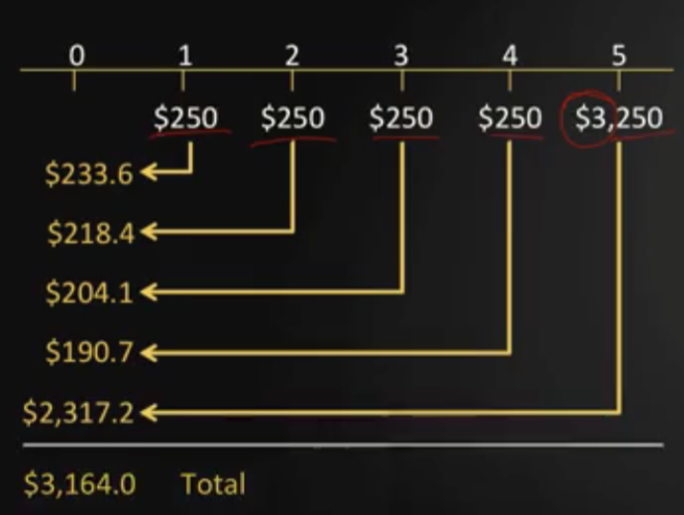
Discounting: Present Value
Consider a simple investment of USD 3000 that makes an annual payment of USD250 for 5 years, if the discount rate is 7%
What are the cash flows?
What are they worth today: Present Value?

Slide 6
Economic discounting: What rate?
Discount rate reflects time value of money
Discount rate for an economic analysis differs from interest rate (financial market) – extensive literature exists on appropriate discount rate for public works projects.
Official discount rate (social discount rate) in South Africa is 8% p.a. Note that:
  Lower discount rates favour capital intensive projects
  Lower discount rates favour projects with long gestation periods
  A low discount rate requires a longer planning horizon
Typically, for water resource projects, a planning horizon of 45 years is used and sensitivity analyses round the 8% discount rate, at 6% and 10%, are undertaken.

Slide 7
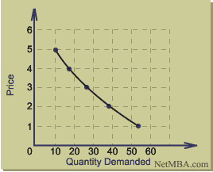
Perspective on Demand (Consumers) and Supply (Firms)
Economists’ starting points:
  Perfect economy: no economic distortions, free entry into market, no monopolies, no transaction costs, no taxes, perfect information, producers and consumers are price takers
  A consumer will allocate her fixed budget in such as way to optimize her utility
Benefit for consumer diminishes with increasing supply
If the price of the commodity in the graph is set at 2 the consumer will buy 38, not more
If the price increases the consumer will buy less

Slide 8
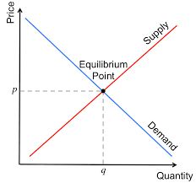
Adding supply of commodity q
Producers will increase supply as price increases (in a prefect economy)
At price p the market clears – it is in equilibrium

Slide 9
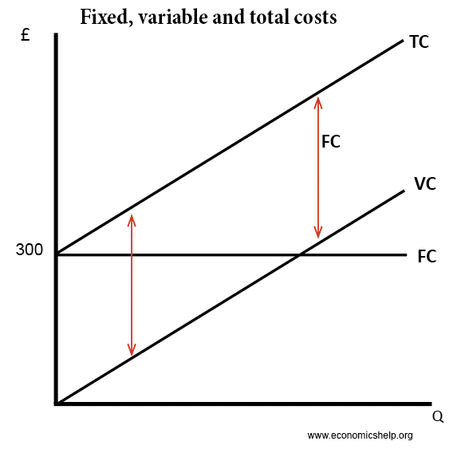
Production Costs
FC = Fixed costs
VC = Variable costs
TC = Total Costs

Slide 10
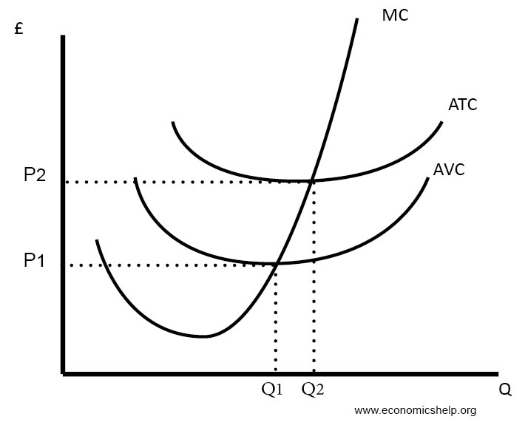
Competitive market
Average Total Cost (ATC) , Average Variable Cost (AVC) and Marginal Cost (MC)
If price is above ATC curve, “excess profit” is made and other firms will enter market
Markets will clear and “allocative efficiency” occurs when consumers pay a market price that reflects the marginal cost of production. The condition for allocative efficiency for a firm is to produce an output where marginal cost, MC, just equals price, P2. The quantity produced will be Q2
Marginal Revenue (MR) is therefore = price P2
Note that this is when the ATC curve is at its minimum

Slide 11
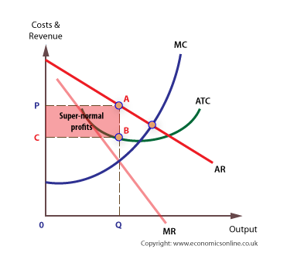
Monopolies
Case where there is a single seller and many buyers
To maximize profit the firm will produce at the point where MC=MR
The quantity produced will be at point B, less than the minimum point of the ATC curve if it were perfect competition.
The monopoly will make above-normal profit
Public work activities are usually “natural monopolies” as the barriers of entry for competitors are too high.

Slide 12
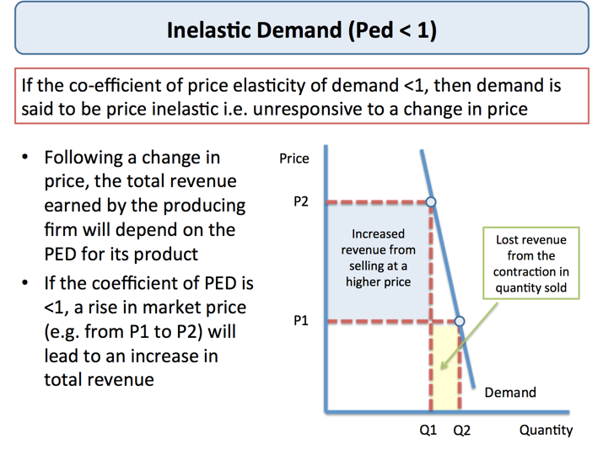
Price elasticity of demand

Slide 13
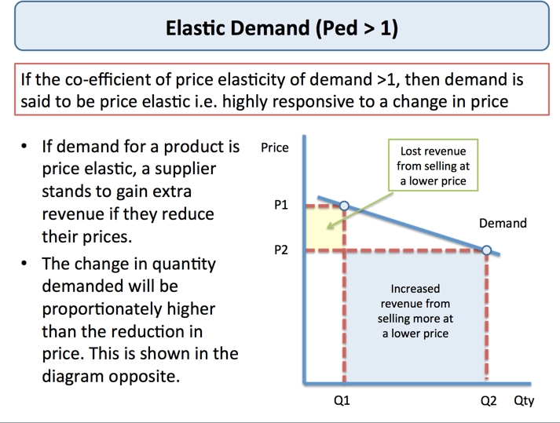
Price elasticity of demand

Slide 14
Public Good vs Private Good
A public good has two characteristics:
  Non-rivalry: When a good is consumed, it doesn’t reduce the amount available for others.
  – E.g. benefiting from a street light doesn’t reduce the light available for others but eating an apple would.
  Non-excludability: It is not possible to provide a good without it being possible for others to enjoy. For example, if you build a dam to stop flooding – you protect everyone below the dam, whether they contributed to the dam or not.
The availability of a private good can be exhausted through use.
It is difficult to assess benefit/value of a public good during the planning process – problem of overstatement of willingness-to-pay by public. Afterwards – free rider issues.

Slide 15
Private or Public good?
Discuss whether the following are private or public goods
  A beach
  A museum
  TV broadcasts
  Electricity
  A park
  Water reticulated to a house
  Water in a river
  Also note positive and negative externalities often associated with public goods.

Slide 16
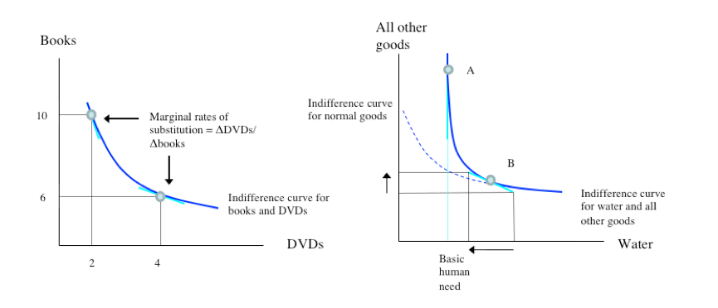
Indifference Curves
Water is different to “normal” goods.
- both a private, marketable good and a basic human right.

Slide 17
Demand forecasting
A planner needs to estimate future water requirements. Various forecasting techniques can be used, including
  Regression techniques
  Econometric modelling
  Time series forecasting
This module does not include further detail – it is incorporated in the Options Analysis module

Slide 18
Identification of Options
After forecasting demands into the future the Planner has to identify options to reconcile demands with supplies of water. (This aspect is covered elsewhere in the course.)
For this module it is assumed viable options have been identified and are ready for economic analysis.

Slide 19
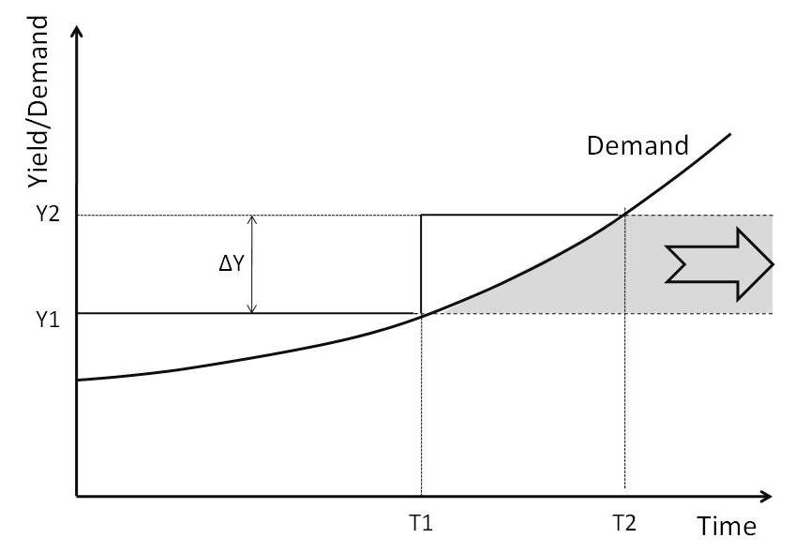
Reconciling demand and supply by adding a new resource
According to projections a new resource intervention, say a dam, is required at T1 as risk of under supply becomes too great
The dam increases system yield from Y1 to Y2
Supply meets minimum levels-of service until T2, by which time the next intervention is required
The dam assures additional system yield into future as shown in shaded area

Slide 20
Identification and Quantification of Benefits
Direct monetary benefits
  Also seen as increase in national income (GDP as proxy for “welfare”)
  Assumes price reflects societal value
    High degree of competition
    High degree of employment of labour and productive capacity
    Absence of external economic forces, diseconomies, taxes
    Otherwise shadow pricing required to correct for distortions
Indirect benefits:
  Example: A proposed new irrigation project will have indirect or secondary benefits:
    Project will result in increase in income in processing, transporting and marketing of products grown with the project water and increase labour in those sectors(“forward linkages”)
    Expenditure on the project (on factors of production) will increase income earned by firms involved in supplying inputs for the projects and increase labour in those sectors(“backward linkages”)
  Secondary benefits are not included up front in cost-benefit analyses, but
  Secondary benefits can be explicitly computed in Leontief input-output models to trace effects of investments in one economic sector on another, or on labour, e.g. employment capital multiplier (jobs per million rand invested).

Slide 21
Identification and Quantification of Costs
Cost estimations (such as engineering costs) are dealt with elsewhere and assumed available for our purposes
Direct Costs
  Capital cost
  Operating cost
  Maintenance cost
Past expenditure are treated as sunk costs and therefore has no relevance
Transfer Payments
  Such payments do not reduce resources in economy as a whole
  Taxes, duties and subsidies are examples of transfer payments
Shadow Pricing required where pricing is distorted, e.g. electricity costs
Opportunity Costs
  Benefit foregone from not using a good or resource in its next best alternative use, e.g. land required for a new dam
Depreciation of capital assets over the planning horizon to be included as a cost by bringing in new assets at appropriate times.

Slide 22
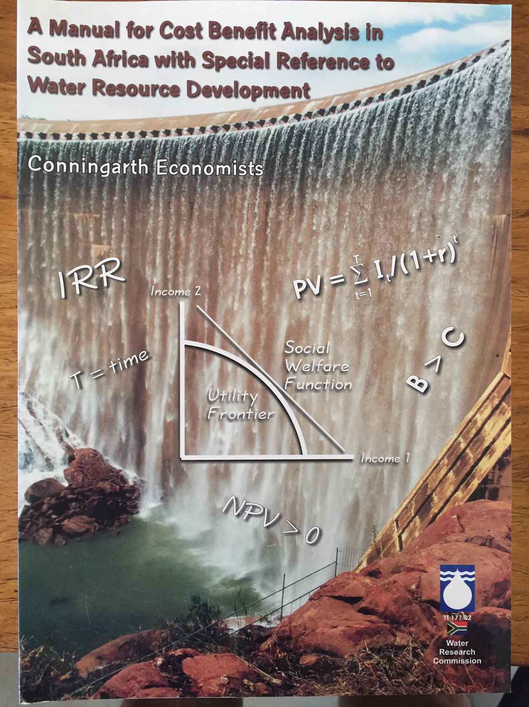
Economic theory applied in water resource appraisal:
  Least cost analysis
  Cost-benefit analysis (CBA)
  Cost-effectiveness analysis (CEA).
  We will briefly look at these methods, but further reading is recommended: WRC Technical Report No. TT 177/02

Slide 23
Least cost analysis
  Choose between projects with very similar objectives
    E.g. water supply to a village for the next ten years growth and choosing between ground water abstraction and a dam
  Select project with lowest Net Present Cost (NPC)

Slide 24
Cost-benefit analysis (CBA)
  Through CBA the desirability of a public investment project is assessed
    Started in 1930s in USA to assess benefits to society of various water resource related legislation
  Applied where it is possible to quantify costs and benefits in monetary terms
  Example of benefits: net farm income (for an irrigation scheme) or value of electricity generated (hydroelectricity power scheme)
  Generally market prices are used, but sometimes shadow prices are required to adjust for market failures and effects of government intervention
  Secondary benefits are not included

Slide 25
Cost-benefit analysis (CBA) (cont’d)
Benefit-cost Ratio
  PV of total benefits divided by PV of total costs
  B/C ratio must exceed 1 for a project to be economically justified
Internal Rate of Return (IRR)
  IRR = Discount rate at which the present value of the net cash flow is zero
  The higher the IRR the better is a project

Slide 26
Cost-effectiveness analysis (CEA)
  Non-monetary metric (e.g. when difficulty of placing monetary value on benefits)
    If the effectiveness measure captures most of the benefits, then it may be reasonable to use CEA to avoid the burden of conducting a CBA
  Cost-effectiveness ratio, e.g. for a road project, R million invested, divided by lives saved per year, compares (mutually exclusive) alternatives in terms of the ratio of their costs and a single quantified, but monetized, effectiveness measure
  As it is difficult to put monetary values on supplying water for urban and industrial purposes, CEA is often used – called the Unit Reference Value method in South Africa.

Slide 27
Unit Reference Value (URV)
URV measure originated with DWA in South Africa in the 1980s
Today used extensively to compare and rank water projects
Referring to figure:
  The total quantity of water supplied is shown in the shaded area, i.e. the sum of all annual demands starting at time T1, growing till equalling the yield of ∆Y at time T2, and thereafter remaining constant until the end of the economic life of the scheme (typically 45 years). The URV of the scheme is derived by dividing the PV of the costs with the PV of the water supplied, as in this equation:

Slide 28
Unit Reference Value (URV) (cont’d)
From a CEA perspective “effectiveness” is considered captured by the “PV of quantity of water supplied”. This is valid in most cases but may need adaptation in cases involving variable operating costs, such as certain inter-basin transfers.
NOTE: URV comparisons should be limited to projects within same effectiveness domain e.g. should not be used to compare a supply side project, such as a dam which increases system yield, with a demand side project, such as one directed at reducing reticulation leakages.

Slide 29
END

Slide 30
Economic Goods
An economic good is a good or service that has a benefit (utility) to society. Also, economic goods have a degree of scarcity and therefore an opportunity cost.
This is in contrast to a Public Good (like air, sea water) where there is no opportunity cost – but abundance.
With economic goods have some scarcity and value, people will be willing to pay for them (in some form).
Another feature of an economic good is that if it can have a value placed on the good, it can be traded in the marketplace and valued, using a form of money.

