Slide 1


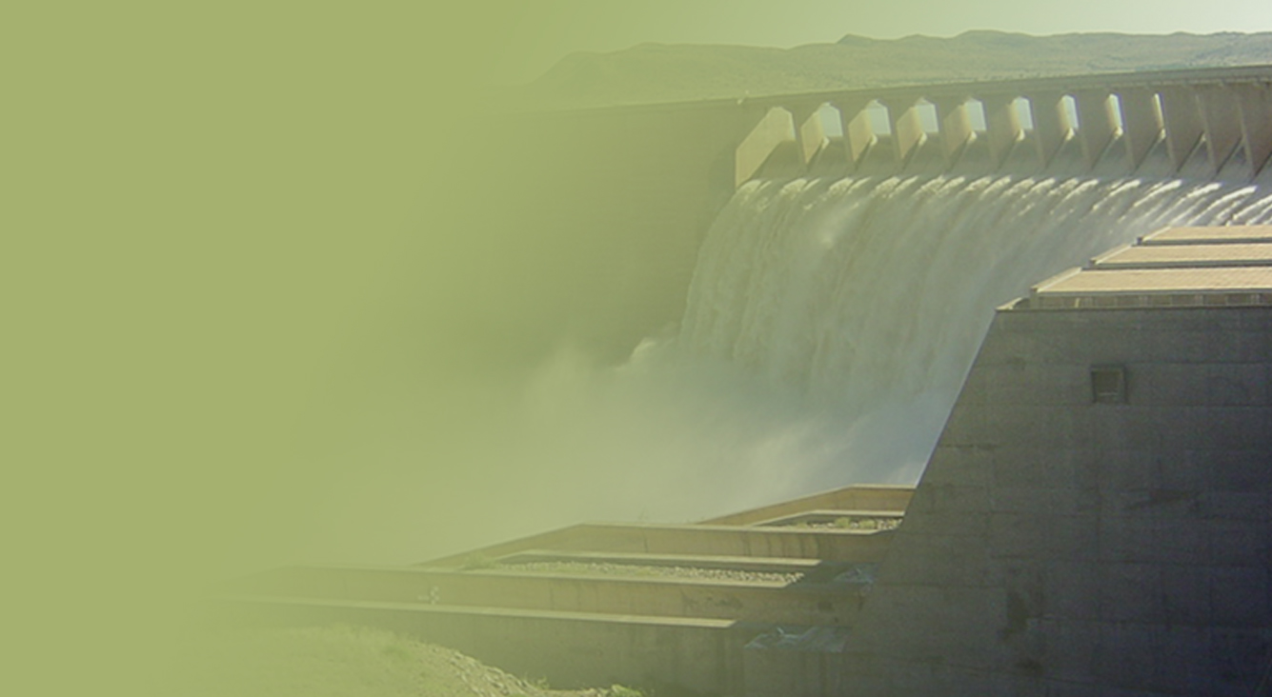
WATER QUALITY ASPECTS
IN
WATER RESOURCE MANAGEMENT
Presented by:
J.J. VAN WYK
Date: 06 November 2018

Slide 2
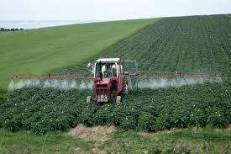
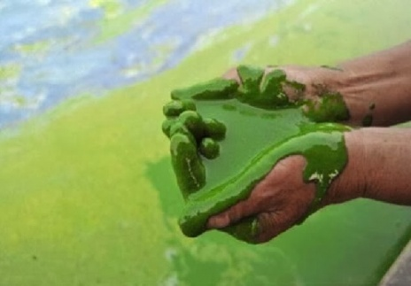
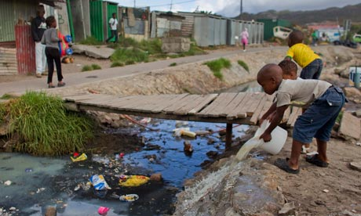
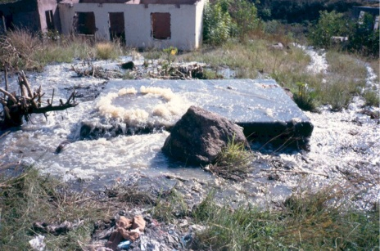

FOCUS OF THE KNOWLEDGE MODULE
1. WQ FROM A WRM PERSPECTIVE
2. WQ IMPACTS FROM AGRICULTURE & URBAN CENTRES
3. WQ IMPACTS FROM MINING & INDUSTRY
4. WATER QUALITY MONITORING & PLANNING
MANAGING WATER RESOURCES,
CONSIDERING WQ RELATED ASPECTS

Slide 3
1. WQ FROM A WRM PERSPECTIVE

Slide 4

CONCEPTS & PRINCIPLES
◆ What is
“Water Quality” ?
Water
Quality
❖ What is meant by
“Management” ?
Complex or
Simple ?
⬥ What does
“Water Quality Management” ?
entail ?

Slide 5
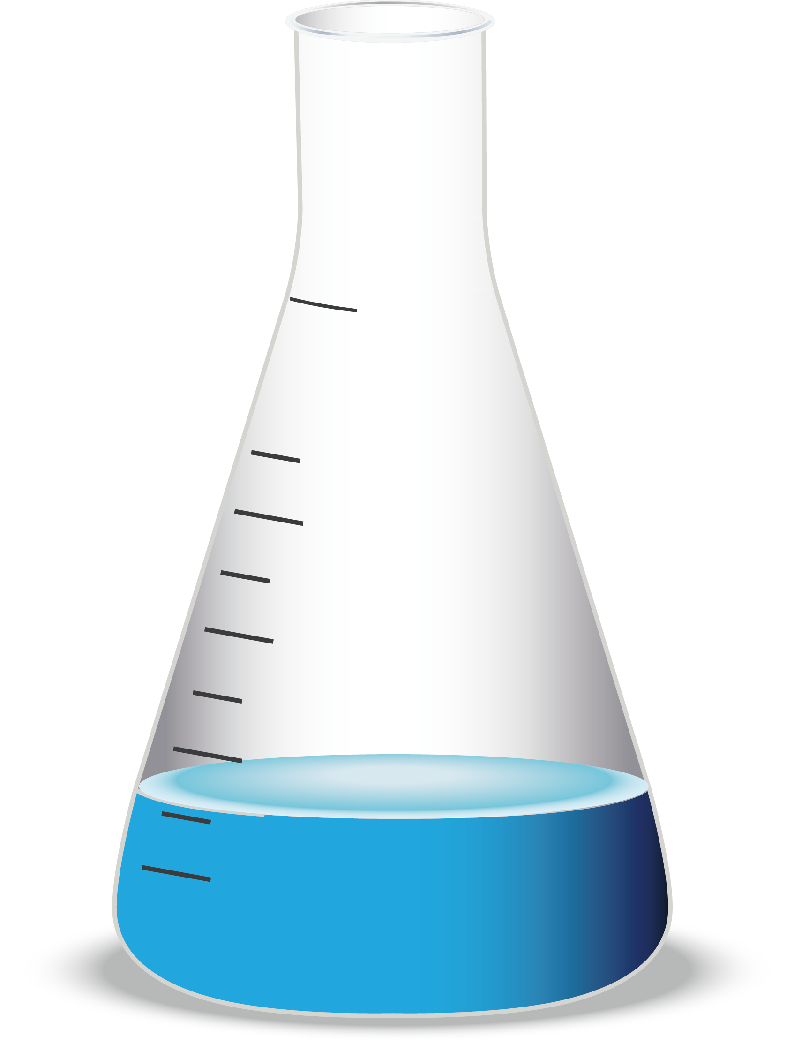
◆ WHAT IS “WATER QUALITY” ?
1. Physical characteristics:
Colour & Aesthetic properties;
Turbidity;
Odour;
Taste;
Temperature;
pH;
Electrical conductivity; and
Radiological properties.
Characteristics that are measurable and that describe the physical state of water.
2. Chemical characteristics:
Gasses: e.g. oxygen & carbon dioxide;
Metals: e.g. iron & aluminium;
Nutrients: e.g. nitrogen & phosphorus;
Pesticides: e.g. atrazine & endosulfan; and
Other organics: e.g. polychlorinated biphenyls.
Product of the substances that are dissolved in water.
WATER
QUALITY
3. Biological characteristics:
Bacteria: e.g. Escherichia coli;
Viruses: e.g. Rotavirus;
Protozoans: e.g. Cryptosporidium;
Phytoplankton, i.e. microscopic algae;
Zooplankton, i.e. tiny animals; and
Insects, Plants & Fish.
Living organisms that occur in water.

Slide 6
❖ WHAT IS MEANT BY “MANAGEMENT” ?
PLAN
DO
the Shewhart & Deming
MANAGEMENT
cycle
ACT
CHECK

Slide 7
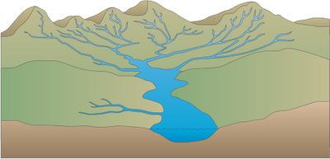
⬥ WHAT DOES “WATER QUALITY MANAGEMENT” ENTAIL ?
Data Acquisition & Information Management
Institute the Pollution Decision-Making Hierarchy
Catchment Assessment
Avoid
Water Quality Modelling
Minimise
Rehabilitate
Plan
Load Balances & Load Objectives Determination
Do
Differentiated use
Concentration Objectives Determination
Offset
WQ Foresight, WQ Reconciliation,
Scenario Evaluation & Management Options Analysis
Self-Regulation
Command
& Control
Fiscal Regulation
Strategy & Plan Development
Participation & Management by shame
Iterative and Continuous
WQ Management Improvement
Corrective Actions, e.g. Directives
Compliance Monitoring
Capacity Building
Sources of Impacts
Resource Quality
Enforcement / Prosecution
Local, Regional, National & Trans-boundary
Monitoring Programmes
Adjusting of the Operating Rules of WR systems
Act
Check
E.g. National Chemical, Microbial, Eutrophication, Toxicity, Radioactivity & Ecosystem Health
Monitoring Programmes
Infrastructure Interventions
Research
Performance Evaluation & Audits
Management Review, e.g. Policy Review
Implementation Committees

Slide 8
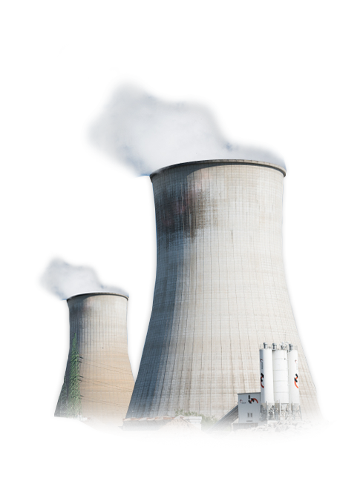
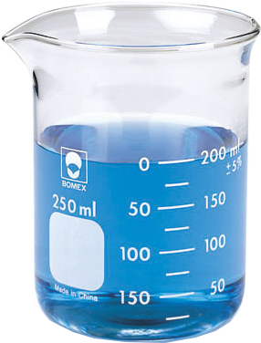
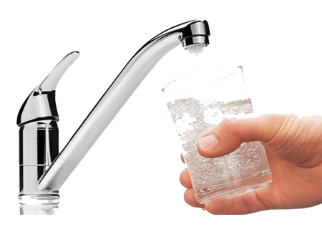
DIFFERENT WATER USERS REQUIRE DIFFERENT QUALITIES OF WATER
≈
WATER QUALITY
WATER QUALITY
?
Water for
Power
Generation
Water for
Human
consumption
How do we know when WQ is GOOD or BAD

Slide 9
EVOLUTION OF WATER QUALITY MANAGEMENT POLICY
Irrigation orientated
(quantity allocation)
Gen. & Spec. Standards
WQ criteria for aquatic
ecosystems
I&CoWA 8:1912
RWQO Approach
NWA 36:1998
WA 54:1956
SAWQGs
RQOs
1652
Balanced
Approach
1912
1956
1991
1996
1996
1998
1961/ 1984
SOURCE
FOCUSSED
MORE
RESOURCE
FOCUSSED

Slide 10
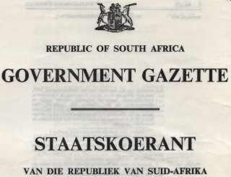
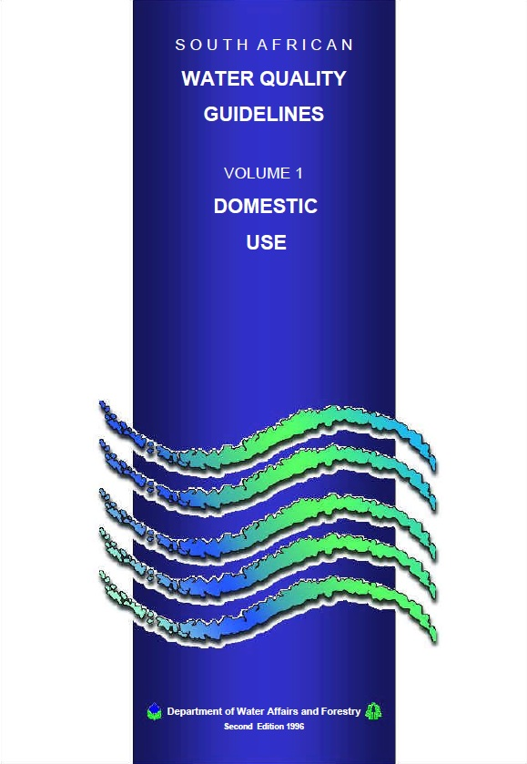

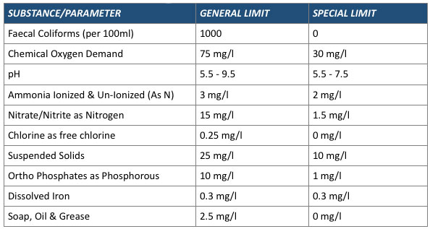


THE DIFFERENCE BETWEEN WQ OBJECTIVES & WQ STANDARDS
Water Quality Standards constitute rules or limits that are established for regulatory purposes.
Water Quality Objectives are utilised in planning and strategic activities as a concrete result that needs to be attained over time.
EXAMPLES
Potable
Water Quality
Standards
Resource Quality Objectives
Uniform Effluent
Standards
(Reg. 991 : 1984)
SA Water Quality
Guidelines
(7x Volumes : 1996)

Slide 11

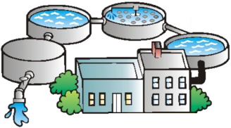

THE WATER SUPPLY VALUE CHAIN AND WQ BENCHMARKING
Relevant
Water Quality
standards
(e.g. SANS 241)
Relevant
Water Quality
standards
(as per municipal Bylaws)
Relevant
Water Quality
standards or limits
(e.g. as per license or
General Authorisation)
Relevant in-stream / in-aquifer
Water Quality
management objectives
Relevant in-stream / in-aquifer
Water Quality
management objectives
Municipal
Water
Supply
Municipal
Waste Water
Treatment
Supplying
Water
Resource
Water
Supply
Return-flow
Water
Receiving
Water
Resource
Raw
Water
Use
Waste
Water
Treatment
KEY
Objectives or standards to
benchmark Water Quality against
Applicable to water resources
Applicable to end-of-pipe discharges of water containing waste
to municipal Waste Water Treatment Works
Applicable to municipal water supply
Applicable to end-of-pipe discharges of water containing waste
to water resources

Slide 12
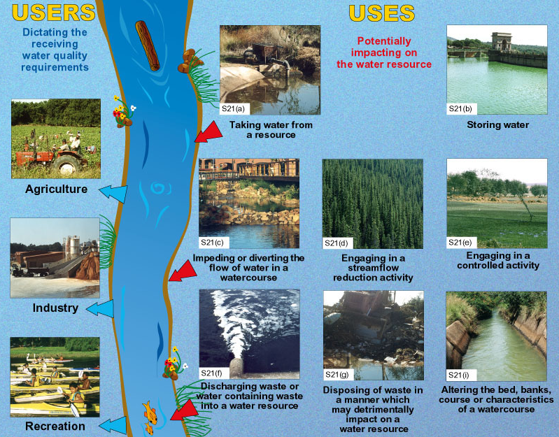

Slide 13
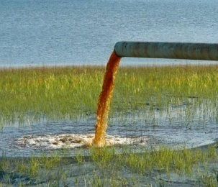
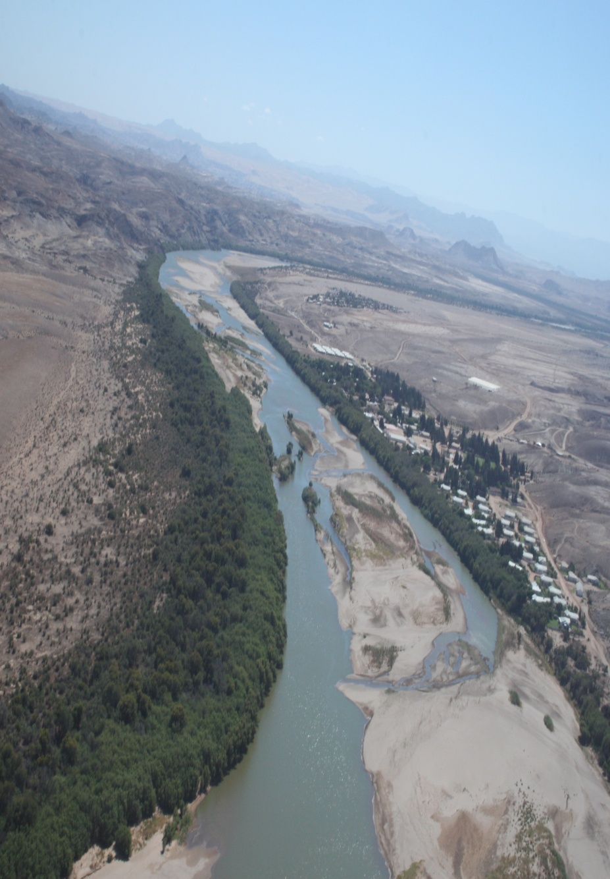

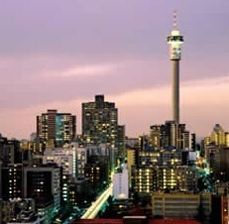
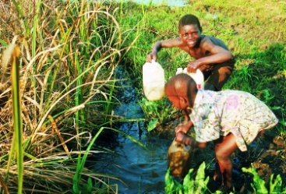
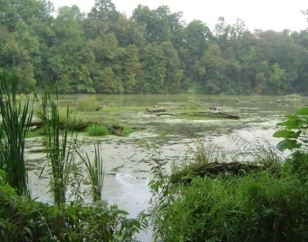
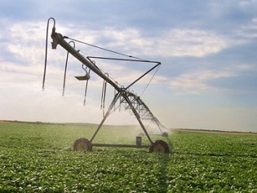
RWQOs & SUSTAINABLE WATER USE
Upstream Water Uses
(S21 of the NWA)
Taking water from the resource
Discharge of water containing waste
Impeding or diverting the flow of water
Upstream
RWQOs:
Balance between need to meet downstream user requirements & and allowing upstream use and development.
RWQO
Downstream
Downstream Water Users
(SAWQGs,1996 & WRC Domestic Use Guideline, 1998)
Domestic
Agriculture
Industry
Recreation
Aquatic Ecosystems

Slide 14
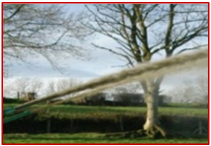
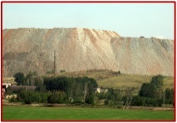
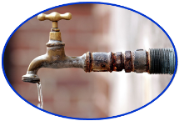
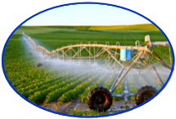
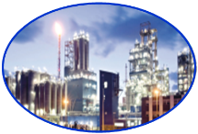

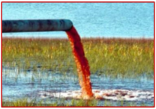
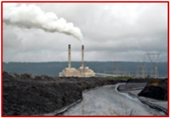
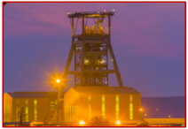
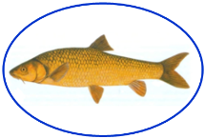
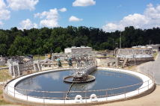

HIGH-LEVEL WQM MASTER PLAN TARGETS
SOURCE
WATER QUALITY MANAGEMENT
(Source Control)
INTEGRATED
WATER QUALITY MANAGEMENT
RESOURCE
WATER QUALITY MANAGEMENT
Disposal to land
Domestic
Use
Agriculture
Section 21(e)
Section 21(g)
Informed by SDG 6
(Indicators 6.5.1 & 6.5.2)
TARGET 3: By 2030, integrated Water Quality Management shall be implemented at all levels,
including the trans-boundary (international), national,
Water Management Area (WMA) and sub-catchment levels.
WATER USES
Industry
WATER
USERS
Recreation
Discharge to a water resource
Aquatic
Ecosystem
Section 21(f)
Section 21(h)
Section 21(j)
Discharge or disposal via a third party
Schedule 1(1)(f)
Informed by SDG 6
(Indicator 6.3.2)
Informed by SDG 6 (Indicator 6.3.1)
TARGET 1: By 2030, water
in, or from water resources
shall be fit for use.
TARGET 2: By 2030, all waste/ water containing waste
generated by households and by economic activities
shall be disposed of/ discharged lawfully and safely.
WATER RESOURCE

Slide 15

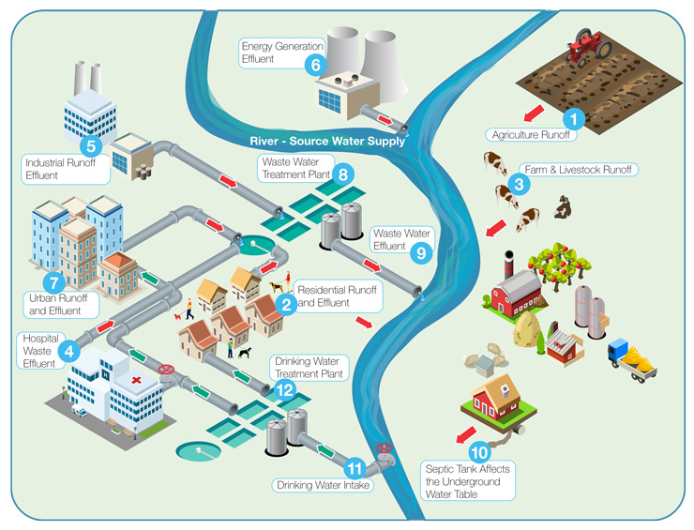
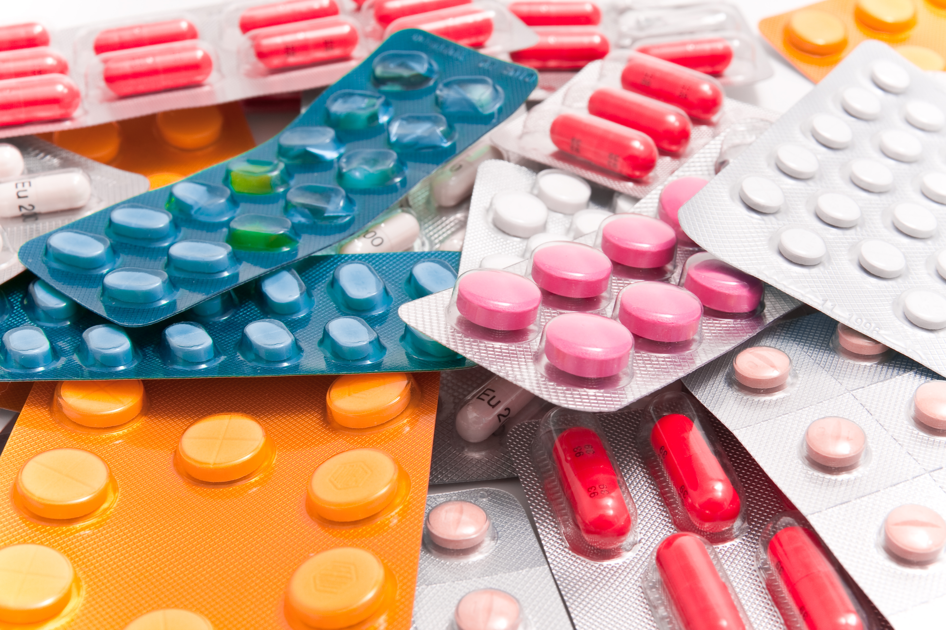

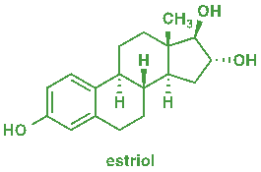

EMERGING POLLUTANTS
Any synthetic or naturally occurring chemical, or microorganism that is not commonly monitored in the environment, but has the potential to enter the environment and cause known or suspected adverse ecological and/ or human health effects.
Definition
Antibiotics
Persistent Organic Pollutants (POPs)
Endocrine Disrupting Chemicals (EDCs)
Nanoparticles (1-100 nm ø)
Notes:
1. Agriculture Pesticide Runoff
Crop treatments (pesticides and fertilizers)
2. Residential Runoff & Effluent
Human waste (Pharmaceutical and Personal Care Products (PPCPs), hormones, steroids, antibiotics and endocrine disrupters), storm water contamination (PFCs and petroleum-based products), pharmaceutical disposal
3. Farm & Livestock Runoff
Veterinary drugs (hormones, steroids and antibiotics), animal waste (microbial pathogens)
4. Hospital Waste Effluent
Medical and dental treatment waste (PPCPs, hormones, steroids and antibiotics)
5. Industrial Runoff & Effluent
Manufacturing by-products and process waste, building material contamination (BFRs, VOCs, PFCs, PCBs, petroleum-based products and nanoparticles)
6. Energy Generation Effluent
Process waste, contaminated fly ash and flue gas, toxic metals (vanadium), inorganic contaminants (bromides)
7. Urban Runoff & Effluent
Construction waste, building material contamination, pet waste (metabolic, vet drug excretion and microbial pathogens)
8. Waste Water Treatment Plant
PPCPs, hormones, steroids and antibiotics, disinfection by-products, nutrients (nitrogen and phosphorus), nanoparticles
9. Waste Water Effluent
PPCPs, hormones, steroids and antibiotics, disinfection by-products, nutrients (nitrogen and phosphorus), nanoparticles
10. Septic tank affects the underground water table
Untreated human waste from poorly contained septic leach fields (microbial pathogens, PPCPs and endocrine disrupters)
11. Drinking Water Intake
Disinfection by-products, hormones, steroids and antibiotics, algal blooms (cyanotoxins), pesticides, nanoparticles, nutrients (nitrogen and phosphorus)
12. Drinking Water Treatment Plant
Disinfection by-products, hormones, steroids and antibiotics, algal blooms (cyanotoxins), pesticides, nanoparticles, nutrients (nitrogen and phosphorus)

Slide 16
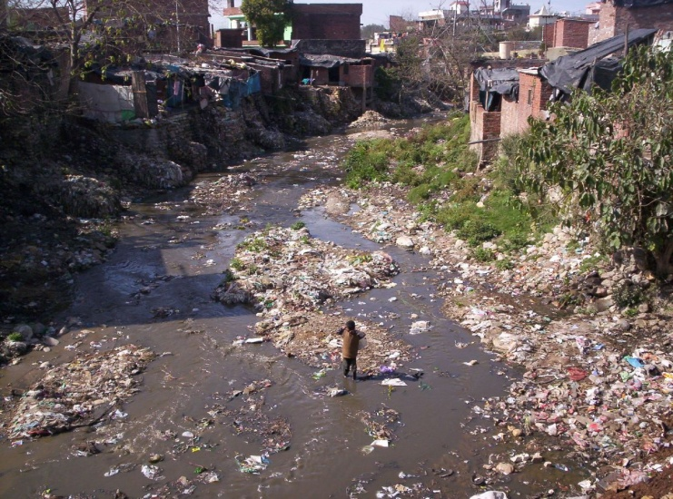
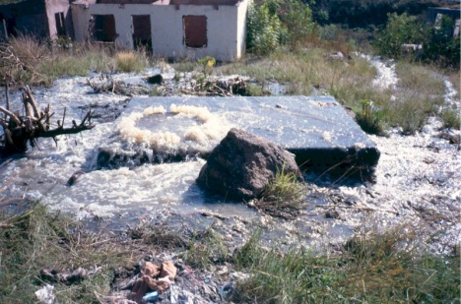
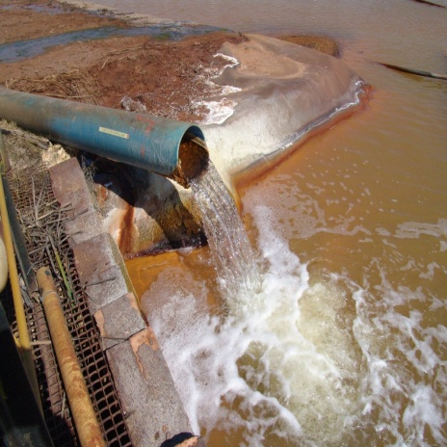
WATER QUALITY ISSUES IN SOUTH AFRICA
Most predominant issues of concern:
  Nutrients;
  Salts;
  Microbial contamination;
  Urban Runoff & Litter;
  Sedimentation/ Siltation.
  Other issues that have been identified are:
  Acidification or Alkalization;
  Metals;
  Radiological pollution;
  Thermal pollution;
  Antibiotics & Antimicrobial substances (Emerging Pollutant);
  Nanoparticles & Micro-plastics (Emerging Pollutant);
  Endocrine Disrupting Chemicals (EDC) (Emerging Pollutant);
  Persistent Organic Pollutants (POPs), (Emerging Pollutant).

Slide 17
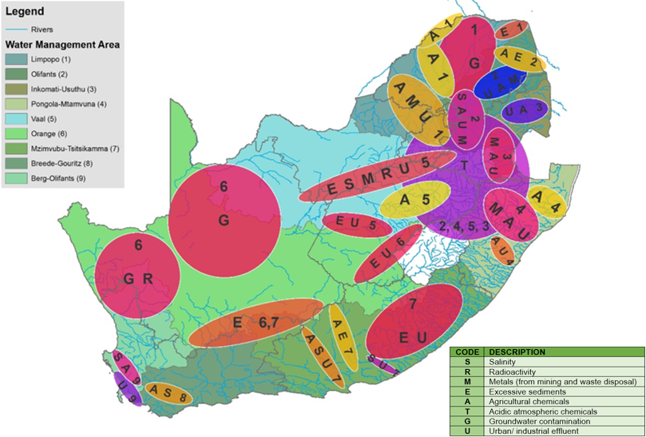
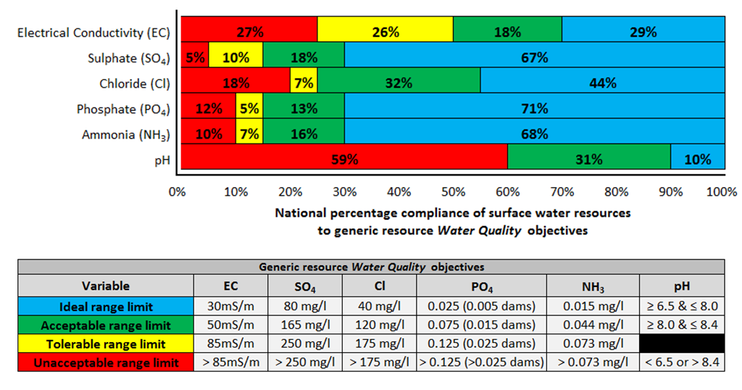
WATER QUALITY PROBLEMS ACROSS SOUTH AFRICA

Slide 18
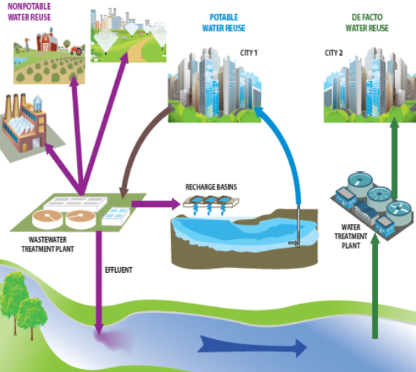
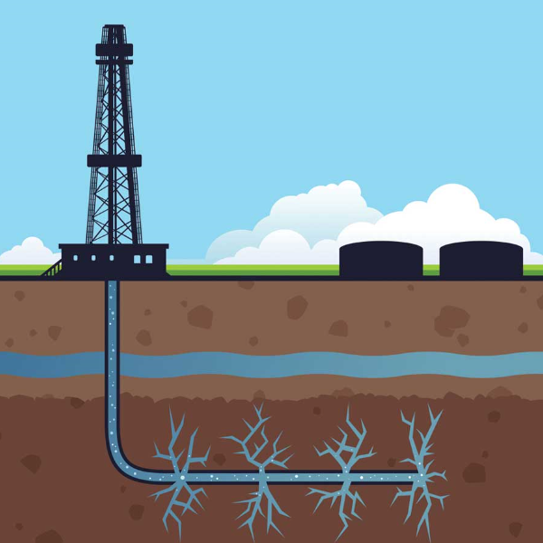
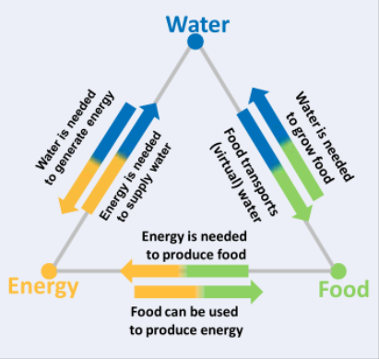

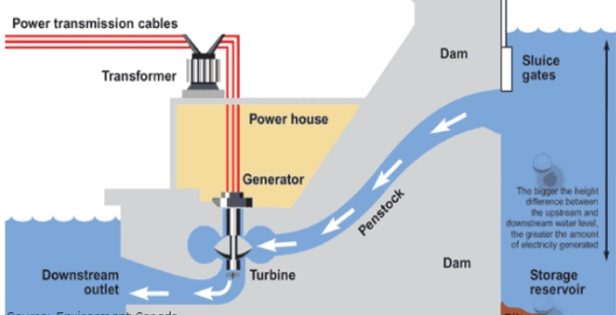
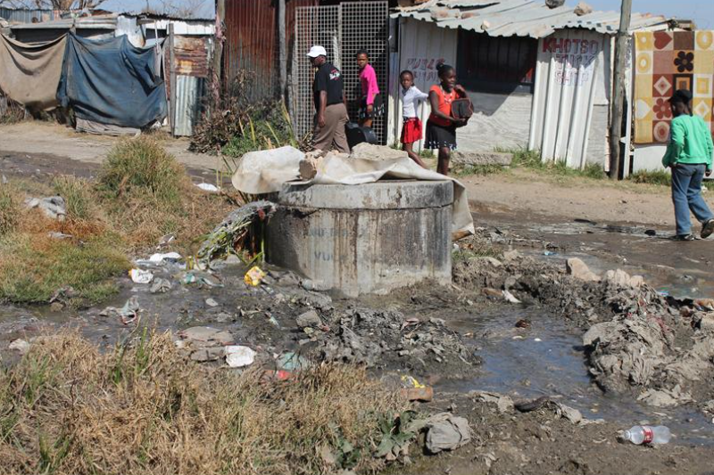
“MEGA-TRENDS” THAT MAY AFFECT WQ IN TIME TO COME
Hydraulic Fracturing
Water-Energy-Food Nexus
Water Re-use
Renewable Energy
Climate Change
Poorly Serviced Dense Settlements

Slide 19

CONSERVATIVE VS. NON-CONSERVATIVE POLLUTANTS (1)
nitrate
nitrogen
(NO₃⁻)
Point B
Concentration
nitrite
ammonia
nitrogen
nitrogen
(NO₂⁻)
(NH₃⁺)
Time
River AB
Concentration
total
nitrogen
(N)
Distance
Vaal
River
A
B

Slide 20
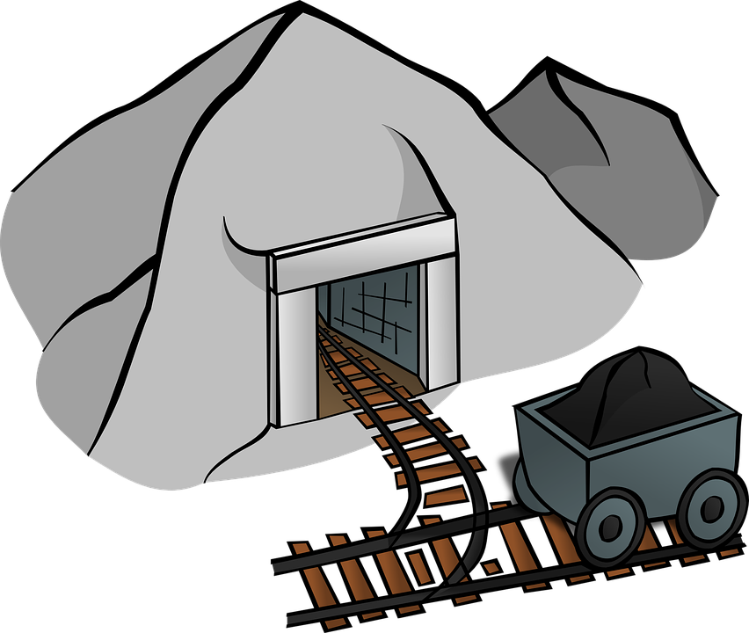
CONSERVATIVE VS. NON-CONSERVATIVE POLLUTANTS (2)
sulphate
(SO₄)
River XZ
Concentration
Distance
Klip
River
Vaal
River
X
Y
Z

Slide 21
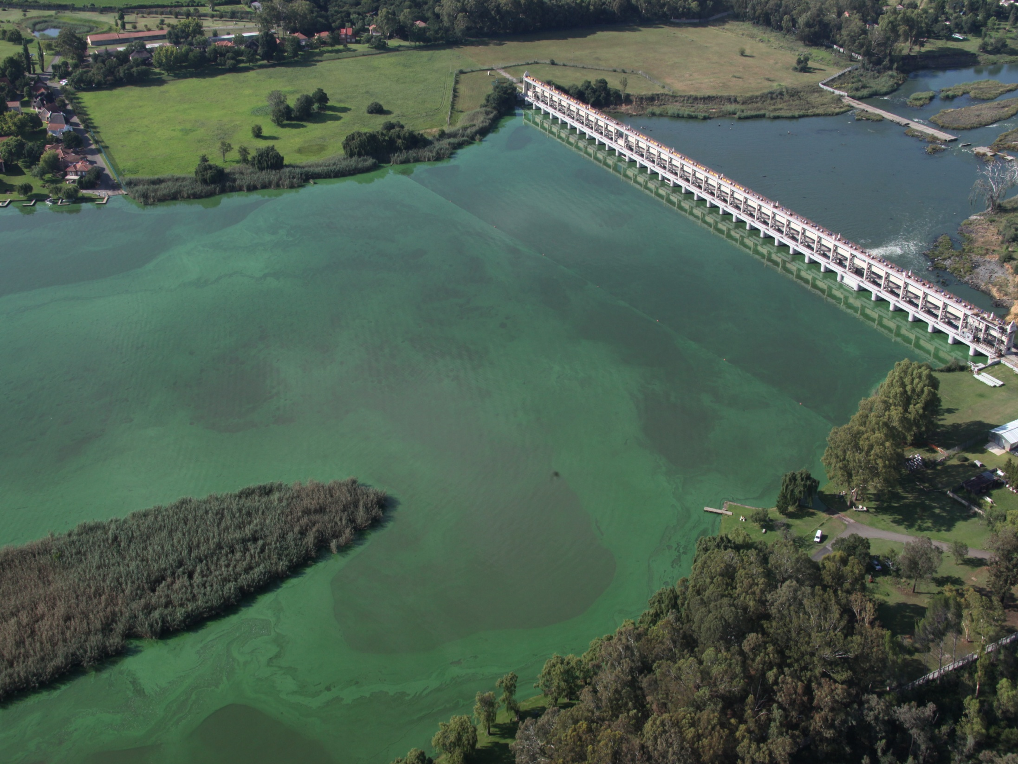
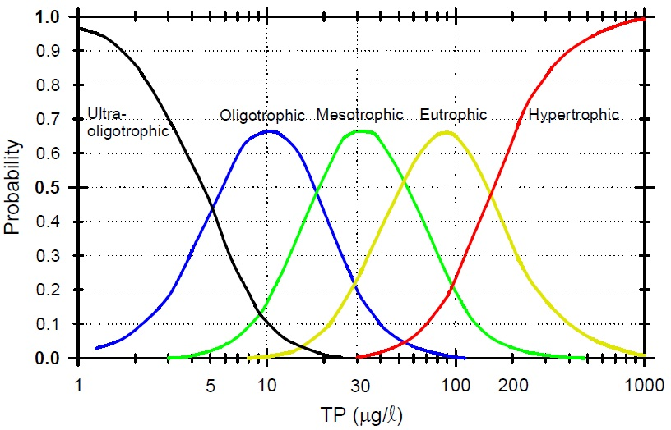
NUTRIENT-LOADING & EUTROPHICATION
Eutrophication: when a body of water becomes overly enriched with nutrients that induce excessive growth of algae, hyacinths, etc.
Vaal Barrage: 26 February 2012

Slide 22
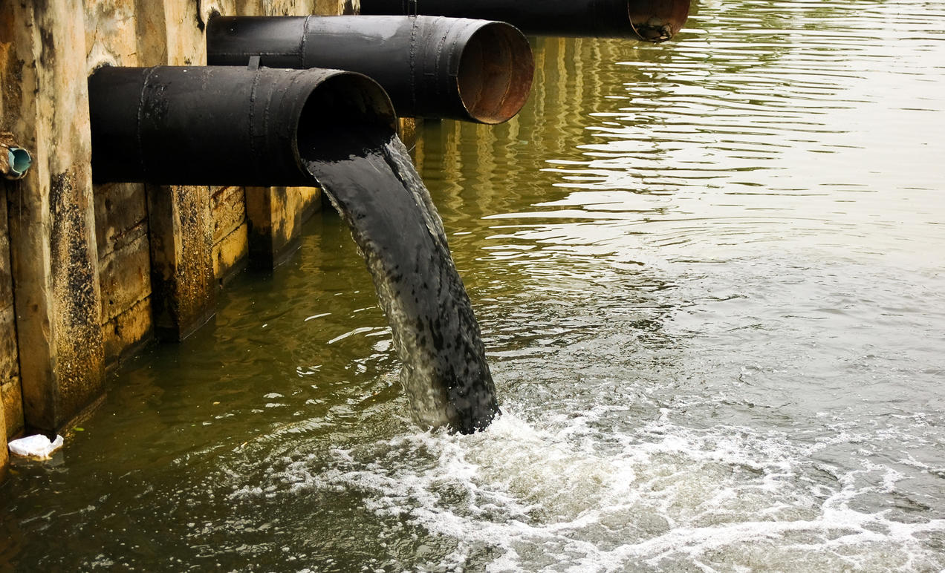
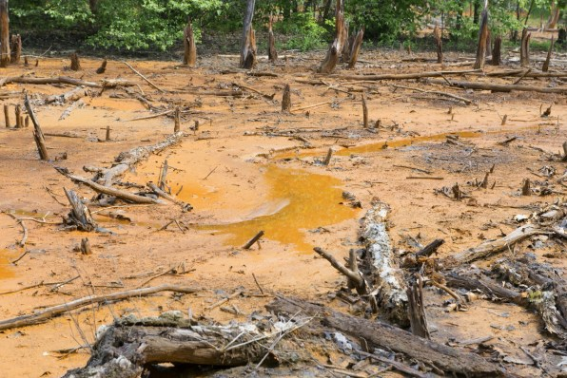
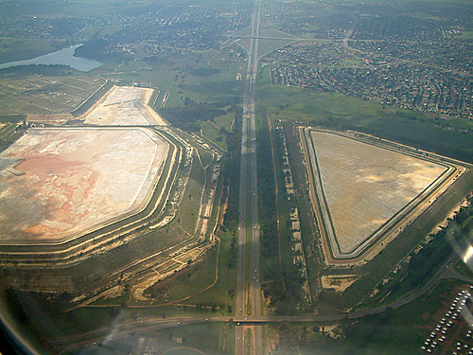








POINT VS. NON-POINT SOURCES OF POLLUTION

Slide 23









CHAIN OF IMPACTS
$$❶$$
Poorly operated & maintained Sewage Works
$$❷$$
Discharge sub-standard effluent
$$❸$$
Nutrient-loading in water resources
$$❹$$
Eutrophic Water Bodies with proliferating biomass production
$$❺$$
$ Impact on Irrigated Agriculture
e.g.
$$❻$$
Input-Cost Increases
PO₄
$$❼$$
Risk to Job Security
Adverse Socio- Economic Consequences
$$❽$$

Slide 24
2. WQ IMPACTS FROM
AGRICULTURE & URBAN CENTRES

Slide 25

WATER PURIFICATION
Water treatment is any process that improves the quality of water to make it more acceptable for a specific end-use. The end use may be drinking, industrial water supply, irrigation, water recreation or many other uses, including being safely returned to the environment.
 Substances that are removed during the process of drinking water treatment include suspended solids, bacteria, algae, viruses, fungi, and minerals such as iron and manganese.
 The processes involved in removing the contaminants include physical processes such as settling and filtration, chemical processes such as disinfection and coagulation and biological processes such as slow sand filtration.
Notes:
Taste and Odour Removal
Taste and odours occur in the water in the late summer or fall. Naturally occurring organic matter decomposes in the raw water source, and causes taste and odours. Carbon or potassium permanganate is added to the water to remove or reduce unpleasant taste and odour.
Disinfection
As the water enters the treatment plant, chlorine dioxide is added for disinfection. Disinfection destroys bacteria and viruses. Chlorine is added to the water as it leaves the treatment plant to ensure that the water that enters your home is safe to drink.
Flocculation
Aluminum sulphate (alum) is mixed into the water. The alum causes small impurities to stick together and form "floc".
Sedimentation
The floc settles to the bottom of the basin, and is removed. Chlorine is also added during this process for further disinfection.
Filtration
Water flows through filters that are made of layers of sand and coal. These filters remove the fine particles that did not settle out during sedimentation.
Final Backwash
To remove particles from the filters, the filters are backwashed to remove sediment every 60 - 72 hours. Approximately 200,000 gallons of water is used to backwash a filter. This water is then recycled back into the raw water supply. Fluoridation
The raw water has naturally occurring fluoride, however, the Centre for Disease Control (CDC) recommends an optimum fluoride level. This requires the city to add supplement fluoride.
Storage
Water is stored in reservoirs throughout the City. The distribution system brings the water to consumers.

Slide 26

WASTE WATER TREATMENT
Wastewater treatment is a process used to convert dirty wastewater into an effluent that can be returned to the water cycle with minimum impact on the environment, or directly reused. The latter is called water reclamation because treated wastewater can then be used for other purposes.
 Substances that are removed during the process of waste water treatment include suspended solids, heavy metals, organic compounds, oils & greases, bacteria, algae, viruses, fungi, and salts such as chlorides.
Notes:
Taste and Odour Removal
Taste and odours occur in the water in the late summer or fall. Naturally occurring organic matter decomposes in the raw water source, and causes taste and odours. Carbon or potassium permanganate is added to the water to remove or reduce unpleasant taste and odour.
Disinfection
As the water enters the treatment plant, chlorine dioxide is added for disinfection. Disinfection destroys bacteria and viruses. Chlorine is added to the water as it leaves the treatment plant to ensure that the water that enters your home is safe to drink.
Flocculation
Aluminum sulphate (alum) is mixed into the water. The alum causes small impurities to stick together and form "floc".
Sedimentation
The floc settles to the bottom of the basin, and is removed. Chlorine is also added during this process for further disinfection.
Filtration
Water flows through filters that are made of layers of sand and coal. These filters remove the fine particles that did not settle out during sedimentation.
Final Backwash
To remove particles from the filters, the filters are backwashed to remove sediment every 60 - 72 hours. Approximately 200,000 gallons of water is used to backwash a filter. This water is then recycled back into the raw water supply. Fluoridation
The raw water has naturally occurring fluoride, however, the Centre for Disease Control (CDC) recommends an optimum fluoride level. This requires the city to add supplement fluoride.
Storage
Water is stored in reservoirs throughout the City. The distribution system brings the water to consumers.

Slide 27




WWT APPLICATIONS: AGRICULTURE

Slide 28





WWT APPLICATIONS: SEWAGE
Kameelmond WWTWs
Abraham Holbors September WWs
± 16 Ml/d

Slide 29


WWT APPLICATIONS: INDUSTRIAL

Slide 30






WWT APPLICATIONS: LEACHATE

Slide 31
WATER RETURN-FLOWS, RE-USE AND RE-CYCLING
Environmental flow
Agricultural use
direct re-use
Urban and community use
direct re-use
Urban and community use
Natural recharge
recycling
indirect re-use
return-flow
Industrial use
return-flow
Industrial use
return-flow
return-flow
indirect re-use
Water Resource
(surface water/
groundwater)
river / stream flow
Water Resource
(surface water/
groundwater)
river / stream flow
Ocean
discharge
recycling
return-flow
Mining use
Environmental flow
return-flow
indirect re-use
return-flow
Note: This figure does not show all possible water use, re-use and recycle scenarios, but demonstrates the concepts.
Agricultural use
Mining use

Slide 32


THE BLUE DROP & GREEN DROP SYSTEM
CRITERIA
1 | Water Safety and Security Plan
2 | Operational staff
3 | Drinking Water Quality Monitoring Programme
4 | Drinking Water Quality Sample Analysis
5 | Submission of Drinking Water Quality Results
6 | Drinking Water Quality Compliance
7 | Management of Drinking Water Quality Failures
8 | Publication of Drinking Water Quality Performance
9 | Drinking Water Asset Management
CRITERIA
1 | Operational Staff
2 | Waste Water Quality Monitoring Programme
3 | Waste Water Quality Sample Analysis
4 | Submission of Waste Water Quality Results
5 | Waste Water Quality Compliance
6 | Management of Waste Water Quality Failures
7 | Stormwater Management
8 | Bylaws
9 | Waste Water Treatment Works Capacity
10 | Publication of Waste Water Quality Performance
11 | Waste Water Asset Management
Municipal
Water
Supply
Municipal
Waste Water
Treatment
Supplying
Water
Resource
Water
Supply
Return-flow
Water
Receiving
Water
Resource
Water Supply Value Chain
Raw
Water
Use
Waste
Water
Treatment

Slide 33


DESALINATION: REVERSE OSMOSIS (RO)

Slide 34

DESALINATION: ION EXCHANGE

Slide 35

DESALINATION: ELECTRO-DIALYSIS REVERSAL (EDR)

Slide 36
WQ IMPACTS: URBAN & AGRICULTURAL RETURN-FLOWS
Sector | Main Associated Contaminant
Urban Centres | Toxins Nutrients Salts Microbial contaminants EDCs Antibiotic & Antimicrobial resistance
Agriculture | Salts Nutrients Microbial contaminants Toxins POPs (pesticides & herbicides) EDCs

Slide 37

REGULATION
How does the Department regulate urban and agricultural pollution?
What measures can be taken by impactors?

Slide 38

GENERAL & SPECIAL WATER QUALITY STANDARDS
Government Gazette: 18 May 1984 (No. 9225)
Regulation No. 991
REQUIREMENTS FOR THE PURIFICATION OF WASTE WATER OR EFFLUENT:
GENERAL STANDARDS
SPECIAL STANDARDS
Maximum concentration in mg/l
Residual chlorine (as CP)……….………… 0,1
Free and saline ammonia (as N) ………… 10,0
Arsenic (as As) …………………….……..… 0,5
Boron (as B)…………………………………. 1,0
Hexavalent chromium (as Cr)………….…. 0,05
Total chromium (as Cr)………………….…. 0,5
Copper (as Cu)………………………………. 1,0
Phenolic compounds (as phenol)……….. 0,1
Lead (as Pb)………………………………….. 0,1
Cyanides (as Cn)…………………………..... 0,5
Sulphides (as S)…………………………..… 1,0
Fluoride (as F)……………………………….. 1,0
Zinc (as Zn)…………………………………... 5,0
Manganese (as Mn)…………………………. 0,4
Cadmium (as Cd)……………………………. 0,05
Mercury (as Hg)……………………………… 0,02
Selenium (as Se)…………………………….. 0,05
Maximum concentration in mg/l
Free and saline ammonia (as N)…………. 1,0
Nitrates (as N)……………………………….. 1,5
Arsenic (as As)………………………………. 0,1
Boron (as B)………………………………….. 0,5
Total chromium (as Cr)……………………... 0,05
Copper (as Cu)……………………………….. 0,02
Phenolic compounds (as phenol)………… 0,01
Lead (as Pb)…………………………………… 0,1
Soluble ortho phosphate (as P)…………… 1,0
Iron (as Fe)……………………………………. 0,3
Manganese (as Mn)………………………….. 0,1
Cyanides (as Cn)…………………………….. 0,5
Sulphides (as S)……………………………… 0,05
Fluoride (as F)………………………………… 1,0
Zinc (as Zn)……………………………………. 0,3
Cadmium (as Cd)………………………......... 0,05
Mercury (as Hg)…………………………….... 0,02
Selenium (as Se)……………………………... 0,05
Soluble orthophosphate (as P)……………. 1.0

Slide 39

COMPLIANCE MONITORING & ENFORCEMENT

Slide 40
3. WQ IMPACTS FROM
MINING & INDUSTRY

Slide 41





THE CLASSIFICATION OF MINES ACCORDING TO POTENTIAL IMPACT
All gold and coal mines;
Any mine with any kind of extractive metallurgical process, including heap leaching; and
Any mines where pyrite could occur in the mineral deposits.
+
Category A
Mines:
e.g.
Category B
Mines:
Mines with a low risk for water quality impacts; and
Mines with a potential significant and/ or permanent impact on the yield/ availability of water, dynamics of the river, riparian rights, etc.
e.g.
Category C
Mines:
Big mines with no significant impact on water, where Resources Quality Objectives for ideal conditions will be realised; and
Small low impacting mines.
e.g.
+
# Depending on the change in mine operation, mine might be re-categorised.

Slide 42

WHAT IS AMD ?

Slide 43

MINING LEGACY ???

Slide 44

ECONOMIC LEGACY !!!

Slide 45

ENVIRONMENTAL LEGACY !!!

Slide 46




MINING IMPACTS (1)
Slimes Dam: Operation & Maintenance
Largo Colliery: Sinkhole Formation
Base Map: East Rand
Base Map: East Rand

Slide 47







MINING IMPACTS (2)
Base Map: Kathu, Northern Cape
Base Map: Kathu, Northern Cape

Slide 48








MINING IMPACTS (3)
Gamsberg, Aggenys: Sensitive Ecosystem
Gamsberg: Northern Cape
Base Map: Northern Cape

Slide 49
WQ IMPACTS: MINE WATER RETURN-FLOWS
Sector | Main Associated Contaminant
Mining | Salts pH changes (acidification & alkalisation) Metals Toxins Radiation
Industry | Salts Thermal contamination Toxins & POPs

Slide 50
GOVERNMENT NOTICE 704
Currently under review
Focus is on pollution prevention
Contains stringent measures & prescriptive controls for mining water issues:
  From prospecting to closure;
  1:100 year and 1:50 year flood lines;
  Obstruction of water pathways;
  Clean and dirty water separation;
  Re-use, reduce, recycle;
  Prohibits groundwater pollution (backfilling of mine);
  Closure rehabilitation; and
  Financial guarantees.

Slide 51
DUTY OF CARE
S.19 deals with situations where pollution of a water resource occurs or might occur as a result of activities on land;
The person who owns, controls, occupies or uses the land in question is responsible for taking measures to prevent pollution of water resources; and
If these measures are not taken, the CMA concerned may itself do whatever is necessary to prevent the pollution or to remedy its effects, and to recover all reasonable costs from the persons responsible for the pollution.

Slide 52
WATER QUALITY
MONITORING & PLANNING

Slide 53

MONITORING – KEY TO EFFECTIVE MANAGEMENT
Goal setting
Planning
Strategy development
& Intervention planning
Assessment
Information
Monitoring
Strategy implementation
Inter alia through Regulation
Data
Compliance monitoring
& enforcement
Management
KEY
Water Quality Management value chain
components
Benefit
Management is an iterative process
Net result of the Water Quality Management
value chain

Slide 54





SPATIAL SCALES OF MONITORING & MONITORING PROGRAMMES
Trans-Boundary RQ Monitoring Programmes
Global Environmental Monitoring System (GEMS)
National Chemical Monitoring Programme,
National Microbial Monitoring Programme,
National Eutrophication Monitoring Programme,
National Toxicity Monitoring Programme,
National Radioactivity Monitoring Programme, &
National Ecosystem Health Monitoring Programme
Regional RQ Status Monitoring Programmes
Water Services Monitoring Programmes
Urban Catchment RQ Monitoring Programmes
Water Use Monitoring
Programmes
Source Specific
Local
Water Management Area
National
International

Slide 55

Reserve?
RQOs?
RWQOs?
WQ Guidelines?
Class?
for the Waterval Catchment
Class: Protection and management class for a significant water resource, as determined through the classification system, that inform RQOs. Preliminary class is a class that has not yet been Gazetted.
Reserve: The quantity and quality of water required to satisfy basic human needs and to protect aquatic ecosystems, that may influence RQOs.
RQOs: Numeric or descriptive (narrative) goals for resource quality within which significant water resource must be managed (S.13, NWA 36:1998). RQOs relate to the Class and may be influenced by the Reserve. These are given legal status by being published in a Government Gazette.
WQGs: Specify concentrations for selected water quality variables which, if not exceeded, are expected to permit specific water user groups to continue unimpaired at variable levels of protection.
RWQOs: Numeric or descriptive (narrative) in-stream (or in-aquifer) WQ management objectives, typically set a finer resolution (spatial or temporal) than RQOs that provide greater detail upon which to base the management of water quality. Also referred to as Water Quality Planning (WQP) Limits.

Slide 56
REGIONAL WQ MONITORING SITES VS. IN-STREAM WQ OBJECTIVES
3
RWQO (a)
RWQO (b)
4
3
4
3
3
RWQO (B)
RWQO (A)
2
2
4
1
1
1
3
3
1
RWQO (1)
RWQO (2)
RWQO (3)
RWQO (4)
MU 1
MU 2
Levels of WQ monitoring | Description
1 | Strategic status and trends monitoring
2
3 | Impact & licence compliance monitoring
4

Slide 57
REGIONAL WQ MONITORING SITES VS. IN-STREAM WQ OBJECTIVES
S 15, NWA 36:1998 The Minister, the Director‑General, an organ of state and a water management institution, when exercising any power or performing any duty in terms of this Act, must give effect to any determination of a class of a water resource and the resource quality objectives as determined in terms of this Part and any requirements for complying with the resource quality objectives.
3
RWQO (a)
RWQO (b)
4
3
4
3
3
RWQO (B)
RWQO (A)
2
2
4
1
1
1
3
3
1
RWQO (1)
RWQO (2)
RWQO (3)
RQO
MU 1
MU 2
CLASS
CLASS
Levels of WQ monitoring | Description
1 | Strategic status and trends monitoring
2
3 | Impact & licence compliance monitoring
4

Slide 58

ALLOCATABLE WATER QUALITY
Data Acquisition & Information Management
Catchment Assessment
Water Quality Modelling
Plan
Load Balances & Load Objectives Determination
Concentration Objectives Determination
WQ Foresight, WQ Reconciliation,
Scenario Evaluation & Management Options Analysis
Strategy & Plan Development

Slide 59



WATER QUALITY PLANNING

Slide 60
WATER QUALITY MODELLING
What is a water quality model?
A mathematical representation of pollutant fate, transport, and degradation within a water body;
OR
A mathematical representation of the movement of pollutants from land-based sources to a water body.
Model Calibration
◆ The procedure of adjustment of parameter values of a model to reproduce the response of reality within the range of accuracy consistent with the intended application of the model.
Model Validation
◆ Substantiation that a model within its domain of applicability possesses a satisfactory range of accuracy consistent with the intended application of the model.

Slide 61
GENERAL CLASSIFICATION OF WATER QUALITY MODELS
BY TYPE OF APPROACH:
BY SIMULATED WATER BODY:
BY POLLUTANT ITEM:
Conceptual
River
Nutrients
Mechanistic
Estuaries
Sediments
Empirical
Reservoirs & Lakes
Salts
Groundwater
BY FUNCTION OF POLLUTANTS:
Water quality in runoff
Point source pollution
Non-point source pollution
BY STATE ANALYSED:
BY DIMENSIONS:
Steady state
1x Dimensional
BY NATURE:
Dynamic Simulation
2x Dimensional
Deterministic models
Salts
3x Dimensional
Stochastic models
Notes:
Mechanistic models: Models that by means of mathematical tools express the mechanisms of the process that cause changes on water quality and lead to establish the "cause-and-effect“ relationship.
Empirical models: Purely empirical models, such as many statistical models, allow description of the fixed relationships between input data and output results with a minimum of understanding bout how the system works. One of the principal restrictions of the empirical models is that they cannot be readily implemented for other close systems.
Deterministic models: Deterministic models have a fixed relationship between input data and output results, which may be empirical or mechanistic.
Stochastic models: Stochastic models contain some random elements. They are divided into: steady-state Monte-Carlo simulation models, using a mass balance model, which generate an output result with varying input conditions in the form of a frequency distribution of the pollutant concentration, and dynamic time series simulation models, using a dynamic finite difference model.

Slide 62
CREATION OF WATER QUALITY MODELS
1. Formulation of objectives
2. Review of theoretical background
3. Formulation of the model
4. Creation of a model structure
5. Formulation of equations
6. Formulation of methods of solution
7. Selection of a computer code
8. Calibration of the model
9. Validation of the model
10. Statistical assessment of paired observations and simulations
11. Sensitivity analysis
Notes:
The main steps of model building may be explained as follows (James, 1996):
1. Formulation of objectives - As more precisely the objectives are formulated, preferably in quantitative terms, the more satisfactory model is possible to be created and adapted;
2. Review of theoretical background - It should include an analysis of the processes affecting water quality, method of representation, and appropriate ranges for any model parameter, review and compile all relevant information at both local and regional scales;
3. Formulation of the model - This step involves a decision about the type of model, elimination of the relationships that do not affect the output results, examination of alternative types of models and careful relationships of base data collection. This information is integrated into a conceptual model, in general through the introduction of simplifying assumptions and qualitative interpretations regarding the flow and the transport process.
4. Creation of a model structure - Generally the process begins by identifying the large subdivisions of a model and proceeds by fitting these together in diagrammatic form with a flow chart. It is better the model to be created from different modules (separated parts) and every part to be developed, tested and calibrated apart.
5. Formulation of equations - On the basis of the review of theory and the model structure it is possible to state the relationships involved in some formal mathematical or statistical way. Adoption of a hierarchical approach to this process often results in a clearer set of equations in which the influence of primary and secondary relations can be more easily appreciated. Some preliminary data may be needed to guide the choice.
6. Formulation of methods of solution - Only in a few special cases it may be possible to solve the equations analytically, but most models involve the use of numerical methods for solving partial differential equations, interpolation, etc. The choice of the appropriate numerical technique is crucial for numerical stability and accuracy and also for minimizing computational effort.
7. Selection of a computer code - The decision depends on the project goals. If a modelling is intended only to provide a first approximation, a simple code may be appropriate. The form of input and output results, and the choice of the language, are in dependence of the available facilities. The simplest programming language is BASIC, which together with QBASIC is a power tool for many modelling purposes.
8. Calibration of the model - It is essential that completely independent data sets are used for the calibration procedure. Calibration is one of the most critical, difficult, and valuable steps in the model application process. After a pollutant transport model is calibrated to a satisfactory degree, it is often applied to predict and simulate the future contaminant migration.
9. Validation of the model - It is impossible to apply the model as representative without suitable proof. The validation of the model depends on the local possibilities. Model validation, evaluation, confirmation, or testing is the process of assessing the degree of reliability of the calibrated model using one or more independent data sets. Ideally it is possible to compare the output results from the model with the observed data.
10. Statistical assessment of paired observations and simulations - The basic statistical parameters and goodness-of-fit criteria are: average error, standard deviation, correlation coefficient, index of agreement, per cent deviation per year by flow and pollutants, and others.
11. Sensitivity analysis -This procedure is used before and after calibration mainly to test the responsiveness and sensitivity of the numerical model to every input parameter. The sensitivity analysis is useful for: examining the likely uncertainty in simulation results due to uncertainty in model input parameters, and examining how well parameters are likely to be estimated from the available data for model calibration. Sensitivity analysis provides important information on how uncertainties in the model parameters affect the model results. If the model results are highly sensitive to a particular parameter, the uncertainty associated with that parameter will significantly affect the ability of the model to make meaningful interpretations and predictions. Sensitivity analysis is the mean of determining the model parameters.

Slide 63



CONCENTRATIONS & WATER QUALITY LOADS
$$V1C1+V2C2+V3C3=C4V4$$
$$(\frac{750 mg}{l}x\frac{500 Ml}{d})+(\frac{100 mg}{l}x\frac{X Ml}{d})+(\frac{500 mg}{l}x\frac{1 Ml}{d})=(\frac{600mg}{l}x \frac{X Ml+500 Ml+1 Ml}{d})$$
$$375 000 ton+100X ton+500 ton=600X ton+300000 ton+600 ton$$
$$500X ton=74900 ton$$
$$X=149.8 Ml/d$$
Modelling fundamentals:
◆ conservation of energy states (first law of thermodynamic);
❖ conservation of mass states (mass balance models); and
⬥ conservation of momentum states (Newton's first law of motion).
C₁ = 750 mg/l TDS
V₁ = 500 Ml/d
C₃ = 500 mg/l TDS
V₃ = 1 Ml/d
River A
C₄ = RQO = 600 mg/l TDS
C₂ = 100 mg/l TDS
V₂ = X Ml/d
V₄ = X Ml/d + 500 Ml/d + 1 Ml/d
River
B

Slide 64
5. MANAGING
WATER RESOURCES, CONSIDERING
WQ RELATED ASPECTS
(GAUTENG AMD CASE STUDY)

Slide 65

KEY PILLARS OF THE VAAL RIVER STRATEGY
► The Vaal River System supply water to 60% of economy and 45% of population.
► To ensure that sufficient water of good quality is available to supply the future requirements of the important area of the VRS a multi-pillar strategy is required:
(1) Eradicate unlawful water use by 2017;
(2) Reduction in water use by 15% through WC/ WDM (focus on loss-management) by 2017;
(3) Augmentation through LHWP#2 by 2022;
(4) Implementation of the IWQMS – Integrated WQM SSC;
Re-use of treated “effluent” (1st: underground mine water return-flows by 2020;
Plan yield replacement scheme in the Orange by 2034;
(7) Manage uncertainties in Crocodile (West) and Olifants; and
(8) Establish a Strategy Steering Committee to facilitate Strategy implementation co-ordination.

Slide 66
SALINITY STATUS: TDS (2006)
900
Douglas
Barrage
800
Bloemhof
Dam
Vaal
700
Barrage
Vaal Dam
600
Grootdraai
Dam
500
TDS (mg/l)
400
300
200
100
0
VS20
VS19
VS18
VS17
VS16
VS14
VS13
VS12
VS11
VS10
VS9
VS8
VS7
VS6
VS5
VS4
VS3
VS2
VS1
Monitoring Point on Vaal River(Level 1)

Slide 67
SUMMARY OF MINE WATER DISCHARGES (2006)
Upper Vaal River, Witwatersrand: (Eastern & Central Basin)
Petrex Gold Mine (Grootvlei) | 72 Ml/ day | 227 ton/ day
ERPM | 20 Ml/ day | 53 ton/ day 280 ton/ day
Upper Vaal River, Mooi River Catchment: (Far Western Basin)
Randfontein Estates | 10 Ml/ day | 8 ton/ day
Driefontein Gold Mine | 26 Ml/ day | 27 ton/ day
Kloof Gold Mine | 34 Ml/ day | 26 ton/ day
Western Areas Gold Mine | 21 Ml/ day | 21 ton/ day
Blyvooruitzicht Gold Mine | 10 Ml/ day | 8 ton/ day 90 ton/ day
Middle Vaal River, KOSH area: (KOSH Basin)
Stilfontein Gold Mine | 37 Ml/ day | 46 ton/ day
Other mines | 13 Ml/ day | 33 ton/ day 79 ton/ day

Slide 68

VAAL RIVER SYSTEM TRANSFERS & RETURN-FLOWS
RUSTENBURG
Vaal Dam
Vaal Barrage
Grootdraai Dam
Bloemhof Dam
Sterkfontein Dam
Proposed
Jana Dam
Katse
Proposed
Mielietuin Dam
Mohale
Proposed Polihali Dam

Slide 69
IWQM STRATEGY FOR THE VAAL RIVER SYSTEM (1)
Interim:
   Allows for the release of partially-treated AMD to the Vaal River system (after neutralisation & removal of metals);
   Dilution releases required from Vaal Dam to comply with the 600 mg/l TDS operating rule set for the Vaal Barrage;
  “Dilution water” mostly used downstream;
  However, the interim scenario will not be sustainable in the longer term !!!

Slide 70
VAAL RIVER SYSTEM WATER BALANCE: INTERIM
High with target WC/WDM | Mine Water: Neutralization and discharge | Unlawful removed
High Water Requirement Scenario with
Water Conservation and Demand Management
Yield reduction due to dilution wastages
Deficit
System
Yield
Polihali Dam Yield
First transfer from LHWP Phase II

Slide 71
VAAL RIVER SYSTEM WATER BALANCE: LONGER TERM
High with target WC/WDM | Desalination of Mine Water | Unlawful removed
High Water Requirement Scenario with
Water Conservation and Demand Management
Polihali Dam Yield
Yield increases due to desalination of mine water
System
Yield
First transfer from LHWP Phase II

Slide 72
IWQM STRATEGY FOR THE VAAL RIVER SYSTEM (2)
In the longer term:
 The return flow volumes from WWTWs are to steadily increase over time;
   Excess “dilution” water in the Vaal River main stem will build up in Bloemhof Dam;
   Salt loading to be curtailed, by first removing the underground mine water induced salinisation;
   Lowering the demand for dilution releases; &
  Delaying the implementation of costly future water supply augmentation options !!!

Slide 73


RELATIVE SALT LOADS REPORTING TO THE VAAL BARRAGE

Slide 74

MOST CONCENTRATED SALT STREAM

Slide 75









“AMD BACKGROUND”
To Crocodile River
Directive to the TCTA
LTS to address the AMD associated with the 3 basins
Cabinet instruction based on IMC Report
(6 April 2011)
(9 February 2011)
Minister T. Manuel
Presidency: National Planning Commission
Minister E. Molewa
Water and Environmental Affairs
IMC:AMD
September 2010
Minister S. Shabangu
Mineral Resources
Basin | Decant Level
Western | 1670 mamsl
Central | 1620 mamsl
Eastern | 1550 mamsl
Minister N. Pandor
Science and Technology
To Vaal Barrage
To Vaal Barrage
30 Jan. 2012
Short-Term Emergency Interventions
31 Jul. 2013

Slide 76

INGRESS MECHANISMS
Notes:
Not massive caverns like the Vaal Dam underground but rather tunnels, drives and stopes that followed the reefs from surface to a maximum depth of ±3km
No large cone of drawdown of the shallow weathered aquifer associated with the underground mine voids, and this aquifer is still used as a water supply and also provides the base-flow to the streams and rivers.
FIVE KEY SOURCES OF INGRESS:
Geology (faults, joints, dykes, dolomite, etc.);
Mine workings/ Pits;
Municipal Infrastructure (sewage works, water reticulation, irrigation);
Surface water bodies; and
Tailings facilities and other mine residue deposits.
POTENTIAL CONSEQUENCES OF FLOODING
Increases the possibility of seismic activity (i.e. tremors);
Negative socio-economic consequences, associated with:
Flooding of Gold Reef City;
Sterilisation of remaining gold reserves;
Etc.
Possible contamination of shallow groundwater resources; and
May cause geotechnical impacts if the underground mine water reaches the near-surface environment.

Slide 77

DRIVERS
Water Control Levels
Abstraction Location & Method
Application of “AMD”
Technologies & Alternative Solutions
Residues & Waste Management
Cost Recovery
Implementation Contract & Funding

Slide 78

EXPECTED CONSEQUENCES OF NOT PUMPING

Slide 79
EXPECTED CONSEQUENCE OF PUMPING

Slide 80

WESTERN BASIN
18 Winze
Then
11 February 2010

Slide 81

WESTERN BASIN
18 Winze
and LATER…
19 September 2012

Slide 82

WATER CONTROL LEVELS

Slide 83
KEY RECOMMENDATIONS & FINDINGS (1)
Applicable Water Control Levels
Static water level (target operating level): Level at abstraction point determined by freeboard required below ECL or SECL across basin:
◆ Western Basin:
    Probable\ Initial TOL_{ECL}: 1 585 m amsl ()
    (Possible conservative long-term TOL_{ECL}): 1 550 m amsl ()
◆ Central Basin:
    TOL_{ECL}: 1 500 m amsl ()
    TOL_{SECL1} (Gold Reef City 245m bs #14CM): 1 454 m amsl ()
    TOL_{SECL2} (Mining – CRG 250m bs SWV): 1 396 m amsl ()
    TOL_{SECL3} (Mining – CRG 400m bs SWV): 1 246 m amsl ()
Eastern Basin:
    Probable long-term TOL_{ECL} : 1 450 m amsl ()
    (Possible conservative long-term TOL_{ECL}): 1 280 m amsl ()
◆ Fluctuations of 15–20m because of safety margin.
◆ Beneficiaries should pay for drawdown to any level below ECL/TOL_{ECL}

Slide 84

CONCEPTUAL MODEL OF THE WESTERN BASIN

Slide 85

CONCEPTUAL MODEL OF THE CENTRAL BASIN

Slide 86

CONCEPTUAL MODEL OF THE EASTERN BASIN

Slide 87
KEY RECOMMENDATIONS & FINDINGS (2)
Western Basin: average 23 Mℓ/d at Rand Uranium Shaft #8, or Mintails Shaft #9 for short to medium-term (as proposed by STI). Longer term (> 15 years) possible abstraction through gravity tunnel;
Central Basin: average 46 Mℓ/d at South-West Vertical Shaft for short to medium-term (STI). Longer-term possible supplementary abstraction at Crown Mines, or further east, or from boreholes if connectivity becomes problematic; and
Eastern Basin: average 80 Mℓ/d at Grootvlei Shaft #3 (STI).

Slide 88

KEY RECOMMENDATIONS & FINDINGS (2)
Water Yield/ Summary of Abstraction Volumes per Basin
Basin | Average Pumping Volume | Pumping Range | Annual Average Pumping Volume
 | Mℓ/d | Mℓ/d | Mil m³/a
Western | 23 | 19-27 | 8
Central | 46 | 30-90 | 17
Eastern | 80 | 70-100 | 29
TOTAL | 149 |  | 54
Rand Water currently supplies ±4.1 million m³/d (4 100 Mℓ/d) ;
Rand Water supplies water to approximately 12 million people/ d;
Rand Water’s water demand projection is to increase by ±2.14% over the next 15 years;
The current allocation will be insufficient to supply the projected growth - intervention necessary;
__________________________________________________________________________
Yield from all three basins < 5% of the total Rand Water requirement;
Savings in respect of dilution releases of ±220 Mil m³/a (±602 Mℓ/d) are substantial.

Slide 89




INGRESS OF “EXTRANEOUS” WATER
Photos: East Rand – Blesbokspruit, Pieter Viljoen (1996)

Slide 90
ESTIMATING AND REDUCING PUMPING VOL’S & COSTS
Volume of Ingress = Volume to be Pumped;
Reduced Ingress = Reduced Volumes to be Pumped; and
Reduced Pumping Volumes = Reduced OPEX
(i.e. due to reduced Pumping, Treatment & Waste Volumes).
Possible savings with improved ingress control:
Basin | Predicted saving | Total Saving
Western | 5 Mℓ/ day | R 30.5 mil/a
Central | 10 Mℓ/ day | R 60.0 mil/a
Eastern | 21 Mℓ/ day | R 75.6 mil/a
Total |  | R 166.1 mil/ a
Base Date: March 2012

Slide 91
COMMENTS ON INGRESS CONTROL
The DMR (and the CGS) is investigating ingress control;
DWA (and the relevant Metropolitan Municipalities) are addressing water use efficiency (leaking pipes and water distribution systems), as part of “Project 15%”;
Although important, it is clear that ingress control will not “totally” terminate the re-watering of the mine void;
The only means to protect the ECLs and/ or SECLs in the short-term, and possibly in the longer term, is through continuous pumping.

Slide 92
UNDERGROUND MINE WATER QUALITIES
Parameter | Unit | Basin 95th Percentile
 |  | Basin: Return-Flow WQ |  |  | Resource WQ
 |  | Western | Central | Eastern | Vaal Barrage
pH | @ 25˚C | 2.7 | 2.4 | 5.9 | 7
TDS^ | mg/ℓ | 5 388 | 5 118 | 3 358 | 488
Conductivity | mS/m @ 25˚C | 426 | 465 | 363 | 71
Ca | mg/ℓ | 823 | 563 | 421 | 54
Mg | mg/ℓ | - | 258 | 166 | 21
Na | mg/ℓ | 243 | 171 | 264 | 68
SO₄ | mg/ℓ | 3 410 | 3 062 | 2 289 | 137
Cl | mg/ℓ | - | 146 | 254 | 65
Total Alkalinity | mg/ℓ CaCO₃ | 1 255 | 34 | 560 | 156
Fe | mg/ℓ | 799 | 108 | 227 | 0.6
Al | mg/ℓ | - | 193 | 2 | 0.5
Mn | mg/ℓ | 114 | 50 | 6 | 0.2
U | µg/ℓ | 100 | 695 | 470 | -
^Estimated

Slide 93

KEY RECOMMENDATIONS & FINDINGS (3)
Possible application of AMD
Notes:
Raw AMD: “Mintails gold abstraction process” neutralises AMD – under review by STI and LTS study teams;
Neutralised AMD: Can be used in short and medium-term for reprocessing mine dumps, dust suppression and irrigation on mine dumps (needs good management); and
Neutralised and desalinated AMD: Recommendation would be that industrial users are supplied via Rand Water. Industries that require better than potable quality are prepared to pay a premium. Not economically viable to discharge treated AMD to the environment.

Slide 94
KEY RECOMMENDATIONS & FINDINGS (4)
Treatment
Options were assessed for passive, biological, chemical and physical treatment (RfI published in Dec. 2012);
Only proven technologies costed for the Reference Projects (that can be recommended if government provides funding):
    Ion Exchange to remove Uranium (physical process);
    High density sludge (HDS) for neutralisation (chemical process); &
    Reverse Osmosis for desalination (physical process).
Possible alternative: government partners with Mogale Gold/ Mintails for combined gold extraction and neutralisation process and shares risks;
Opting for a suitable turnkey solution may allow alternatives to RO to be implemented.

Slide 95

REFERENCE PROJECT CONFIGURATION

Slide 96
KEY RECOMMENDATIONS & FINDINGS (5)
Residues & Waste Management
HDS process: → Gelatinous sludge with range of chemical components, unsuitable for use and difficult to manage;
Co-disposal of sludge with tailings: (short and medium- term) – depends on continuous production of tailings, possibly for 30 years;
Neutralisation: → Stable product in conjunction with gold extraction process, suitable for disposal on tailings dam?;
Only proven long-term option: Sludge storage on purpose-designed SSFs & Brine disposal in purpose-designed brine evaporation facilities; and
Underground disposal: Currently being investigated by the STI Team.

Slide 97
TYPICAL PURPOSE DESIGNED SSFS
Basin | AMD (Ml/d) | H (m) | L₂ (m) | B₂ (m)
Western | 23 | 22 | 735 | 590
Central | 46 | 38 | 1030 | 630
Eastern | 80 | 32 | 1200 | 800
H
7H
L₁ x B₁
L₂ x B₂

Slide 98
CAPEX & OPEX ESTIMATES
Description | Basin
 | Western | Central | Eastern
 | R million
CAPITAL COSTS (CAPEX) – STI | 553 | 436 | 721
Grand Total for CAPEX | 1 710
Description | Basin
 | Western | Central | Eastern
 | R million
CAPITAL COSTS (CAPEX) – LTS | 1 410 | 2 280 | 2 970
Grand Total for CAPEX | 6 660
Average Annual O&M and Lifecycle Costs (OPEX) – STI and LTS | 230 | 330 | 430
Grand Total for OPEX per annum | 990
Base Date: March 2012
Excluded:
Pipelines to possible remote industrial users;
Acquisition of servitudes;
Movable furniture and equipment; and
Professional Fees.

Slide 99
KEY RECOMMENDATIONS & FINDINGS (6)
Separation of Funding and Cost Recovery
COST
FUNDING
COST RECOVERY
LTS
Mines
Mines
Products
(water & waste)
Government (Fiscus & Loans)
Vaal River Tariff
WDCS
STI
PPP Loans
Others
Tax Payer

Slide 100
POTENTIAL BASE FOR COST RECOVERY
Contributors to salinisation
(WDCS)
Mines’ Financial Provisioning
(Trust Fund, etc.)
Polluter-Pays
Specific Mines
(Liability Apportionment)
Mining Sector
(Possible Environmental Levy)
Cost
Recovery
Sale of desalinated water to Rand Water
Sale of residue products
User-Pays
Sale of raw AMD to Mintails
Vaal River User
Rand Water User
General Tax Payer

Slide 101



IMPLEMENTATION TARGET DATES
    Short-Term Emergency Works
    Stop decanting in Western Basin (Fully operational: August 2012);
    To protect the ECLs in Central Basin (Fully operational: August 2014); and
    To protect the ECLs in Eastern Basin (Fully operational: June 2016).
    Medium & Long-Term Solution
     To remove the mine water induced salt-loading (October/ November 2020)

Slide 102

QUOTE: PREFEASIBILITY REPORT, MAY 2013
“In the evaluation of the technologies, it needs to be taken into account that the volume of AMD to be managed on the Witwatersrand is currently one of the largest volumes AMD in one location anywhere in the world.
Nowhere have plants been constructed to meet the level of demand on the Witwatersrand,
and South Africa is thus embarking on untested territory.”
    Short-Term Emergency Works
    To stop decanting in Western Basin;
    To protect the ECLs in Central Basin (Early 2014); and
    To protect the ECLs in Eastern Basin (June 2014).
    Medium & Long-Term Solution
     To remove the mine water induced salt-loading (i.e. 2014-16)

Slide 103

THE END
THANK YOU!

