Slide 1
Pilot Training Week 2: 5 November 2018
Water Reconciliation Strategies and Intervention Measures

Slide 2
Overview
Background
Purpose
Approach
Interventions
Implementation

Slide 3
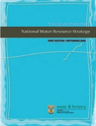
Background
2004: National Water Resource Strategy (NWRS), First Edition
Chapter 2 and Appendix D summarised the water resource situation
Addressed the scarcity of water in South Africa
Fresh water is limited and unevenly distributed
Situation varied from area to area

Slide 4
Background cont.
NWRS information on a broad overview level
Can for instance not be used to build infrastructure
More detail required
Internal Strategic Perspectives (ISPs) – Catchment Management Area level, but still not detailed enough
Reconciliation Strategies for:
Large systems supplying areas of large economic importance
Rest of towns covered in “All Town Strategies”

Slide 5
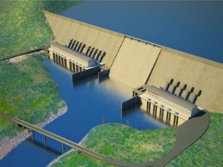
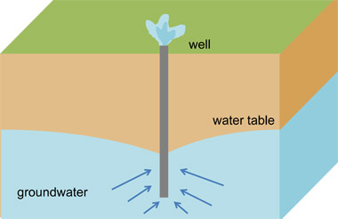
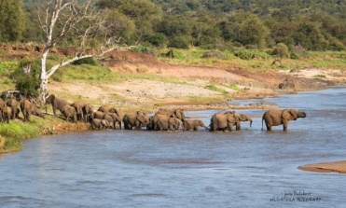
Water Reconciliation Strategies
Determine if system is in balance, now and into the future
If not determine appropriate interventions to avoid deficits
Significant Communication with Stakeholders
Water requirements
Water resources

Slide 6
Background cont.
What is reconciliation:
Develop future water requirement scenarios in consultation with users
Investigate all possible water resources and other interventions
Investigate all possible methods for reconciling the water requirements with the available resources
Make recommendations for development and implementation of interventions

Slide 7
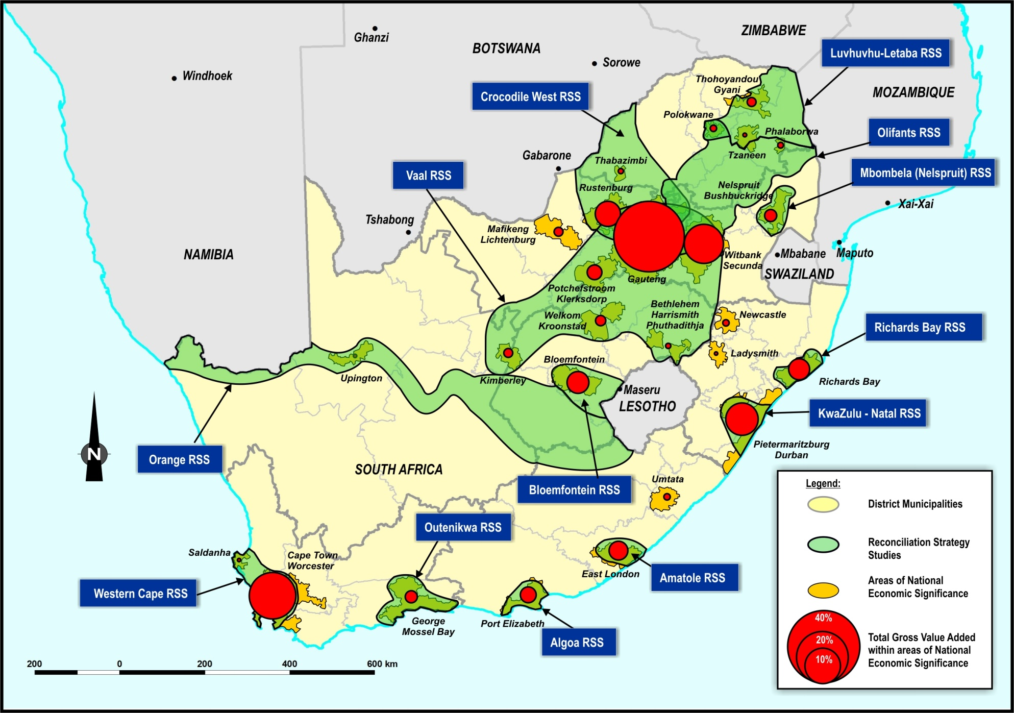
NSDP: Key demand centres

Slide 8
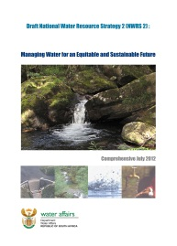
Background cont.
2012 National Water Resource Strategy (NWRS 2, draft)
NWRS 2 is building on NWRS 1, not replacing it
Putting water at the centre of integrated development planning and decision making
Ensuring water for equitable growth and development
Protecting water ecosystems
Implementing water use efficiency and WC/WDM
Optimising water resources
Achieving effective water governance and Developmental Water Management

Slide 9
Background to All Towns
2008: Development of Reconciliation Strategies for All Towns
Intention to support Municipalities and encourage improved planning and management of water resources
Key general messages from All Town Studies (2008-2011)
Improved management will solve largest portion of immediate problems
Identified priority Towns where water requirements exceed water resources availability
Minimal metering
High per capita use in many towns pointing to WC/WDM potential
Groundwater remains a feasible source of water for many towns

Slide 10
Background to All Towns cont.
Key general messages from All Town Studies (2008-2011) cont.
Infrastructure constraints rather than water resource availability limitations
Rudimentary strategies for all towns – improvement required
2012: Continuation of the DWA Planning Regions’ All Town Reconciliation Strategies: Phase 1
Update and review priority strategies - three year appointment (till 2015)

Slide 11
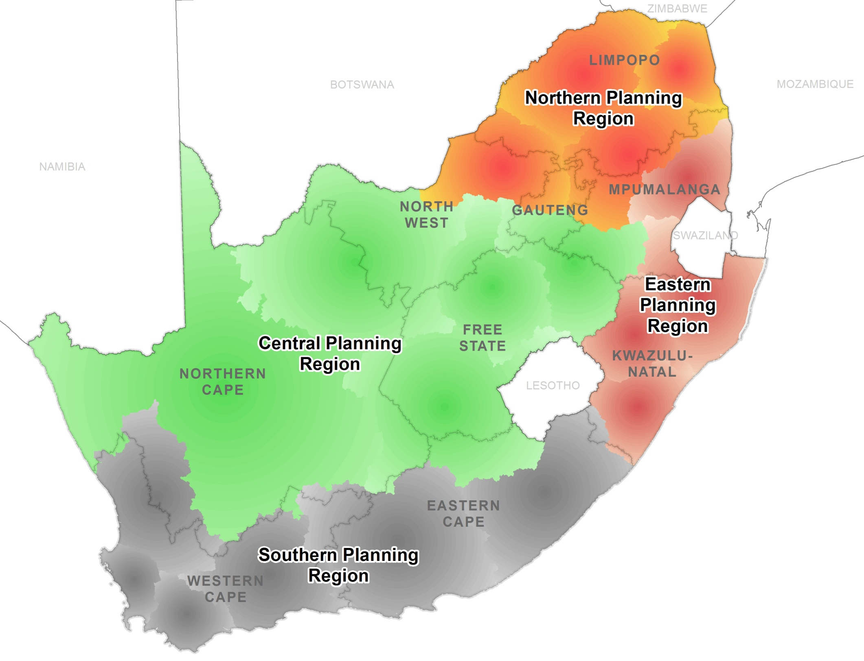
Overview of DWA Planning Regions
DWA: NWRP - National Office
Eastern Planning Region
PSP, SSC
PSP, SSC
Southern Planning Region
PSP, SSC
Central Planning Region
PSP, SSC
Northern Planning Region

Slide 12
What is a Reconciliation Strategy?
Plans of action or policy designed to ensure sufficient water is made available to towns/wider area over the next 20-25 years
Uses information collected (building blocks) on:
Water requirements
Water use and infrastructure
Water resources
WC/WDM
Develop scenarios to meet water requirements for current and future use, including optimisation of local resources, improved water services and water resource management

Slide 13
What is a Reconciliation Strategy? Cont.
It aims to answer these questions:
How must water is needed? - now and in the future
What water resources are available or can be made available?
Which interventions can be considered to achieve a balance between water needs and supply?
Focuses on the projected annual water balance (high and low growth scenarios)
Also consider the accuracy of all components that make up the water balance

Slide 14
Purpose
Becomes the “policy” of all water related work in a specific area
After Recon done, ongoing efforts of “maintenance” or “implementation” to continuously update Strategy and keep it alive
DWS still custodian, implementers need to take ownership

Slide 15
3: Approach

Slide 16
Reconciliation Strategies: Components
1 Introduction
2 Demographics
3 Water Requirements
4 Water Supply Infrastructure
5 Water Conservation & Water Demand Management
6 Water Resources
7 Water Balance
8 Reconciliation Options to Meet Shortages
9 Institutional Issues
10 Conclusions & Strategy Recommendations
Supporting Reports, Full Recon Strategy, Executive Summary

Slide 17
Introduction
General Layout of the Study Area
Objectives
Background
First Strategy
Maintenance: outcomes of first Strategy

Slide 18
Demographics
Existing population assessment and update
Future population projections
Natural growth
Migration

Slide 19
Water Requirements
Various Sectors
Urban: linked to population, level of service
Irrigation
Bulk Industrial
EWR, latest available
Allocations vs actual use
Future growth

Slide 20
Water Infrastructure
Existing infrastructure
Water Treatment Works
Waste Water Treatment Works
Abstraction points
Pipe network
Status quo, bottlenecks, future requirements

Slide 21
WCWDM
Assessment of status of water losses in study area
Linking with demographics, water requirements
Determination of potential savings that can be made
Adjusted future requirement projection relating to WCWDM initiatives

Slide 22
Water Resources
Hydrology
Groundwater
Water availability assessment
Yield Analyses
Planning analyses
Water Quality

Slide 23
Water Balance
Scenarios of water requirements and water availability
Determination of date when deficits will occur

Slide 24
Reconciliation Options to Meet Shortages
Assessment of intervention options to meet deficit
Infrastructure
Savings
Groundwater
Costing and ranking of options
Timeline of when augmentation should occur to maintain a balance

Slide 25
Institutional Issues
Water Services Authorities
Water Services Providers
Other Institutions
Capacity constraints

Slide 26
Conclusions & Recommendations
Action Plan
Assigning Responsibilities and targets

Slide 27
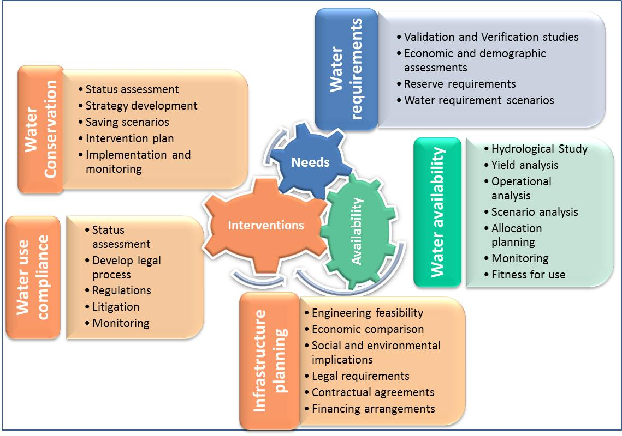

Slide 28
5: Implementation

Slide 29
Role of Strategies Steering Committee (SSC)
To provide executive guidance to the direction and outcomes of the study
To provide supplementary information and input from a local and regional perspective
To facilitate strategic linkages with other initiatives
To disseminate information from study into the relevant organizations
Incorporate strategies’ recommendations into development plans such as WSDPs, IDPs etc.
To facilitate the acceptance and sign-off of the updated Reconciliation Strategies

