Slide 1
Hydrology Rainfall-Runoff modelling: Pitman/WRMS 2000
Presented By: Sebastian Jahnke
Notes:
WRC Logo

Slide 2
Contents
Introduction and Overview
WRMS 2012 Resources
Collection and Collation of Input Data
Rainfall/Runoff Model
Calibration and Naturalisation of Flows
Conclusion

Slide 3
Introduction and Overview

Slide 4
Introduction and Overview
Originally developed in 1973 by Pitman (periodically updated)
Purpose: Simulate runoff from gauged/ ungauged catchments in South Africa/ Africa
Used for small and large catchments (developed and undeveloped scenarios)

Slide 5
Introduction and Overview
Countries in which Pitman Model is used
Source: WRSM training

Slide 6
Introduction and Overview
Rainfall/ Land Use data most important input to Water Resources Model(s)
Product of Pitman Model: Six major water resources assessments of South Africa conducted over last 7 decades
E.g. WR90, WR2005 and WR2012 (Online Resources)

Slide 7
Introduction and Overview
Rainfall/ Land Use data most important input to Water Resources Model(s) – decline in Rainfall Stations
?????

Slide 8
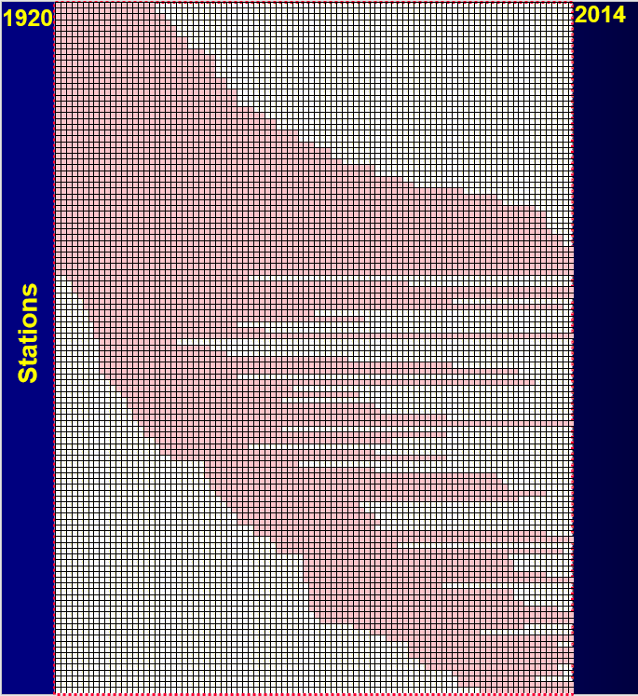
Introduction and Overview
Usuthu Catchment example
Major decline in rainfall stations
Left with short/ ”patchy” rainfall datasets

Slide 9
Introduction and Overview
Not only major decline in Rainfall Stations but also flow gauging stations
Constant decline in Gauging stations

Slide 10
Introduction and Overview
Major changes in Land Use and Water Requirements experienced over past decades
Water use in South Africa grew from (estimated):
3 500 million m³/a in 1953
16 000 million m³/a in 2016
Reservoir Balances used as important planning instrument
Records are deteriorating
Many dams without records

Slide 11
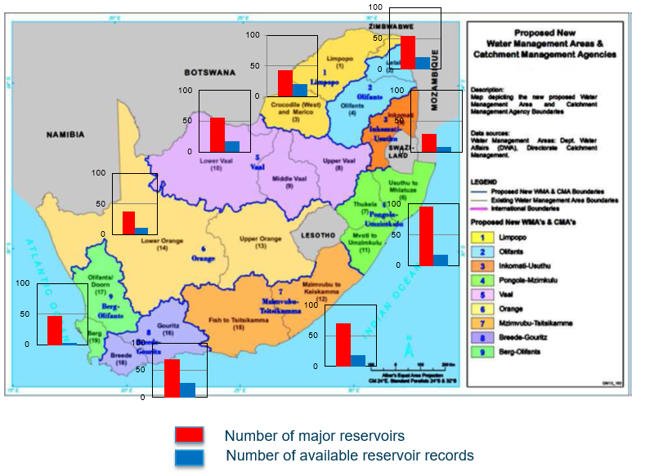
Introduction and Overview
Number of Reservoirs vs. Reservoir Records

Slide 12
Introduction and Overview
Model consists of following modules:
Surface- and Groundwater interaction (Runoff mod.)
Afforestation (Commercial Forestry)
Alien Vegetation (IAPs)
Dryland crops
Off Channel Wetlands
Mining
Irrigation

Slide 13
WRMS 2012 Resources

Slide 14
WRMS 2012 Resources
Pitman model used for country wide assessment
Website http://waterresourceswr2012.co.za/

Slide 15
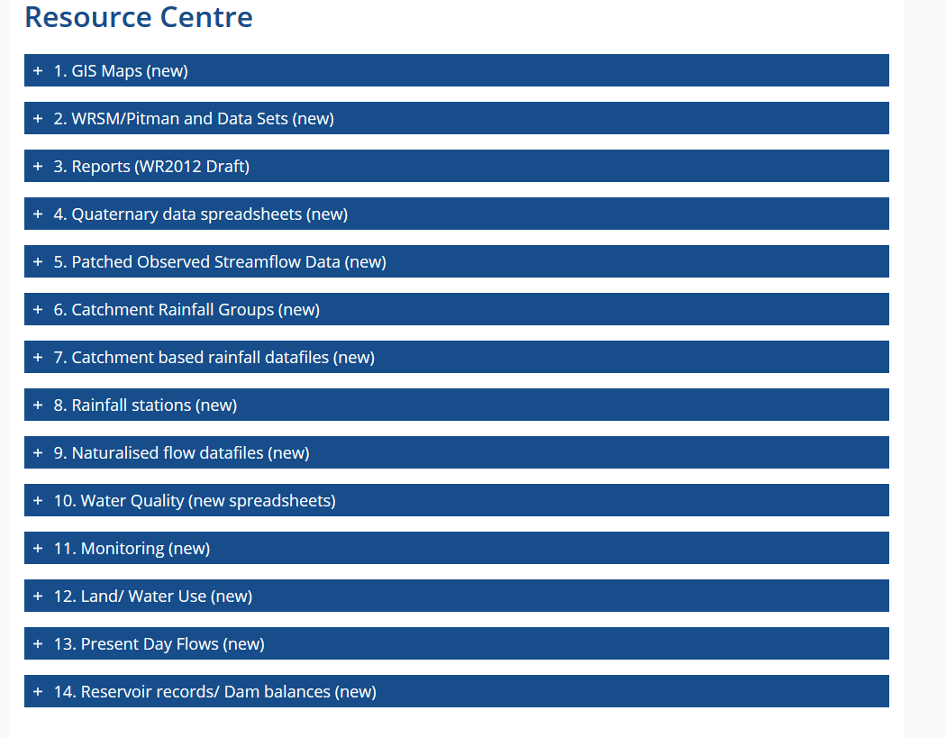
WRMS 2012 Resources
Resources menu available on website

Slide 16
WRMS 2012 Resources
Download relevant material from the website (9GB) such as:
Maps (download ArcViewer - freeware)
Model Datasets
Rainfall/ Gauging/ Water Quality Stations Data
Land Use Data
Reservoir Datasets
Etc.

Slide 17
WRMS 2012 Resources
Download relevant material from the website (9GB) such as:
Maps (download ArcViewer - freeware)
Model Datasets
Rainfall/ Gauging/ Water Quality Stations Data
Land Use Data
Reservoir Datasets
Etc.
Keep in mind that it was a high level country wide assessment – should be used by decision makers as overview instrument
Refine inputs for detailed studies

Slide 18
WRMS 2012 Resources
Reference documents:
WRSM2000 Theory Manual
WRSM2000 Programmers Code Manual
WRSM2012 User Manual
WR2012 SALMOD
WR2012 Groundwater Report
WR2012 Executive Summary
WR2012 Calibration Accuracy
WR2012 Book of Maps
Many more….
(All included in the training material)

Slide 19
Data Collection and Collation as Data Inputs

Slide 20
Data Collection and Collation (Inputs)
Data requirements:
• Rainfall
• Evaporation
• Streamflow
• Groundwater use
• Irrigation
• Mines
Extensive detailed inputs are required
• Major/Minor reservoirs
• Alien invasive plants
• Forestry
• Geology
• Land Use Data

Slide 21
Data Collection and Collation (Inputs)
Data requirements (cont.):
Important to maintain monitoring sites/equipment
Expand and improve measuring networks
To measure is to know
Engage with stakeholders to obtain best possible water use data

Slide 22
Rainfall/Runoff Model

Slide 23
Rainfall/Runoff Model
Why:
Risk analysis (extreme drought)
Used if flow gauging network insufficient
Too short record periods and major changes in land use
To naturalise flow records (remove land-use effects)
Extend natural flow records (from rainfall)
Estimating flow in ungauged catchments (from neighbouring catchments)

Slide 24
Rainfall/Runoff Model
Why:
Reservoir yield analysis
Conduct regional high level assessments of water resources, i.e. WR2012 study
Reserve Assessment and Determination
Input to WRYM, WRPM, WSAM and Water Quality Model

Slide 25
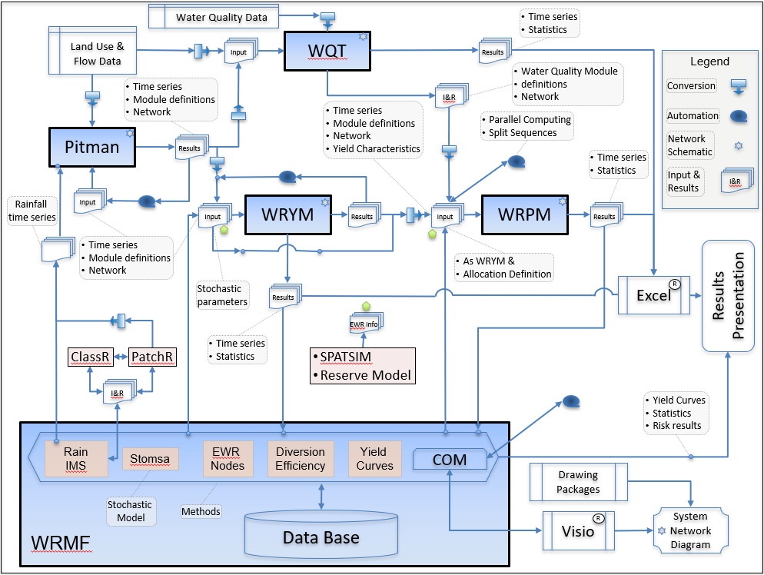
Rainfall/Runoff Model

Slide 26
Rainfall/Runoff Model
How (Process):
“Simplify” natural system by creating an equivalent network diagram (Step 1)
Tertiary/Quaternary Catchment Resolution
Describing the catchment linkages and water/land use
Indicate where streamflow is measured (for calibration)
5 different modules form network
Routes joining the modules
Loss free river reaches, canals or pipelines
Each route has two modules – Source and Sink

Slide 27
Rainfall/Runoff Model
Modules:
Runoff
Reservoir
Irrigation
Channel
Mining

Slide 28
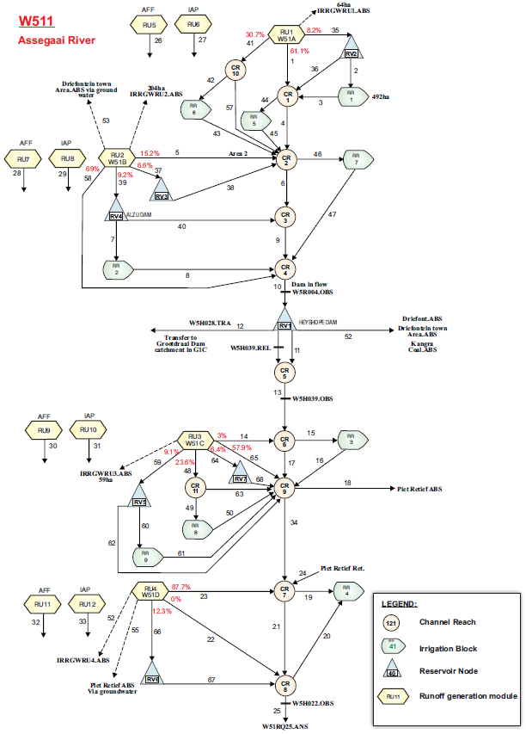
Rainfall/Runoff Model

Slide 29
Rainfall/Runoff Model
Runoff Module
Main element of model
Provides streamflow to the system
Catchment area,
Rainfall,
Evaporation,
Calibration parameters, used to derive streamflow

Slide 30
Rainfall/Runoff Model
Runoff Module (cont.)
Parent and Child (afforestation and alien vegetation)
Streamflow reduction area
Parent catchment
Riparian zone
Child catchment e.g alien vegetation
Child catchment e.g.
afforestation

Slide 31
Rainfall/Runoff Model
Runoff Module (cont.)
Three different Runoff models available
Pitman – as in original WRSM/Pitman – no surface/groundwater interaction
Hughes – with surface/groundwater interaction, hence use Child module if appropriate
Sami – same as for Hughes

Slide 32
Rainfall/Runoff Model
Runoff Module (cont.)
Four different Afforestation models available
Gush/ Pitman (ACRU) preferred
Breakdown into three tree types
Pine, Eucalyptus and Wattle

Slide 33
Rainfall/Runoff Model
Runoff Module (cont.)
Alien vegetation
Only CSIR option available
Requires breakdown into 3 vegetation types
(tall trees, medium trees and tall shrubs)
Upland/riparian split to account for higher water loss in riparian area

Slide 34
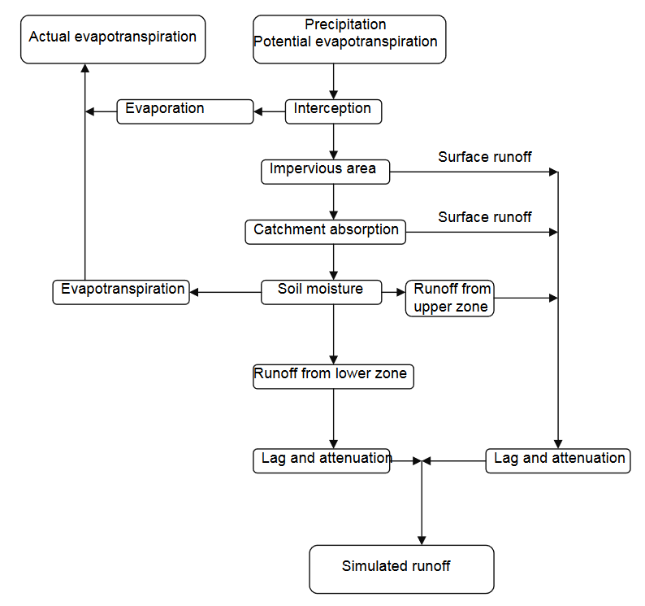
Rainfall/Runoff Model
Runoff Module

Slide 35
Rainfall/Runoff Model
Reservoir Module
Can be large dam or collections of smaller dams
Storage area relationship used as input
(varies over time)
Is affected by:
Inflows
Abstractions
Releases
Spillages
Rainfall and evaporation

Slide 36
Rainfall/Runoff Model
Reservoir Module (cont.)
Reservoir records used to determine water balance
For large dams simulated inflows calibrated against inflow records
Compare observed and simulated storage

Slide 37
Rainfall/Runoff Model
Irrigation Modules
Irrigation schemes of any size
Major water user in South Africa → significant impact on available yield
Complex data requirements:
Irrigation area, crop types, irrigation method, … etc.
Four different methods to analyse irrigation
Irrigation influences simulated low flows – used as calibration tool
Notes:
Irrigation influences simulated low flows → adjust irrigation module and seasonality of water require.

Slide 38
Rainfall/Runoff Model
Channel Modules
Used to connect:
Abstraction and return flow modules
Wetland modules
Hub for modules

Slide 39
Rainfall/Runoff Model
Mining Module
Data inputs are extensive/ difficult to obtain
Only used for large mines (major impact on water resources)
Three different types of mines can be modelled
Underground
Open Cast
Slurry dumps

Slide 40
Rainfall/Runoff Model
SAMI Groundwater Model
Procedure:
Run Pitman model first
Obtain best estimates of parameters shared between models
Enter required groundwater parameters in the “Sami GW” window
HGSL, GPOW and HGGW parameters should be entered in the “Calibration” screen

Slide 41
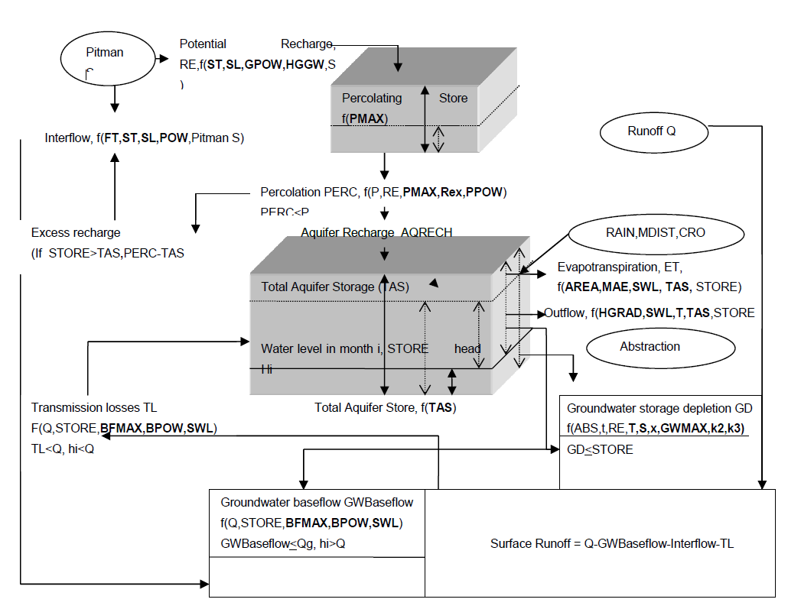
Rainfall/Runoff Model
SAMI Groundwater Model (cont.)
Refer to User Groundwater Manual for more details

Slide 42
Rainfall/Runoff Model
SAMI Groundwater Model (cont.)
Different colours have been chosen for the data input window to assist users in select appropriate data:
Red : Data should not be changed unless there is a very good reason
Blue : Data could be changed if better information is available
White : Default should always be changed unless there is no information whatsoever
(This will be covered in the tutorial)

Slide 43
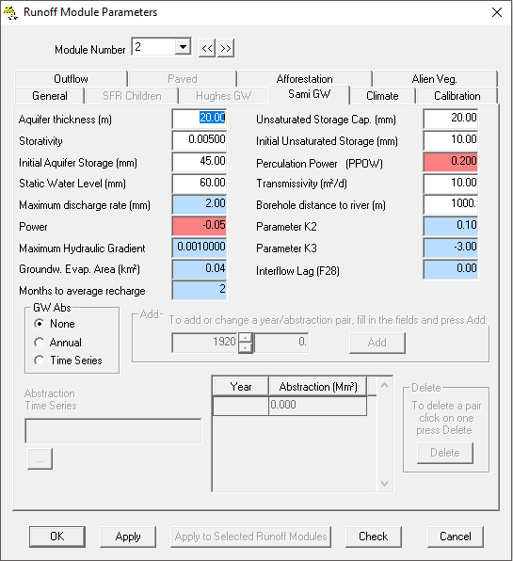
Rainfall/Runoff Model
SAMI Groundwater Model (cont.)

Slide 44
Rainfall/Runoff Model
Comprehensive Wetland Model
Water body linked to the main river channel
Inflow from channel to wetland starts above a prescribed discharge (level) in channel
Evaporation losses and abstractions occur (same as reservoir)
Comprehensive inputs required

Slide 45
Rainfall/Runoff Model
Comprehensive Wetland Model (cont.)
Q_{ds}
Q_{out}
Q_{loc}
Q_{abss}
Q_{in}
Qloc = Local inflow directly into wetland
Qus = Flow in river channel upstream of wetland
Qds = Flow in river channel downstream of wetland
Qin = Flow into wetland from river channel
Qout = Flow into river channel from wetland
Qabs = Rate of abstraction from wetland/off-channel storage
Notes:
Simulate as dam in WRYM with high penalty downstream channel

Slide 46
Rainfall/Runoff Model
Model Outputs:
Summary of flows, storages in routes and reservoirs
Graphs
Statistics
Shortages
Data for runoff (groundwater data), channels (wetland data) and mining modules (runoff, seepage, storage etc.)

Slide 47
Rainfall/Runoff Model
Output graphs:
Monthly hydrograph: Outliers, range of flows, dry season recession (perennial rivers)
Annual hydrograph: Outliers, wet & dry sequences
Seasonal distribution: Seasonal pattern, baseflow
Gross yield curves: Flow during critical periods
Scatter diagram: Goodness-of-fit, outliers
Histogram: See cumulative frequency (easier to interpret)
Cumulative frequency: Baseflow (perennial rivers), percentage time of zero flow (intermittent rivers)

Slide 48
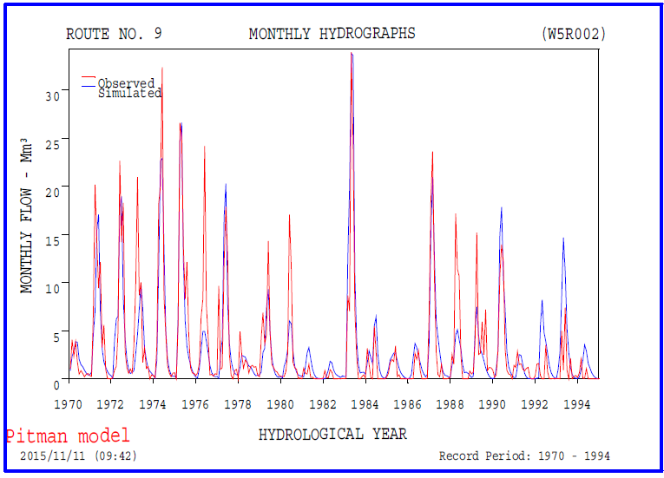
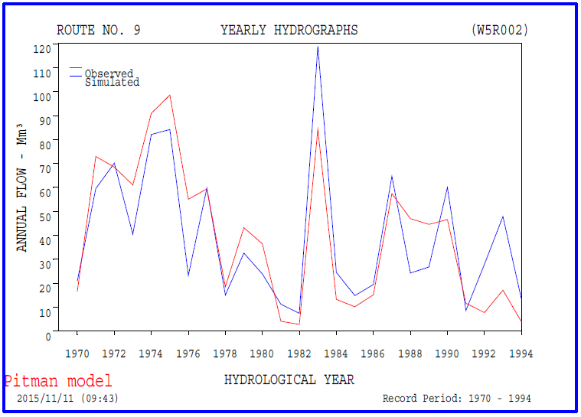
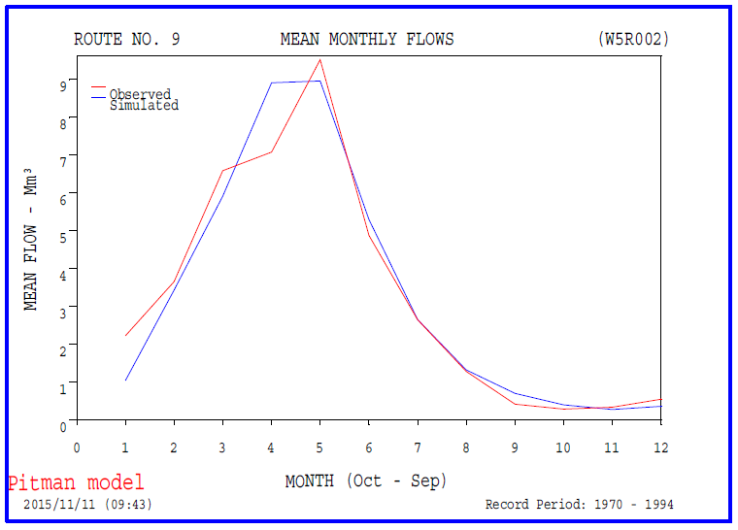
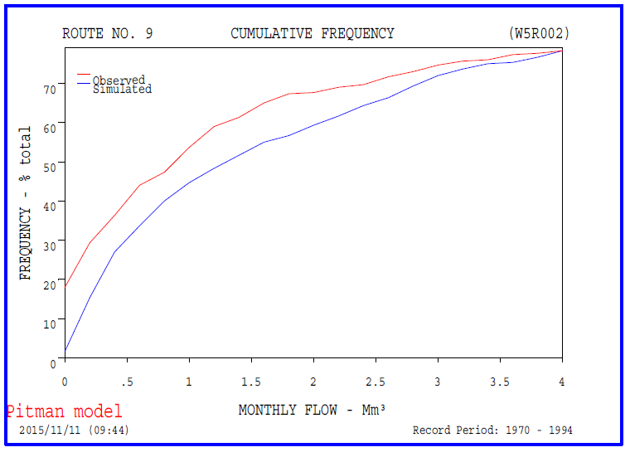
Rainfall/Runoff Model

Slide 49
Naturalisation and Calibration of Flows

Slide 50
Naturalisation and Calibration of Flows
Naturalisation
Naturalisation is the exclusion of man-made influences from the catchment hydrology
Dams, Irrigation, abstractions, return flows, paved areas and mines are removed and “virgin” hydrology is determined
Naturalised flows can be determined from the runoff sub-model

Slide 51
Naturalisation and Calibration of Flows
Calibration makes use of route statistics window
Flow gauging station data
Model Outputs
Suggestions to improve calibration

Slide 52
Naturalisation and Calibration of Flows
Statistical Good Fit
Error in MAR and Mean (log) : < 4%
Error in Std. Dev. (natural & log) : < 6%
Error in Seasonal Index : < 8%

Slide 53
Naturalisation and Calibration of Flows
Statistical Good Fit
Error in MAR and Mean (log) : < 4%
Error in Std. Dev. (natural & log) : < 6%
Error in Seasonal Index : < 8%

Slide 54
Naturalisation and Calibration of Flows
Calibration flow chart

Slide 55
Conclusion

Slide 56
Conclusion
Used for long-term planning of water resources and water supply for South Africa, Lesotho and Swaziland
Naturalised streamflow (etc.) determined for WRYM (analyse yields of dams)
Used to analyse droughts and flood events
Create catchment water balance
Add value in terms of uncertainty analysis

Slide 57
THE END

