Slide 1
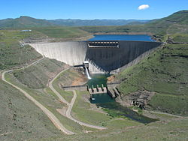
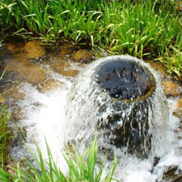
A Systems Management Approach to
Water Resource Management (KM-01-KT03)

Slide 2
Outline
Surface water catchment boundaries highlighting scale differences between primary, secondary, tertiary, quaternary and quinary catchments
Groundwater aquifer boundaries
Differences between water catchment boundaries and other administrative boundaries such as international, provincial, district municipality, local municipality, metropolitan and city/town boundaries
Management approach to Water Management Area (WMAs) including changes in the number of catchment management areas

Slide 3
Outline (Cont.)
Delineation of Water Management Area (WMAs) in South Africa
Importance and complexities of managing water resources as systems such as the need to cross administrative boundaries and interactions with the neighbouring countries and organisations such as Orange-Senqu Commission (ORASECOM) and Limpopo Commission (LIMCOM).
Systems management approach in South Africa to all inter-basin water transfers across water management area boundaries such as Thukela to Vaal, Usuthu/Komati to Vaal, Vaal to Olifants, Orange to Fish Lesotho to Vaal and Breede to Berg

Slide 4
Background
Based on the NWRS-1, 19 water management areas (WMA) were proposed.
Leading to the establishment of the corresponding 19 Catchment Management Agencies (CMAs) (Fig. 1).
However, since 1999, 8 of the 19 CMAs have been gazetted, of which two are operational (i.e. Inkomati CMA in Mpumalanga and the Breede-Overberg CMA in the Western Cape).
The management model, viability assessments w.r.t WRM, available funding, capacity, skills and expertise in regulation and oversight was reviewed.
It is proposed that the 19 WMAs be consolidated into 9 WMA in order to improve integrated water systems management (Fig 1).

Slide 5
Figure 2: 19 Water Management Areas

Slide 6
Map of the Proposed 9 Water Management Areas.

Slide 8
Nine proposed Water Management Areas (9 WMAs)
There are nine planned Water Management Areas, (WMAs,) that will be decentralized to CMAs, namely
  Limpopo,
  Olifants,
  Inkomati-Usuthu*,
  Pongola-Mzimkulu,
  Vaal,
  Orange,
  Mzimvubu-Tsitsikama,
  Breede-Gouritz* and
  Berg- Olifants.
Currently only two CMAs* are operational.

Slide 9
Advantages of the 9 proposed WMAs:
- Improved management of integrated systems which were previously split across the WMAs;
- Distribution of scarce technical skills over a smaller number of institutions;
- Improved balance in revenue streams supporting more sustainable institutions;
- Facilitates the faster establishment of CMAs, and
- Larger CMAs enables improved cooperation and coordination on regional, provincial, and international levels.

Slide 10
Water Management Areas
The responsibility and authority for water resources management rests with CMAs and, at a local level, WUAs.
These institutions are representative of water users and facilitate effective participation in the management of
water resources in their areas and will ultimately enable the DWS to withdraw from its role of operator to that of sector leader, policymaker, regulator and performance monitor.

Slide 11
Implications of having 9 WMAs
Facilitating sector involvement, community participation, empowerment of stakeholders and communities through structures such as catchment committees, catchment forums and water user associations (participatory management).
Increasing the size of the water management areas has an impact on the ability to engage effectively with stakeholders on the ground.
Key objectives of CMAs:- promotion of equity through effective WRM, greater responsiveness to the needs of poor and marginalized communities, and closer links with stakeholder groups in the water management area.

Slide 12
Implications of having 9 WMAs
The boundaries of these water management areas take into account catchment and ground water boundaries, financial viability, stakeholder participation, and equity considerations and are,
as a result, not aligned with provincial or local government boundaries.
Pongola-Mzimkulu; Vaal; Orange; Mzimvubu-Tsitsikamma; Breede-Gouritz and Berg- Olifants.

Slide 13
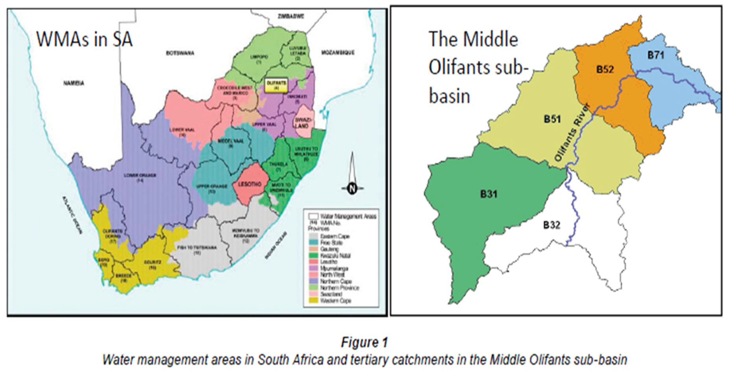
Surface water catchment boundaries: primary, secondary, tertiary, quaternary and quinary catchments.

Slide 14
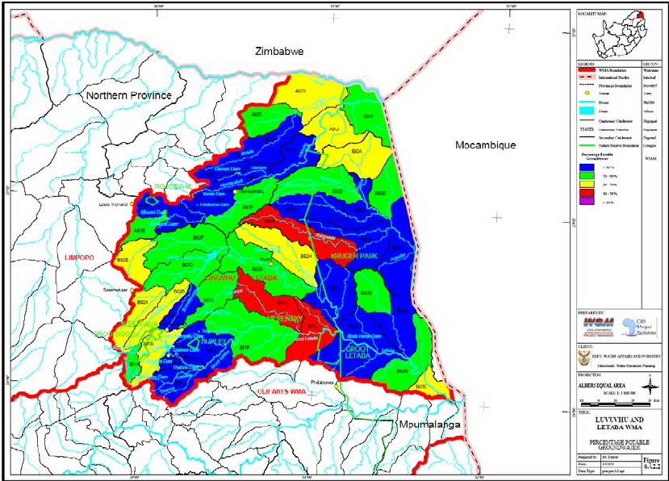
Quaternary Catchment

Slide 15
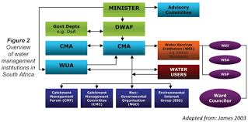
Complexities of WRM across boundaries

Slide 16
Administrative boundaries: International
International- There are existing trans-boundary river commissions established to manage joined water resources.
South Africa's most important rivers are trans-boundary:
  The Orange River Basin is shared between SA, Botswana, Namibia and Lesotho, the "water tower" of Southern Africa.
  The Limpopo River Basin is shared between SA, Botswana, Zimbabwe and Mozambique, which lies the furthest downstream.
This is a pro-active, collaborative initiative between South Africa and its neighbouring states established for a collaborative management of trans-boundary water resources.
There is a potential future water resources are seawater desalination or the transfer of water from the Zambezi River.

Slide 17
Provincial level
Water is not a direct provincial function.
The Department of Water and Sanitation has provincial offices in each province.
However, the Provinces may be required to intervene in municipal water affairs if a municipality is not performing well enough.
Provinces are also required to participate in water sector planning in conjunction with national and local government.
The responsible provincial department is usually that covering environmental affairs.

Slide 18
District municipality
Municipalities are responsible for basic water supply and sanitation services, e.g. City of Cape Town Water and Sanitation.
They may be designated Water Services Authorities (WSAs), e.g., Amajuba District Municipality.
The Department of Water Affairs have been measuring and monitoring the overall performance of water services authorities through the Regulatory Performance Measurement System (RPMS) and drinking water quality through the Blue/Green Drop Certification Programmes.

Slide 19
MUNICIPALITIES AND WATER SERVICES AUTHORITIES

Slide 21
Metros, District and Local Municipalities

Slide 22
Water Boards
Water boards distribute raw and potable water across vast distances, (via regional water supply schemes), a role mandated and controlled by the Minister of the DWS.
The WS Act added new responsibilities, in that water boards or any other WSPs must be formally appointed by the recipient municipalities to provide such services, where required.
Not all municipalities depend on water boards for regional bulk water supply infrastructure, but can do so as long as they operate within the norms and standards of the WS Act, National Water Act and related regulations and strategies.

Slide 24
Local municipality
The functions of local government are defined by the Constitution of South Africa (Act 108 of 1996) which states that:
152 (1) The objects of local government are –
a) To provide democratic and accountable government for local communities;
b) To ensure the provision of services to communities in a sustainable manner;
c) To promote social and economic development;
d) To promote a safe and healthy environment;
e) To encourage the involvement of communities and community organizations in the matters of local government.

Slide 25
Local Municipality (cont…)
Arising from s156, it is clear that municipalities have executive authority w.r.t the following matters from Schedule 4 and 5 part B, as they impact on IWRM:
municipal planning,
storm water management systems in built-up areas,
water and sanitation services limited to potable water supply systems and domestic waste-water and sewage disposal
systems,
local sport facilities,
refuse removal, refuse dumps and solid waste disposal.

Slide 26
Institutional relationship of water sector institutions

Slide 27
Groundwater aquifer boundaries
The boundaries of these water management areas take into account:
  catchment and aquifer boundaries,
  financial viability,
  stakeholder participation, and
  equity considerations.
As a result, not aligned with provincial or local government boundaries.

Slide 28
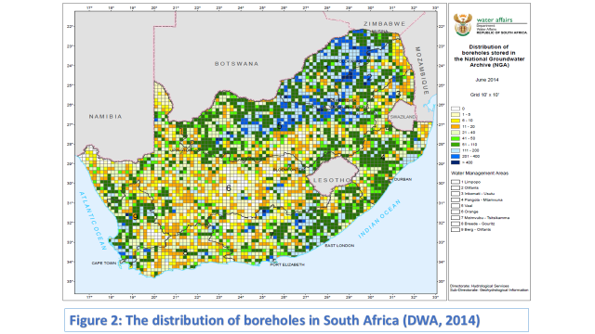
Groundwater aquifer boundaries

Slide 29
Sectorial groundwater use (million m3/annum) per water management area

Slide 30
Ground water use
Groundwater use has increased dramatically, from approximately 684 million m3 in 1950 to 1 770 million m3 in 2004, mainly due to increased irrigation. Nationally,
irrigation comprises over 64% of groundwater use, while mining and domestic consumption in urban and rural areas, each use 8%. Groundwater is used for different
purposes in various parts of the country, according to patterns of land use. Irrigation is the largest user in many of the WMAs, but groundwater is used for mining in the
Highveld, while domestic use in rural areas occurs in KwaZulu-Natal, the Eastern Cape, Mpumalanga, and Limpopo.

Slide 31
Water Resource Systems management approach in S. Africa
There are contributions of different water components (surface water, groundwater, and return flows) to the available yield in each of the WMAs.
The local yield is calculated from the contribution of both natural resources and usable return flows (irrigation, urban, and mining/industrial).
It should be noted that substantial volumes of water are returned to streams after use; the water is then available for re-use, provided that the quality of the return flows satisfy the relevant user requirements.

Slide 32
Water Resource Systems management approach in S. Africa (Cont)
The total usable return flows are close to twice the current yield from groundwater sources.
The deficit in yields over time from surface water in the Middle Vaal, Lower Vaal, and Lower Orange WMAs indicate that river losses due to evaporation and seepage are greater than the additional yield contributed by local runoff in these areas.

Slide 33
Water Resource Systems management approach in S. Africa (Cont)
Although the yield takes account of the estimated allowance for protecting aquatic ecosystems (that is, the ecological Reserve), insufficient knowledge of the functioning and habitat requirements of these systems exist.
Catchments have different characteristics, and the estimates of requirements needed to sustain each aquatic ecosystem component of a Reserve vary from 12 to 30% of the total river flow in drier parts of the country.
Estuarine requirements are difficult to estimate and not understood very well.

Slide 34
Water Resource Systems management approach in S. Africa (Cont)
An appropriate understanding of water use requirements is essential for managing water resources judiciously.
What complicates this understanding is the large variation in water requirements across the country, as different sectors have different needs in terms of quantity, quality, temporal distribution, and assurance of supply.
Factors to be taken into account are the divergent social and economic values associated with water, the ability to pay, and priorities with regard to the provision of water.

Slide 35
WMAs and inter-catchment transfer in SA

Slide 36
The End

