Slide 1
South African Water Sectorial Context
(KM-01-KT01)

Slide 2
South African Water Context
Global/World Water Distribution
South African Water Situation
  Water Resources
  Water Requirements
Hydrological / Water Cycle
  Precipitation
  Infiltration
  Transpiration
  Surface Run-off
  Evaporation
  Condensation

Slide 3
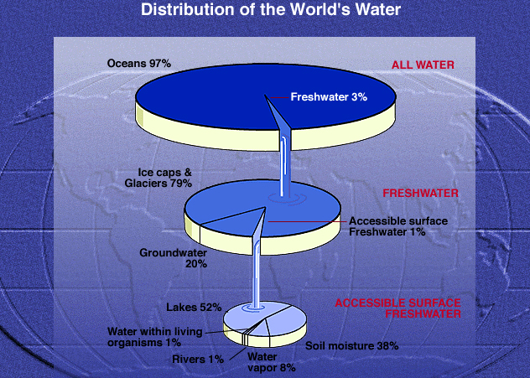
Figure 1: World’s Water Distribution ( Earth Forum, Houston Museum of Natural Science)

Slide 4
Distribution of water on Earth
All Water (Top pie):
  The vast majority of the Earth's water is contained in the oceans and seas (97%), and
  only 3% of the Earth's water is freshwater.
Fresh Water (Middle pie):
  Of the freshwater portion, 79% is frozen in glaciers and ice caps at the North and South Poles,
  20% is groundwater, and
  only 1% is accessible surface freshwater.
Accessible Surface Water (Bottom pie):
  Of that 1% of accessible surface freshwater, 53% is in rivers, streams, lakes and dams;
  8% in the atmosphere as water vapour; and
  38% is soil moisture.

Slide 5
SOUTH AFRICA’s WATER SITUATION
South Africa is a predominantly semi-arid country.
Thus, in global terms, South Africa’s water resources are scarce and extremely limited.
With an average rainfall for the country of about 450 mm per year (mm/yr), well below the world average of about 860 mm/a, while evaporation is comparatively high.

Slide 6
SOUTH AFRICA’s WATER SITUATION
The climate varies from desert and semi-desert in the west to sub-humid along the eastern coastal area (see Fig. 2 below).
The natural availability of water across South Africa is highly uneven due to poor spatial distribution of rainfall (Fig. 1).
At times, strong, seasonal rainfall over virtually the entire country often leads to floods, while low rainfall is associated with low stream flow and even droughts.

Slide 7
Figure 2: Rain Water Distribution in South Africa

Slide 8
NATURAL WATER RESOURCES
The country has no truly large or navigable rivers, and
The combined flow of all the rivers in the country amounts to approximately 49 000 m³/a, which is less than half of that of the Zambezi River, the closest large river to South Africa.

Slide 9
NATURAL WATER RESOURCES
Most urban and industrial development, as well as some dense rural settlements have been established in remote areas from the large water courses.
This is due to the influence of the occurrence of mineral resources and political dispensation of the past in stead of plentiful availability of water.
Thus the requirements of water exceeds the natural availability of water in several river basins.

Slide 10
NATURAL WATER RESOURCES
Hence over the years, there is a widespread of large scale transfers of water across catchments (See Figure 3).
Groundwater plays a pivotal role in especially rural water supplies.
Because of the predominantly hard rock nature of the South African geology, only about 20 percent of groundwater occurs in major aquifer systems that could be utilised on a large scale.
Four main rivers that South Africa shares with other countries:
  Limpopo River ( SA, Botswana, Zimbabwe and Mozambique)
  Inkomati River (SA, Swaziland, Mozambique),
  Pongola (Maputo) River (SA-Mpumalanga, Mozambique), and
  Orange (Senqu) River (SA, Namibia, Lesotho and Botswana).

Slide 11
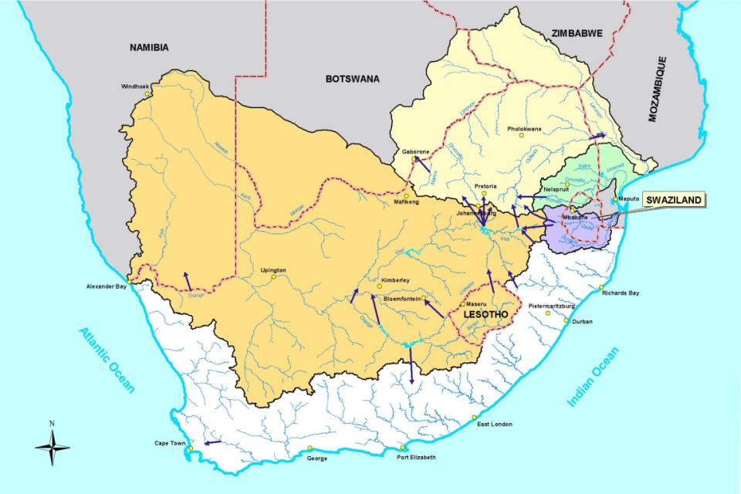
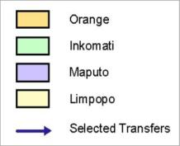
International Rivers shared by South Africa
11
Notes:
Let us again go back to the big picture and consider the water resources shared with neighbouring countries.
Four main rivers shared with neighbouring countries.
International basins cover 60 % of SA land area.
Contribute 45% of country's total river flow.
Support ± 70% of gross domestic product and similar proportion of population.
(Several inter-catchment transfers introduced to achieve this).

Slide 12
SOUTH AFRICA’s WATER SITUATION cont.
These 4 major rivers collectively drain about 60% of the land area and contribute over 30% of the country’s total surface runoff (river flow).
Approximately 30% of the country’s GDP and 70% of the population of the country are supported by water supplied from rivers.
Therefore, judicious joint water management is important to S Africa.
South Africa has been divided into 19 water management areas (WMAs). (See Fig 3 below & Table 1.1, Pg. 13 of the study guide).
The Crocodile West and Marico WMAs have the largest proportion of GDP, but the have smallest mean annual runoff (MAR).
On the contrary, the Mzimvubu to Kieskama WMA has a relatively low GDP, despite having the highest MAR.

Slide 13
Figure 3: Water Management Areas of South Africa and inter-water management area transfers

Slide 14
SOUTH AFRICA’s WATER SITUATION cont.
Water Resource Management and Development in SA has evolved over the years in order to meet the needs for population growth and economic development within the constraints of limited water resources.
As a result of the many control structures (dams, weirs), abstractions of water, return flows to the river, as well as parts of the land use , the flow regime in many rivers has been significantly altered (See Figure 4 below).
In some cases it has resulted in the quality of water as well as the integrity of aquatic life in the river being severity degraded. This will continue to happen as long as there is continuous population growth and economic development.

Slide 15
SOUTH AFRICA’s WATER SITUATION cont.
Hence the introduction of National Water Resource Strategy (NWRS) which is used to promote actions which ensure the long term sustainable and beneficial utilisation of the country’s water resources.
There are several water users who compete for this limited water resources as indicated in Figure 5 below, each consuming a certain percentage as allocated by the Department of Water Affairs (now referred to as Department of Water and Sanitation).
The following policies govern the management and use of water resources :
  South Africa Constitution: (Bill of Rights), The National Water Act 36 of 1998, Water Services Act, National Water Resources Strategy, & National Environmental Management Act.

Slide 16
NATIONAL WATER ACT 36 of (1998):
  The National Water Act deals with the water resources (i.e. rivers, streams, dams, and ground water).
  It contains rules about the way that the water resource (surface and ground water) is protected, used, developed, conserved, manage and controlled in an integrated manner.
THE CONSTITUTION (Act 108 of 1996):
It says that :
everyone has the right to have access to sufficient food and water;
everyone has the right to an environment that is not harmful to their health or well-being;
the environment must be protected for the benefit of all people living now and in the future;
national government is the custodian of the sources of water, such as rivers, ground water and dams; and
local government is in charge of municipal water services.

Slide 17
WATER SERVICES ACT (108 of 1997)
1. The Water Services Act deals mainly with water services or potable (drinkable) water and sanitation services supplied by municipalities to households and other municipal water users.
2. It contains rules about how municipalities should provide water supply and sanitation services.
THE NATIONAL WATER RESOURCE STRATEGY
facilitates the proper management of the nation’s water resources;
provides a framework for the protection, use, development, conservation, management and control of water resources for the country as a whole;
provides a framework within which water will be managed at regional or catchment level, in defined water management areas;
provides information about all aspects of water resource management;
identifies water-related development
opportunities and constraints.

Slide 18
NATIONAL ENVIRONMENTAL MANAGEMENT ACT (NEMA) 107 OF 1998
The NEMA provide for co-operative environmental governance by establishing:
principles for decision-making on matters affecting the environment,
institutions that will promote cooperative governance and procedures for co-ordinating environmental functions exercised by organs of state;
  to provide for certain aspects of the administration and enforcement of other environmental management laws; and
  to provide for matters connected therewith.

Slide 19
Figure 4: Diagram of a catchment area

Slide 20
Figure : Areas (red or orange) key economic significance in the 2006 NSDP, in relation to existing water supply systems. Current reconciliations studies are shown in green

Slide 21
Water Resources
SA is mainly dependent on surface water for urban, industrial and irrigation water supplies.
Generally, surface water resources are highly developed in the country.
Ground water which is extensively utilised in rural areas and arid areas, is limited due to the geology of the country (largely hard rock structures).
In the Northern parts of the country (WMAs 1-5, 8-10), both surface and underground water are nearly fully developed and utilised.

Slide 22
Water Resources
On the contrary, the south-eastern region of the country (WMA 11-13) are well watered, where there are still significant undeveloped and little-used resources.
Under natural conditions, the MAR of South Africa is estimated at over 49 200 million m3/year. This includes nearly 4 800 million m3/year from Lesotho and nearly 700 million m3/year from Swaziland.
With time, these figures are subject to change due to changes that occur in the social and economic landscape.

Slide 23
Water Resources
There also evidence that underlying patterns of the water cycle maybe altered as a result of climate change which may cause variations to the MAR figures.
In addition to appropriate quantities of water being made available for use, it is essential that water also be of suitable quality for a particular use for both human and economic purposes, and maintenance of the ecosystems.
Pollution of water occurs when too much undesirable or harmful substances are discharged into the resource so that the natural assimilative capacity of the resource is exceeded, and thereby rendering it unfit for subsequent use.

Slide 24
Water Resources
Deterioration of water quality is one of the treats faced by SA’s capability to provide water to meet it needs for sustainable development.
Ground water pollution is of particular concern because it is difficult and costly to reverse.
Water Quality Management is therefore an integral part of the NWRS.
Desalination of sea water offers particular opportunities for costal users. It is expensive compared to the development of surface water resource (e.g. Dam or pipeline construction).
It is achieved through the use of membrane technologies (e.g. Reverse Osmosis) especially in the Middle East.

Slide 25
Water Requirements
The knowledge and understanding of water requirements and availability is essential for a careful management of water resources.
This is further complicated by the large variation of water requirements as well as the variability of water resources that exist across the country.
These variability relate to various requirements of various water use sectors with respect to quantity, quality, temporal distribution and assurance of supply, for different social and economic values associated with water and ability to pay for water.

Slide 26
Water Requirements
Certain priorities regarding water provision need to be recognised.
Provision for the reserve which is made up of:
  Basic Human Need (25 L/person/day) / Human Reserve; and
  Ecological Water Requirements/ Ecological Reserve.
Different statistics for different water users are reflected on Figure 5 below.

Slide 27
Figure 5 : Estimated volume of water per sector

Slide 28
Water Allocation
The priorities are listed in the National Water Resource Strategy in descending order of importance:
1. Provision for the Reserve (Ecological and Human needs);
2. International agreements and obligations;
3. Water for social needs, such as poverty alleviation, primary domestic needs and uses that will contribute to maintaining a social stability and achieving greater racial and gender equity;
4. Water for uses that are strategically important to the national economy (such as power generation),

Slide 29
Water Allocation
5. Water for general economic use, which includes commercial irrigation and forestry.
In this category, allocation is best dictated by the economic efficiency of use.
With the introduction of water trading, demand will automatically adjust over time to reflect the value of water in particular uses; and,
6. Uses of water not measureable in economic terms.
*This may include convenience uses and some private water uses for recreational purposes, which are likely to be of low priority.

Slide 30
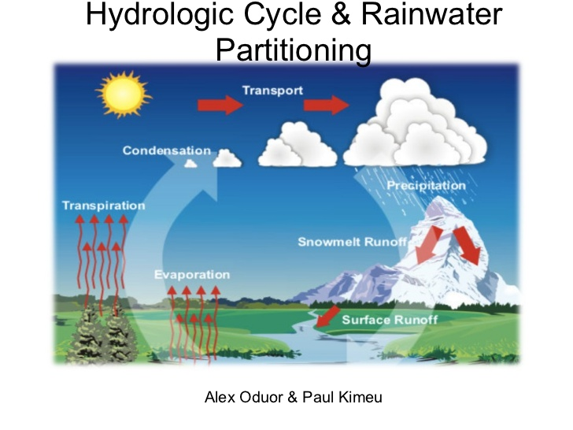

Slide 31
THE WATER / HYDROLOGICAL CYCLE
Water (hydrological) cycle - is the journey water takes as it circulates from the land to the sky and back again.
The sun’s heat provides energy to evaporate water from the Earth’s surface (oceans, lakes, etc.).
Plants also lose water to the air (this is called transpiration).
The water vapour eventually condenses, forming tiny droplets in clouds.
When the clouds meet cool air over land, precipitation (rain, sleet, or snow) is triggered, and water returns to the land (or sea).

Slide 32
THE WATER / HYDROLOGICAL CYCLE
4. Some of the precipitation soaks into the ground (infiltration).
5. Some of the underground water is trapped between rock or clay layers; this is called groundwater.
6. But most of the water flows downhill as runoff (above ground or under ground), eventually returning to the seas as slightly salty water.

Slide 33
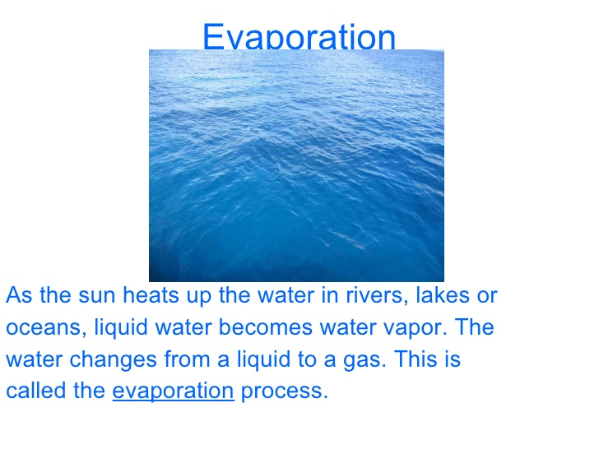
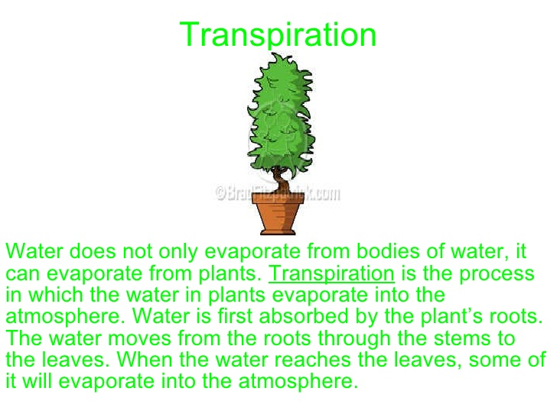
HYDROLOGICAL CYCLE

Slide 34
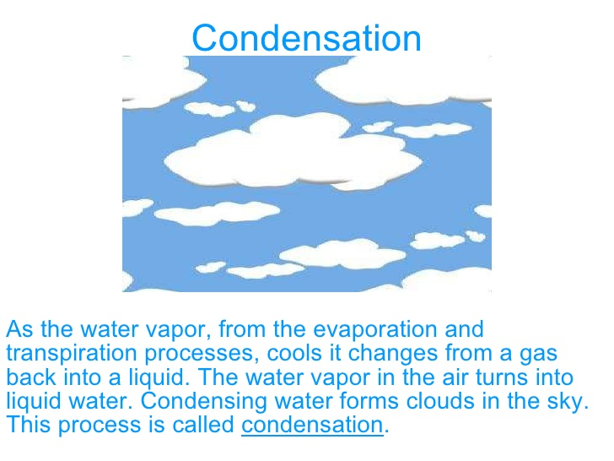
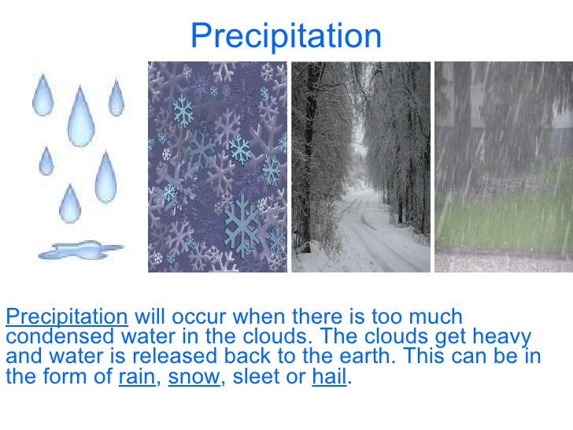
HYDROLOGICAL CYCLE

Slide 35
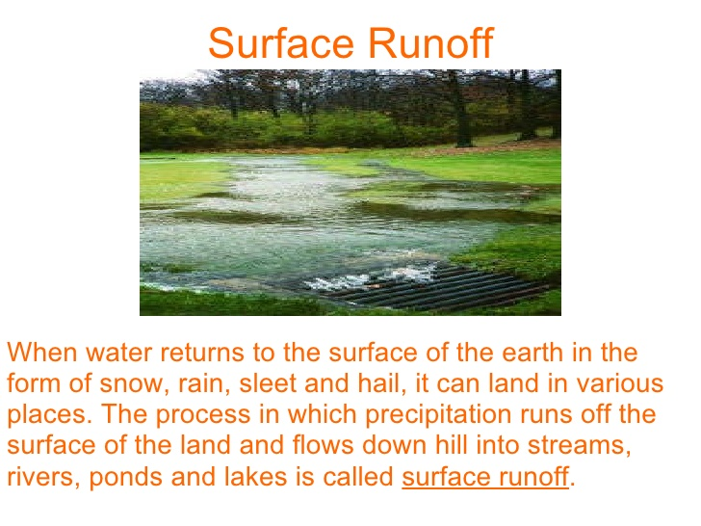
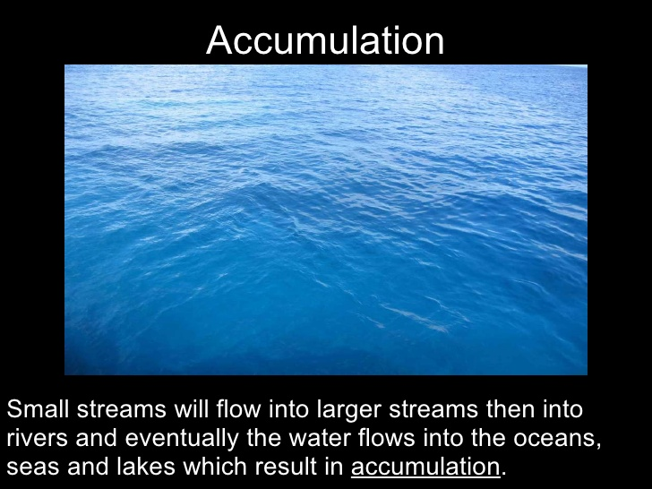

Slide 36
THANK YOU!!!

